Slide 1
Python Workshop part II
Fitting, large data and GitHub
By Jordi Ferrer Orri (jf631@cam.ac.uk)

Slide 2
Preparation before the workshop
for part = 2:
Create a GitHub account (if done with @cam.ac.uk email you get PRO features)
Download GitHub desktop and log in with your username
for part = 1:
Download and install Spyder (normally installed with Anaconda, already done in Tom’s practical)
Load Jupyter lab (or Jupyter notebook)
Thanks! Ivan and Jordi

Slide 3

FITTING MODELS TO DATA in python

Slide 4
Fitting a model to experimental data
Packages used
sklearn.linear_model
pandas
Tutorials
Fitting different arbitrary models to model historical temperature in Cambridge and predict future temperature
Manual fitting
Sinusoidal fitting
Secular fitting
Error analysis and parameter space interpretation

Slide 5

Large data files in python

Slide 6
Large datafiles
Packages used
Pandas (using dataframes == excel sheets for managing data)
Dask (numpy for huge datasets)
Tutorials
Simple pre-processing techniques to reduce loaded data
Binning
Sampling (with pandas)
Lazy data (with dask)
Advanced tools to load large files
Using remote desktops/clusters with large RAM memories (e.g. Google Colab for machine learning projects)
Releasing memory in Python (tricky but doable in iPython/Jupyter notebooks using magic commands) to avoid MemoryError
Os and Glob (internal batch management packages)
Loading multiple files at once.

Slide 7

Github
Interactive part! Get ready…
Software development version control

Slide 8
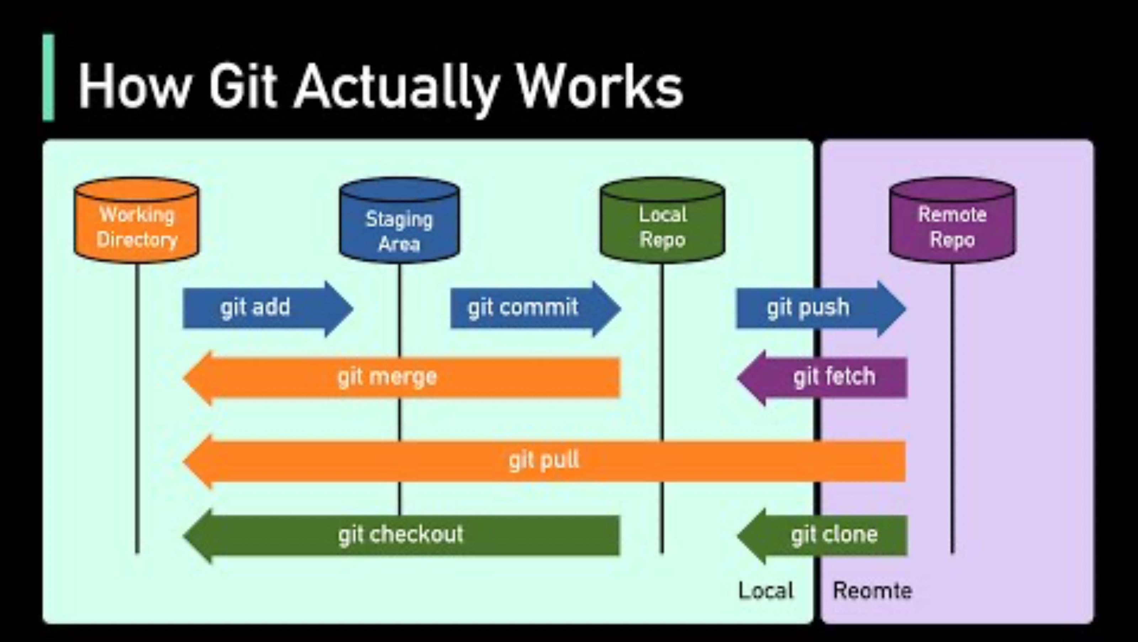
The git flow
https://youtu.be/PBI2Rz-ZOxU
Notes:
https://www.youtube.com/watch?v=PBI2Rz-ZOxU

Slide 9

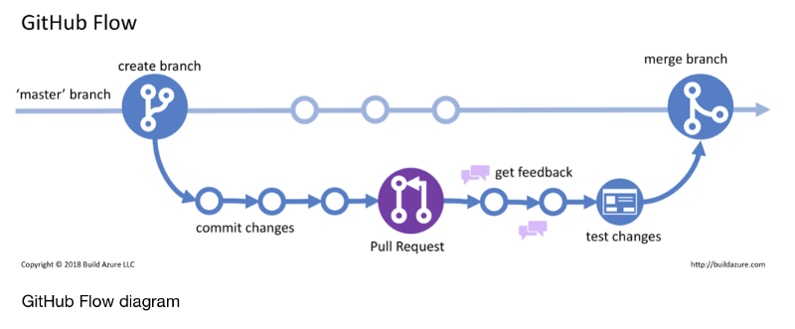
The github flow

Slide 10
Example shown first
I will edit my personal GitHub repository (because it is mine, the process is simpler, no need for forking)
https://github.com/jordiferrero/nanoDTC
I have realised an error in my code (spelling mistake)!
Files are already in my computer (show how local folder == GitHub cloud folder)
Edit locally my file (apply changes)
Load GitHub desktop (or run git diff) → shows differences
Commit changes
Push changes (loaded on the cloud)
Imagine I had a second computer with the same local folder, now it is outdated…
I would need to pull changes to get the latest version form GitHub

Slide 11
Your go!
Because you want to edit a repository that is not yours, you need to copy/fork and then apply changes.
Go to the example repository in jordiferrero/NanoDTC
Check for issues (or add one you want to work on)
Fork repository (so it becomes user_name/NanoDTC)
Sometimes you also need to create a new branch (1 branch = 1 issue) to solve different issues simultaneously. The default branch is the master branch
Clone your personal branch (either the master or the new_issue_branch) using GitHub desktop (notice it is saved in the Documents/Github/user_name folder) and now you can edit files in your computer
WORK ON THE ISSUE by changing files
Commit + Push files to your personal repository
Check you GitHub → changes have been uploaded!
Now you are ready to pull request your changes to the original repository 🎉!

Slide 12
YOUR CONTRIBUTION!
From GitHub create a pull request
Select the original branch (with your changes, by default master) and the repository and branch you want to change
Describe which changes you are adding
Reference the issue you are trying to solve
Now the responsible person of the main repository can accept and merge your changes or ask for a review.
NOTE: Any change you add to your personal repository branch will automatically be updated in your pull request ☺ (that’s why you keep one branch for every different pull request)
After your pull request has been accepted and merged, you will need to update your personal repository to the newest version of the original/upstream repository
Go to GitHub desktop
[Branch] → Merge into current branch… → upstream/master
Start again

Slide 13
Github extra
Create/Resolve an issue
Assign yourself to an issue
Automatize issue resolution to TO DO tasks
Contribute to a PR discussion
Use the Projects tab
Go back in time
Live in a multiverse (several versions of the same)

Slide 14
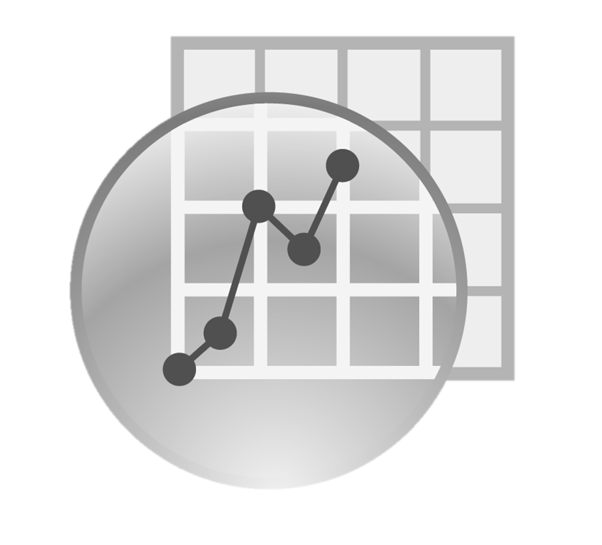
Origin pro…?

Slide 15
Where is origin actually pro?
Quick to use
Good for 1D signals
Interactive
Useful function (background subtraction, manual interpolation, peak finding tools…)
Slows down during batch processing
Advanced functionalities are harder than in Python
Limited documentation
Pricey (license only works in “Eduroam”)
Black box tools (most of them)

Slide 16

Luminescence analysis using python

Slide 17

Luminescence packages
Packages used
LumiSpy package (multidimensional data analysis tools for luminescence)
Anaconda included packages (e.g. Scipy for model fitting, numpy for matrices…)
Tutorials
Loading multidimensional data
Plotting data interactively
Fitting and getting a model for luminescence data
Segmentation based on fitting
Plotting modelled data

Slide 18

Appendix

Slide 19
What tools to use for dealing with python projects?
For sporadic data analysis:
Jupyter Lab (or the older version the Notebook)
For writing scrips:
Spyder
SublimeText
For everything:
PyCharm (unlimited, keep projects, interpreters, files, GitHub all seperate)

Slide 20
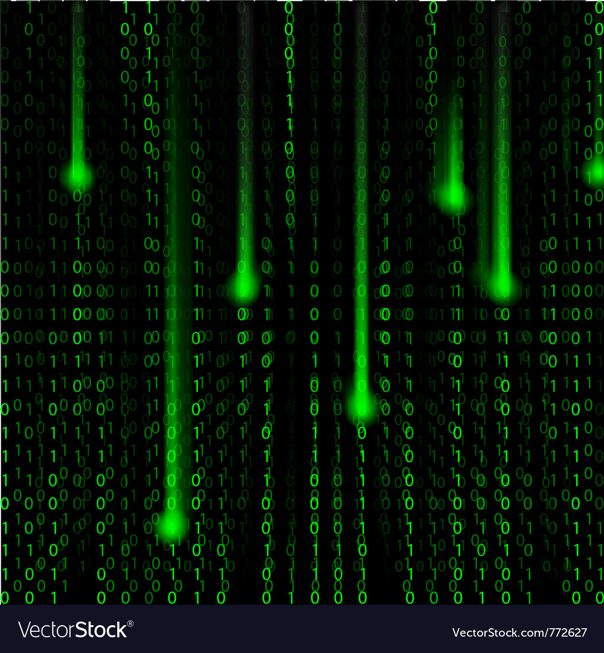
Q&A
Or send me any questions via email: jf631@cam.ac.uk

