Slide 1
online maze problem solver

Slide 2
The Purpose of the Project is -
It is very helpful for beginner software developers or software engineers to deploy their work.
The public will test the developer work from all over the world
It is completely free to use google storage for the first 12 projects.
Thank you Google ☺

Slide 3
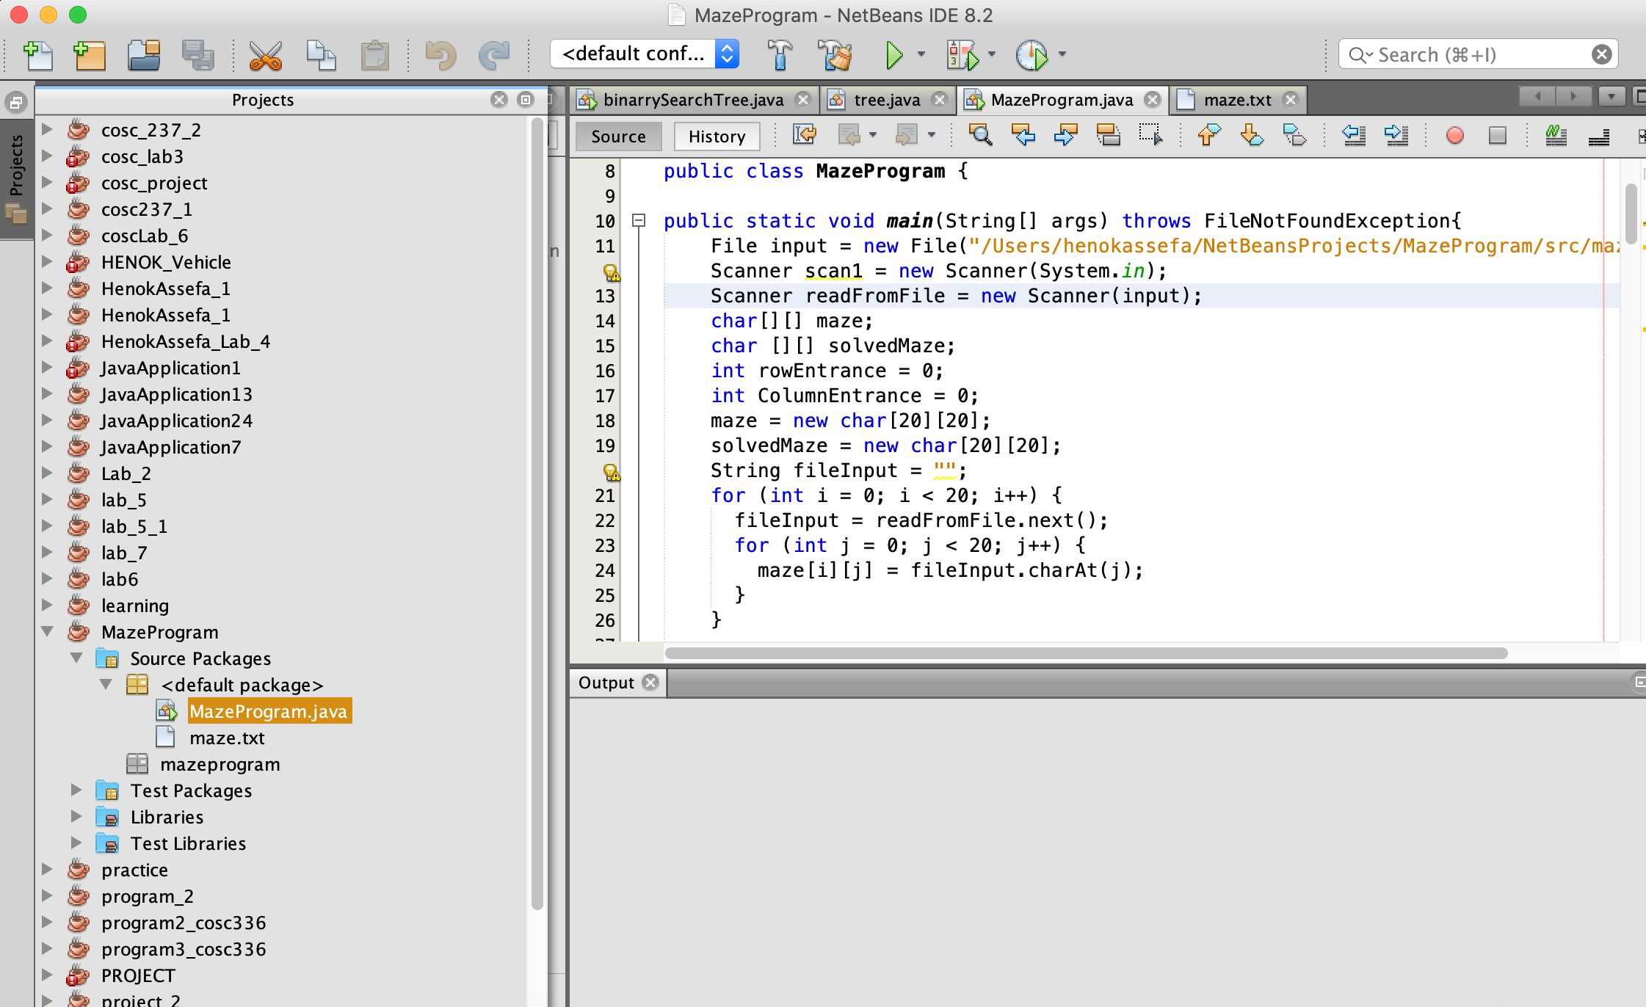
The fist step is to have the source code ready.

Slide 4
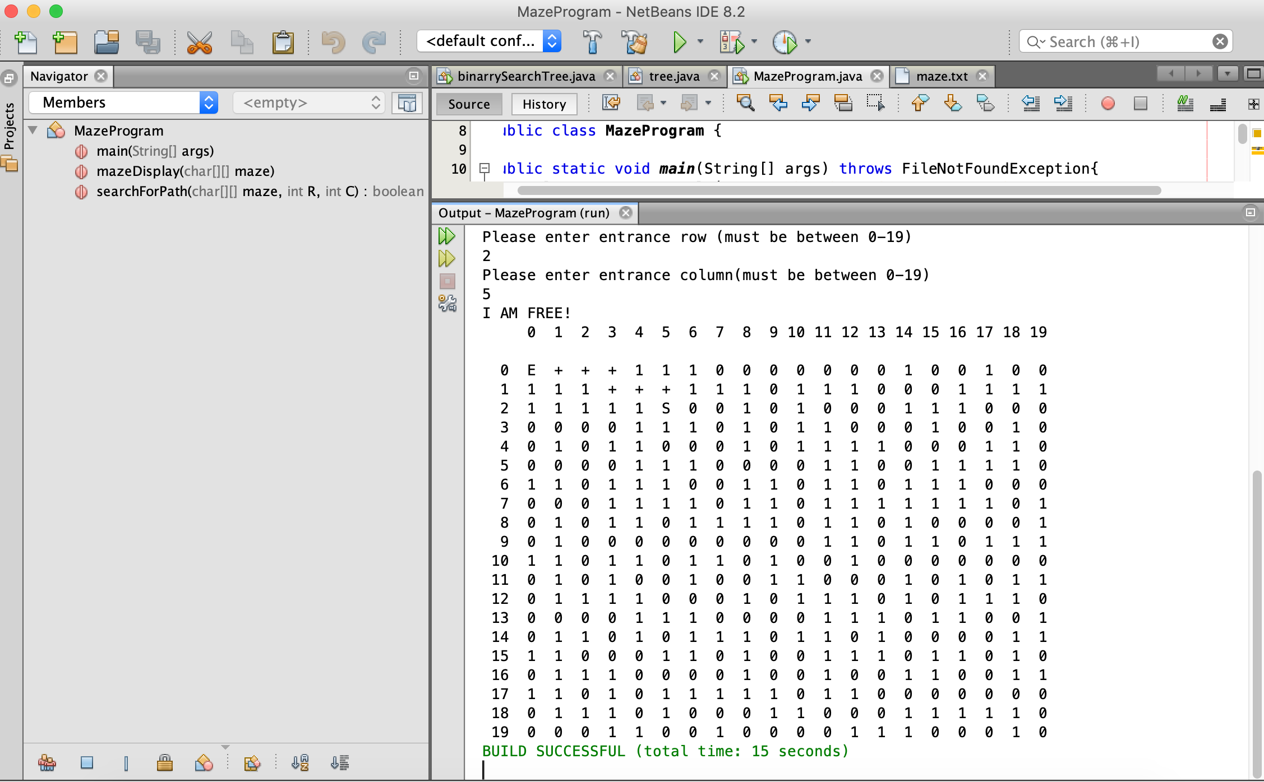
Check if our source code is working

Slide 5
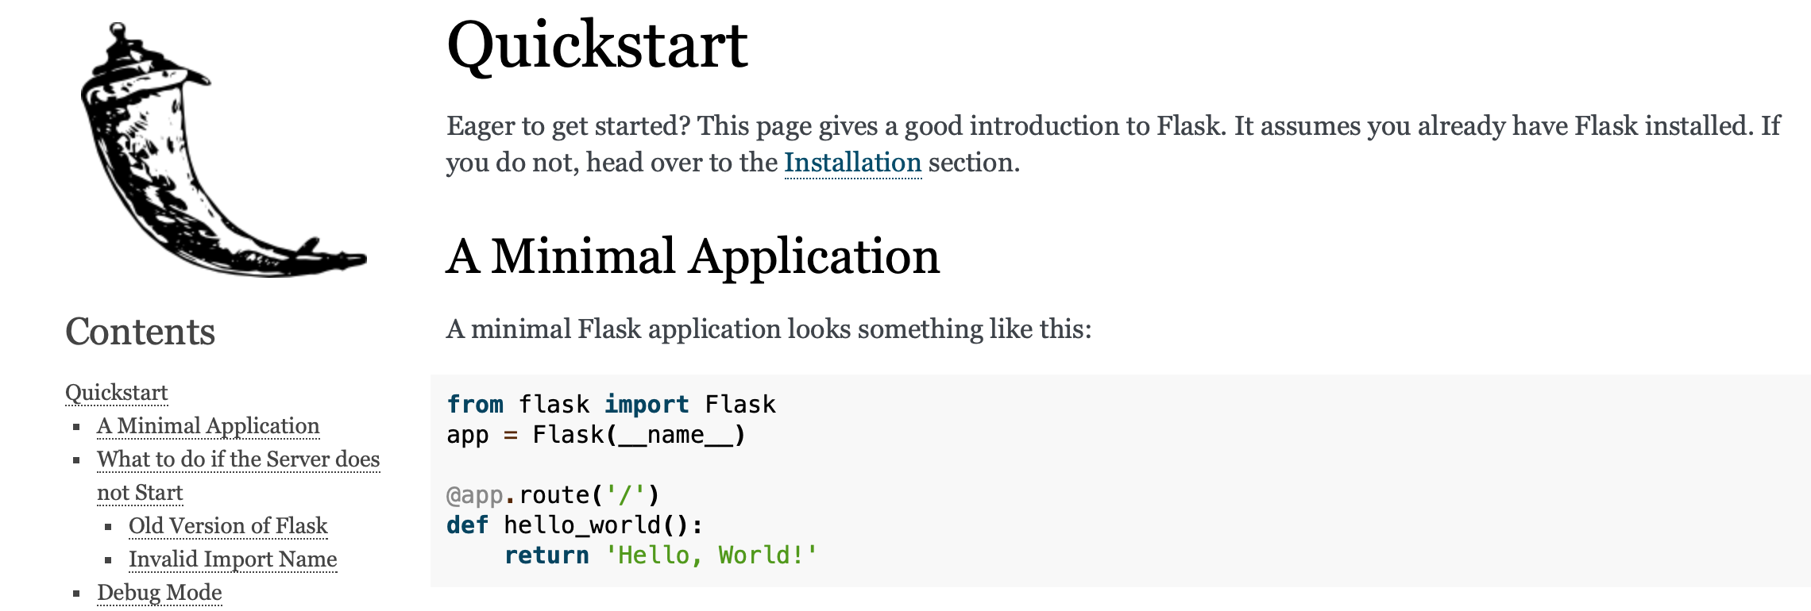
Go to flask.palletsprojects.com . Learn how to import Flask library

Slide 6
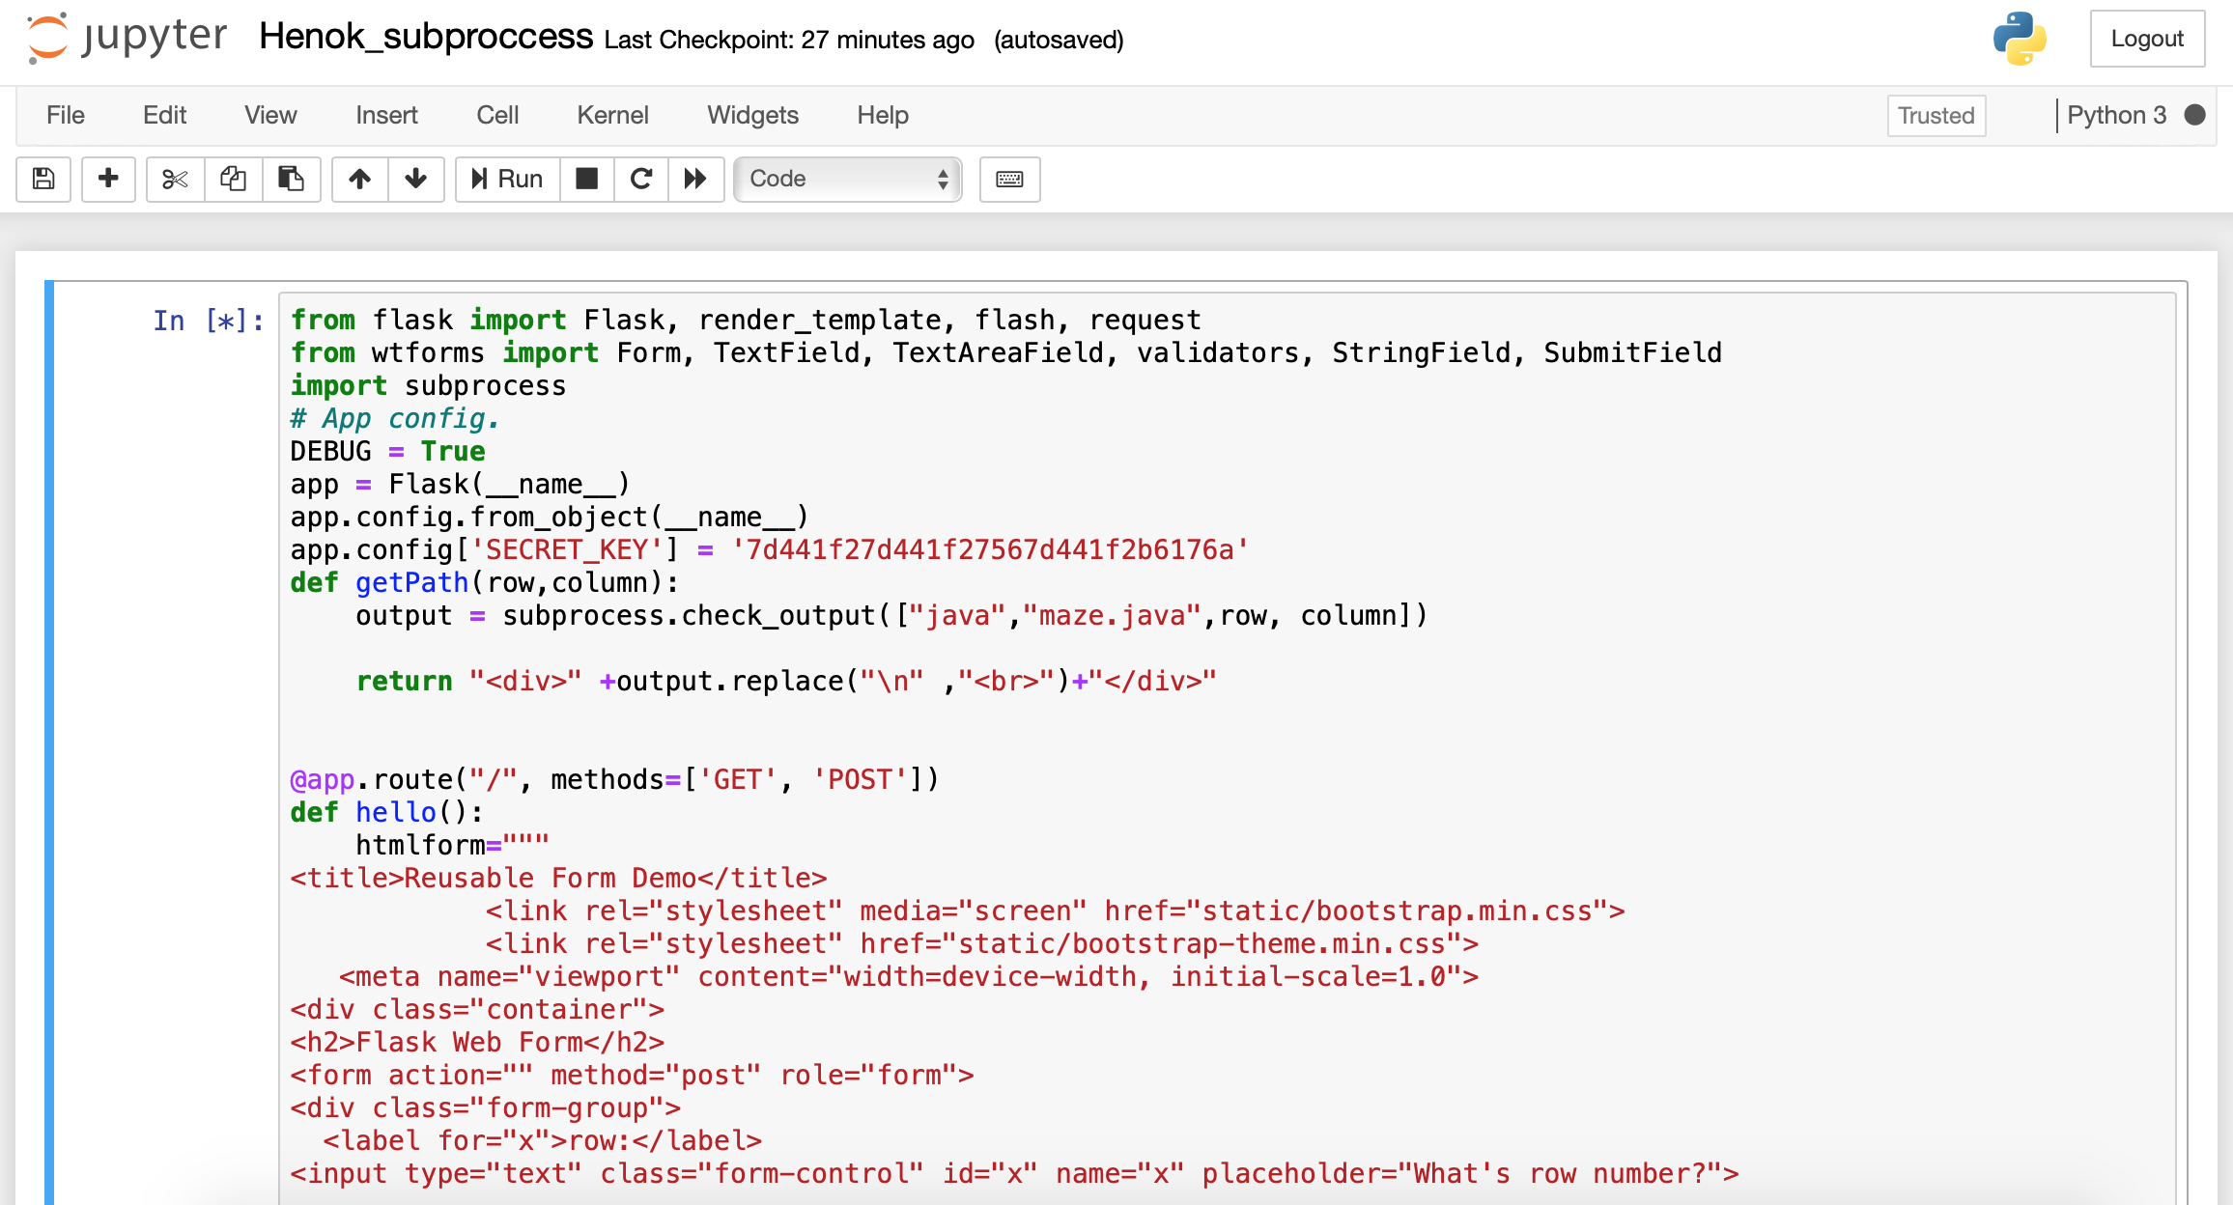
Flask is a framework written in Python so we need to relate our code with python. In this case, I used subprocess to run my java file.

Slide 7
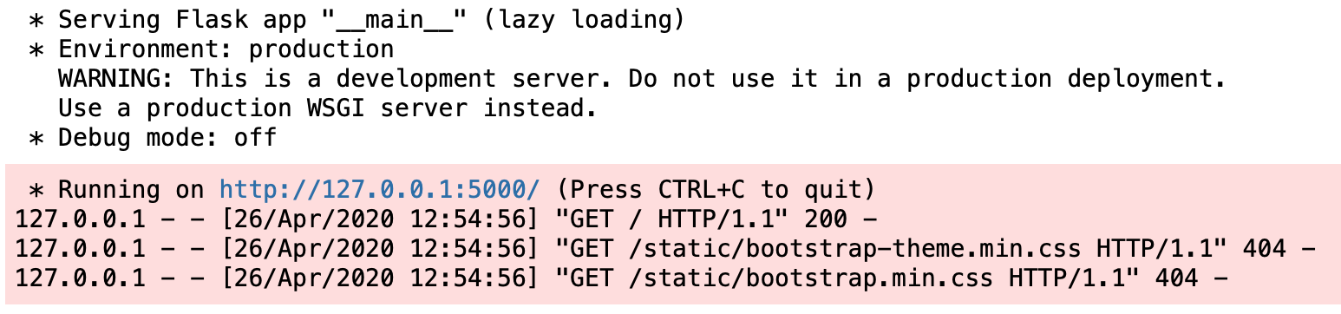
. After we run our code, Flask will give us an IP address (the local host and 5000) . The link http://127.0.0.1:5000/ will work only for the same local host (for example if the users are sharing the same WIFI)

Slide 8
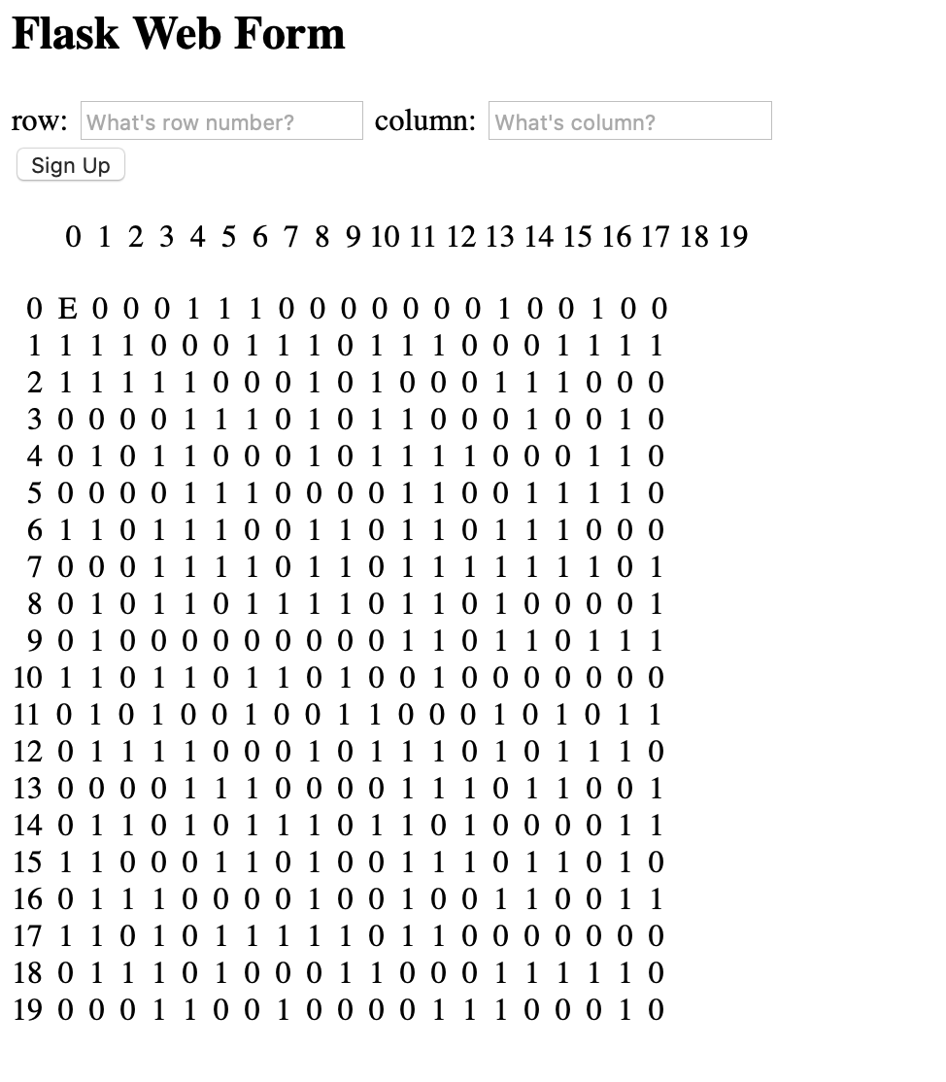
Running http://127.0.0.1:5000/ will give us the front page of our application. In this case, the maze, option to choose row and column. - The next step is to clone out code to google cloud platform

Slide 9
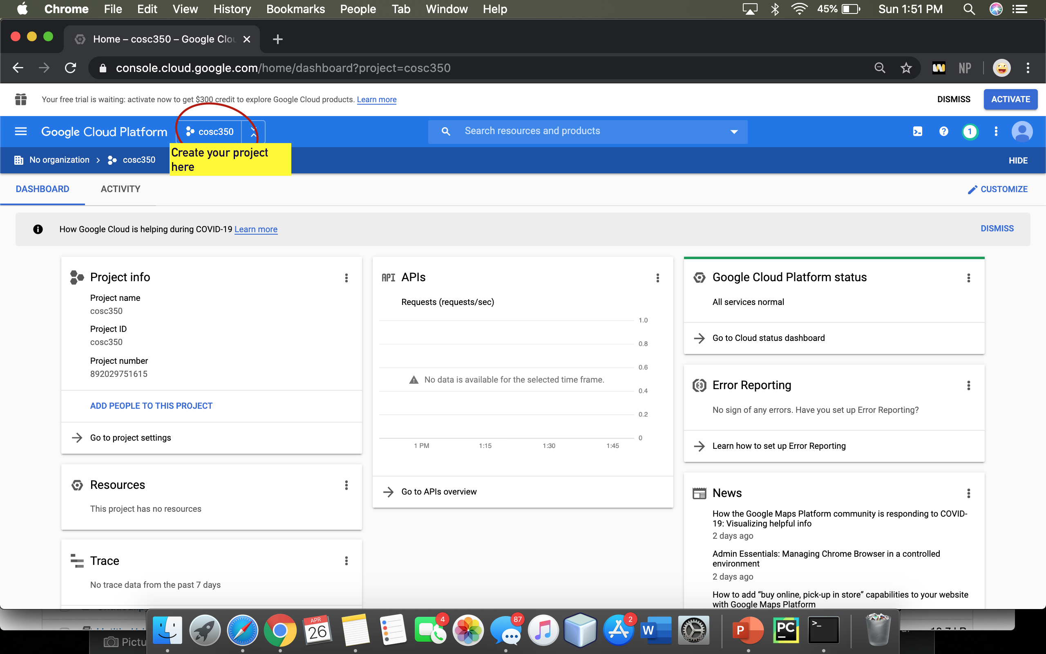
. Login to google cloud platform and create our first project. . Gmail account is needed to use the platform

Slide 10
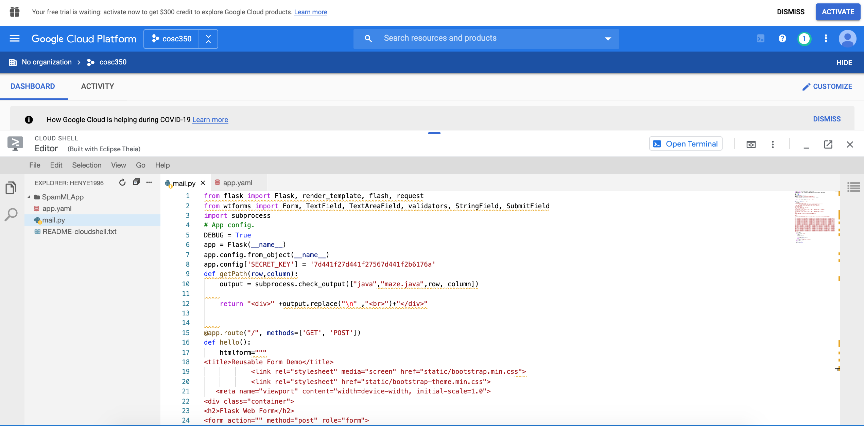
Copy the source code to our google storage and use it as a server then use the new IP address which will work for everyone requesting.

Slide 11
Thank you

