Slide 1
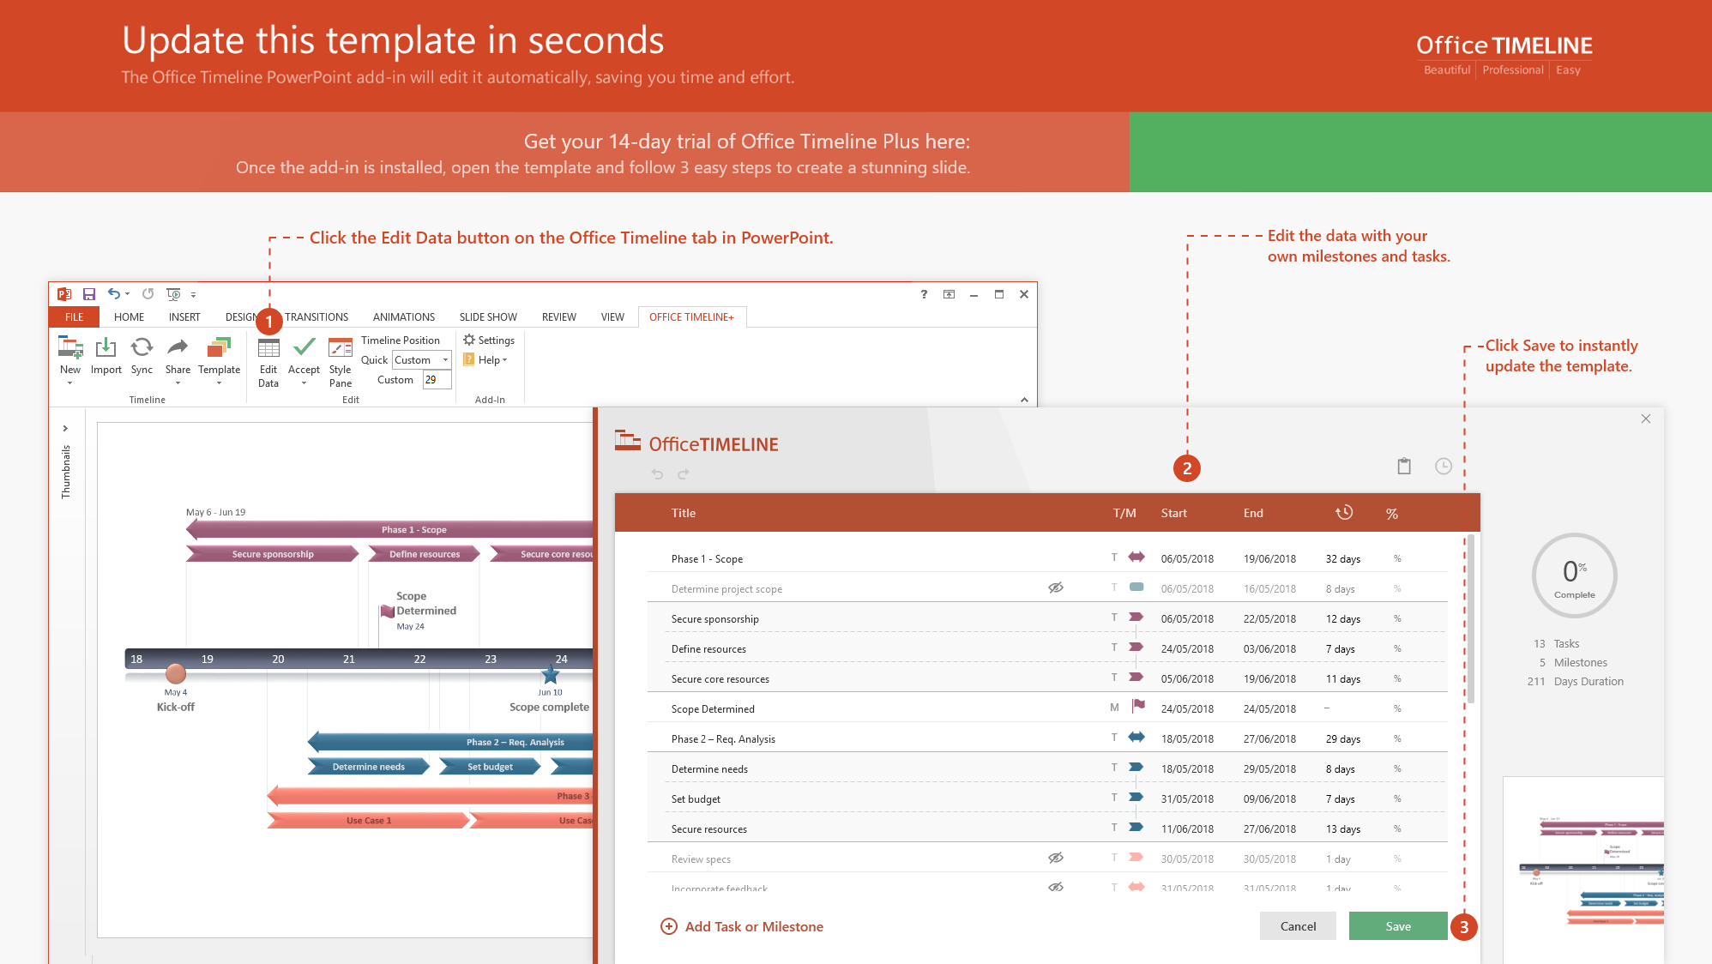
https://www.officetimeline.com/14-days-trial

Slide 2
Gant Chart
Project review 3
Use cases and requirements
Project review 1,2
Project deployment plan
Project Kickoff
presentaion
Sep 10
Oct 6
2020
Sep 28
Oct 13
Oct 20
Dec 8
Sep
Oct
Nov
Dec
Setup services
Working Plans
Planning
Use cases and requirements
Design the website
Designing
Game designing
Homepage
About page
Contact us
Tool selection
Develop
Add plugging
Homepage, about page, Contact us, and Donate page
Single player
Team player
Launch
Finalizing the website
Testing
Fixing and Testing
Nov 13
Presentation

