Slide 1
Kademlia: A Peer-to-peer Information System Based on the XOR Metric
Petar Mayamounkov
David Mazières
A few slides are taken from the authors’ original presentation

Slide 2
What is different?
One major goal of P2P systems is object lookup: Given a data item X stored at some set of nodes in the system, find it. Unlike Chord, CAN, or Pastry Kademlia uses Tree-based routing.

Slide 3
Kademlia
Nodes, files and key words, deploy SHA-1 hash into a 160 bits space.
Every node maintains information about files, key words close to itself.
The closeness between two objects measured as their bitwise XOR interpreted as an integer.
distance(a, b) = a XOR b

Slide 4
Claims
Only a small number of configuration messages sent by the nodes.
Uses parallel asynchronous queries to avoid timeout delays of the failed nodes. Routes are selected based on latency
Unlike (unidirectional) Chord Kademlia is symmetric i.e. dist (a,b) = dist (b,a)

Slide 5
Kademlia Binary Tree
Treat nodes as leaves of a binary tree.
Start from root, for any given node, dividing the binary tree into a series of successively lower subtrees that don’t contain the node.

Slide 6
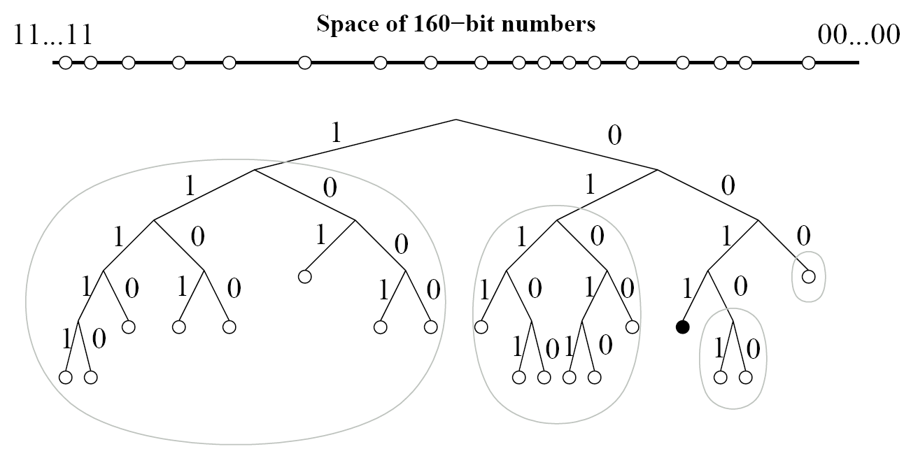
Kademlia Binary Tree
Subtrees of interest for a node 0011……

Slide 7
Kademlia Binary Tree
Every node keeps touch with at least one node from each of its subtrees. (if there is a node in that subtree.) Corresponding to each subtree, there is a k-bucket.
Every node keeps a list of (IP-address, Port, Node id) triples, and (key, value) tuples for further exchanging information with others.

Slide 8
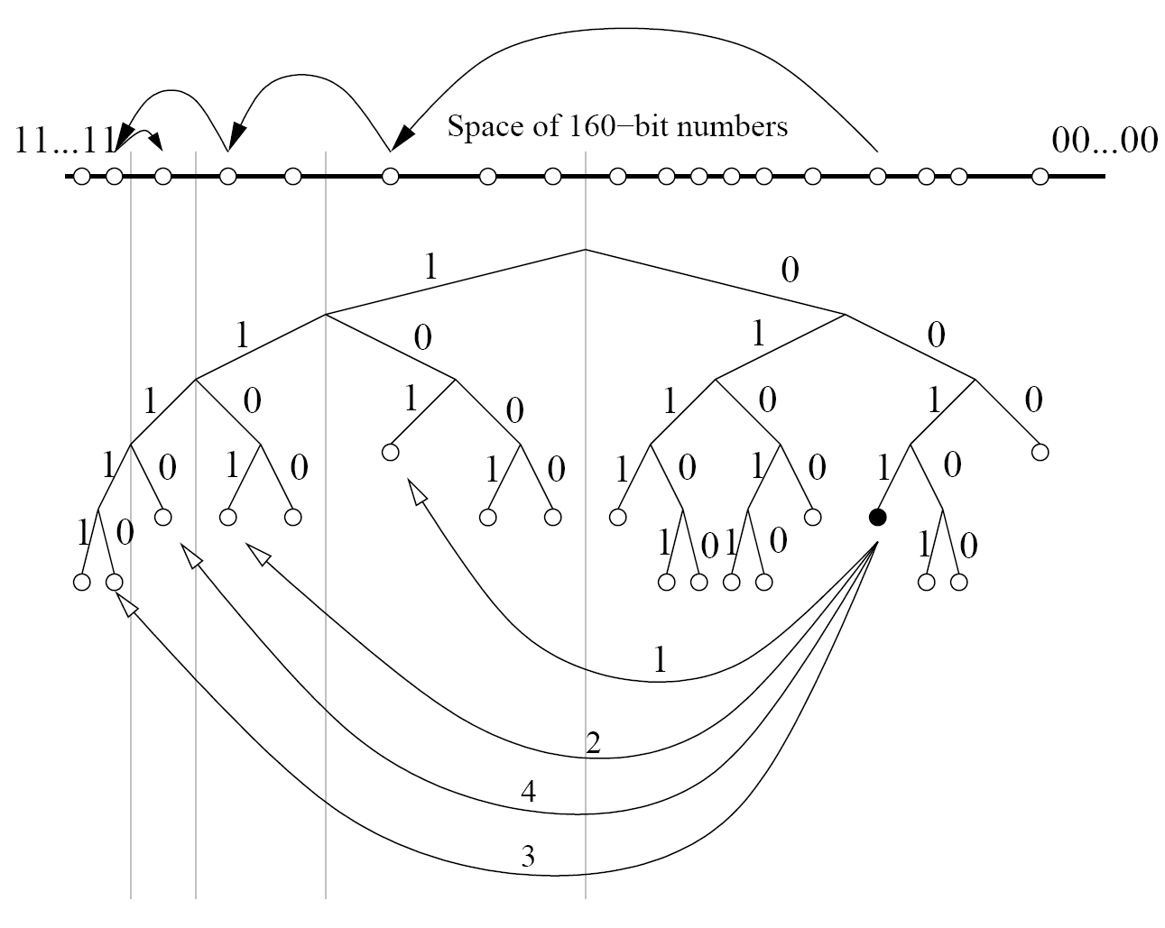
Kademlia Search
An example of lookup: node 0011 is searching for 1110……in the network

Slide 9
The XOR Metric
d (x,x) = 0
d (x,y) > 0 if x ≠ y
d (x,y) = d (y,x)
d (x,y) + d (y,z) ≥ d (x, z)
For each x and t, there is exactly one node y for which d (x,y) = t

Slide 10
Node state
head
For each i (0 ≤ i <160) every node keeps a list of nodes of distance between 2^{i} and 2^{(i+1)} from itself.. Call each list a k-bucket. The list is sorted by time last seen. The value of k is chosen so that any give set of k nodes is unlikely to fail within an hour. The list is updated whenever a node receives a message.
k = system-wide replication parameter
Least recenly seen
Most recenly seen
tail
Gnutella showed that the longer a node
is up, the more likely it is to remain up for
one more hour

Slide 11
Node state
The nodes in the k-buckets are
the stepping stones of routing.
By relying on the oldest nodes,
k-buckets promise the probability
that they will remain online.
DoS attack is prevented since
the new nodes find it difficult
to get into the k-bucket
Least recenly seen
Most recenly seen
How is the bucket updated?

Slide 12
Kademlia RPC
PING: to test whether a node is online
STORE: instruct a node to store a key
FIND_NODE: takes an ID as an argument, a recipient returns (IP address, UDP port, node id) of the k nodes that it knows from the set of nodes closest to ID (node lookup)
FIND_VALUE: behaves like FIND_NODE, unless the recipient received a STORE for that key, it just returns the stored value.

Slide 13
Kademlia Lookup
The most important task is to locate the k closest nodes to some given node ID.
Kademlia employs a recursive algorithm for node lookups. The lookup initiator starts by picking α nodes from its closest non-empty k-bucket.
The initiator then sends parallel, asynchronous FIND_NODE to the α nodes it has chosen.
α is a system-wide concurrency parameter, such as 3.

Slide 14
Kademlia Lookup
When α = 1, the lookup resembles that in Chord in terms of message cost, and the latency of detecting the failed nodes. However, unlike Chord, Kademlia has the flexibility of choosing any one of the k nodes in a bucket, so it can forward with lower latency.

Slide 15
Kademlia Lookup
The initiator resends the FIND_NODE to nodes it has learned about from previous RPCs.
If a round of FIND_NODES fails to return a node any closer than the closest already seen, the initiator resends the FIND_NODE to all of the k closest nodes it has not already queried.
The lookup terminates when the initiator has queried and gotten responses from the k closest nodes it has seen.

Slide 16
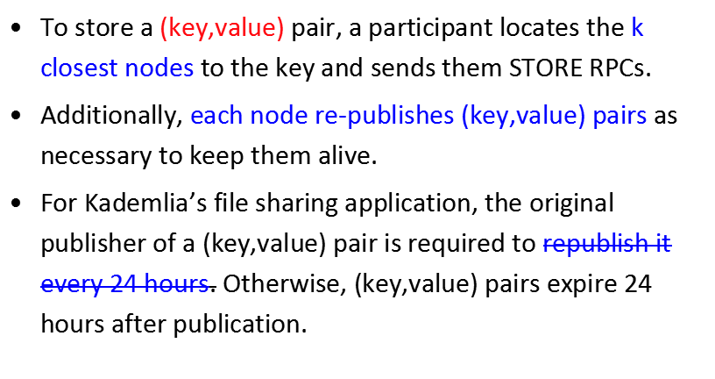
Kademlia Keys Store

Slide 17
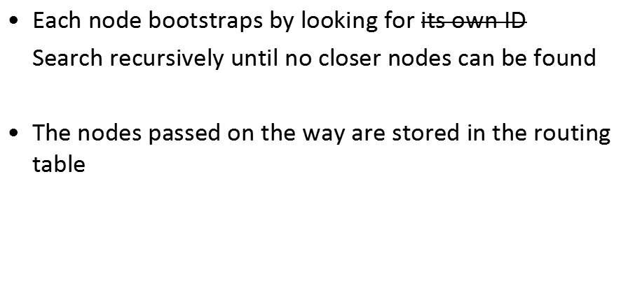
New node join

Slide 18
Trackerless torrent
Common problems with a single tracker
is the single point of failure
A solution is to use multiple trackers. Kademlia helps implement this

Slide 19
Main idea
The DHT uses the SHA-1-hashes as keys
The key is the hash of the metadata. It uniquely identifies a torrent.
The data is a peer list of the peers in the swarm

Slide 20
Distributed tracker
Each peer announces itself with the distributed tracker by looking up the 8 nodes closest to the SHA1-hash of the torrent and sending an announce message to them
Those 8 nodes will then add the announcing peer to the peer list stored at that info-hash
A peer joins a torrent by looking up the peer list at a specific hash

Slide 21
Conclusion
Operation cost
  As low as other popular protocols
  Look up: O(logN), Join or leave: O(log²N)
Fault tolerance and concurrent change
  Handles well via the use of k-buckets
Proximity routing -- chooses nodes that has low latency
Handles DoS attacks by using that are up for a long time
The architecture works with various base values. A common choice is b=5.

