Slide 1
Generic Solution for Visualizing/Forecasting
Incoming Data Volume and Disk Usage

Slide 2
Proposed Features
(1) Predict the future date on which the data drive will run out of space.
(2) Predict and visualise the incoming data volume for next 14 days for all Applications (combined data volume)
(3) Predict and visualise the incoming Data Volume for next 14 days for individual Applications
(4) Alert the user/team if the individual applications' last 7 days actual data volume goes beyond the 95%
confidence band, comparing with predicted data volume.
(5) Alert the engineering team if the predicted volume gives indication to out of space within 14 days.

Slide 3
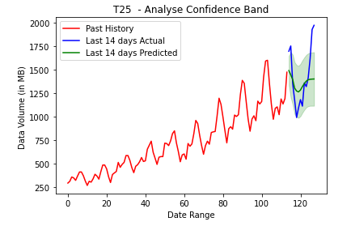
Alert the user/team if the individual applications' last 7 days actual data volume goes beyond the 95% confidence band, comparing with predicted data volume.

Slide 4
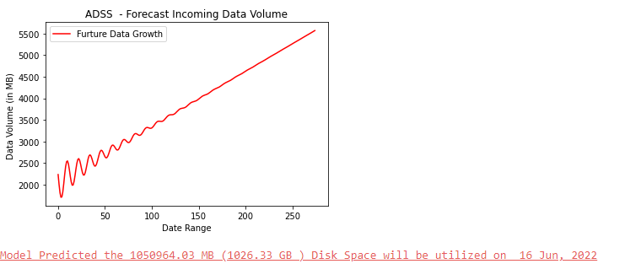
Predict the future date on which the data drive will run out of space

Slide 5
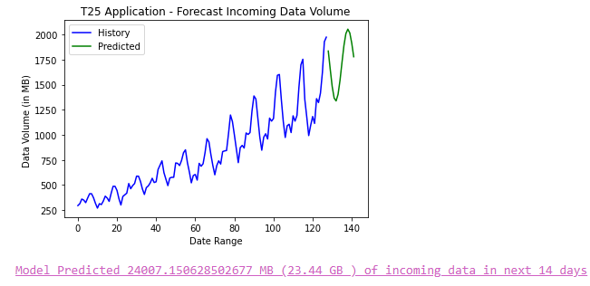
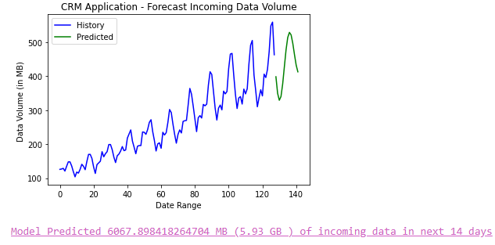
Predict and visualise the incoming Data Volume for next 14 days for individual Applications

Slide 6
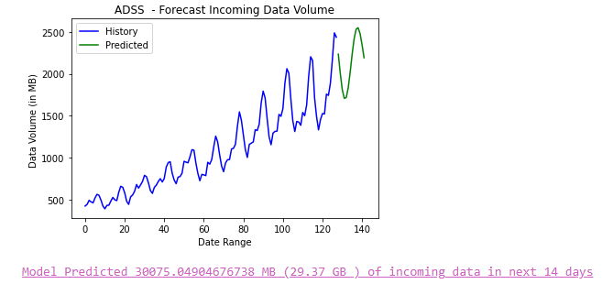
Predict and visualise the incoming data volume for next 14 days for all Applications (combined data volume)

Slide 7
Alert the engineering team if the predicted volume gives indication to out of space within 14 days
- Predict Season ? – Predict Trend?

