Slide 1


Significance Testing Between Sleep Time and Daily Caffeine Consumption

Slide 2
Analysis Objectives
Is there a relationship between the dependent variable sleep time and the independent variable daily caffeine consumption
Can this relationship be visualized in graph form
If relationship is visual present, can we create a model to predict average future sleep time based on daily caffeine consumption

Slide 3

Data
The sample range was from 11/10/2022 to 11/27/2022
Sleep was tracked via Samsung app
Sleep time was converted from hours & minutes to minutes only
Caffeine was manually record by Product type
Data was transcribed daily in excel file

Slide 4
Data Preview
Date | Minutes Slept | Daily Caffeine Amount(in mg) | Drinks Consumed | Monster Sunrise | Monster Rehab Raspberry Tea | Pure Leaf Unsweetened Black Tea
11/10/2022 | 464 | 150 | 1 | 1 | 0 | 0
11/11/2022 | 495 | 69 | 1 | 0 | 0 | 1
11/12/2022 | 442 | 138 | 2 | 0 | 0 | 2
11/13/2022 | 392 | 310 | 2 | 1 | 1 | 0

Slide 5
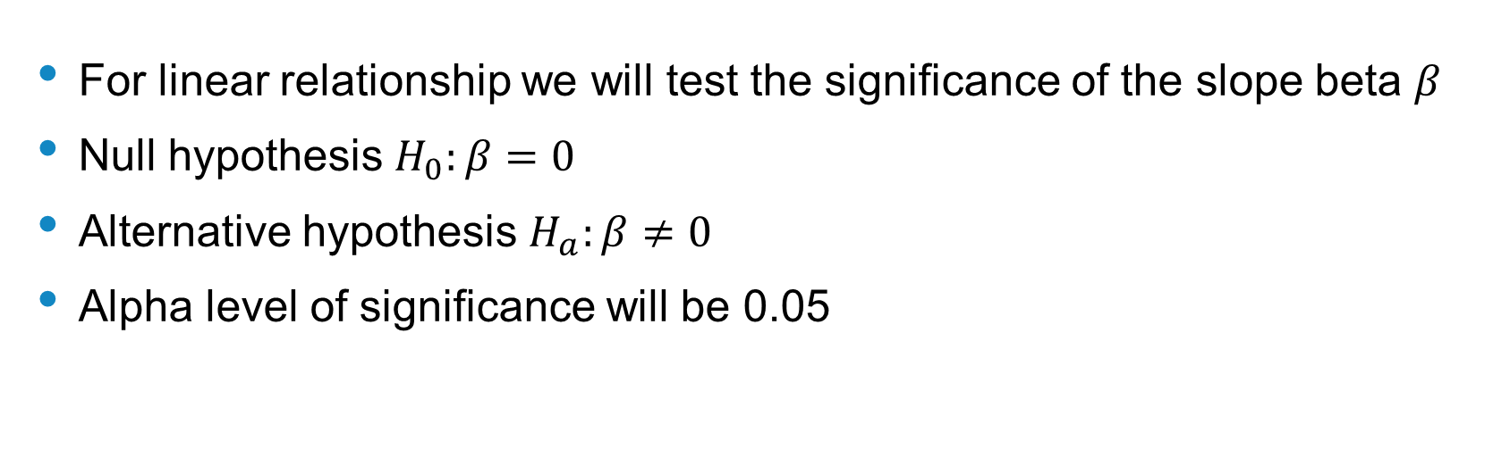
Hypothesis Statement
For linear relationship we will test the significance of the slope beta $β$
Null hypothesis $H_{0}:β=0$
Alternative hypothesis $H_{a}:β≠0$
Alpha level of significance will be 0.05

Slide 6
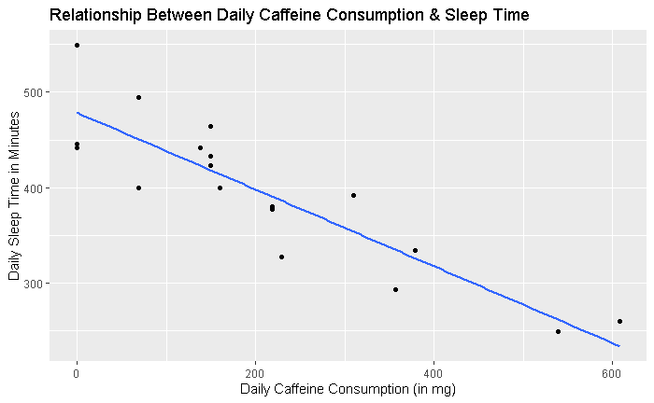
Graphing Relationship

Slide 7
Regression Modeling
Coefficients:
Estimate Std. Error t value Pr(>|t|)
(Intercept) 478.54254 14.06246 34.030 2.35e-16 ***
daily_caffeine -0.40250 0.05238 -7.684 9.31e-07 ***
---
Signif. codes: 0 ‘***’ 0.001 ‘**’ 0.01 ‘*’ 0.05 ‘.’ 0.1 ‘ ’ 1
Residual standard error: 37.69 on 16 degrees of freedom
Multiple R-squared: 0.7868, Adjusted R-squared: 0.7735
F-statistic: 59.05 on 1 and 16 DF, p-value: 9.312e-07
Regression modeling shows daily caffeine consumption to be statistically significant to the dependent variable of sleep time
Regression formula y-hat = 478.54254 + (daily_caffeine * -0.4025)
p-value for daily caffeine is .000000931 < 0.05 alpha level for this study
For every 1 mg in caffeine consumed we expect on average time slept to decrease by 40 seconds

Slide 8
Conclusion
Graph shows clearly a negative relationship between daily caffeine consumption and sleep time
Regression modeling showed daily caffeine is statistically significant to sleep time as we are below the 0.05 alpha level in this analysis
https://github.com/hend0479/Data211-01.git

