Slide 1

Pharmaceutical Inventory & Financial Risk Analytics
Power BI Dashboard for Inventory, Expiry & Risk Mitigation
Team: Rana Essam • Youssef Sami • Hend Khaled • Mahmoud Allam
DEPI Program • Data Analytics Track • July 2026

Slide 2

The Project Idea
The Core Problem
The pharmacy warehouse achieves $185.94M in Total Sales with a healthy 25.88% gross margin, yet still records a Net Loss of $27.16M.
This "Profitability Paradox" is driven by $75.52M in storage/holding expenses and $56.41M in inventory waste (expiry, damage, and cold chain failure) — a direct result of poor stock rotation and weak visibility into shelf-life risk.
The Proposed Solution
An interactive Power BI dashboard built on a Star Schema data model, integrating inventory, sales, purchases, and waste data into a single source of truth.
By classifying risk into live action tiers, the dashboard enables FEFO (First Expired, First Out) dispensing, faster stock turnover, and converts the $56M waste leakage into recovered profit.

Slide 3
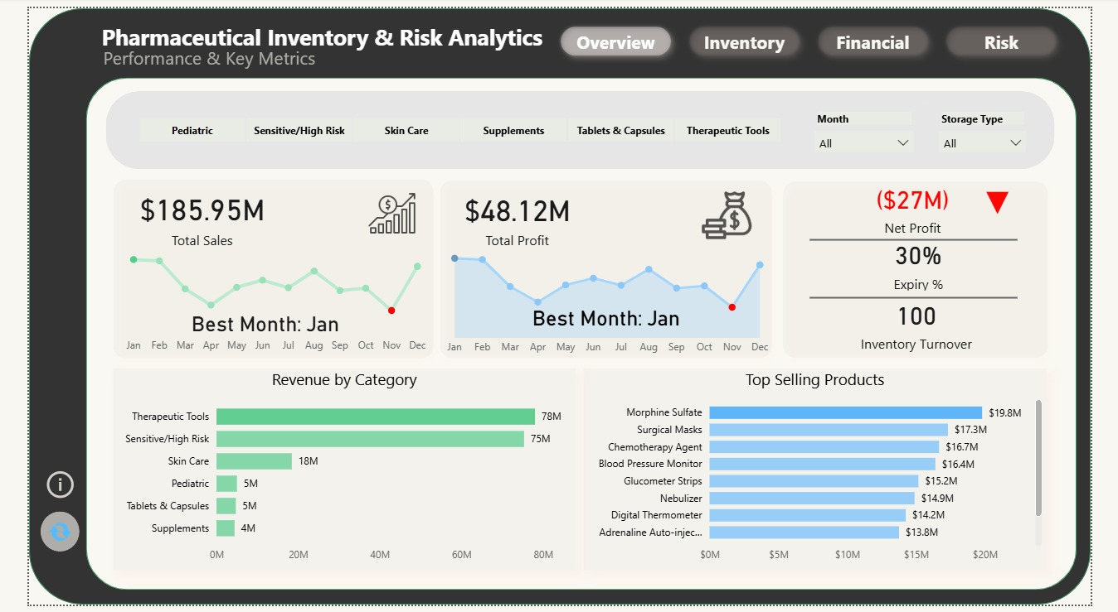

Dashboard User Journey
UX & Usability Focus
Tab Navigation: Seamless switch between Overview, Inventory, Financial and Risk views.
Unified Slicers: Filter by Month and Storage Type to detect localized expiry bottlenecks.
Risk Color Coding: Red/green highlights draw immediate focus to critical stock points.
Top Products List: Keeps focus on the highest-velocity revenue drivers.

Slide 4

End Users & Key Features
Pharmacists
Instantly identifies medications with ≤ 30 days to expiry.
One-click action to move items to the priority dispensing counter (FEFO).
Pharmacy Owners
Tracks the full P&L chain: Sales ($185.94M), Gross Profit ($48.11M), Net Loss (-$27.16M).
Sees exactly where holding cost and waste are eroding margin.
Inventory Managers
Monitors Inventory Turnover and Days of Inventory to flag over-ordering.
Uses Reorder Point alerts to avoid both stockouts and dead stock.

Slide 5
Database & Modeling Structure
Dimension Tables (Context)
Dim_Product – Product_ID, Category, Batch_Number, Purchase/Selling Price, Reorder_Level, Shelf_Life_Days
Dim_Supplier – Supplier_ID, Lead_Time_Days, City, Supplier Risk Loss
Dim_Date – Date_ID, Day, Month, Quarter, Year
All relationships: 1:∞ from dimensions to facts, with enforced referential integrity.
Fact Tables (Transactions)
Fact_Sales – Quantity_Sold, Total_Revenue, COGS
Fact_Purchases – Quantity_Purchased, Unit_Cost
Fact_Inventory – Quantity_On_Hand, Storage_Cost_per_Unit
Fact_Waste – Quantity_Expired, Loss_Value, Reason
Built and modeled in Power BI using Power Query + DAX on a Star Schema.

Slide 6
Technology Stack & Tools
Power BI Desktop
Interactive dashboard canvas: custom theme, 4-tab layout, trend lines and slicers.
Star Schema data model with enforced 1:∞ relationships.
Excel & Power Query
Data cleaning: removed errors, empty records, normalized data shapes.
ETL layer feeding Fact_Sales, Fact_Purchases, Fact_Inventory and Fact_Waste.
DAX & Modeling
Core measures: Gross Margin, Total Storage Expense, Total Waste, Net Profit.
Supply-chain metrics: Inventory Turnover, Days of Inventory, Reorder Point.

Slide 7
Live Application & Testing
Current State
The Power BI dashboard is complete and ready for final presentation — all 4 pages (Overview, Inventory, Financial, Risk) are fully built and interactive.
All DAX measures are validated: Gross Margin (25.88%) and Net Loss (-$27.16M) match the underlying source data.
Live Dashboard: app.powerbi.com/links/pe43NPpJJo
Testing Approach
Testing was conducted internally between the 4 team members, simulating daily pharmacist and manager workflows.
Responsiveness: verified fast refresh when slicing by Month and Storage Type.
Fidelity: confirmed accurate cross-filtering on category and tab clicks.

Slide 8
Deliverables
Excel Workbook
Cleaned dataset & source tables
Project Description
Problem, objectives & scope
PowerPoint Deck
This presentation
Source Code
DAX measures & Power Query steps
Live Application
Published public Power BI dashboard
Documentation
Full technical write-up
Video Walkthrough
4-minute dashboard demo
GitHub Repository
All project files hosted publicly
All deliverables will be consolidated and hosted in a single public GitHub repository.

Slide 9
Project Team & Roles
Youssef Sami
Data Cleaning & Modelling
Cleaned and structured the raw data in Excel & Power Query, and built the Star Schema data model (Fact/Dimension tables and relationships).
Rana Essam
Calculations
Built the core DAX measures (Gross Margin, Net Profit, Turnover, Reorder Point) on top of the data model and verified all financial logic.
Hend Khaled
Visualization & Documentation
Designed the dashboard UI, page navigation and color palette; authored the full technical documentation.
Mahmoud Allam
Visualization
Designed dashboard visuals, trend lines, and the interactive layout tabs alongside Hend.
Coordination: the team worked closely together, continuously cross-checking calculations against visuals to keep the dashboard accurate.

Slide 10
Thank You!
Any questions or feedback?
Rana Essam • Youssef Sami • Hend Khaled • Mahmoud Allam
DEPI Program • Data Analytics Track

