Slide 1
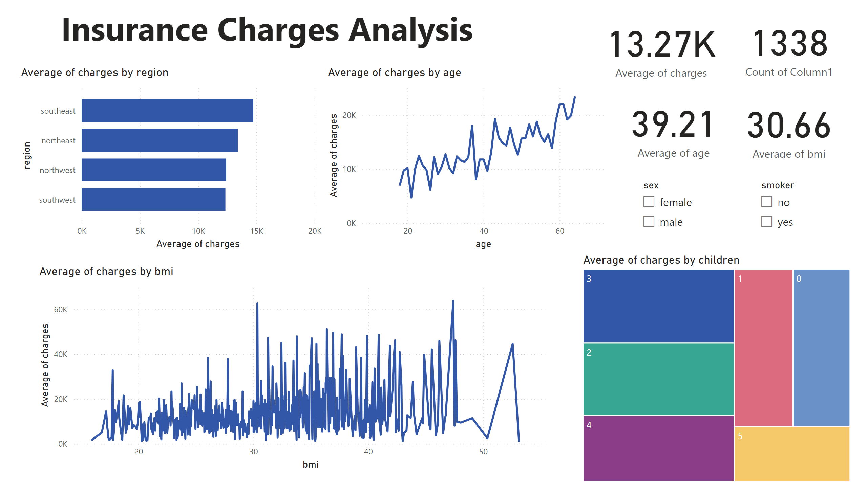
Insurance Charges Analysis
Notes:
textbox
No alt text provided
card
No alt text provided
card
No alt text provided
slicer
No alt text provided
card
No alt text provided
card
No alt text provided
lineChart
No alt text provided
lineChart
No alt text provided
barChart
No alt text provided
treemap
No alt text provided
slicer
No alt text provided

