Slide 1



car_sales
View in Power BI
Last data refresh:
9/20/2025 8:04:43 AM UTC
Downloaded at:
9/20/2025 12:23:51 PM UTC

Slide 2
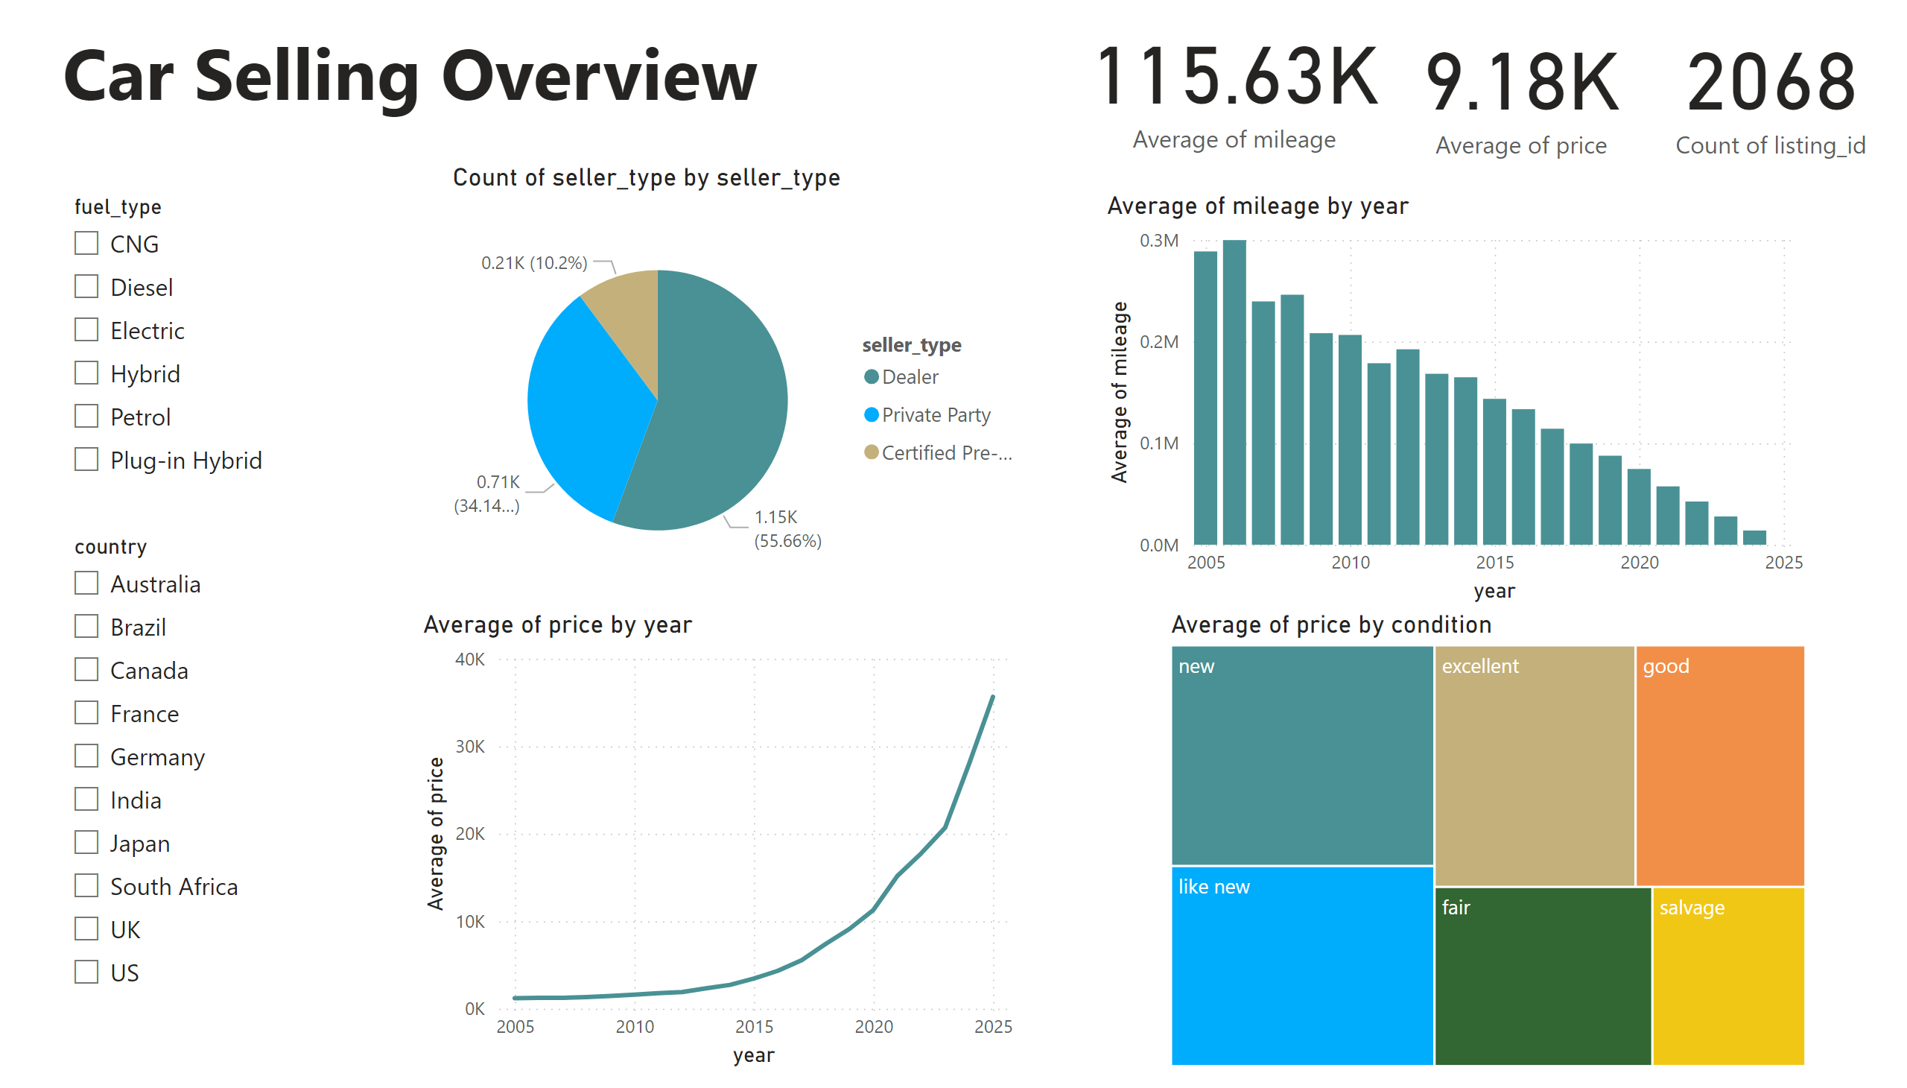
Overview
Notes:
columnChart
No alt text provided
slicer
No alt text provided
slicer
No alt text provided
textbox
No alt text provided
pieChart
No alt text provided
treemap
No alt text provided
lineChart
No alt text provided
card
No alt text provided
card
No alt text provided
card
No alt text provided

Slide 3
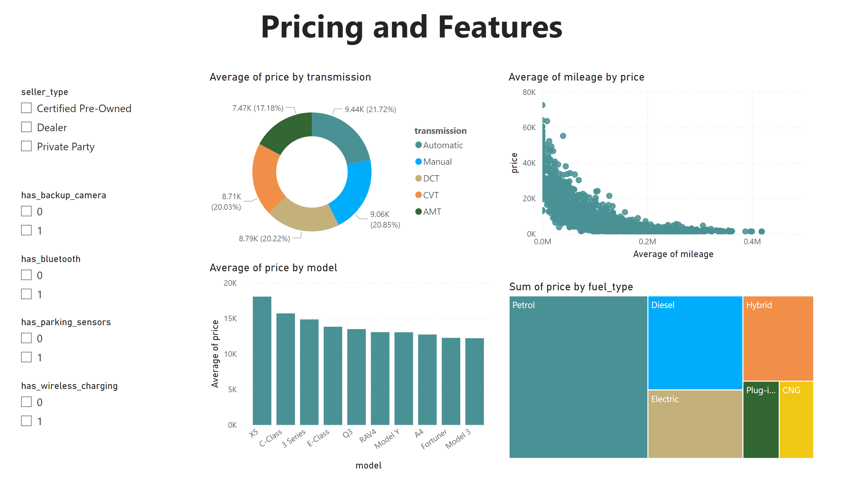
Pricing
Notes:
slicer
No alt text provided
slicer
No alt text provided
slicer
No alt text provided
slicer
No alt text provided
slicer
No alt text provided
columnChart
No alt text provided
treemap
No alt text provided
donutChart
No alt text provided
scatterChart
No alt text provided
textbox
No alt text provided

