Slide 1
LABOR MARKET STUDY
Determinants of Advertised Pay
in the US Energy and Data Center Sector
Evidence from employer-published job postings, nationwide
Regressing log advertised pay on attributes stated in the posting
Notes:
Current estimation sample: 531 postings with a disclosed pay range. The dependent variable is the log of the midpoint of the employer-stated range, annualized.

Slide 2
The question
What attributes stated in a job posting predict the pay an employer advertises?
Data center buildout is driving technical and analytical hiring across the energy sector
Seniority and location enter as regressors, not sample filters — which is what makes the disclosure contrast estimable
Postings state requirements, benefits, location and work arrangement — all potential pay determinants
Outcome: log of the employer-stated pay range midpoint, annualized to USD
28
regressors coded from posting text
13
jurisdictions mandating pay in the posting
Notes:
Roles stay narrow — an energy-analytics core. Geography and seniority are what widened.

Slide 3
Why not LinkedIn
LinkedIn's User Agreement §8.2 prohibits using scripts, robots or crawlers to scrape or copy the Services — including the unauthenticated endpoints used in most tutorials.
Data is collected instead from the public, unauthenticated ATS APIs employers publish through
These are the upstream systems that syndicate postings to job boards, including LinkedIn
Greenhouse, Lever, Ashby, SmartRecruiters, Workable, Recruitee and Workday
Full untruncated description text and the employer's own stated range — no key, no cost
Aggregators were rejected as a backbone: they truncate text and often return predicted salaries, which would make the regression circular
Notes:
The compliance posture — rate limiting, identifying User-Agent, no circumvention — is documented in docs/methods.md.

Slide 4
Why pay-transparency mandates make this possible
13
92%
48%
US jurisdictions requiring a pay scale
disclose (n=438)
disclose without one (n=272)
Where a mandate applies, the employer must state a pay scale in the posting itself — so the dependent variable is legally required to appear
Coverage attaches to the JOB's location, so a posting listing any covered place is covered
That asymmetry is what makes the disclosure contrast estimable at all, and it is the study's clearest result
mandate_state is carried as a regressor, so the contrast is examined rather than assumed away
It is associational: one cross-section, no time variation, no difference-in-differences available
Notes:
Illinois HB 3129 was the original motivation; the study is national now and the contrast spans 13 jurisdictions in force at collection.

Slide 5
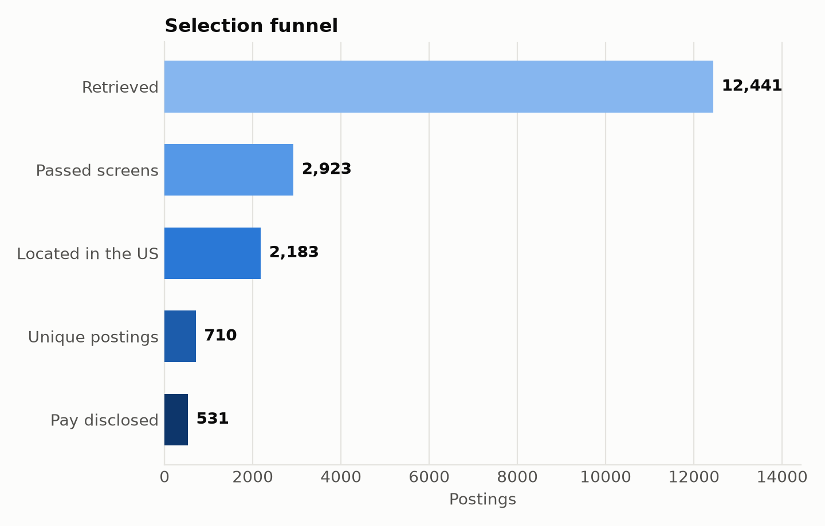
From raw postings to the estimation sample
Retrieved: 12441
Passed screens: 2923
Located in the US: 2183
Unique postings: 710
Pay disclosed: 531
Every rejection is counted and reported by reason, so the sample can be described rather than merely stated.
Notes:
Full rejection reasons live in data/analysis/selection_funnel.json.

Slide 6
Results
43–45pp
531
7
disclosure gap, every cut of the sample
postings, 99 employers
predictors surviving the bootstrap and the region check
Pay is stated far more often where a mandate applies, and the gap is stable across every cut — this is the result the study stands behind
Within disclosed pay, seniority, required experience, a stated cloud skill, a Northeast location, a West location, stating an experience minimum and a STEM degree are the only attributes distinguishable from zero — stating an experience minimum, a STEM degree and a West location only narrowly, so read them as tentative; a Northeast location and a West location do not survive price adjustment
3 coefficients reach significance under clustered standard errors and do NOT survive the wild cluster bootstrap — reported as inconclusive, not as findings
Seniority was predicted to dominate and does; it also survives every robustness cut applied
Notes:
The model is re-estimated on every collection run; this slide regenerates from analysis.json.

Slide 7
What this data cannot support
Advertised, not realized pay
Posted ranges reflect compliance and negotiating posture, not earnings.
Disclosure is selected
Outside mandate jurisdictions most postings state no pay, so every pay coefficient is conditional on disclosure. This is the central threat.
Exelon and ComEd are missing
They run iCIMS: its feed goes only to approved job boards, its API is partner-gated, no syndication feed exists, and its terms bar automated access. Verified by reading them, not assumed.
No historical backfill
ATS APIs serve only open postings, so the panel starts when collection starts.
Few employer clusters
Clustered errors cover at 92% against a nominal 95%. Significance is read off a wild cluster bootstrap, which leaves 7 predictor(s) standing: seniority, required experience, a stated cloud skill, a Northeast location, a West location, stating an experience minimum, a STEM degree.
Notes:
Stating these plainly is part of the deliverable; docs/limitations.md carries the full treatment.

Slide 8
METHOD
Reproducible end to end
Collection, screening, coding, estimation and this deck all regenerate from committed artifacts.
Scheduled GitHub Actions runs extend the panel; every number traces to data/analysis/.
Notes:
pip install -r requirements.txt && python tests/run_all.py

