Slide 1

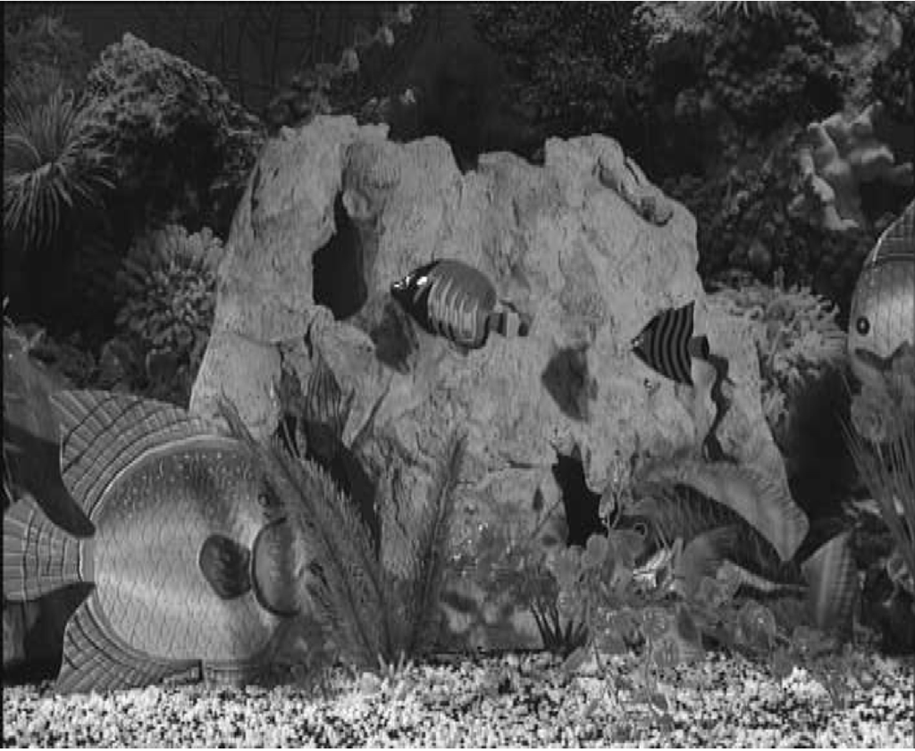
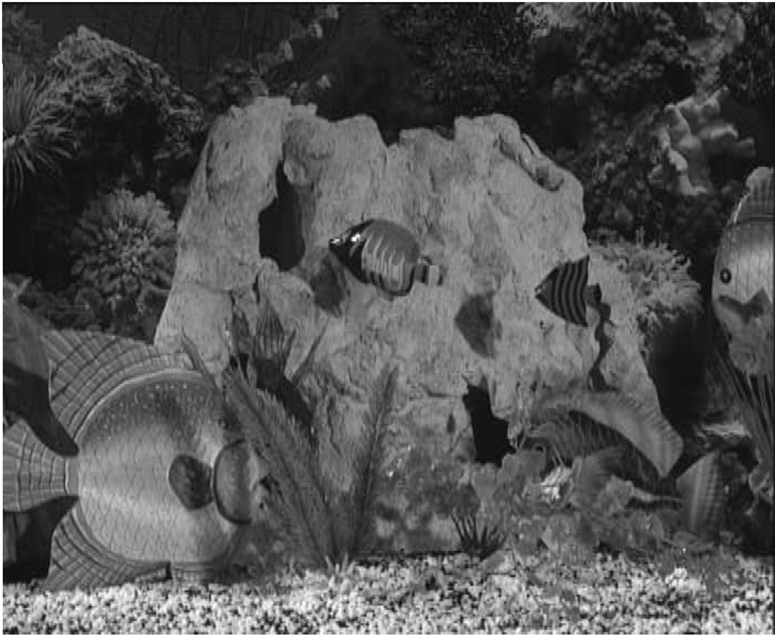
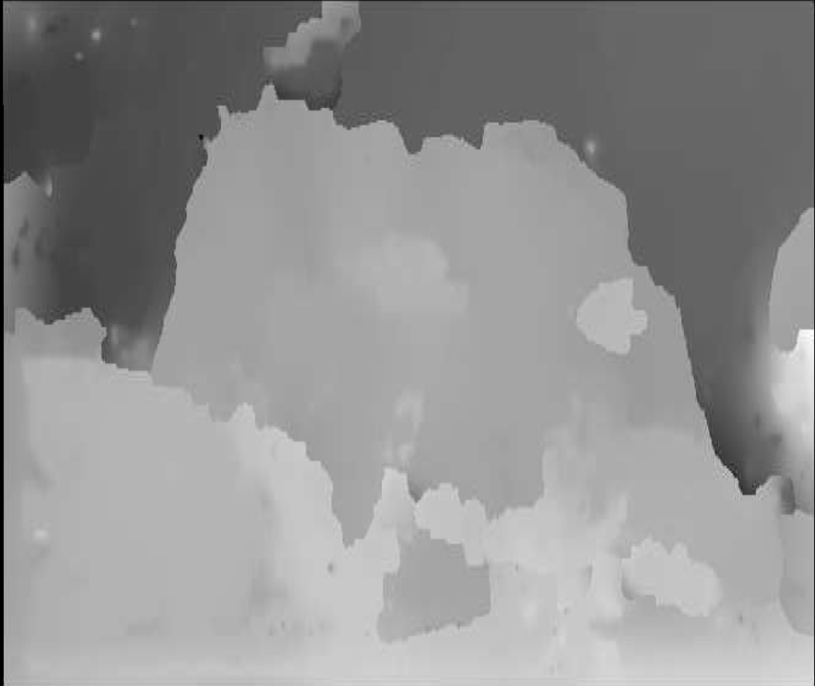
Stereoscopic Image
Depth Mapping
+
=
Combination of two or more 2D source images into a depth map, with the goal of creating a 3D reconstruction of the scene.
Eric Henderson, Nick Kamper, Laura Moss, James Savage
ftp://reports.stanford.edu/pub/cstr/reports/cs/tr/75/521/CS-TR-75-521.pdf

