Slide 1
CHAPTER 2:
WESTERN WASHINGTON STATE YOUTH CAMP AND ASSOCIATED HOUSEHOLDS
Determinants of the Transmissibility of Pandemic Influenza A (H1N1) 2009 in Community Settings
Notes:
The first analysis I will discuss involves estimation of the transmissibility of symptomatic pandemic H1N1 and the effect of age on susceptibility, using data from the investigation of an outbreak in a youth camp and associated households in Western Washington State.

Slide 2
Study Objectives
Transmission of symptomatic pH1N1 in a “school-like” camp and associated households
Estimate a …
  Daytime Camp Local R
  Nighttime Cabin SAR
  Households SAR
  Odds ratio: Effect of age on susceptibility to symptomatic pH1N1
Notes:
We estimated a camp local reproductive number for the daytime, a cabin secondary attack rate for the nighttime, and a secondary attack rate for the associated households.
We also estimated the effect of age on susceptibility to symptomatic pandemic H1N1.

Slide 3
Study Setting and Context
Person:
  Camp population: 96 participants (66% of attendees)
    72 6th-grade students
    24 teachers and camp staff
  Household members (primary case definition)
    42 camp participants (index cases)
    136 household contacts
Place: Western Washington State
  youth camp
  41 households of ill camp participants
Time: Spring 2009
  Camp: April 25 – May 7 (closed April 30)
  Households: April 30 – May 12
Notes:
Between April 23 and May 12, this outbreak started during a week-long session at a youth camp in Western Washington State and then moved to the households of camp participants.
The study population consists of 96 camp participants and 136 contacts in the households of participants with camp-acquired symptomatic pandemic H1N1

Slide 4
Methods
Data Collection
Study design: Retrospective cohort study
  Data collection: May 18 – June 9, 2009
  Public Health – Seattle & King County AND Centers for Disease Control and Prevention (CDC)
  Retrospective interviews: multiple modes
  Data:
    symptom histories, onset dates, attendance, demographic
    Camp participants and households of ill participants
Determined to be public health response by the relevant IRBs
Notes:
An outbreak investigation was conducted using a retrospective cohort study design.
Within 1-3 weeks of the end of the outbreak, members of Public Health – Seattle & King County and the Centers for Disease Control and Prevention collected data from camp participants and household contacts using a structured interview form.
The information collected included symptom histories, symptom onset dates, attendance, and demographic data.
The institutional review boards of Washington State, the CDC, and the FHCRC reviewed this research and determined it to be part of a public health response.

Slide 5
Methods
Definitions
Outcome: Symptomatic pH1N1
  6 case definitions
  Primary ~ CDC’s influenza-like illness (ILI)
Predictor: Age
  Children = ≤17 years
  Adults = ≥18 years
Case Definition |  | Symptoms
I (ILI) |  | - Reported Fever or Feverishness and - Cough or Sore throat
II |  | At least one of the following symptoms: Reported Fever, Feverishness, Cough, Sore throat, Diarrhea, Difficulty breathing, Runny nose, or Vomiting
III |  | Reported Fever or Feverishness
IV |  | Reported Fever with measured temperature ≥ 100.4°F (38°C)
V |  | - Reported Fever and - Cough or Sore throat
VI |  | - Reported Fever with measure temperature ≥ 100.4°F (38°C) and - Cough or Sore throat
Notes:
The outcome of interest was symptomatic pandemic H1N1.
Since most of the symptomatic individuals were not laboratory-confirmed infections, we used the detailed symptom history data to establish the 6 case definitions shown in the table on the right.
The primary case definition, represented by Roman numeral I, is similar to the CDC’s surveillance definition for influenza-like illness, or ILI.
We will focus on the study results for case definition I, but we will also present the results for the other case definitions.
Our primary exposure of interest is age, which, due to sample size considerations, we categorize into children, who are younger than 18, and adults who are 18 and older.

Slide 6
Descriptive Statistics for the Primary Case Definition (I)
Characteristic |  | Camp Participants (N = 96) |  |  | Household Contacts (N = 136)
No. male (%) |  | 38 (40%) |  |  | 63 (28%)
Age (years)
Children (≤17 years): No. (% of all individuals) |  | 79 | (82%) |  | 48 | (35%)
Adult (≥18 years): No. (% of all individuals) |  | 17 | (18%) |  | 88 | (65%)
Mean (SD: Range) |  | 16 | (12: 10, 59) |  | 34 | (18: 0.5, 74)
Number of cabins or households |  | 13 |  |  | 41
Individuals per cabin or household: Mean (SD: Range)
Children |  | 7.2 | (2.1: 4, 10) |  | 1.2 | (0.8: 0, 3)
Adults |  | 3.0 | (2.0: 1, 5) |  | 2.1 | (0.7: 1, 5)
All individuals |  | 6.3 | (2.8: 1, 10) |  | 3.3 | (1.3: 1, 8)
Notes:
The following are several descriptive statistics for the camp participants, shown in the left-hand column, and for the household contacts, in the right-hand column.
In general, both groups had a higher proportion of females than males.
Since this was a youth camp, a large proportion of the participants were children.
The opposite trend was observed among the household contacts, likely reflecting the fact that most of the child members of these households attended the camp.
The number of individuals per cabin was greater than the number of contacts per household.
This difference was especially large for the children, again reflecting the differences in age structure between the camp participants and household contacts.

Slide 7
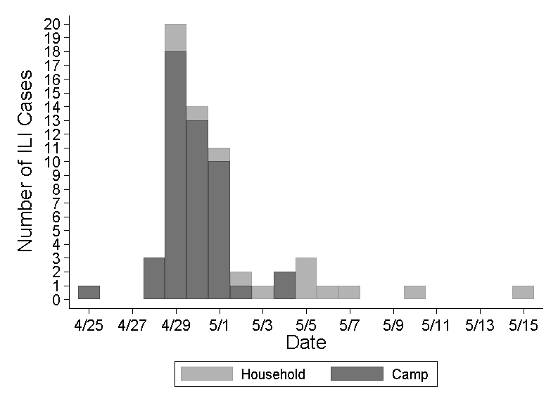
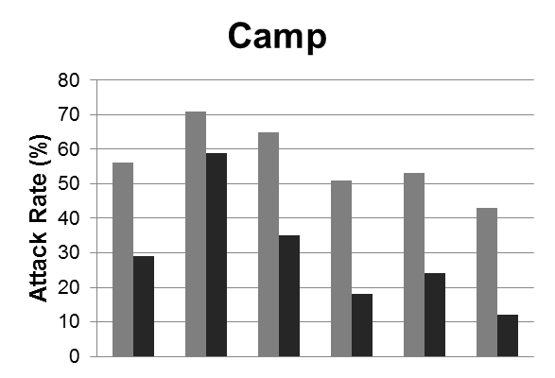
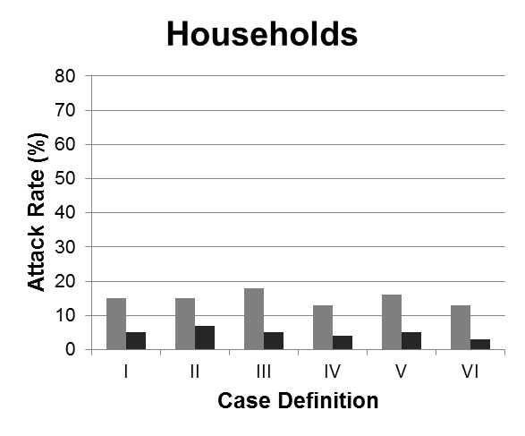
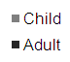
ILI attack rate
  Camp: 51% (N = 49)
  Household contacts: 8% (N=11)
Camp: 5 cases were laboratory-confirmed
Notes:
On the left, we have the epidemic curve for influenza-like illness, with the frequency of ILI on the y-axis and the date on the x-axis.
ILI cases among camp participants are shown in dark gray and among household contacts in light gray.
On the right, we have the illness attack rates for all 6 case definitions, by age-group and by camp versus household.
Attack rates among children are shown in light gray and among adults in dark gray.
Note, that the attack rate for ILI is much higher in the camp, as indicated by both the epidemic curve and the attack rate bar graphs.
Also, camp and household attack rates are higher in children when compared to adults.
Please note that 5 of the symptomatic camp participants were later confirmed to have been pandemic H1N1 infections by RT-PCR.

Slide 8
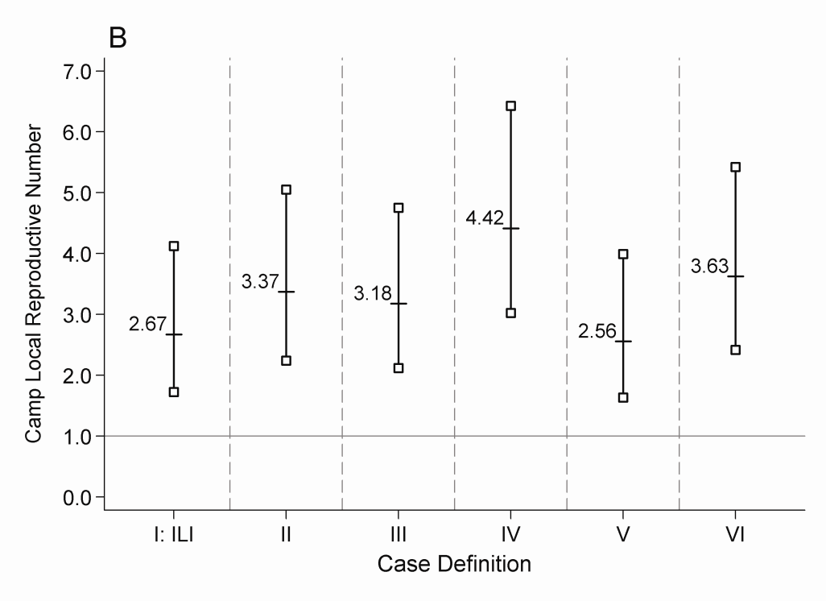
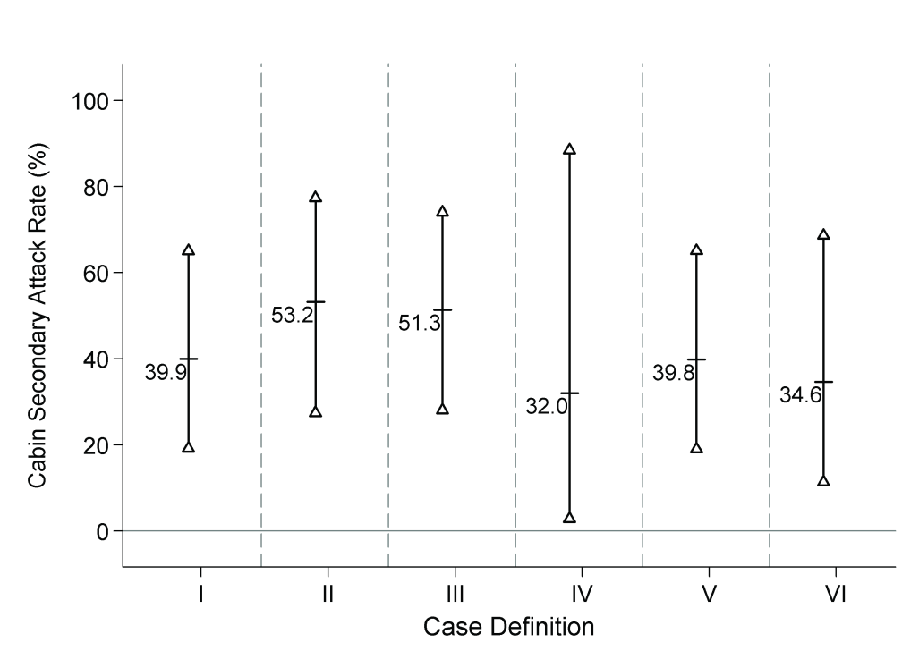
Results:
Camp Transmission
Camp Local R: Daytime
Cabin SAR: Nighttime
Notes:
Here we have the estimates for both the camp local reproductive number and cabin secondary attack rate among children.
The vertical bar-bells denote the 95% confidence intervals for the point estimates, which are represented by the labeled short horizontal cross bars.
This method of plotting estimates will be used frequently throughout this presentation.
Note that:
1) Daytime exposure to a typical symptomatic pandemic H1N1 case of ILI in the camp resulted in an average of 2.7 new cases
2) ~40% of children exposed to a symptomatic pandemic H1N1 case of ILI in their cabin at night fell ill
3) Transmission of symptomatic pandemic H1N1 in the camp and the cabins was consistently elevated, regardless of the case definition employed.

Slide 9
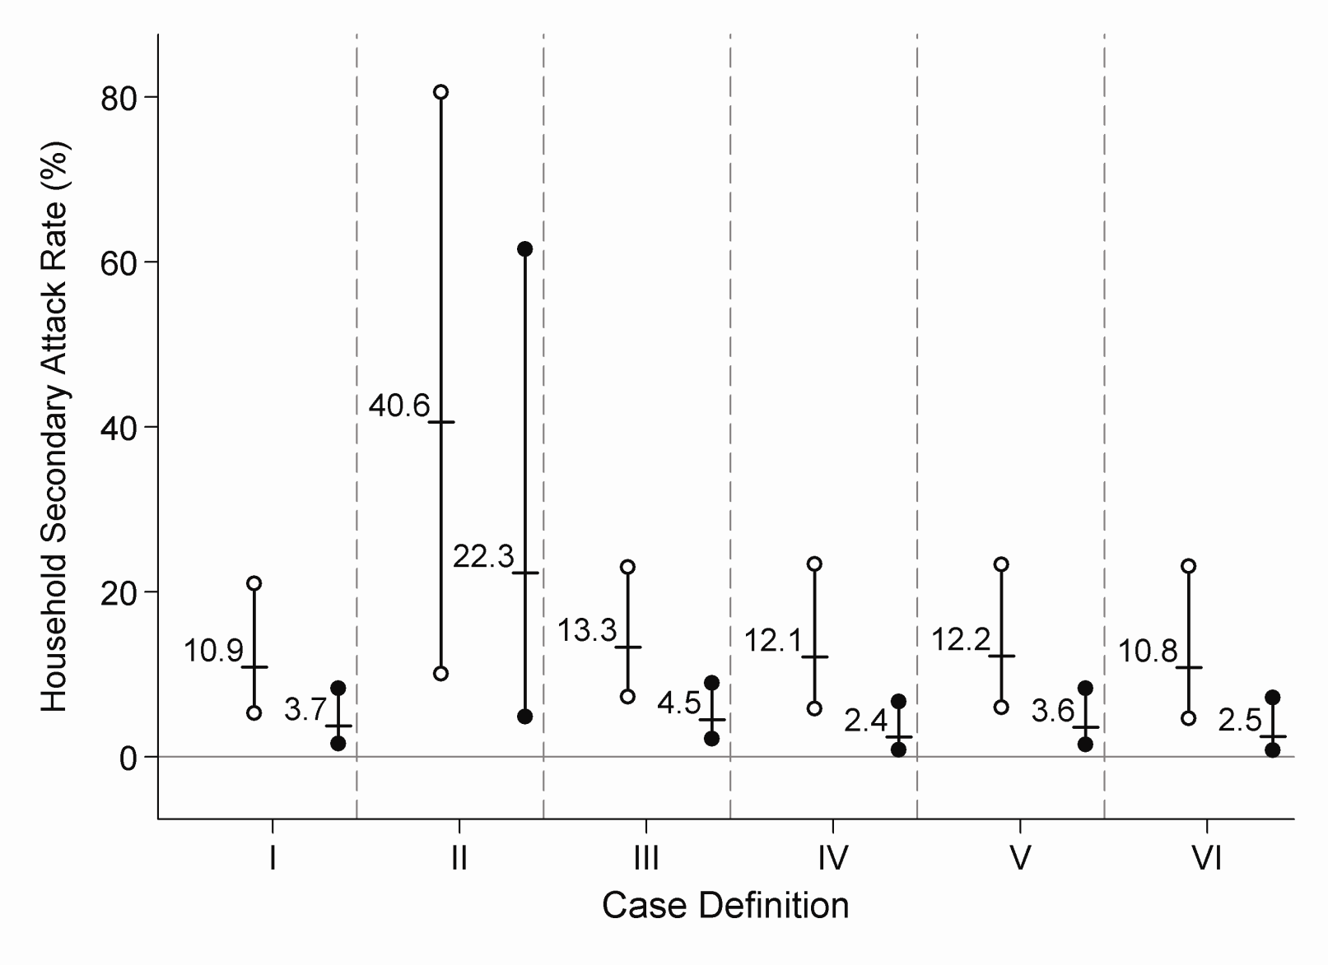
Results:
Household Transmission
Notes:
Here we present, for each case definition, the household secondary attack rates for children and adults, represented by hollow and solid circles, respectively.
Not shown here, the un-adjusted household secondary attack rate for influenza-like illness, or case definition I, was 6.2%.
Except for the non-specific definition II, the household secondary attack rates are lower-than-expected given the previously-shown estimates for other prior strains of influenza A (H1N1).
Household secondary attack rates values are consistently 2 – 3 times greater in children than adults.

Slide 10
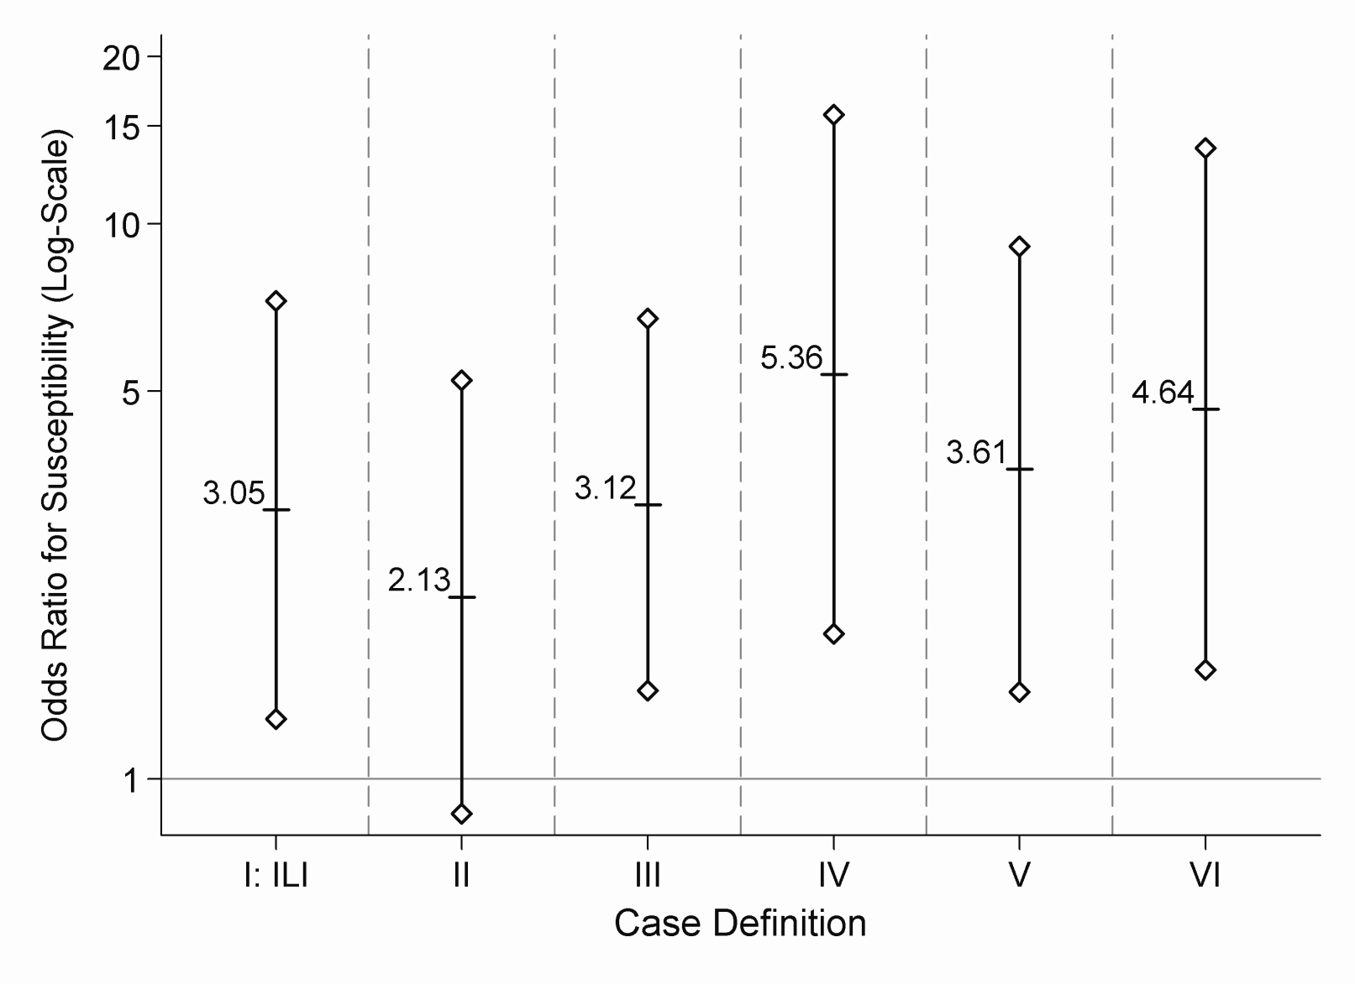
Results:
Age-group Odds Ratio
Notes:
This relative difference is demonstrated by the age-group odds ratio comparing the susceptibility to symptomatic pandemic H1N1 among children versus adults.
Children are 3.1 times more susceptible than adults to pandemic H1N1 associated influenza-like illness.
The non-significance of the odds ratio for case definition II may again reflect the broad, non-specific nature of that definition.

Slide 11
Limitations
Low survey response rate: 66%
  Selection bias: differential response for case vs. non-case
  If all non-respondents had been …
    Non-cases: camp ILI attack rate = 34%
    Cases: camp ILI attack rate = 68%
  Households: condition out the camp-attending index cases
Limited laboratory confirmation:
  5 of 49 camp cases
  Multiple case definitions: sensitivity analysis
Small sample size: limited number of age groups
Notes:
This study is subject to several limitations.
The response rate to the interview was 66% among all individuals who attended the camp, which could have introduced selection bias if the response rate was differential among cases versus non-cases.
Since a small proportion of the symptomatic individuals attending the camp were actually laboratory-confirmed pandemic H1N1 infections, we can’t be absolutely certain that all individuals meeting the primary case definition were in fact infected with this novel viral strain.
In order to address the potential misclassification resulting from limited laboratory-confirmation, 1) we consider camp attendance and household membership as epidemiologic links between the confirmed and suspected symptomatic pandemic H1N1 infections and 2) we used multiple case definitions as a form of sensitivity analysis.
An additional limitation is the small sample size, which limited the number of age strata that we could investigate.

Slide 12
Summary
Observed …
  Children are significantly more susceptible than adults to symptomatic pH1N1
  Elevated transmission in the camp, which is similar to levels reported for schools
  Lower-than-expected transmission in households, which is similar to other published estimates
SAR’s and R were not sensitivity to assumptions about the incubation/latent and infectious period distributions
Notes:
In summary,
age-group is significantly associated with susceptibility to symptomatic pandemic H1N1.
Elevated transmission was observed in the camp, with levels similar to those reported for schools.
As reported by other investigators, the household secondary attack rate was lower-than-expected.
These results were not sensitive to our distributional assumptions about the incubation, latent, and infectious periods.

