Slide 1
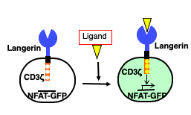
Figure 1.
A.
B.
C.
D.
C:M:W = 90:30:5

Slide 2
Figure 2.
A.
B.

Slide 3
Figure 3.
A.
B.
C.

Slide 4
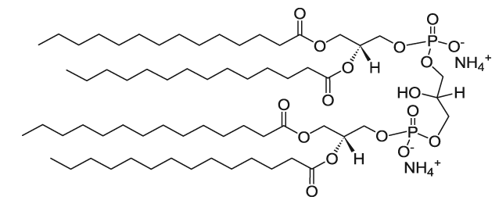

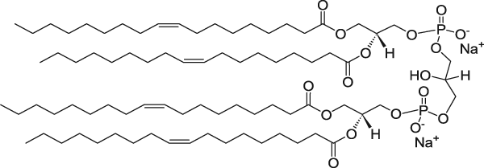

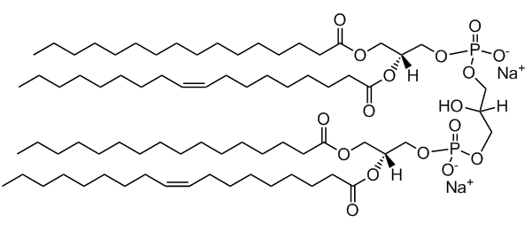
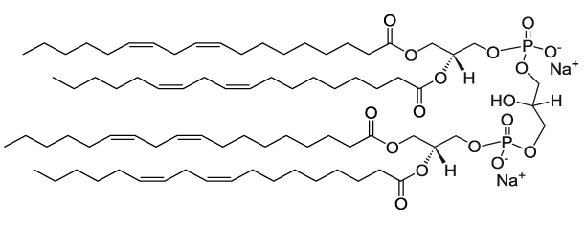
Supplementary Figure 1.
A.
B.
Alpha Mycolate
14:0 CL
Methoxy Mycolate
Keto Mycolate
18:1 CL
16:0/18:1 CL
18:2 CL

Slide 5
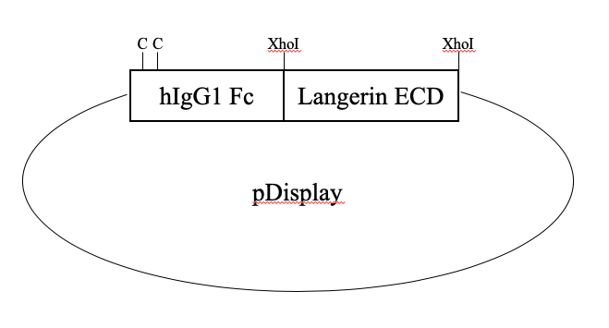
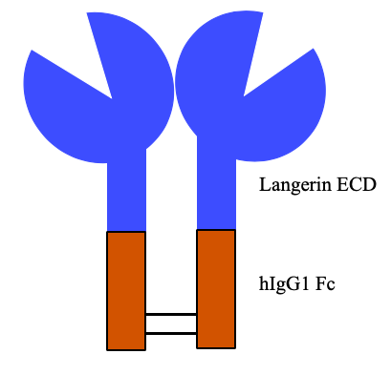
Supplementary Figure 2.
C.
A.
B.

