Slide 1
UGA Computer Team
Hend Rasheed, Andrew Palmer, Mina Jeong, Michael Hearn, Anna Gann

Slide 2
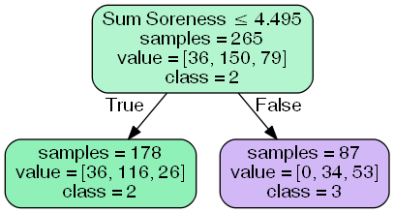
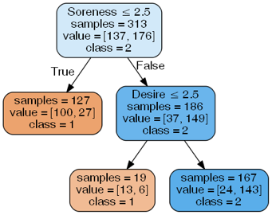
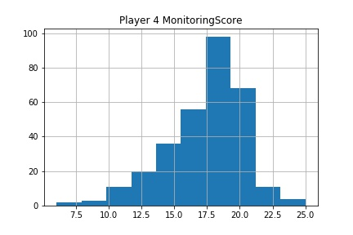
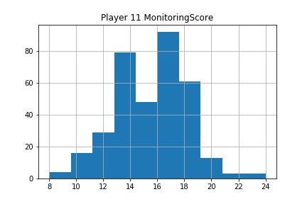
Class 1: High Fatigue
Class 2: Moderate
Class 3: Low Fatigue
Number of Leaf Nodes: 2
R2: -0.0131815458358
Accuracy: 0.606741573034
Sum Soreness was the only feature that carried significant weight
Player: 11
R2: 0.606741573034
Accuracy: 0.885714285714
Feature Importances:
‘Soreness': 0.83985342774388894
'Desire': 0.16014657225611098

Slide 3
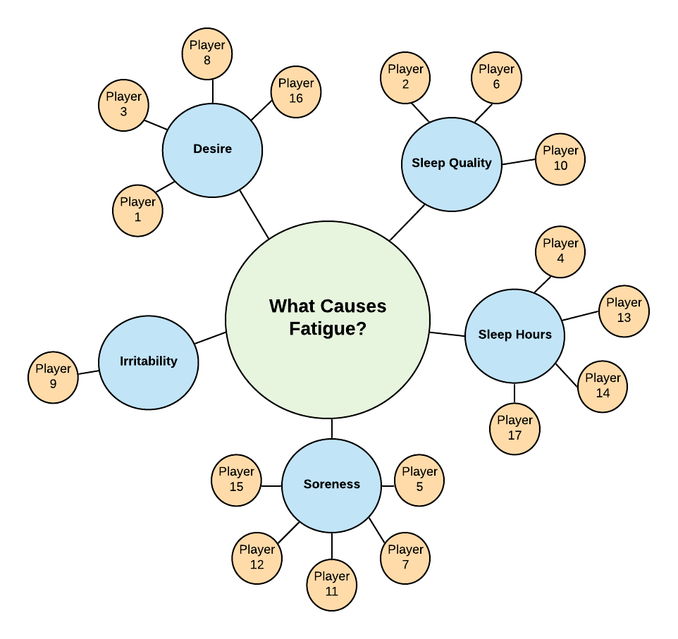
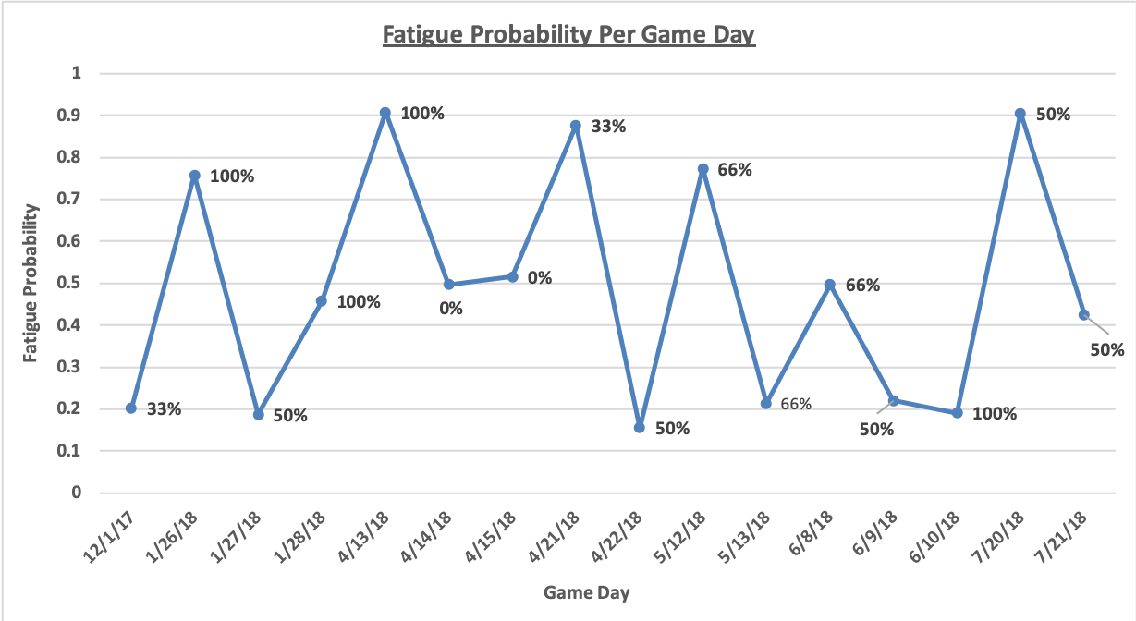
Average Accuracy for Individual Trees: 0.839166300956
Feature Importance Totals:
'Soreness': 0.31799449079176989
'SleepHours': 0.21635534450185029
'Desire': 0.20829638942725115
'SleepQuality': 0.12302946731485367

