Slide 1

Fuzzy Table
Distributed Fuzzy Matching Database
Ed Kohlwey
kohlwey_edmund@bah.com
Notes:
Fuzzytable is a distributed, real-time database for biometrics and multimedia

Slide 2
Session Agenda
Fuzzy Matching?
The Big Data Problem
A Scalable Solution
Performance
Questions?
Notes:
What is fuzzy matching
How does it relate to hadoop and big data
Our solution and how it works
Performance testing and results
And finally take questions

Slide 3

Fuzzy Matching?
Notes:
Pause

Slide 4
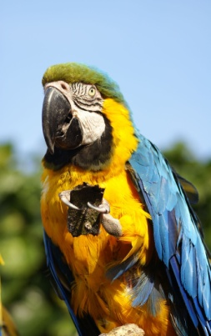
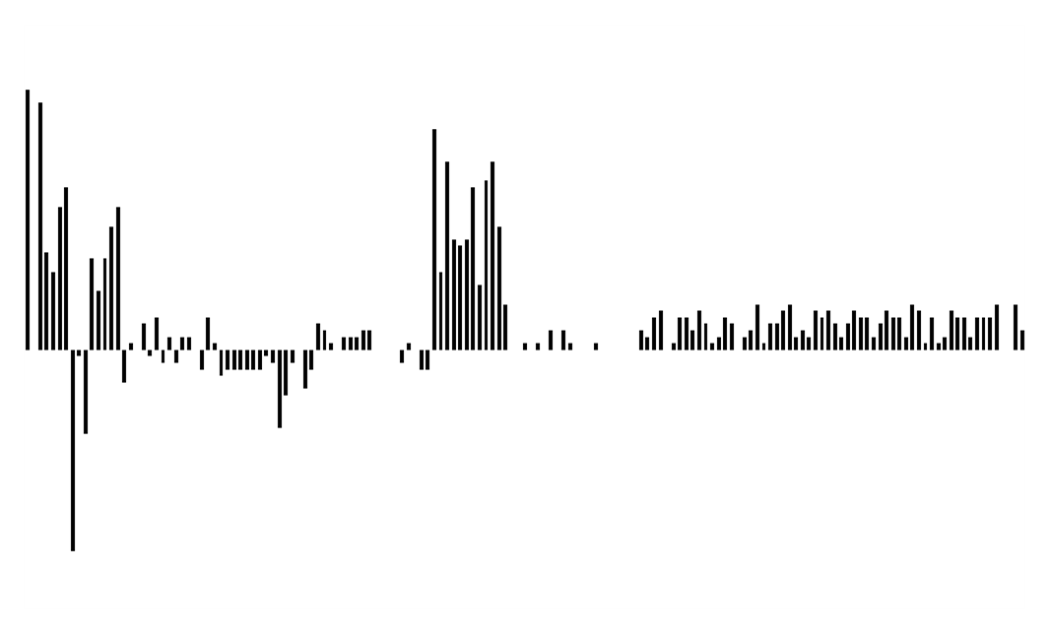
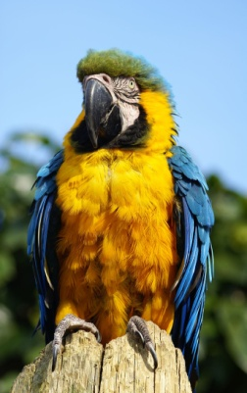
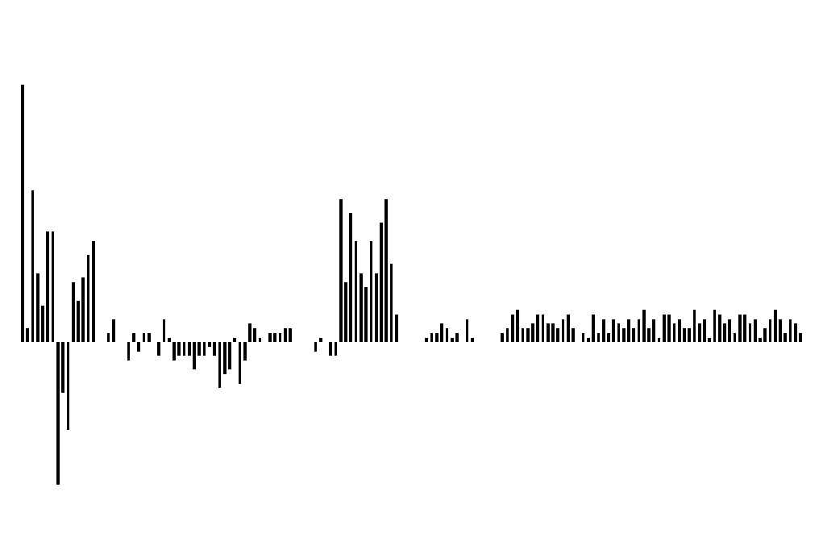
What is Fuzzy Matching?
Start with some multimedia
image/voice/audio/video/etc
Create a Vector or Matrix of doubles
1
Feature
Extraction &
Normalization
Distance
Function*
31.46
Feature
Extraction &
Normalization
2
These images are very similar, but obliviously not the same.
To find image #2 given image #1, some sort of fuzzy matching technique needs to be used
Images from Flickr; Licensed under Creative Commons
http://www.flickr.com/photos/mdpettitt/455527136/sizes/l/in/photostream/
http://www.flickr.com/photos/mdpettitt/455539917/sizes/l/in/photostream/
*Euclidean Distance in this example
Notes:
An operation that determines how similar two objects are to each other
Lots of distance measures
MPEG 7 Standard
Color histograms
Edge histograms
Most frequent color
How are colors distributed

Slide 5



How Is Fuzzy Matching Being Used Today?
Notes:
Shazam – Music searching service
Google Goggles – Image search service from Google
Face.com – Automatic image tagging for facebook

Slide 6

Why Do We Care?
At the forefront of strategy and technology consulting for nearly a century
Deep functional knowledge spanning strategy and organization, technology, operations, and analytics
US government agencies in the defense, security, and civil sectors, as well as corporations, institutions, and not-for-profit organizations
Notes:
We’re strategy + technology consulting
Biggest client is US government
Government has a lot of fuzzy data

Slide 7
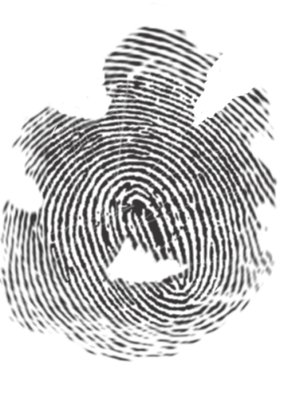
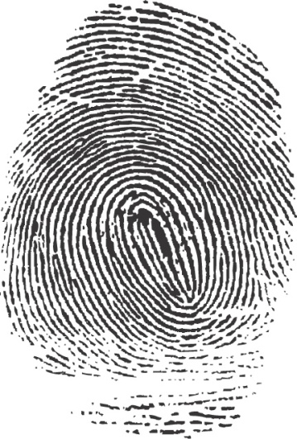
Biometrics – A Fuzzy Matching Problem
Same Person?
Lifted From A Crime Scene
Law Enforcement Database
Notes:
Example from the security market
Evidence from a crime scene probably won’t perfectly match the record in your database

Slide 8
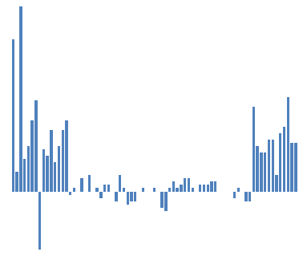
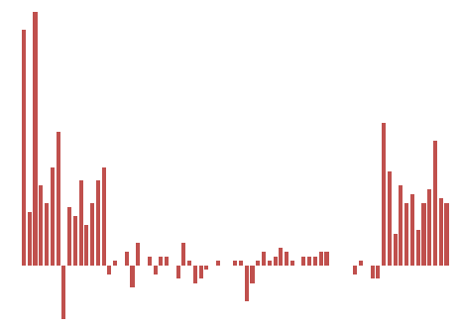
Biometrics – Example
Query Biometrics Database
Create a Vector or Matrix of doubles
Feature
Extraction &
Normalization
1
Distance
Function*
2.41
2
Feature
Extraction &
Normalization
*Euclidean Distance in this example
Notes:
It turns out you can perform the same type of analysis on biometric data

Slide 9
The Big Data Problem

Slide 10
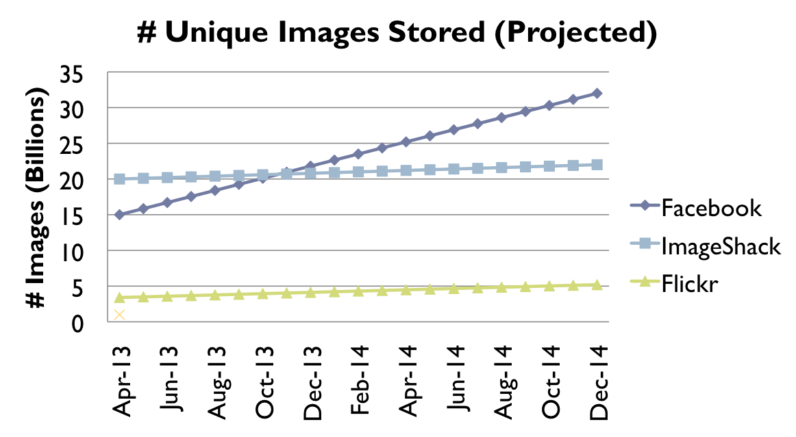
Growth of Multimedia Databases
Flickr – over 5 billion images
ImageShack – over 20 billion unique images
Youtube – over 6 billion videos
Hulu – over 380 million videos
http://techcrunch.com/2009/04/07/who-has-the-most-photos-of-them-all-hint-it-is-not-facebook/
http://ksudigg.wetpaint.com/page/YouTube+Statistics
http://techcrunch.com/2009/04/28/as-youtube-passes-a-billion-unique-us-viewers-hulu-rushes-into-third-place/
Notes:
Fuzzy data is growing in the private sector
A few data points
Assuming an image is around 300 k, Facebook will have about 8 Exabytes of images

Slide 11
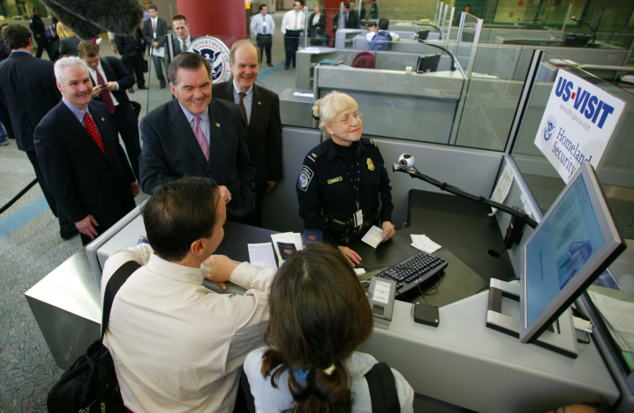
Growth of Biometric Databases
Combined U.S. government databases will soon hold billions of identities
  DHS’s US-VISIT has the world’s largest and fastest biometric database: over 110 million identities and 145,000 transactions daily*
  The FBI’s Integrated Automated Fingerprint Identification System has 66 million identities with 8,000 added daily **
US-VISIT
India working on a database of fingerprints and face images it’s population of 1.2 billion ***
European Union’s Biometric Matching System (supporting visa applications, immigration, and border control) will grow to 70 Million****
AllTrust Networks Paycheck Secure system has over 6 Million identities and has performed over 70 Million transactions*****
* US-VISIT: The world’s largest biometric application. William Graves.
** http://www.fbi.gov/hq/cjisd/iafis/iafis_facts.htm
*** http://www.business-standard.com/india/news/national-population-register-to-start-biometrics-data-collectiondec/399135/
**** http://www.findbiometrics.com/articles/i/5220/
***** http://www.alltrustnetworks.com/News/6Million/tabid/378/Default.aspx
Notes:
Fuzzy data is also growing in the public sector
Governments are applying biometric databases everywhere
Social services
Border security
Visas
Criminal investigations

Slide 12
Biometric Databases are a Big (Data) Problem
Large scale operations
  Searching and storing 100’s of millions to billions of Identities
Multiple biometric templates and raw files per identity
  Fingerprints, Faces, and Iris
New raw files and templates stored on each verification
  Computation to update models for identity
Results are expected in real time
Cost efficient storage and retrieval is hard
  Need innovative ways to reduce costs per match
    500 M Identities x (16 KB to 300 KB) x (10 to 20)
= 1 – 2 PB
    500 M Identities x (256 b to 3 KB) x (10 to 20)
= 2 – 27 TB
Notes:
These databases are big
Must be fast
Must support complex online operations
First figure is estimate of raw data storage
Second is estimate of metadata and template storage

Slide 13
A Scalable Solution

Slide 14
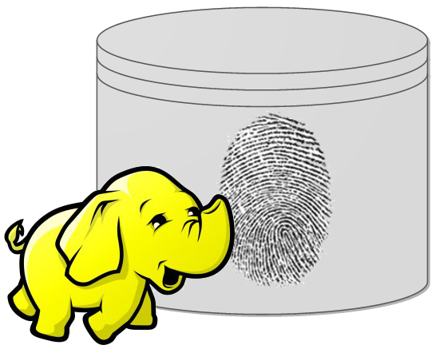
Hadoop and Multimedia Databases
HDFS as file storage for petabytes worth of multimedia (images/audio/video/etc)
  Redundancy
  Distribution
Mahout and MapReduce used for indexing and binning similar objects
  Improve overall search speeds
Improving feature selection by analyzing the entire database with MapReduce
  Select most effective features in distinguishing identities
N-to-N matching search (special type of Identification search) to
  cleanse database
What about low latency matching?
Notes:
HDFS Opens the doors to storing more and more raw images and at higher resolutions
MapReduce Easy to test and deploy new algorithms against all data at scale
Map Reduce can be used for batched searching where latency doesn’t matter, but
what about low latency searching…?

Slide 15
Fuzzy Table: Large-scale, Low Latency, Fuzzy Matching Database
Designed for biometric applications, has uses in other domains
Enables fast parallel search of keys that cannot be effectively ordered
  Biometrics
  Images
  Audio
  Video
  Enabled by Mahout and MapReduce for binning, re-encoding, and other bulk data operations
Inherits nice features of Hadoop:
  Horizontal scalability over commodity hardware
  Distributed and parallel computation
  High reliability and redundancy
Notes:
Things that differentiate this solution
Scales linearly
Real-time retrieval
Highly parallel
Cheap

Slide 16
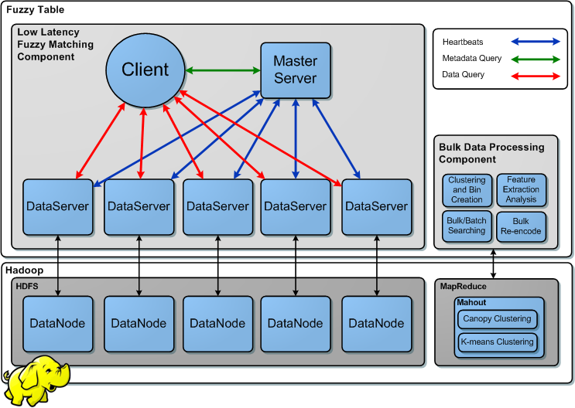
Fuzzy Table Architecture
Notes:
Overall architecture architecture
Built on hadoop core components
DON’T break down beyond two top level components

Slide 17
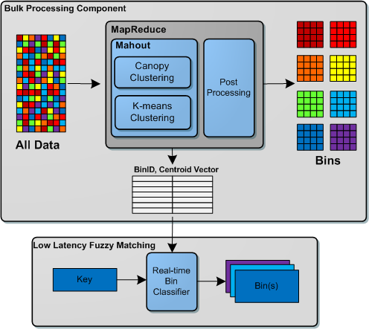
Bulk Binning and Real-time Classification
* Efficient fingerprint search based on database clustering. Manhua Liu, Xudong Jiang, Alex Chichung Kot
Notes:
Bulk processing organizes data, constraints search space
Real time retrieval queries database, presents response

Slide 18

Fuzzy Table: Bulk Data Processing Component
Canopy Clustering and K-means Clustering partitions data into bins
  Reduces search space
  This concept is based on work done in academia*
Centroids from K-means clustering are used to create a “Bin classifier”
  Determines the best bins to search for a given key
{Key, Value} records are stored as Sequence Files in HDFS
  Spread across the cluster for optimal parallel searching
MapReduce is used for all other bulk or batch data processing
  Batch operations (many to many search, duplicate detection)
  Encoding the raw files into feature vectors
  Feature evalutation
*Efficient Search and Retrieval in Biometric Databases by Amit Mhatre, Srinivas Palla, Sharat Chikkerur and Venu Govindaraju
* Efficient fingerprint search based on database clustering. Manhua Liu, Xudong Jiang, Alex Chichung Kot
Notes:
Clustering
Produces bins
Produces bin metadata
Records are stored in HDFS
Map/Reduce used for bulk processing tasks

Slide 19
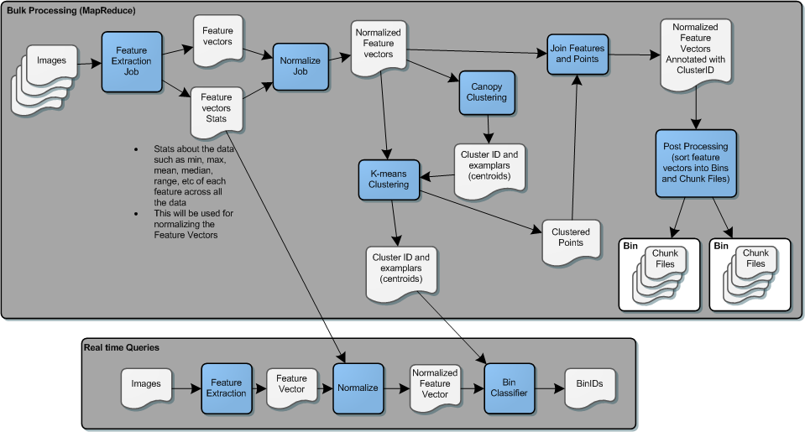
Procedure
Notes:
Entire pipeline
Shows complexity of whole procedure
Blue boxes in bulk processing area are all implemented in map/reduce

Slide 20
Fuzzy Table: Data Storage and Bins
Bins are represented as directories, contain chunk files:
  /fuzzytable/_table_fingerprints/_bin_000001/_chunk_000001
Chunk files contain many {Key, Value} pairs
  Key is biometric template, Value is a reference to the biographic record
  Chunks are same size as HDFS block to simplify data-local search
HDFS load balancing distributes data evenly across cluster
  Enables parallel search
  Replication provides fault tolerance and speculative execution of queries
Data Servers only search local chunk files
  Results returned in real-time as soon as a match is found
  Preserve principle of keeping computation next to data
Notes:
Use HDFS structure to express database organization
Focus on simplicity in implementation;
Chunks are limited to block size, makes determining data locality easy
Reliance on HDFS load balancing to distribute data
Preserving data local execution

Slide 21

Low Latency Component
After data is organized, we want to retrieve it quickly
Does not use MapReduce
  MapReduce is high latency due to jar shipping, other misc. tasks which support redundancy in the process
  Need lightweight framework to perform realtime queries with minimum overhead
Provides real time matching and responses over Apache Avro-based protocol.

Slide 22
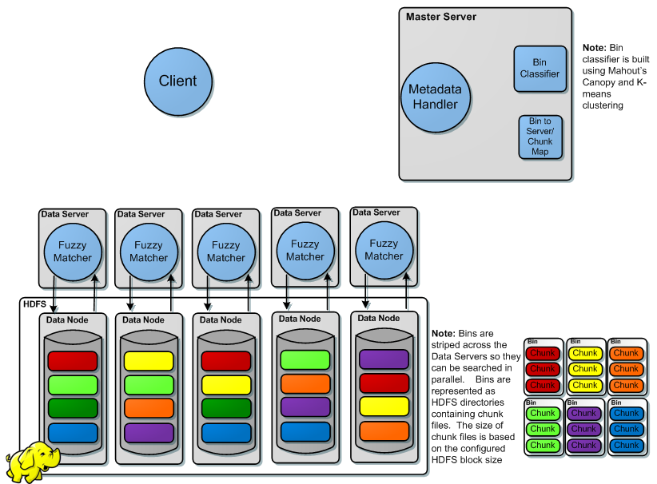
Fuzzy Table Query
Notes:
Draw audience attention to arrows
The low latency component consists of three main parts
Client – submits queries for Keys and get back {Key, Value} pairs
Master Server – serve metadata about which Data Servers host which bins
Data Servers – Actually perform fuzzy matching searches

Slide 23
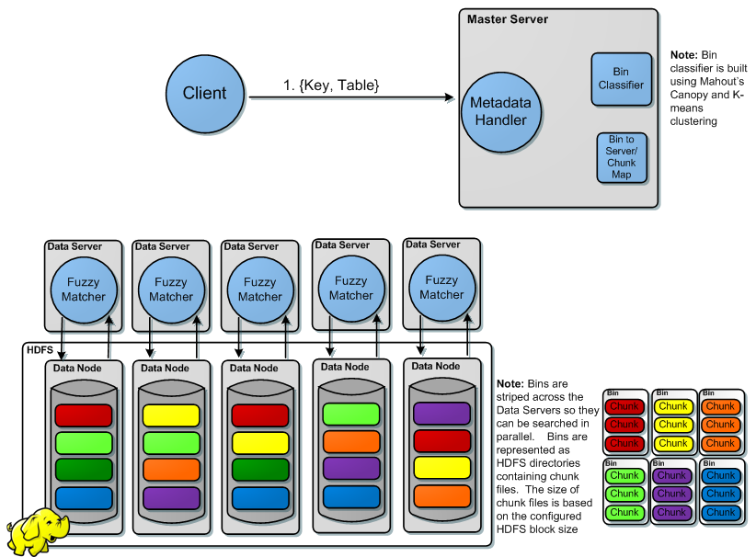
Fuzzy Table Query
Notes:
First, “query record” is submitted to master

Slide 24
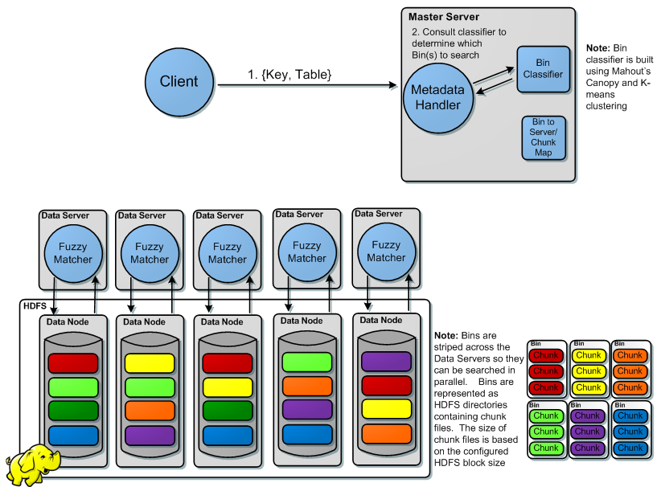
Fuzzy Table Query
Notes:
Master determines which bins contain similar records

Slide 25
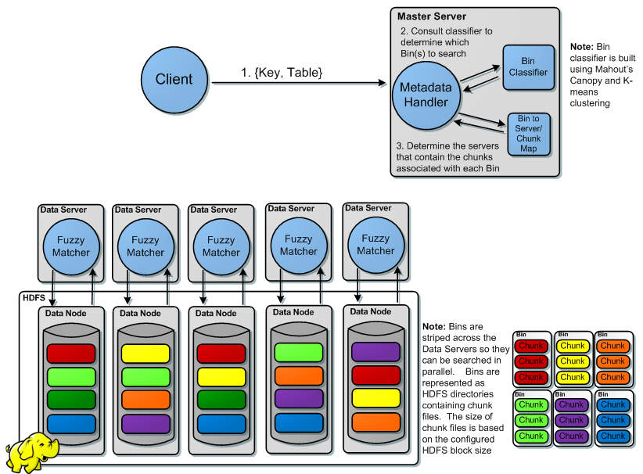
Fuzzy Table Query
Notes:
Master determines which servers host the relevant bins

Slide 26

Fuzzy Table Query
Notes:
Master returns bin/server metadata

Slide 27
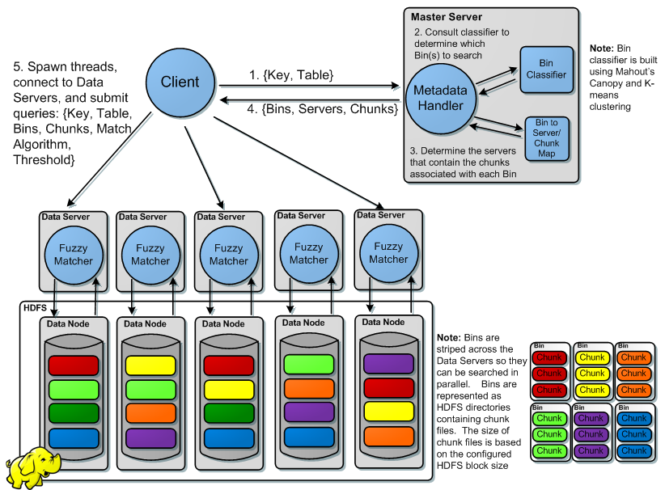
Fuzzy Table Query
Notes:
Client queries servers which host relevant data (in this case, data in the red bin)

Slide 28
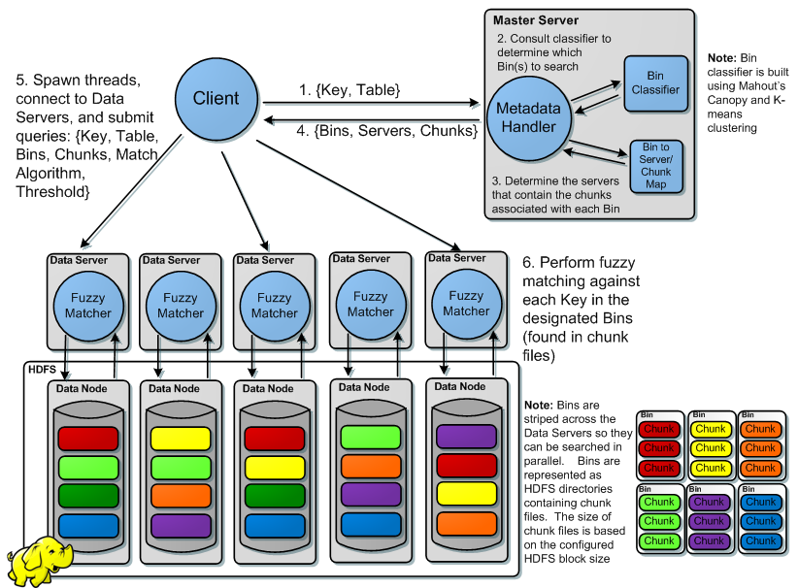
Fuzzy Table Query
Notes:
Data servers search their chunks

Slide 29
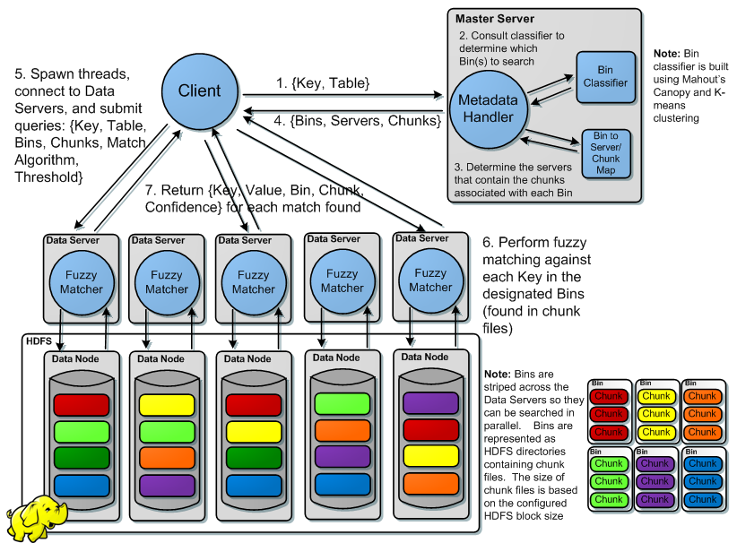
Fuzzy Table Query
Notes:
Data servers return results in real time.
NEXT: Optimizations

Slide 30
Fuzzy Table: Optimizations
Master Server HDFS Metadata Caching
  The HDFS Namenode is a performance bottleneck for low latency searches
  Master Server caches HDFS Block locations for all Fuzzytable files (Bins and Chunk Files)
  Periodic refresh of the cache so its metadata is always fresh
Increased HDFS replication factor (Replication factor of N)
  Fuzzytable is close to a read only system
  Data replication enables speculative execution
Data Servers only perform searches against data that resides locally on disk
Notes:
Optimizations
Metadata caching; db structure is expressed in HDFS; this is a bottleneck
Replication and speculative execution
Data locality

Slide 31
Performance

Slide 32
Performance and Scalability Testing On EC2
Employed EC2 for all testing
Downloaded ~1 TB of images from Flickr (100 Nodes)
Performed the Bulk Processing Components tasks across all 1 TB of images (80 nodes)
  Duplicate detection and removal
  Feature extraction and normalization
  Mahout’s canopy clustering
  Mahout’s k-means clustering
  Join Clusters with Features
  Post processing data into bins and chunk files
  Run a series of test iterations against the low latency component
  Querying increasing cluster sizes
  Queries performed using random images from the larger set
Notes:
EC2 Used for performance testing
1 tb of input data
Ran series of tests over low-latency component

Slide 33
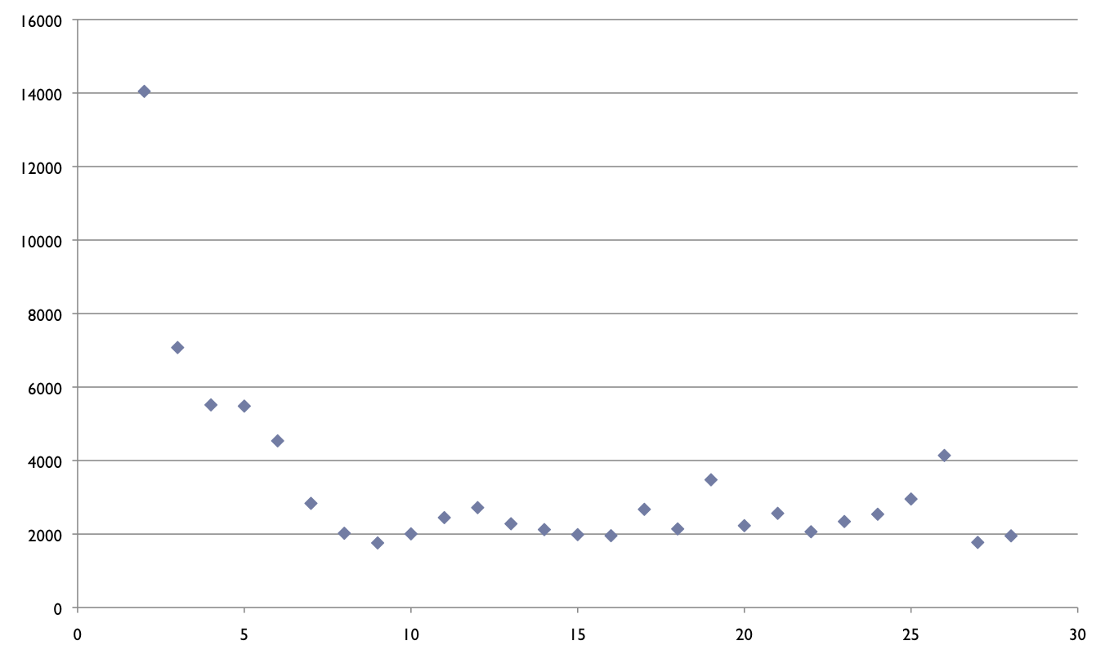
Average Query Times
Time To Respond (ms)
# Of Data Servers
Notes:
This shows results
Pause before next slide

Slide 34
Average Query Times
Linear Scalability to ~ 7 Nodes
Time To Respond (ms)
Lower limit due to I/O latencies
# Of Data Servers
Notes:
Application performance scales linearly to a point
I/O inefficiencies place lower bound on scalability

Slide 35
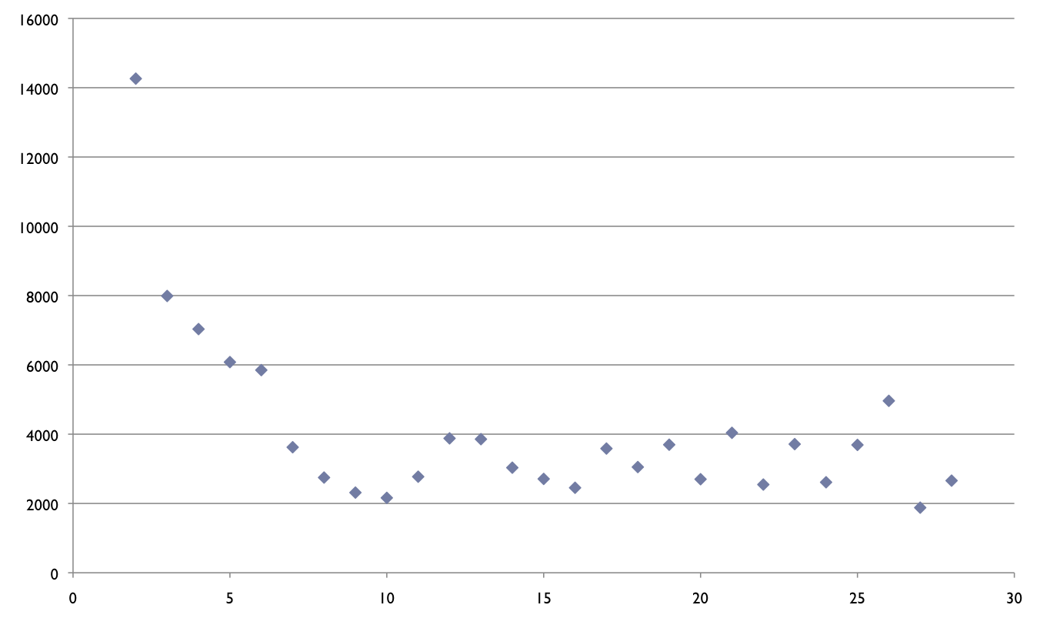

Longest Query Times
Frequent Namenode access + large
number of DFS clients
begins to erode performance
Time To Respond (ms)
# Of Data Servers
Notes:
More evidence of namenode issues

Slide 36
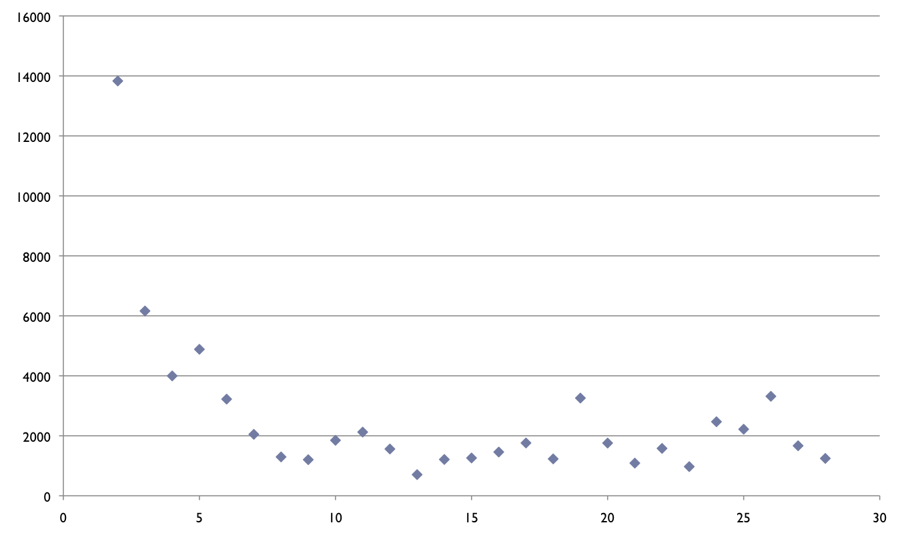
Shortest Query Times
Time To Respond (ms)
~500 ms
# Of Data Servers
Notes:
Very short query times are achievable

Slide 37
EC2 Results Discussion
Linear scalability – great!
  One data point shows 500 ms queries are possible
I/O Latency is a lower bound on average query response time
  Combined disk, network
Future enhancements
  Reduce disk penalty via hardware, cleaver data structures, specialized data store
  Reliance on HDFS/Namenode for filesystem metadata is another bottleneck
  Optimizations to HDFS client
  Distributed Namenode
Notes:
Summary: application scales well
Query 1TB of images in 500 ms possible
Simple I/O optimizations can make this system faster + more robust

Slide 38
Performance and Scalability (Local)
Instrumented Master Server code
Compared initial implementation that accesses Namenode frequently with rework that caches filesystem metadata
Results matched those anticipated from EC2 testing

Slide 39
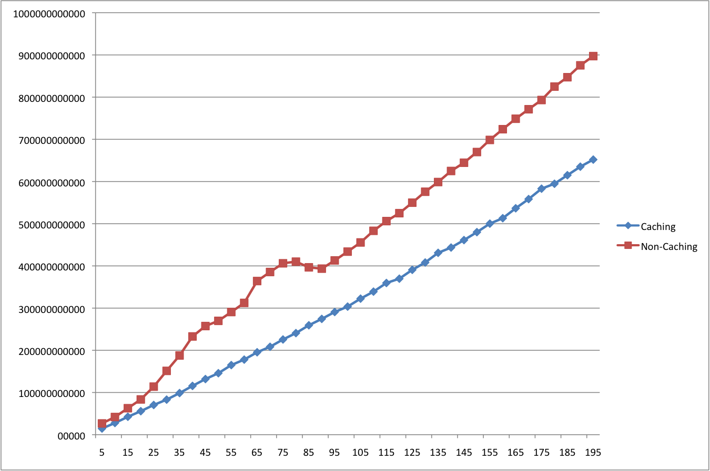

Caching Performance
Major discrepency, grows with load
Average Response Time (ns)
# Threads Polling The Master Server

Slide 40
Conclusion & Future Work
Large-scale, real-time Multimedia/Biometric Database search is a hard problem
  And it’s becoming computationally more expensive as the amount of data grows
Hadoop is a potential solution to this problem
MapReduce can be used for bulk processing to enable distributed, low latency fuzzy matching over HDFS
Hadoop is a great platform for solving all sorts of Big Data and distributed computing problems, even for low latency searching
Future work
  Hadoop-level optimizations
  Currently implementing a new version based on Hbase which supports online insertion and reorganization
Notes:
This is a difficult problem
We presented a scalable solution
Provides look at innovative real-time applications for Hadoop ecosystem

Slide 41
Contact Information – Cloud Computing Team
Edmund Kohlwey
Senior Consultant
Jason Trost
Associate
@ekohlwey
@jason_trost
Booz Allen Hamilton Inc.
134 National Business Parkway.
Annapolis Junction, Maryland 20701
(301)821-8000
kohlwey_edmund@bah.com
Booz Allen Hamilton Inc.
134 National Business Parkway.
Annapolis Junction, Maryland 20701
(301)543-4400
trost_jason@bah.com
Robert Gordon
Associate
Jesse Yates
Consultant
@jesse_yates
Booz Allen Hamilton Inc.
134 National Business Parkway.
Annapolis Junction, Maryland 20701
(301)821-8000
gordon_robert@bah.com
Booz Allen Hamilton Inc.
134 National Business Parkway.
Annapolis Junction, Maryland 20701
(301)617-3523
yates_jesse@bah.com
Michael Ridley
Associate
@mikeridley
Booz Allen Hamilton Inc.
134 National Business Parkway.
Annapolis Junction, Maryland 20701
(301)543-4611
ridley_michael@bah.com
Notes:
This is everyone who worked on the project

Slide 42
Thanks
Lalit Kapoor (@idefine) – Former team member
Brandyn White (@brandynwhite) – Assistance with Flickr image retrieval
Notes:
Special thanks
Lalit, former team member
Brandyn White – UMD computer vision researcher

Slide 43
Questions

Slide 44

Questions?

Slide 45
Appendix

Slide 46
Technologies Used
Cloudera’s Distribution of Hadoop (CDH3)
  MapReduce
  HDFS
Mahout
Avro
Amazon EC2
Ubuntu Linux
Java
Python
Bash

Slide 47
Fuzzy Table: Low Latency Fuzzy Matching Component Details
The low latency component consists of three main parts
  Client – submits queries for Keys and get back {Key, Value} pairs
  Master Server – serve metadata about which Data Servers host which bins
  Data Servers – Actually perform fuzzy matching searches
Data Servers perform fuzzy matching against Keys in order to find {Key, Value} records
  double score = fuzzyMatcher.match(key, storedRec.getKey());
  if(score >= threshold)
  return storedRec;
Fuzzy matching searches are performed in parallel across many Data Servers

