Slide 1
An Overview of Pipelining
CMP-334 Computer Organization

Slide 2
Why pipelining?
simply because...
it improves throughput
in other words, it improves execution performance using processor resources efficiently

Slide 3
Tell me how?
dividing the processor’s datapath into stages that are separated by pipeline latches
one stage of the pipeline per clock cycle
shorter clock cycle
starting a new instruction each clock cycle

Slide 4
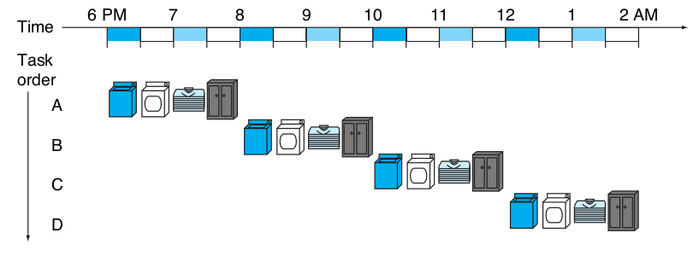
Show me
ok, but here is single clock cycle first...

Slide 5
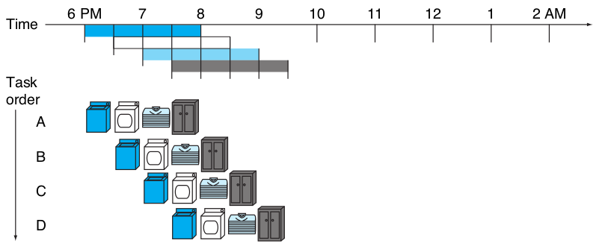
Show me pipelining please

Slide 6
I got that. What is pipelining again?
pipelining is an implementation technique in which multiple instructions are overlapped in execution.
Today, pipelining is nearly universal.

Slide 7
But, those were washing machines...
true, but...
the same principles apply to processors where we pipeline instruction execution

Slide 8
Show me in MIPS instructions
mips instructions take five steps...
fetch instruction from memory
read registers while decoding the instruction
execute the operation or calculate an address
access an operand in data memory
write the result into a register

Slide 9
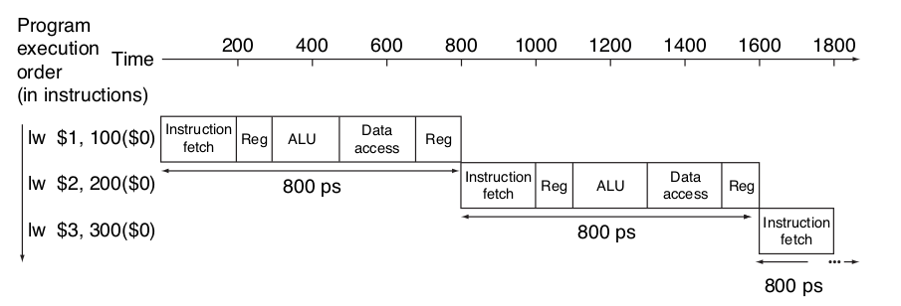
An instruction please...
ok, here is lw (the slowest one)

Slide 10
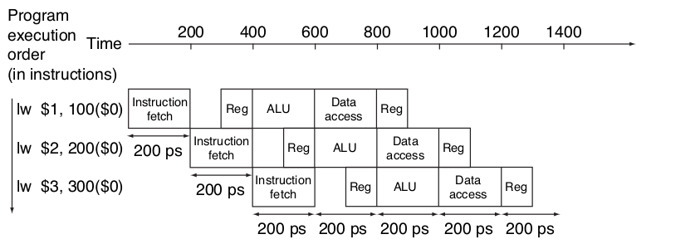
Wait, that was single cycle...
you got me, here is lw pipelined

Slide 11
Where did you get 800 ps?
it is just an example...
that’s 800 picoseconds
that is 800 one trillionth of a second

Slide 12
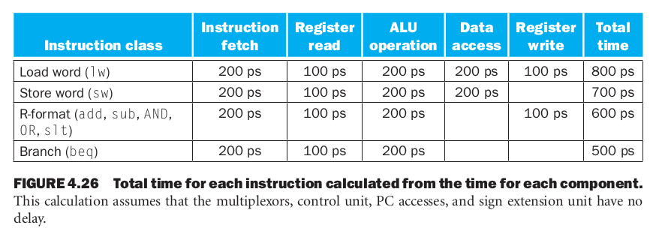
Ok, lw 800ps. What about others?
here is a list…

Slide 13
Ok, I got those time. How do I calculate performance?
we need to compare it...
nonpipelined and pipelined execution of three load word instructions
time between the first and fourth instructions:
nonpipelined: 3 × 800ps or 2400ps
pipelined: 3 × 200ps or 600ps

Slide 14
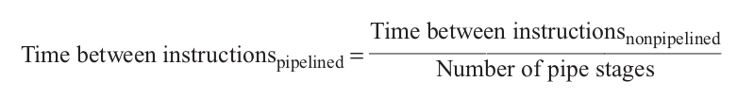
Is there a formula?
of course...
formula suggests that a five-stage pipeline should offer nearly a fivefold improvement over the 800 ps nonpipelined time, or a 160 ps clock cycle

Slide 15
Fivefold improvement? Are you sure?
well… well… you got me…
even fourfold improvement for our example is not reflected in the total execution time for the three instructions: it’s 1400ps vs. 2400ps
but that’s because...

Slide 16
Ok tell me why?
this is because the number of instructions is not large enough
Let’s add 1,000,000 instructions

Slide 17

That’s a lot but go ahead?
extending to 1,000,003 instructions
pipelined:
1,000,000 × 200ps + 1400ps = 200,001,400 ps
nonpipelined:
1,000,000 × 800ps + 2400ps = 800,002,400 ps

Slide 18
Alright then, pipeline it is...
wait, not so fast…
there are problems with it you know

Slide 19
Problems? I don’t like that
well… it is just hazards really
things that could go wrong

Slide 20
Tell me about these hazards
there are situations in pipelining when the next instruction cannot execute in the following clock cycle. These events are called hazards, and there are three different types

Slide 21
Three hazards type, ok cool
structural hazard:
hardware cannot support the combination of instructions that we want to execute in the same clock cycle
a hardware resource is unavailable

Slide 22
That’s one, what else?
data hazards:
pipeline must be stalled because one step must wait for another to complete
a value is not available when and where it is needed

Slide 23
One more
control hazards:
also known as branching hazard
the location of an instruction depends on a previous instruction
the next instruction is not known

Slide 24
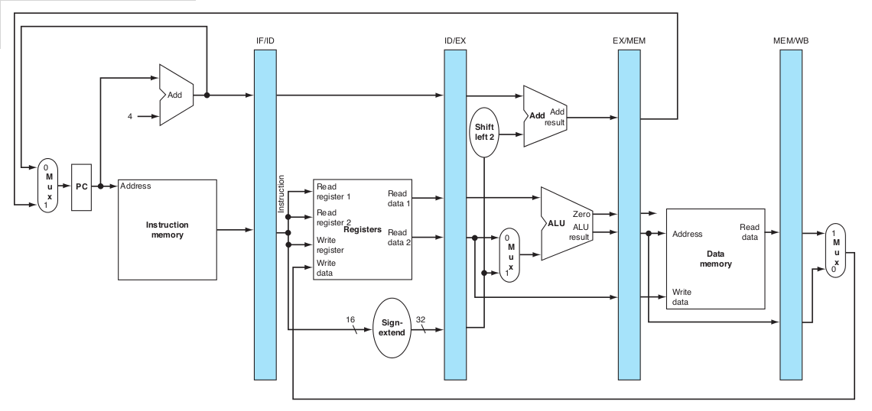
What are these hazards looks like?

Slide 25
Ok nice picture but...
yes, that’s the pipelined version of the datapath
did you notice that we use two memories
instruction memory and data memory

Slide 26
And that’s important how?
because we use two memories we do not need to worry about structural hazards
if it is single shared memory,
instruction fetch and load/store causes problems

Slide 27
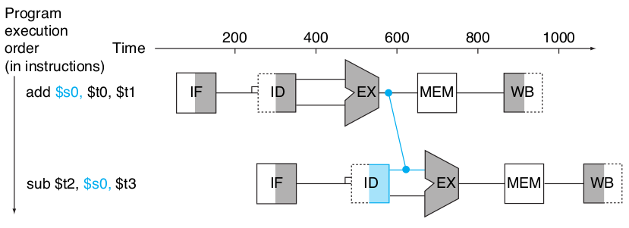
How about data hazards?
glad you asked… here is the problem and solution illustrated

Slide 28
Forwarding fixes data hazards?
it works very well but it cannot prevent all pipeline stalls

Slide 29
Pipeline stalls?
pipeline stall also called bubble
a stall initiated in order to resolve a hazard
stalling the pipeline holds instructions in the early stage of the pipeline in place
noop instructions ﬂow through the rest of the pipeline in their place

Slide 30
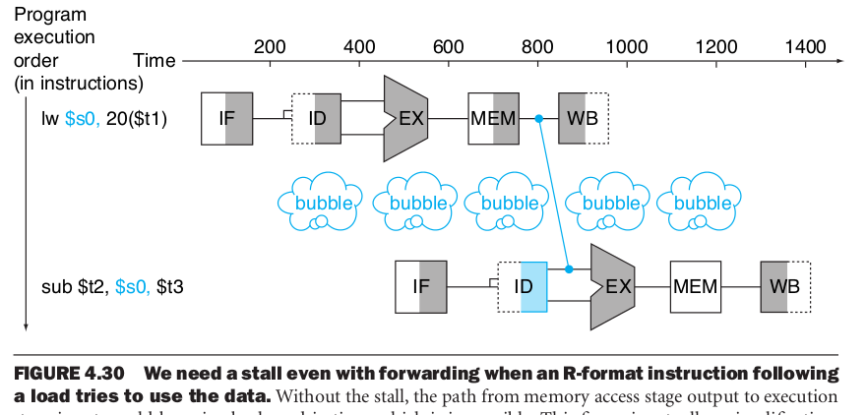
Show me

Slide 31
Did you forget control hazards?
absolutely not… let me remind you
instruction cannot execute in the proper pipeline clock cycle because the instruction that was fetched is not the one that is needed

Slide 32
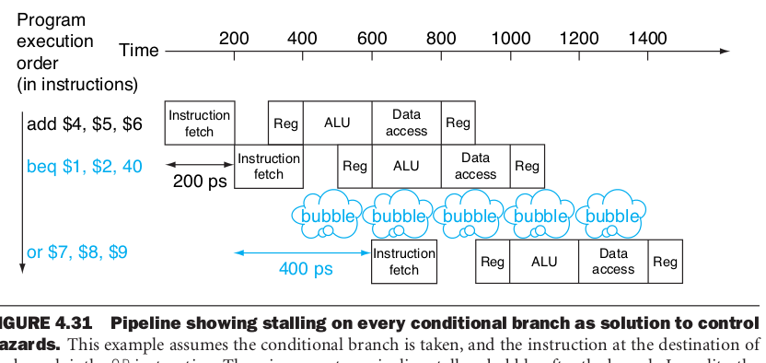
Picture please

Slide 33

Ok, I think I got it
nice, so tell me…

Slide 34
Extras

Slide 35
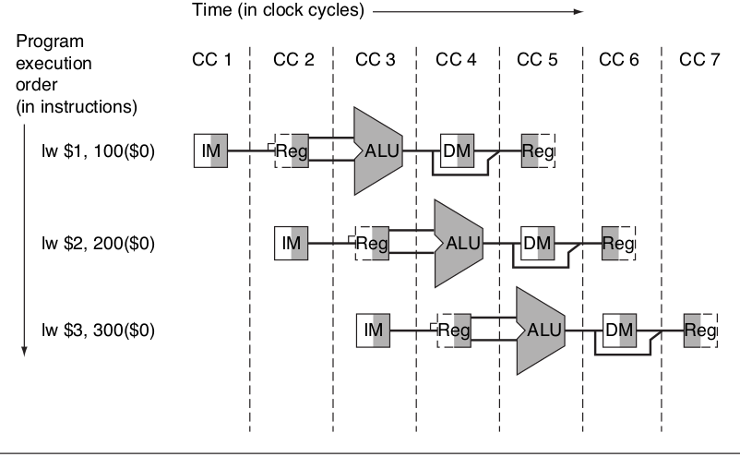

Slide 36
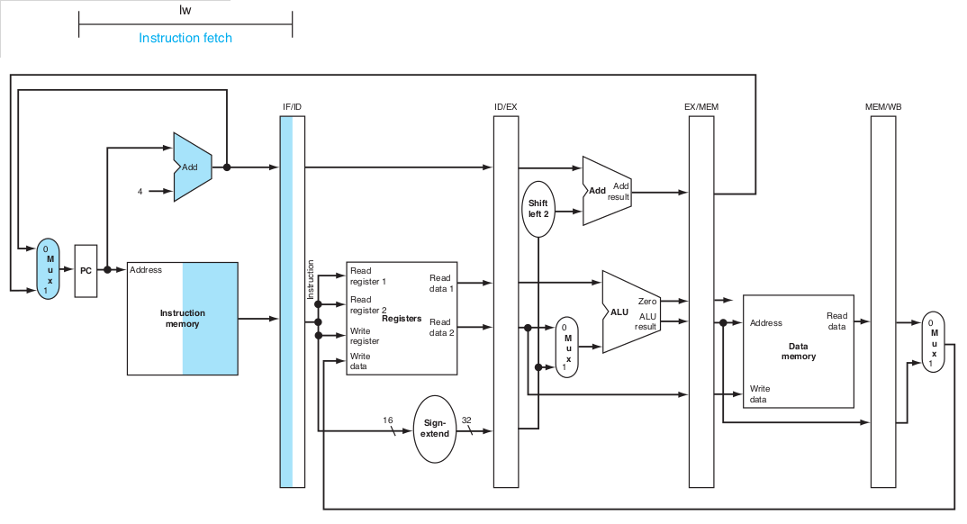

Slide 37
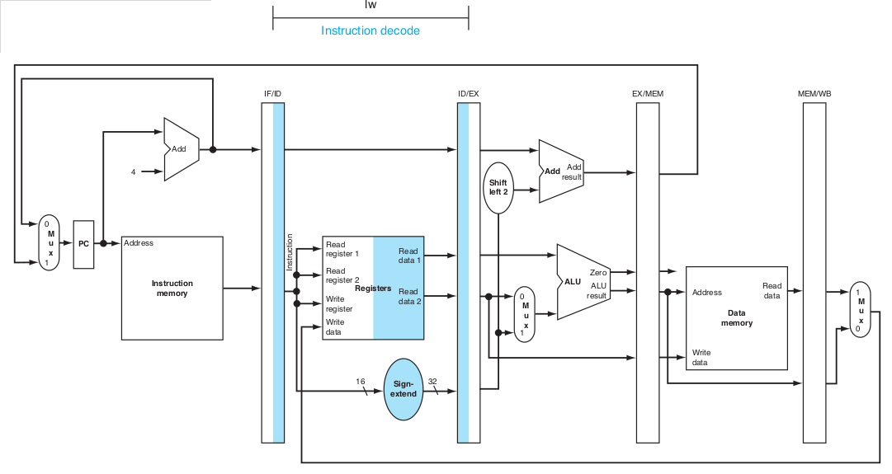

Slide 38
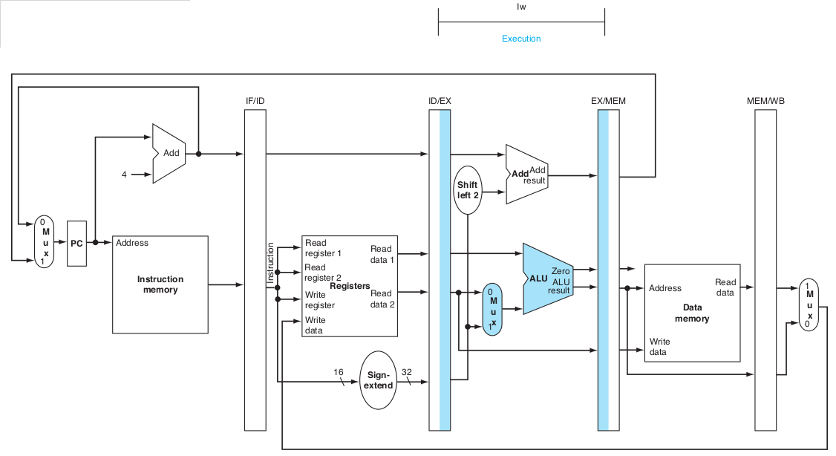

Slide 39
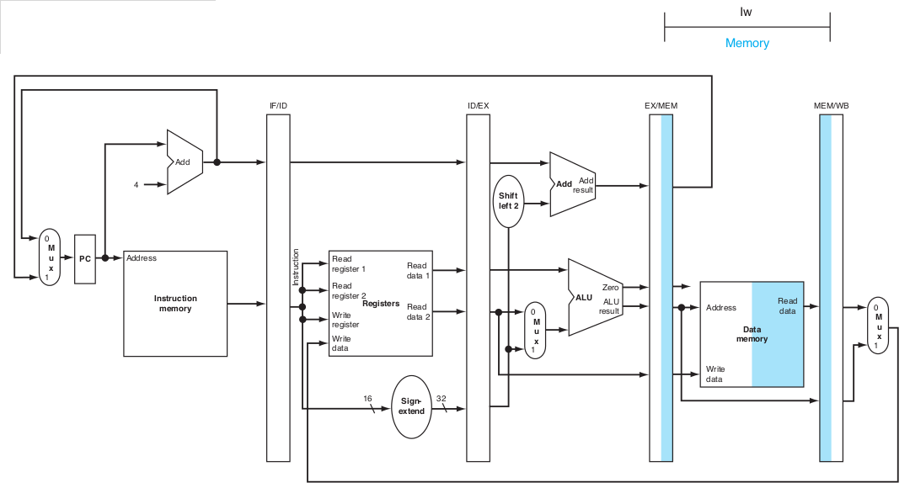

Slide 40
