Slide 1
Fat Mike’s Pizza Joint
Chandler DeLoach, Ethan Hendrix, Jayse White

Slide 2
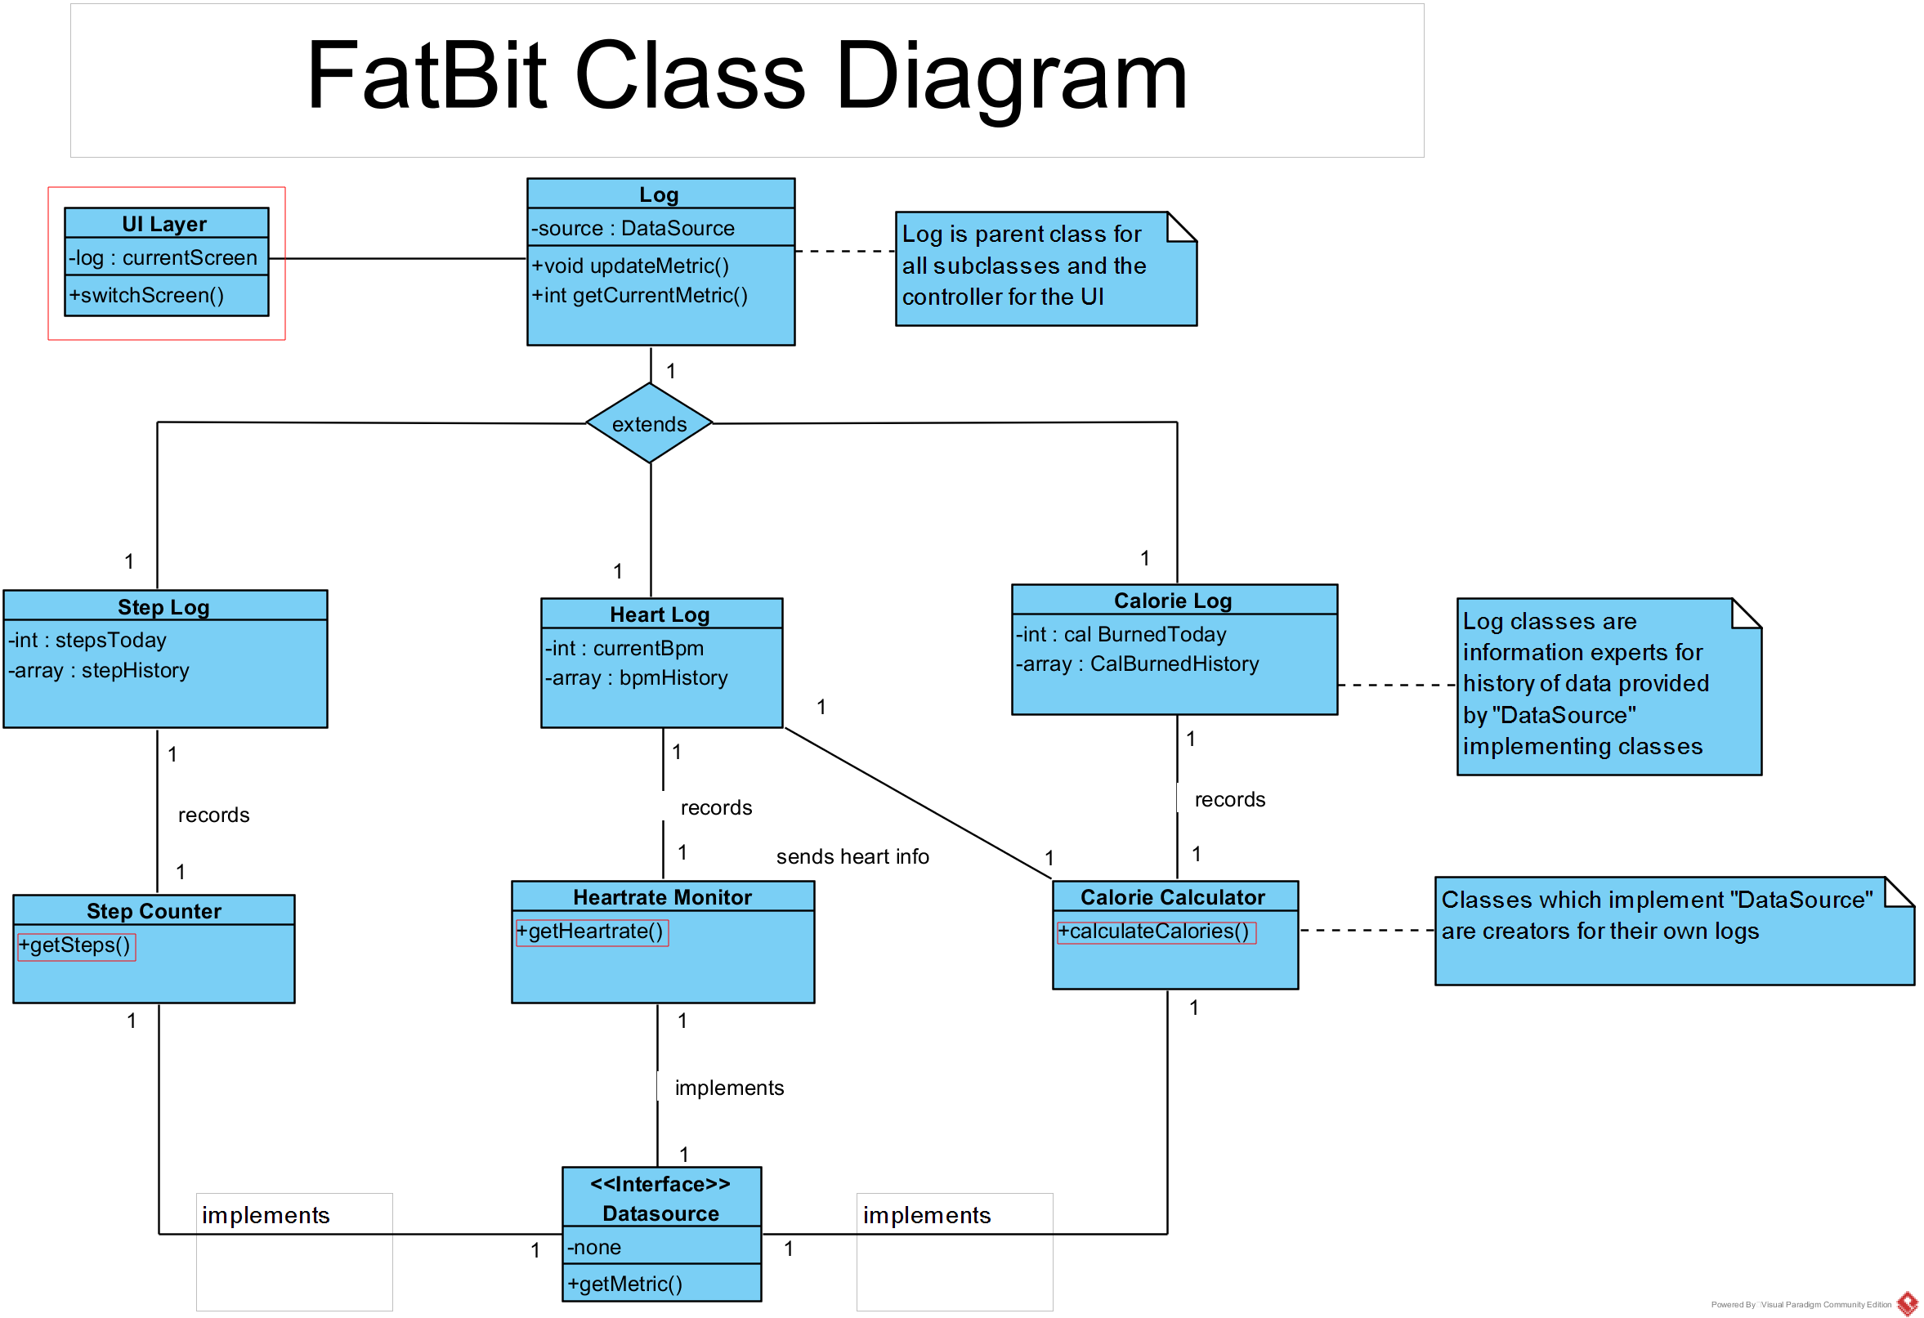

Slide 3
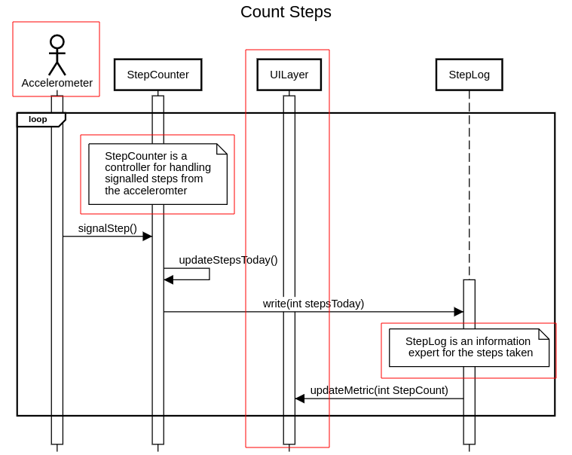

Slide 4
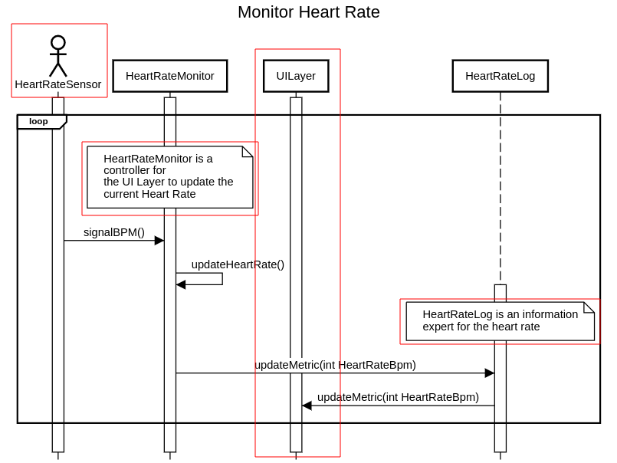

Slide 5
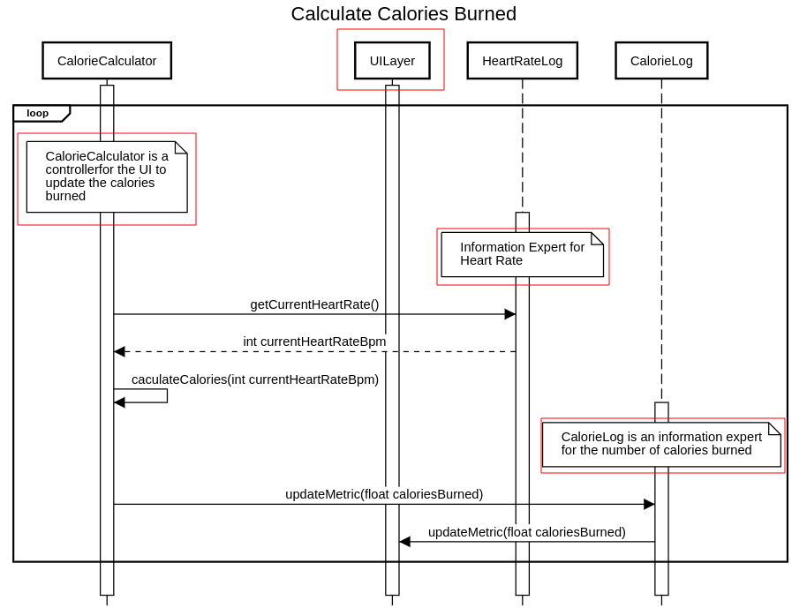

Slide 6
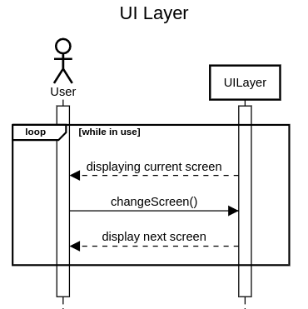

Slide 7
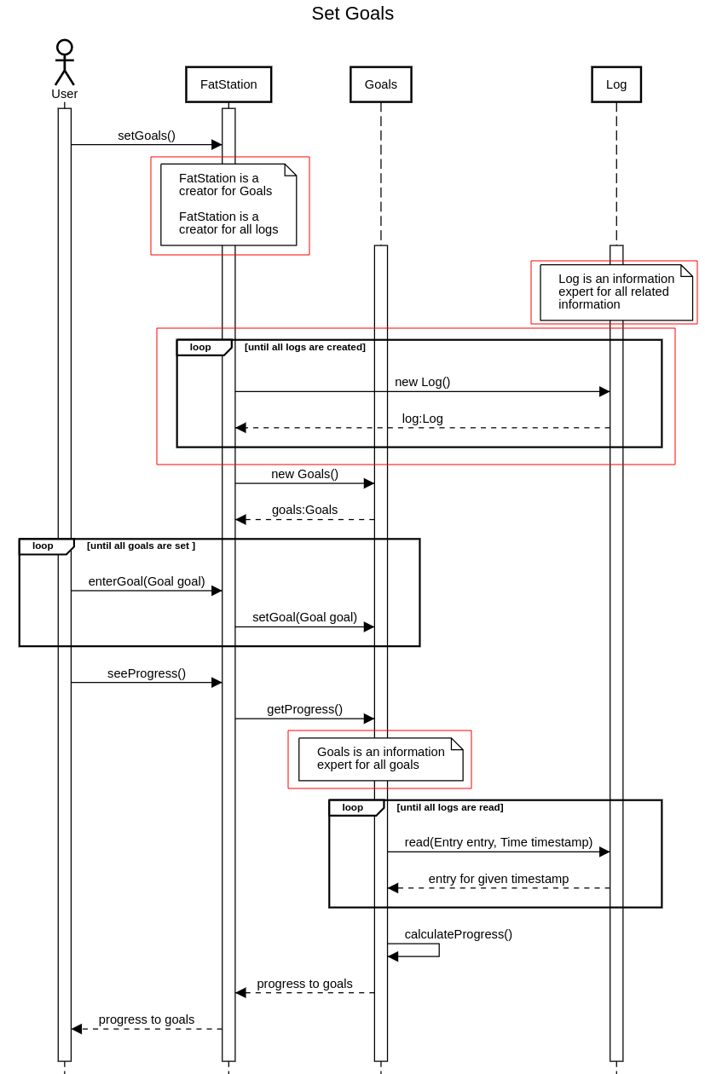

Slide 9
Questions?

