Slide 1
Family Tree Database Presentation
Joseph Hendrix
CS7700 Advanced Database Systems
Summer 2015
Wright State University
College of Engineering & Computer Science
Department of Computer Science & Engineering
Code & documentation, including this PowerPoint, available at:
https://github.com/hendrixjoseph/FamilyTree

Slide 2
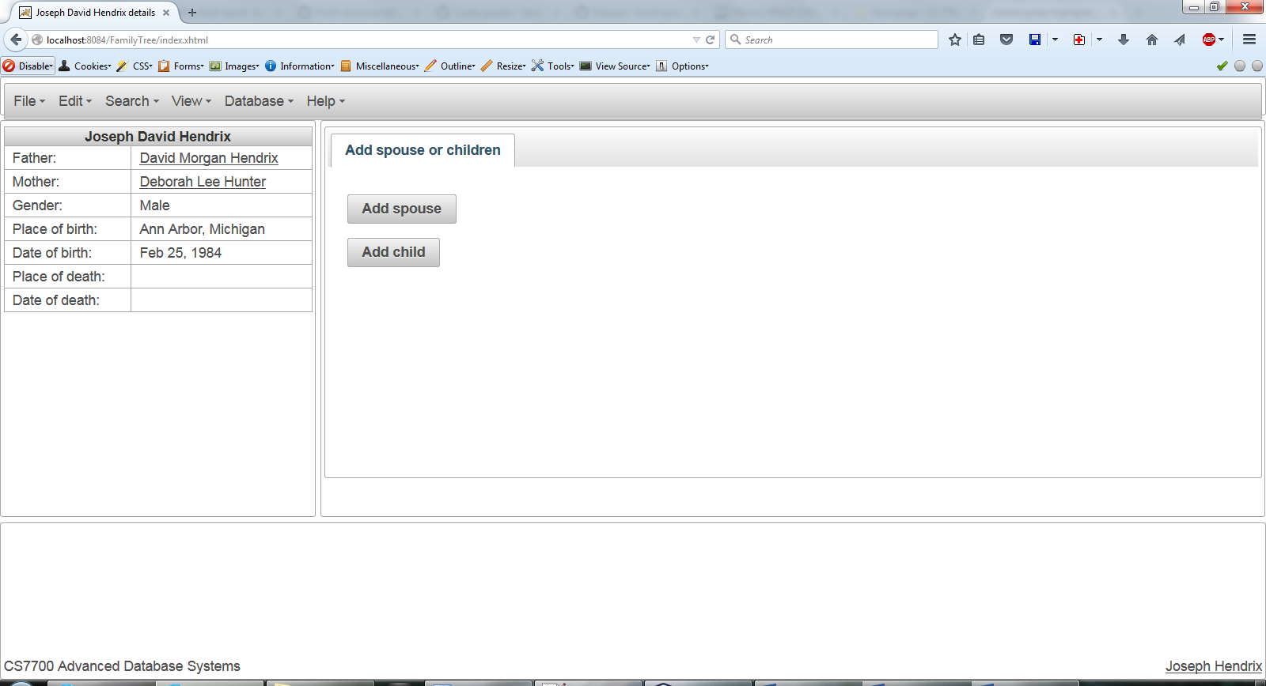
1. Main page

Slide 3
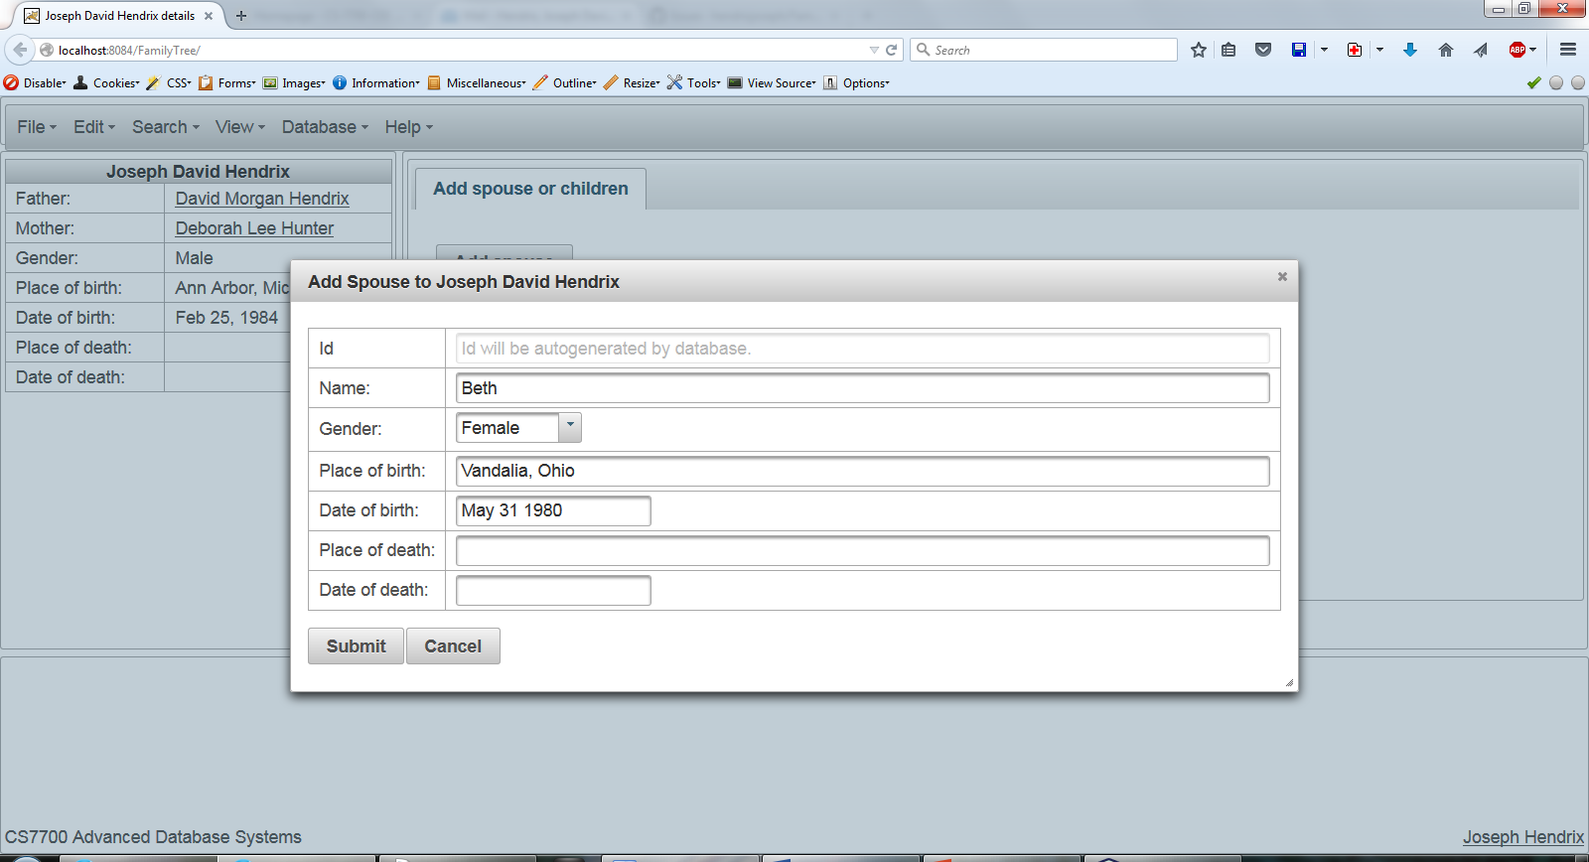
2. Insert Spouse

Slide 4
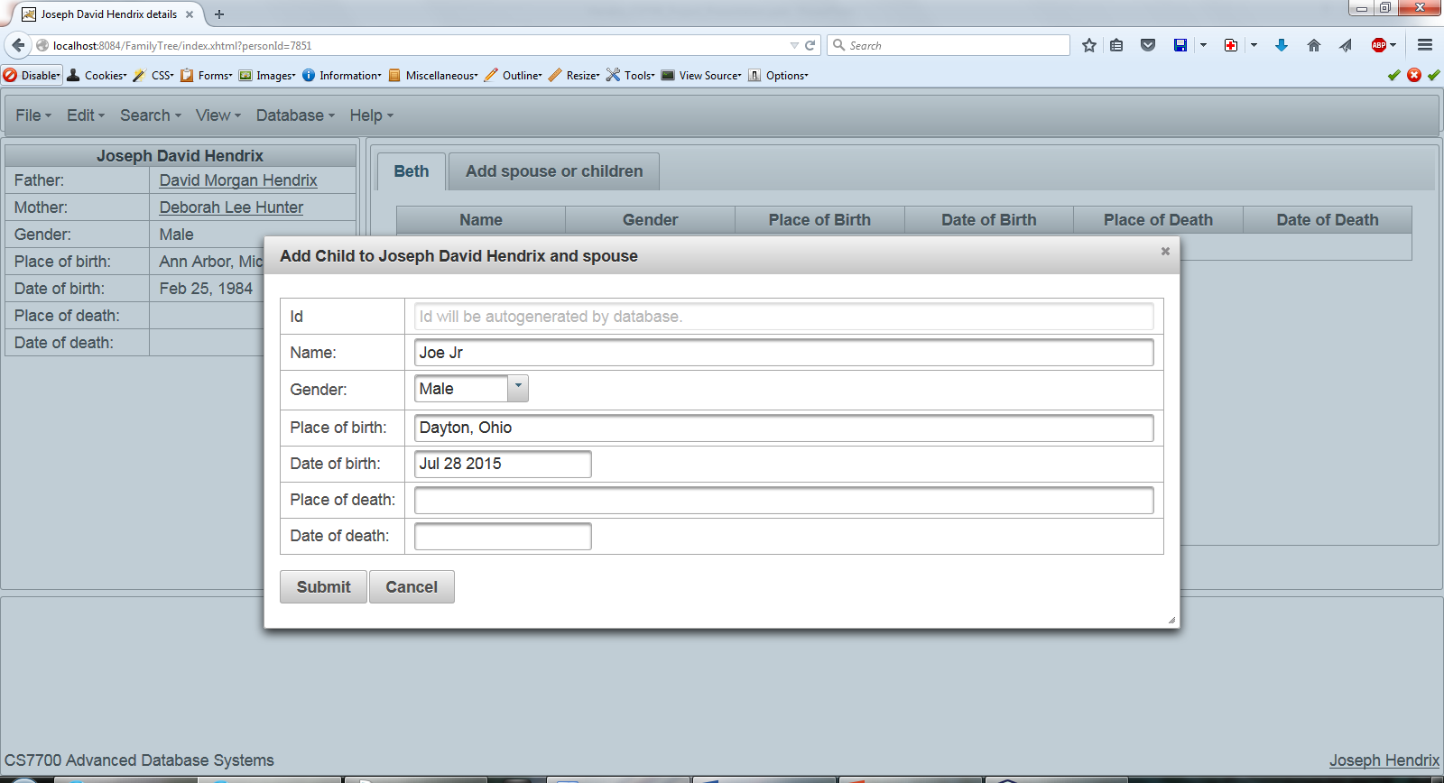
3. Insert Child

Slide 5
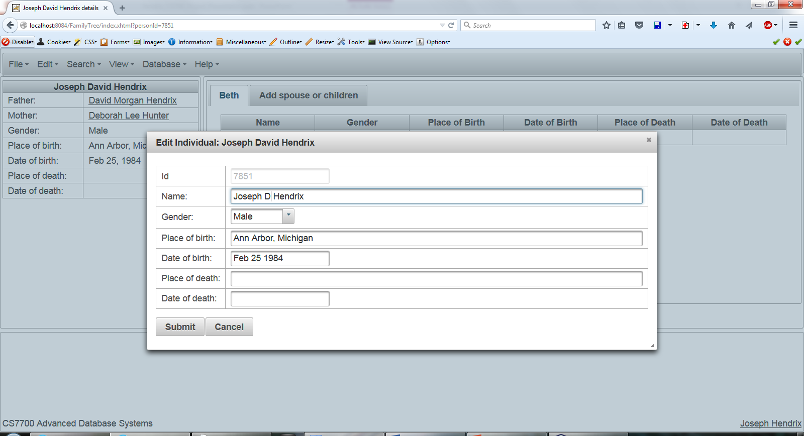
4. Edit Person

Slide 6
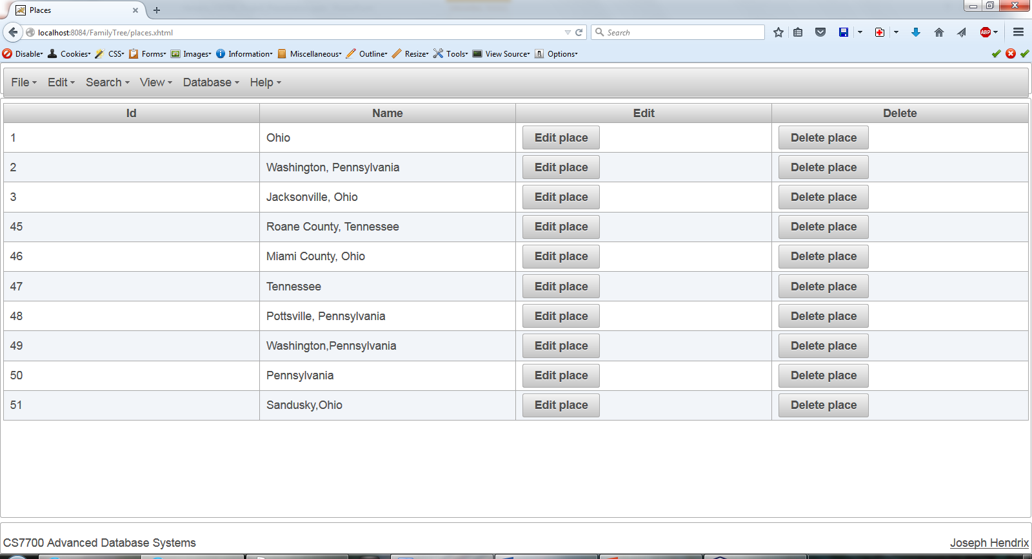
5. Places View

Slide 7
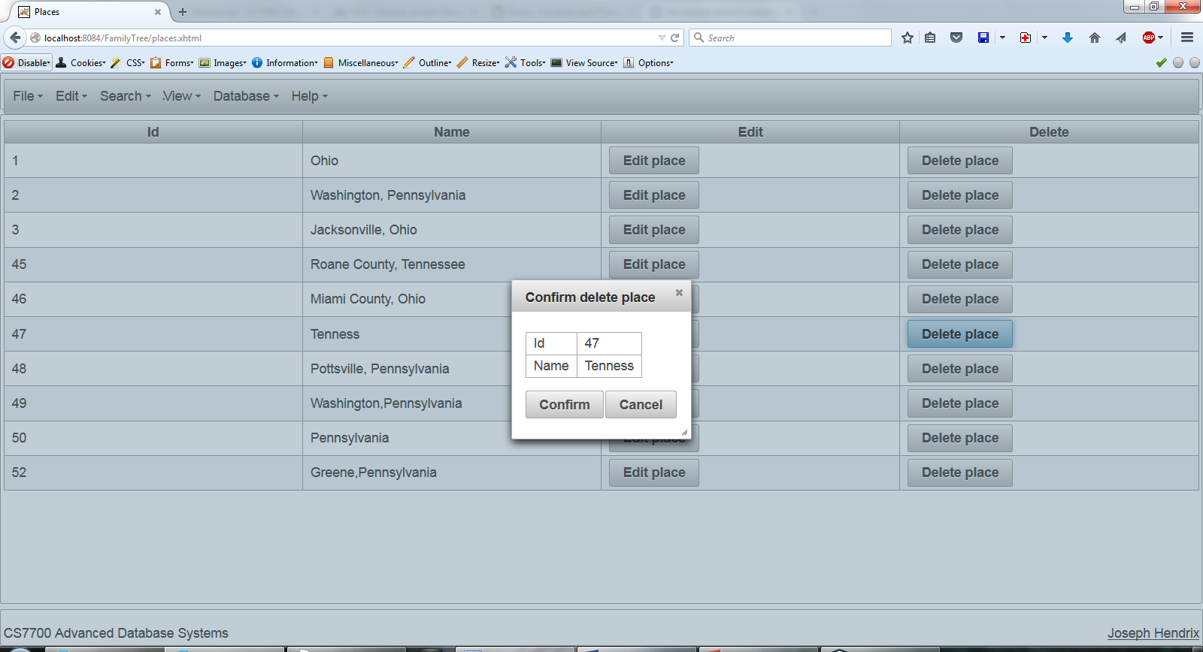
6. Delete Place

Slide 8
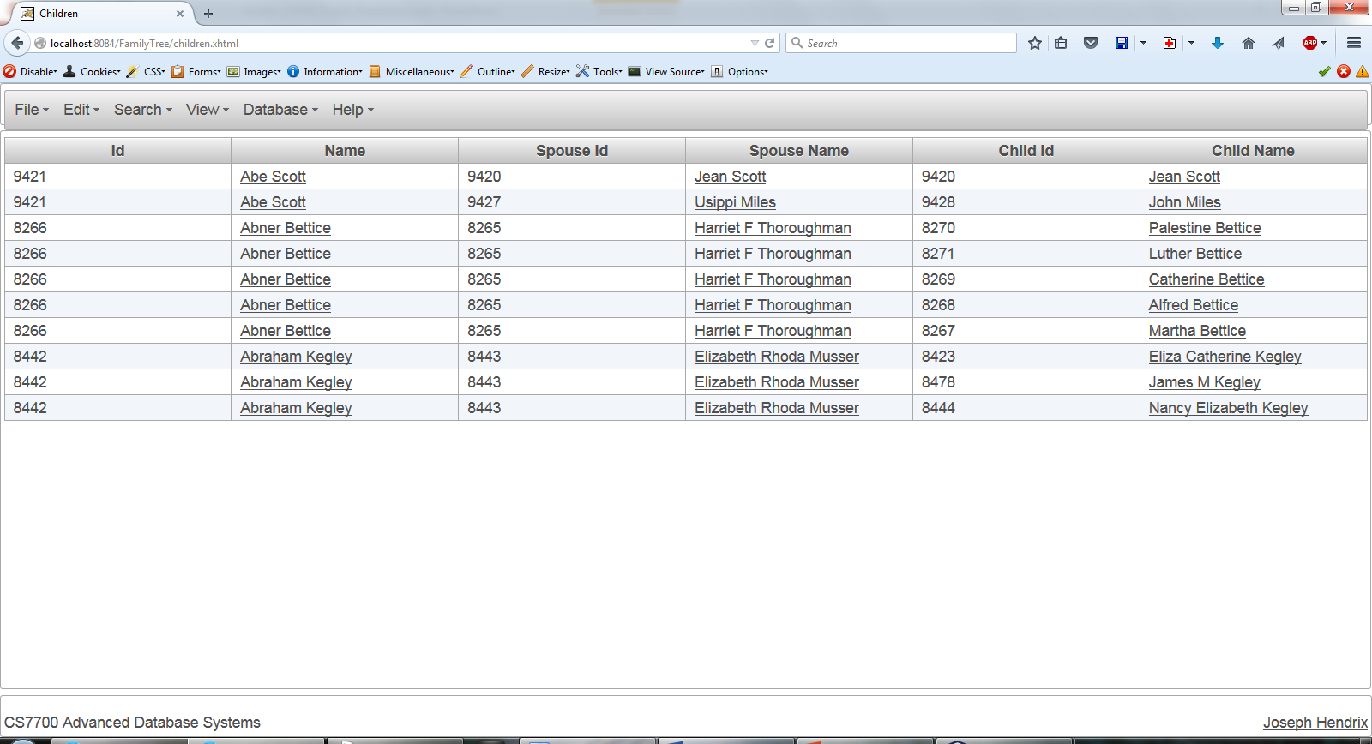
7. Children view

Slide 9
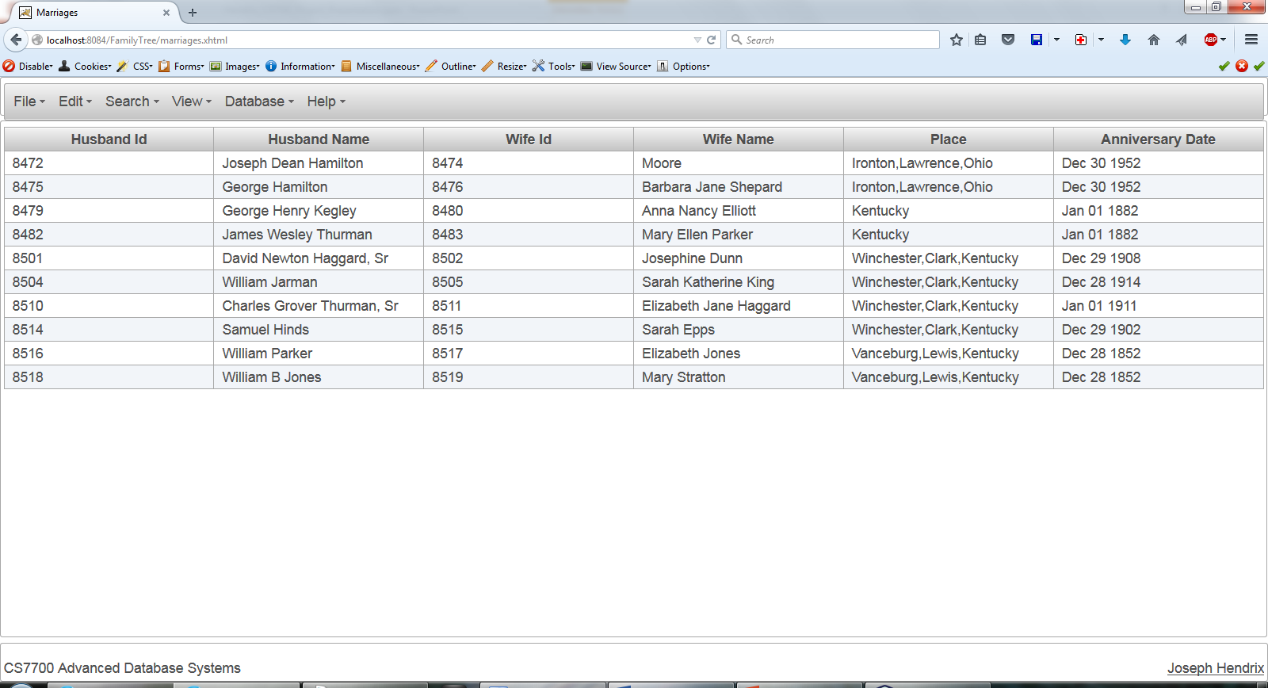
8. Marriages view

Slide 10
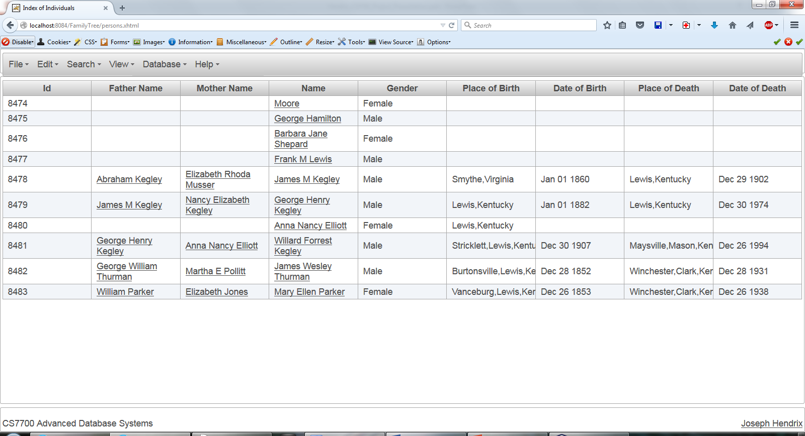
9. Index of Individuals view

Slide 11
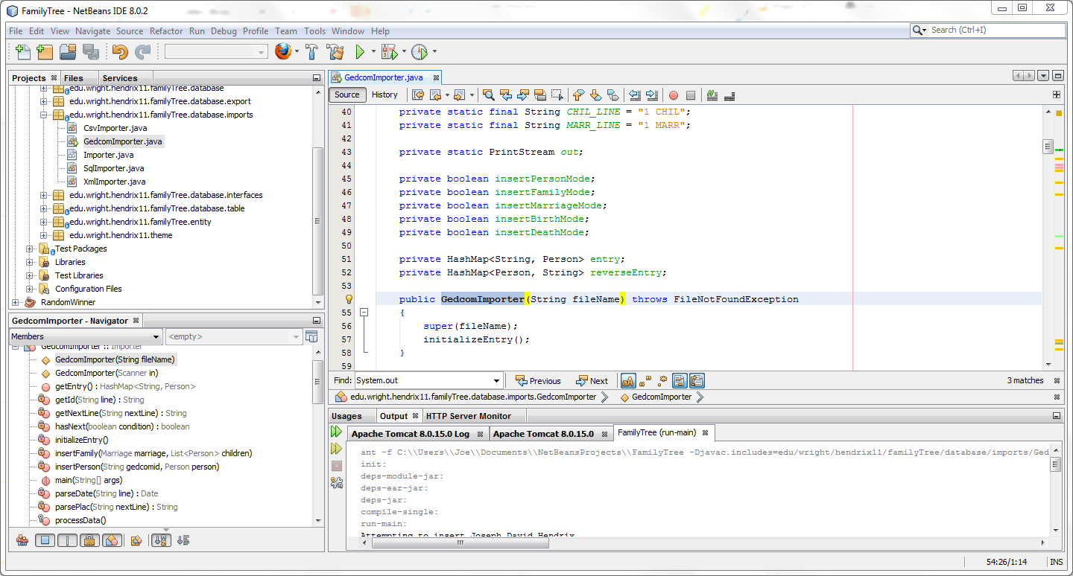
Import Example
First clear database:
DELETE FROM PERSON;
DELETE FROM PLACE;
Then:
Run GedcomImporter.java
May need to reset Oracle if sqldeveloper locked a row….

Slide 12
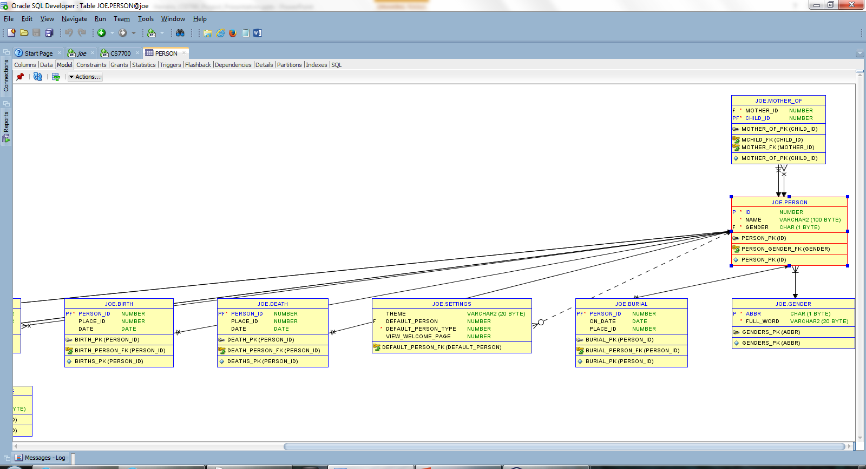
Database Schema

Slide 13
PERSON_VIEW select part
SELECT
P.ID,
DAD.ID AS FATHER_ID,
DAD.NAME AS FATHER_NAME,
MOM.ID AS MOTHER_ID,
MOM.NAME AS MOTHER_NAME,
P.NAME,
GENDER.FULL_WORD AS GENDER,
B_PLACE.NAME AS PLACE_OF_BIRTH,
BIRTH."DATE" AS DATE_OF_BIRTH,
D_PLACE.NAME AS PLACE_OF_DEATH,
DEATH."DATE" AS DATE_OF_DEATH

Slide 14
PERSON_VIEW from part
FROM
PERSON P,
PERSON DAD,
PERSON MOM,
MOTHER_OF,
FATHER_OF,
BIRTH,
DEATH,
PLACE B_PLACE,
PLACE D_PLACE,
GENDER

Slide 15
PERSON_VIEW where part
WHERE P.GENDER = GENDER.ABBR
AND FATHER_OF.FATHER_ID = DAD.ID (+)
AND MOTHER_OF.MOTHER_ID = MOM.ID (+)
AND P.ID = FATHER_OF.CHILD_ID (+)
AND P.ID = MOTHER_OF.CHILD_ID (+)
AND P.ID = BIRTH.PERSON_ID (+)
AND P.ID = DEATH.PERSON_ID (+)
AND BIRTH.PLACE_ID = B_PLACE.ID (+)
AND DEATH.PLACE_ID = D_PLACE.ID (+);

Slide 16
Other Database stuff
PROCEDURE INSERT_OR_UPDATE_BIRTH
TRIGGER PERSON_VIEW_INSERT_TRIGGER
TRIGGER "PERSON_SEQ_TRIGGER“
SEQUENCE_PERSON
CHILDREN_VIEW
MARRIAGE_VIEW
CUSTOM_DATE

