Slide 1
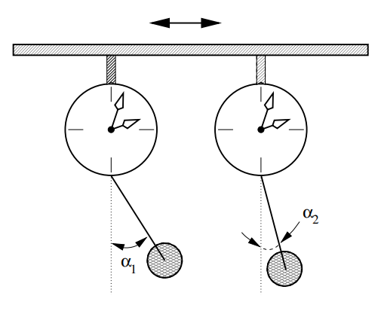
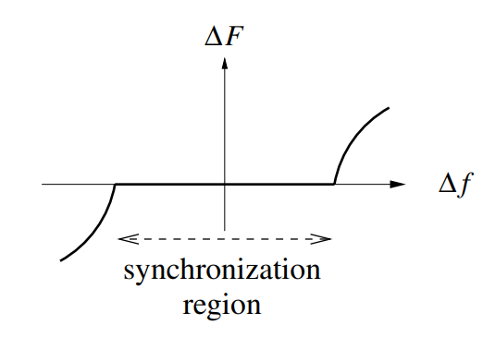

Synchronization $→$ Phase/frequency locking
between $≥2$ oscillating systems
Depends on:
Coupling strength.
Detuning
(Pikovsky2001)
(Pikovsky2001)

Slide 2
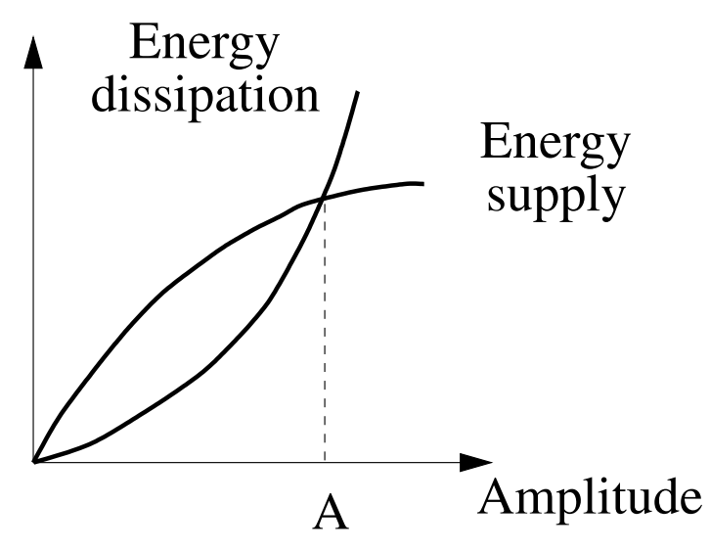
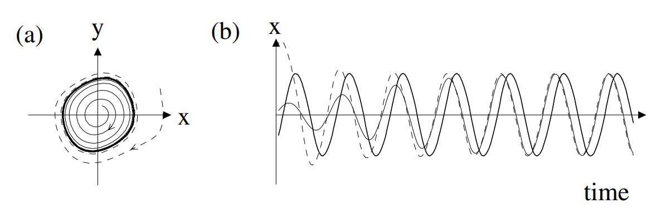

Self-sustained oscillator $→$ Fixes phase space trajectory using internal energy pump.
Limit cycle
(Pikovsky2001)

Slide 3
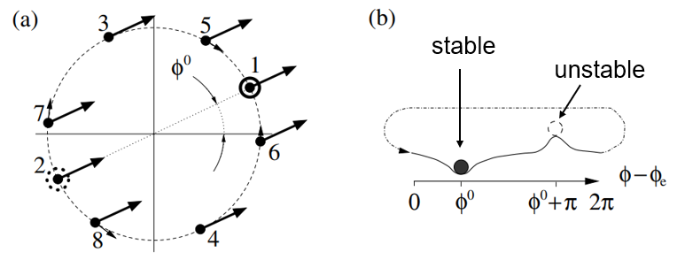
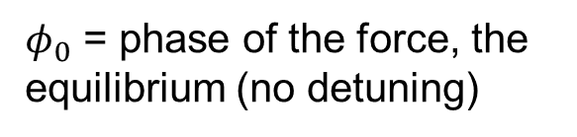
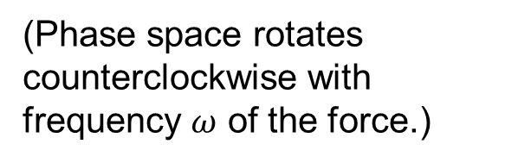


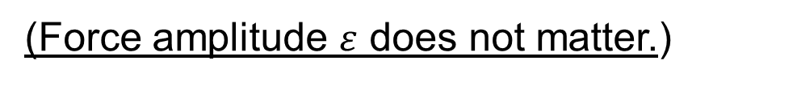
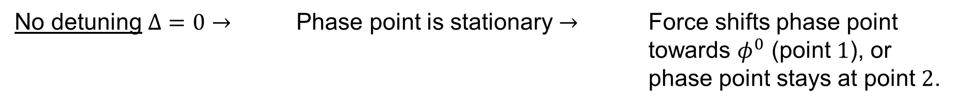
Synchronization by External Harmonic Force
Attracted towards $1$
(Phase space rotates counterclockwise with frequency $ω$ of the force.)
Repelled from $2$
$φ_{0}$ = phase of the force, the equilibrium (no detuning)
(Pikovsky2001)
Equilibrium = force does not act on the phase point $→$ perpendicular to the unit cycle.
No detuning $Δ=0$ $→$ Phase point is stationary $→$ Force shifts phase point towards $φ^{0}$ (point $1$), or phase point stays at point $2$.
Phase locking
(Force amplitude $ε$ does not matter.)

Slide 4
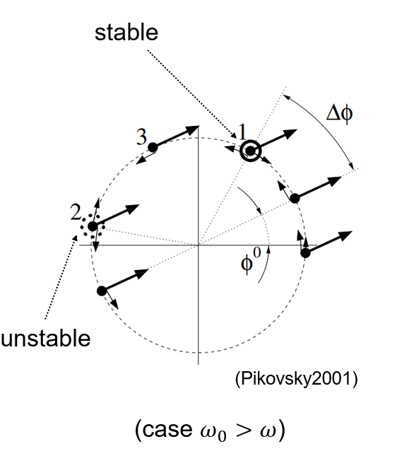
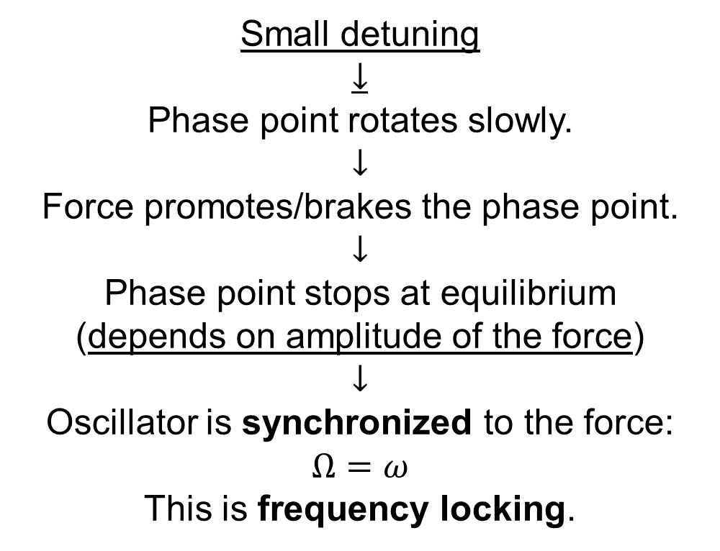
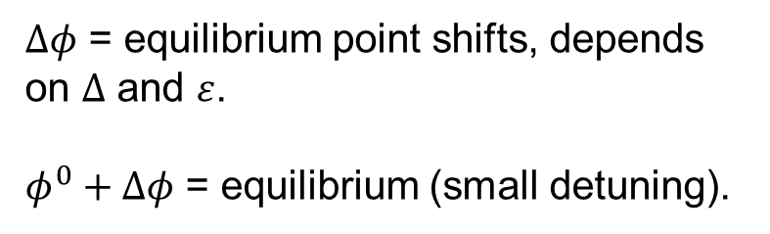
Small detuning
$$↓$$
Phase point rotates slowly.
$$↓$$
Force promotes/brakes the phase point.
$$↓$$
Phase point stops at equilibrium
(depends on amplitude of the force)
$$↓$$
Oscillator is synchronized to the force: $Ω=ω$
This is frequency locking.
$Δφ$ = equilibrium point shifts, depends on $Δ$ and $ε$.
$φ^{0}+Δφ$ = equilibrium (small detuning).
Equilibrium = force exactly counteracts the motion of phase point.

Slide 5
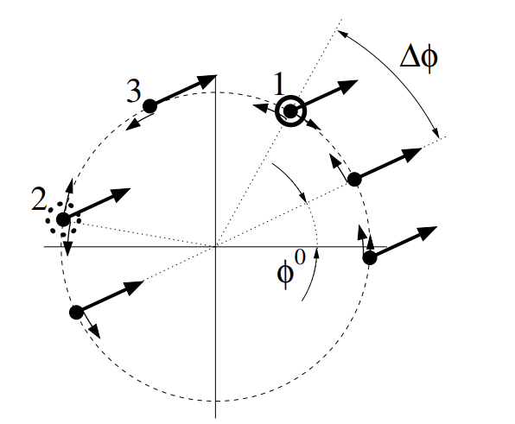
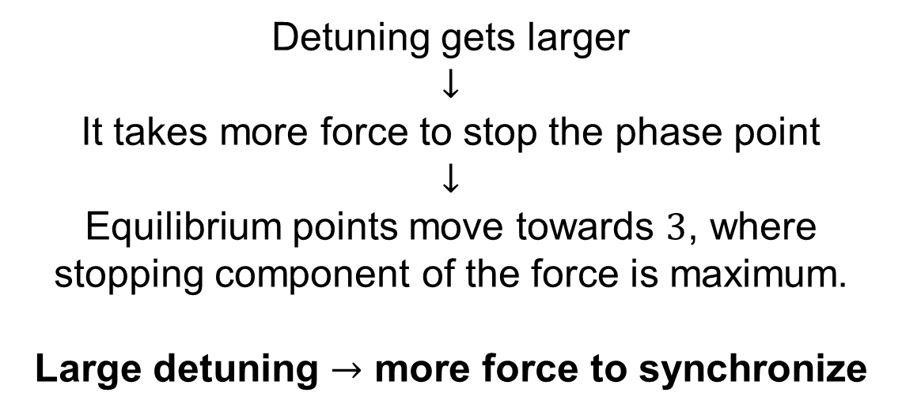

Detuning gets larger
$$↓$$
It takes more force to stop the phase point $$↓$$
Equilibrium points move towards $3$, where stopping component of the force is maximum.
Large detuning $→$ more force to synchronize
(Pikovsky2001)
(case $ω_{0}>ω$)

Slide 6
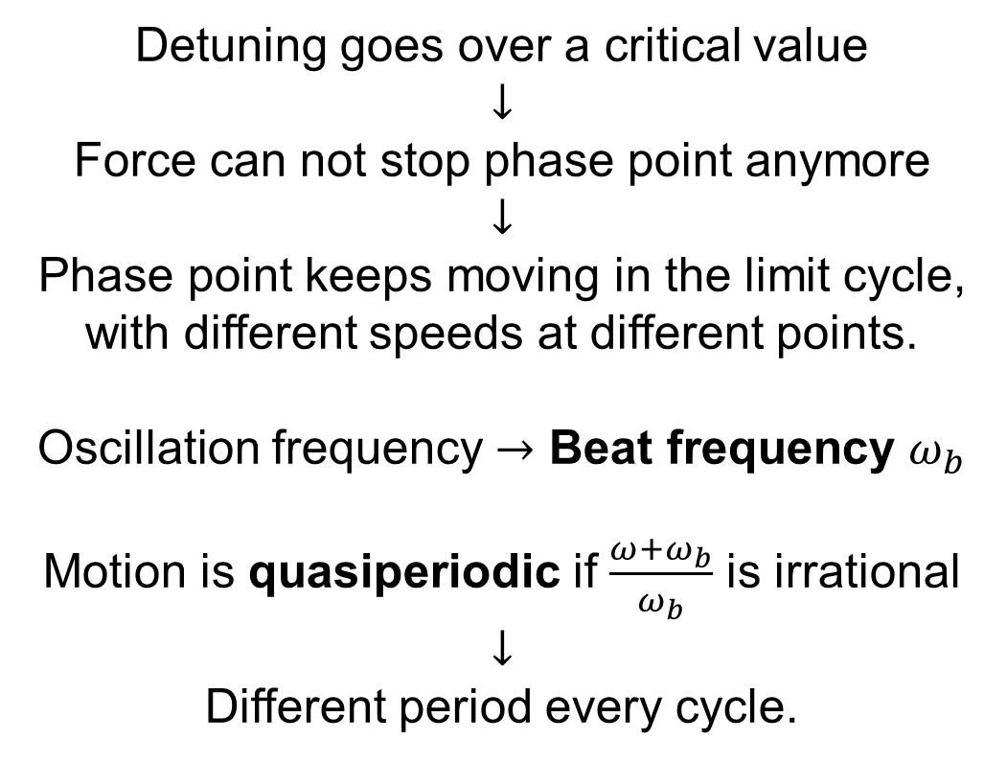

stable
Detuning goes over a critical value
$$↓$$
Force can not stop phase point anymore
$$↓$$
Phase point keeps moving in the limit cycle, with different speeds at different points.
Oscillation frequency $→$ Beat frequency $ω_{b}$
Motion is quasiperiodic if $\frac{ω+ω_{b}}{ω_{b}}$ is irrational
$$↓$$
Different period every cycle.
unstable
(Pikovsky2001)
(case $ω_{0}>ω$)

Slide 7
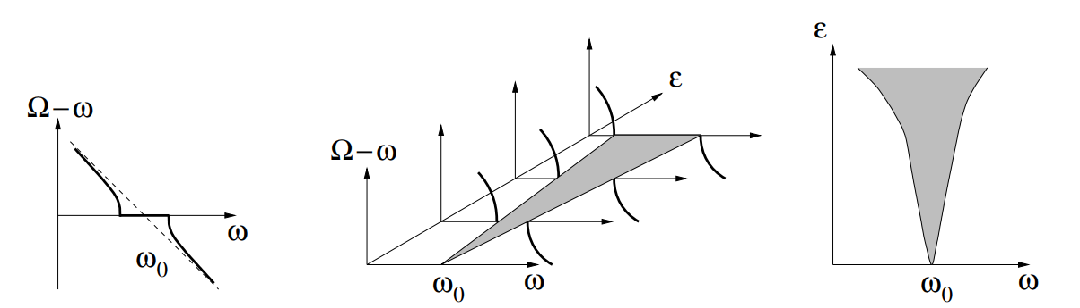

Implication:
For a given force amplitude, there is a range of detuning which enables synchronization, i.e. from zero until the critical value.
Synchronization region / Arnold tongue
$$Ω≠ω$$
(Pikovsky2001)

Slide 8
Does synchronization exist in the quantum world?

Slide 9
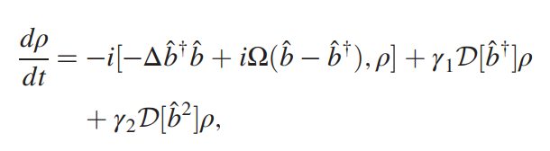
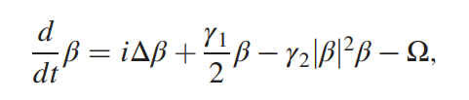
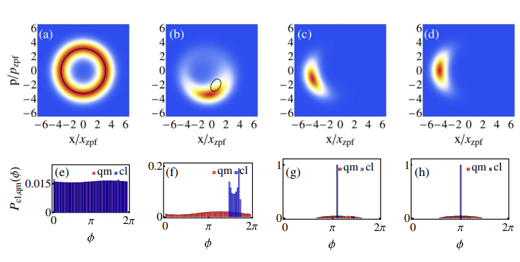
Quantum van der Pol oscillator
(Walter2014)

Slide 10
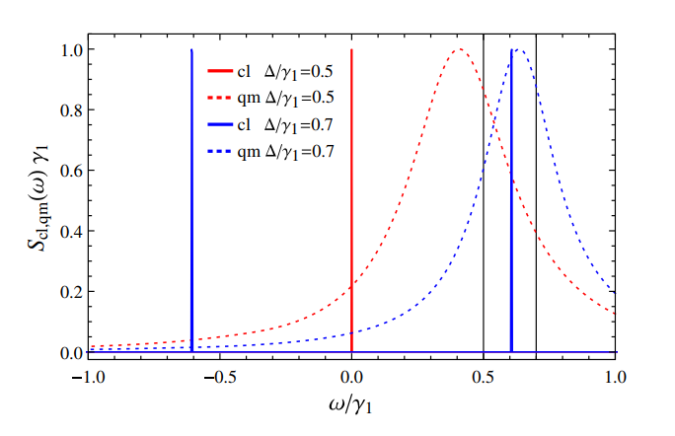
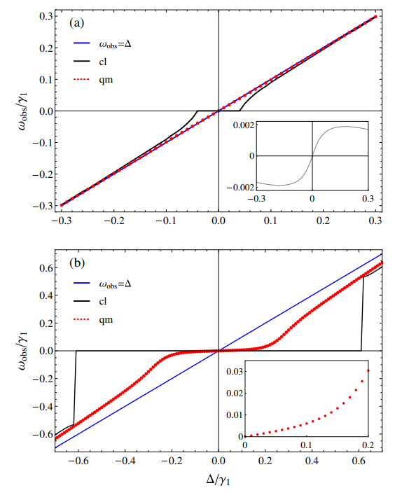
(Walter2014)
Synchronization exists (though a bit different)

Slide 11
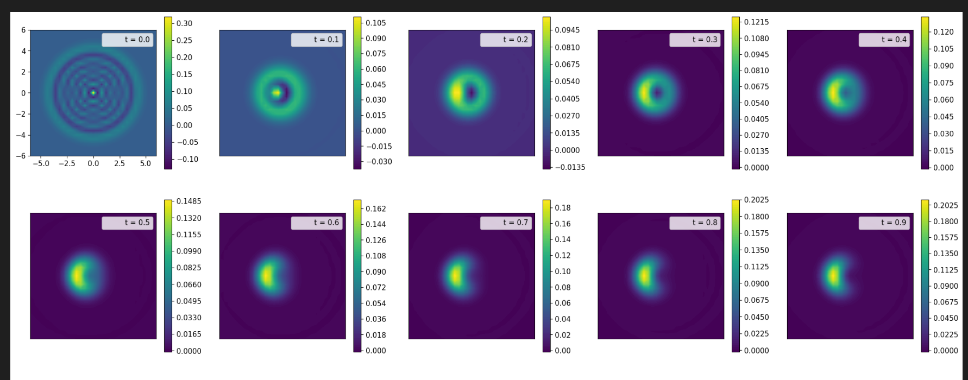
What is done:
Reproduced some of Walter2014’s results.
Looked at the time it takes for a quantum van der Pol oscillator to reach limit cycle, given different initial states (number, coherent, thermal).

Slide 12
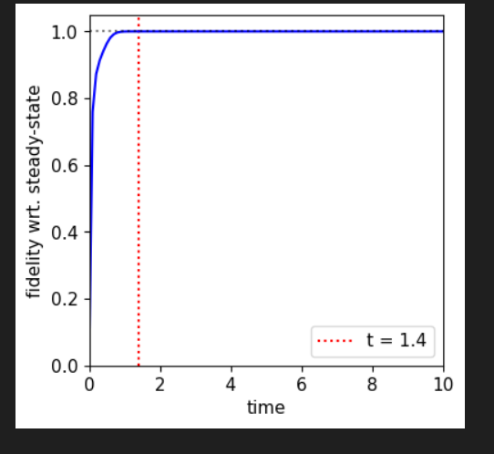

Slide 13
The plans:
Build a python framework to calculate relevant quantities for quantum synchronization, like those in Walter2014.
Study another paper by Walter about synchronization of two oscillators.
Inspect quantum synchronization with dephasing or coupling.
Inspect what determines the rate at which a state reaches the limit cycle.
Study the Fisher information corresponding to a quantum oscillator.
Inspect the quantum speed limit and its dependence on the parameters of the oscillator.

