Slide 1
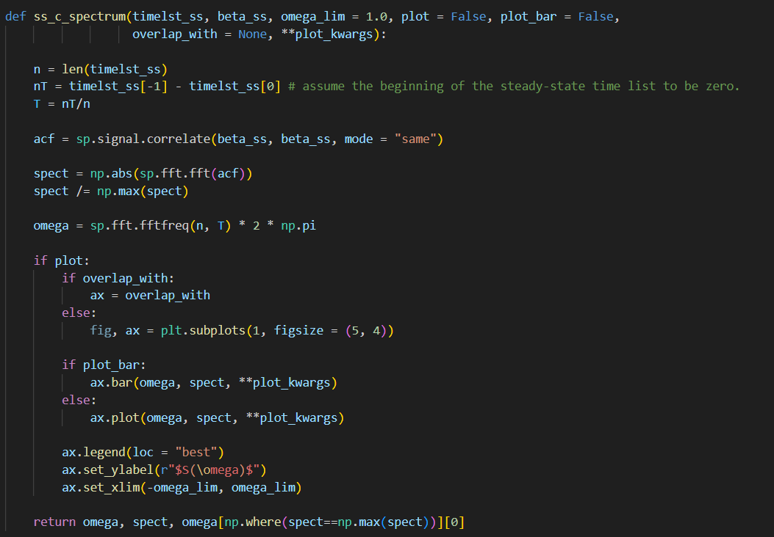

Slide 2
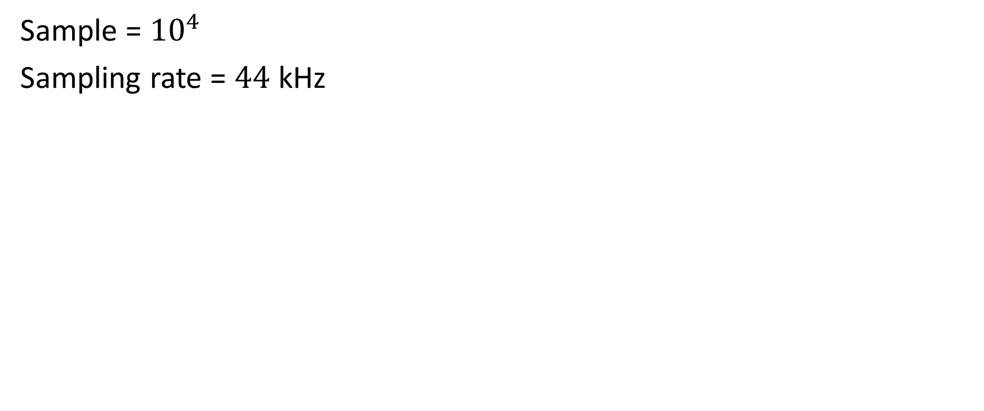
Sample = ${10}^{4}$
Sampling rate = $44$ kHz

Slide 3
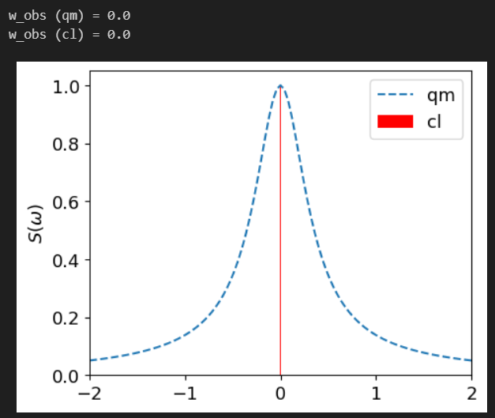

$$Ω=1, γ_{1}=1, γ_{2}=0.1$$
$$Δ=0.0$$

Slide 4
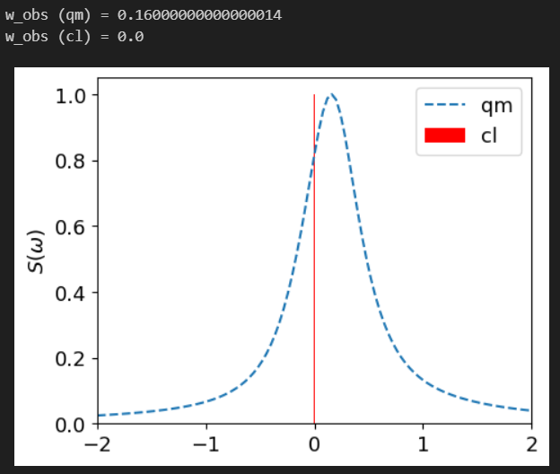

$$Ω=1, γ_{1}=1, γ_{2}=0.1$$
$$Δ=0.3$$

Slide 5
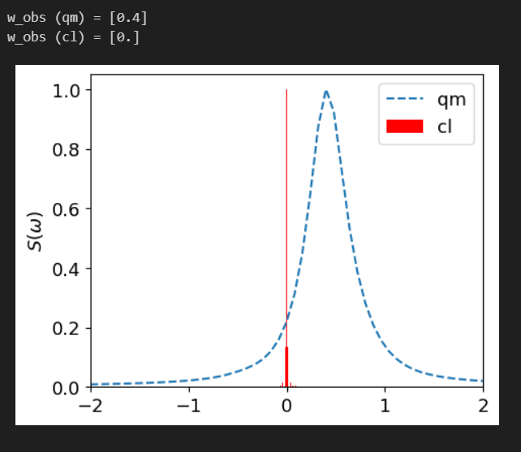

$$Ω=1, γ_{1}=1, γ_{2}=0.1$$
$$Δ=0.5$$

Slide 6
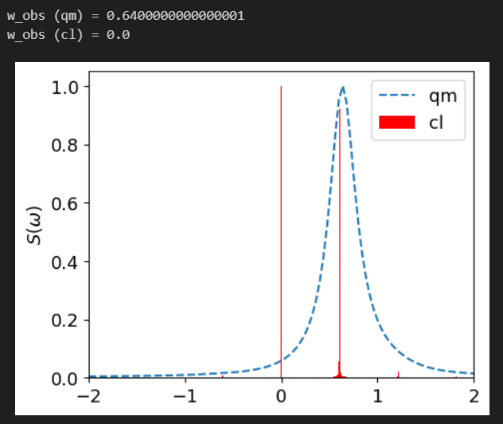

$$Ω=1, γ_{1}=1, γ_{2}=0.1$$
$$Δ=0.7$$

Slide 7
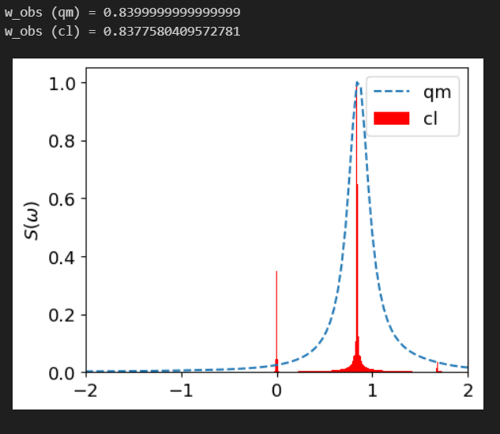

$$Ω=1, γ_{1}=1, γ_{2}=0.1$$
$$Δ=0.9$$

Slide 8
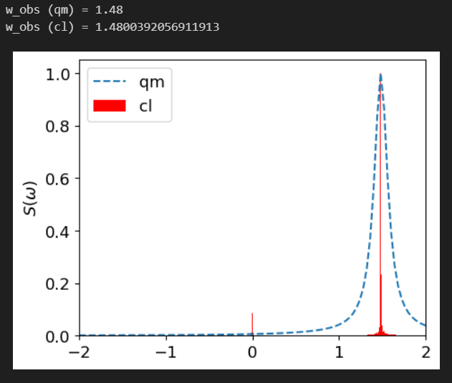

$$Ω=1, γ_{1}=1, γ_{2}=0.1$$
$$Δ=1.5$$

