Slide 1
DATA MINING
WINE QUALITY
3311811052 - Arif Widaryanto
3311811053 - Jaya Napitupulu
3311811079 - Andika Paska
3311811086 - Hendry Putra Pratama
Politeknik Negeri Batam

Slide 2
CONTENT
01
link github project =
https://github.com/hendry456/tugasbesardatamine
02
dataset = winequality-white.csv
03
Akun github=
1. arifwidaryanto2
2. andikapaska
3. jayanapitupulu
4. hendry456

Slide 3
01
Proses Data Mining

Slide 4
Label & Keterangan
4 = sangat tidak baik
5 = tidak baik
6 = sedang
7 = baik
8 = sangat baik

Slide 5
Full Code
setwd("D:/TugasBesarDataMine")
getwd()
dataset <- read.csv("winequality-white.csv", sep= ";")
install.packages("C50")
install.packages("printr")
library(C50)
library(printr)
dataset["quality"]<-lapply(dataset["quality"],factor)
str(dataset)
model <- C5.0(quality ~., data=dataset)
model
summary(model)
plot(model)
datatesting<-dataset[,1:11]
predictions <- predict(model, datatesting)
table(predictions, dataset$quality)

Slide 6
Terjemahan
fixed acidity = keasaman tetap
volatile acidity =keasaman tidak tetap
citric acid = asam sitrat
residual sugar = sisa gula
chloride = klorida
free sulfur dioxide = sulfur oksida bebas
total sulfur dioxide = total sulfur oksida
density = massa jenis
ph = ph
sulphate = sulfat
alcohol = alkohol
quality = kualitas

Slide 7
Decision Tree Text
Decision tree:
alcohol > 10.4:
:...fixed.acidity <= 6.8:
: :...fixed.acidity > 6.6: 8 (3)
: : fixed.acidity <= 6.6:
: : :...volatile.acidity <= 0.48: 7 (7/1)
: : volatile.acidity > 0.48: 8 (2)
: fixed.acidity > 6.8:
: :...alcohol <= 11.7:
: :...free.sulfur.dioxide <= 22: 5 (4/1)
: : free.sulfur.dioxide > 22: 6 (6)
: alcohol > 11.7:
: :...citric.acid <= 0.38: 7 (3)
: citric.acid > 0.38: 5 (2)
alcohol <= 10.4:
:...sulphates > 0.51:
:...volatile.acidity > 0.25: 5 (6/1)
: volatile.acidity <= 0.25:
: :...total.sulfur.dioxide <= 124: 5 (2)
: total.sulfur.dioxide > 124: 6 (4/1)
sulphates <= 0.51:
:...sulphates > 0.37:
:...citric.acid <= 0.14: 5 (3)
: citric.acid > 0.14: 6 (25/1)
sulphates <= 0.37:
:...volatile.acidity <= 0.23: 6 (4)
volatile.acidity > 0.23:
:...residual.sugar <= 2.9: 6 (2)
residual.sugar > 2.9: 5 (6)

Slide 8
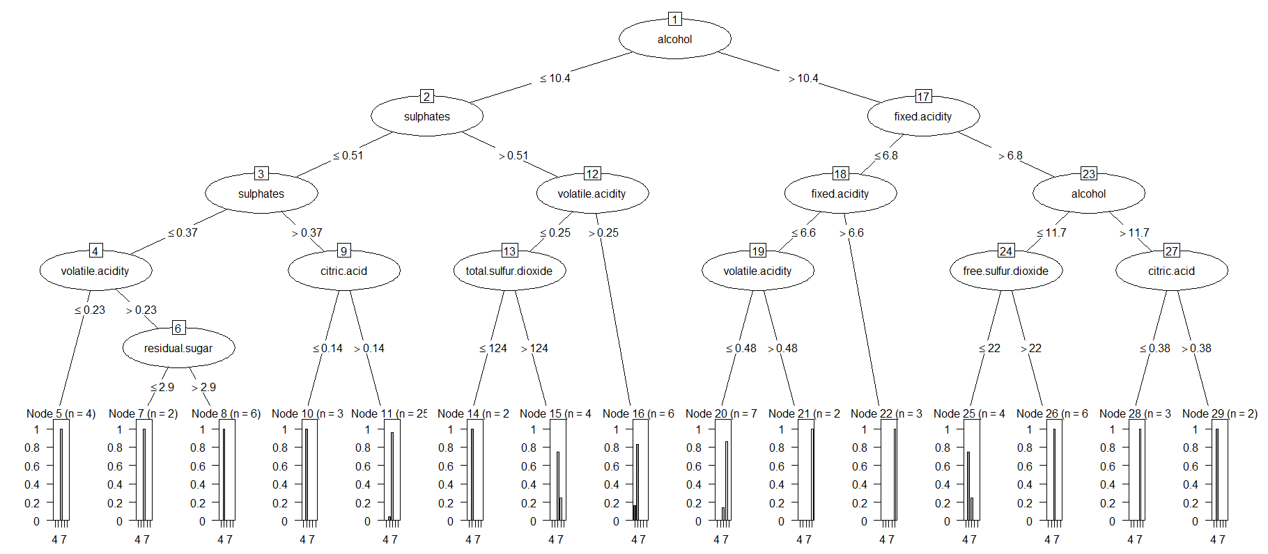
Decision Tree

Slide 9
Referensi
Dataset = https://archive.ics.uci.edu/ml/datasets/wine+quality

Slide 10
THANKS

