Slide 1
Investigation on Monte Carlo Method
Haocheng An
11/30/2017

Slide 2



Gauss Seidel
Monte Carlo Estimating Pi
Monte Carlo Solve Laplace
Solve SWE

Slide 3
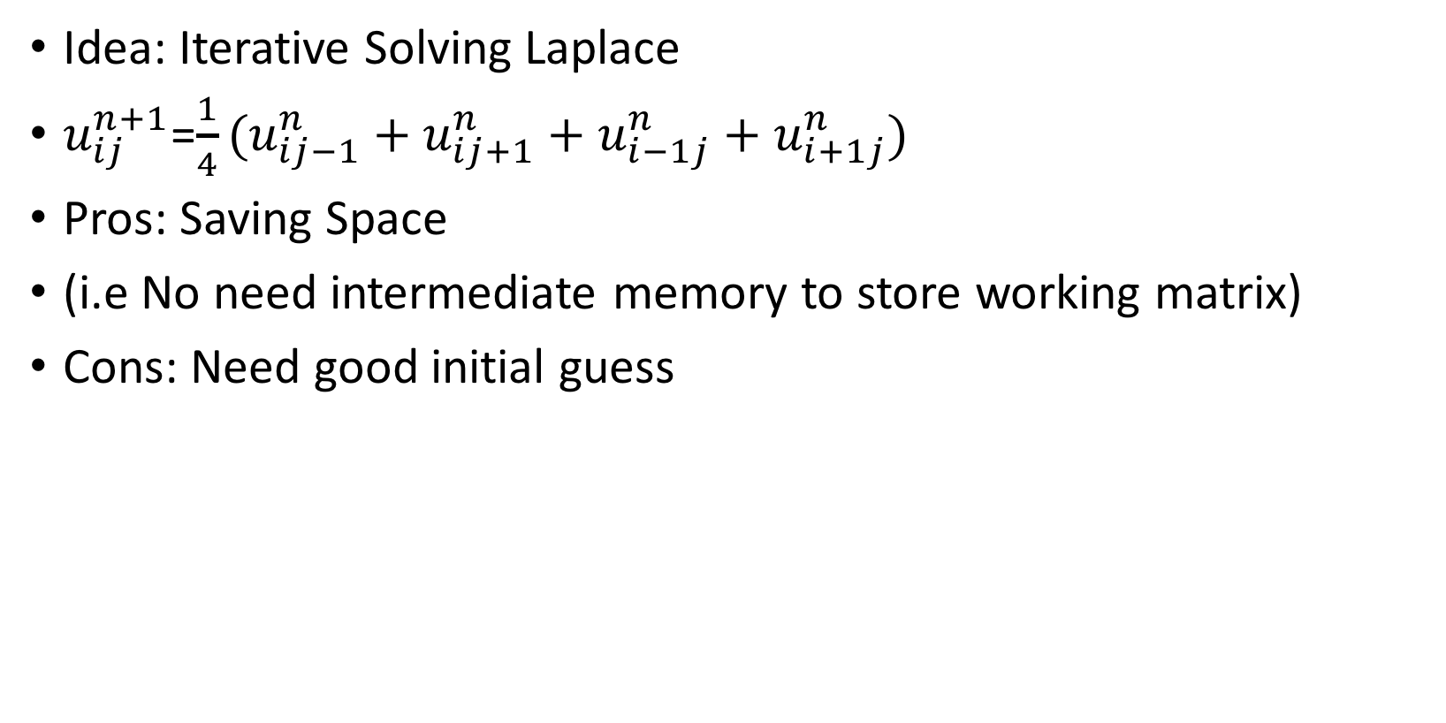
Gauss Seidel
Idea: Iterative Solving Laplace
$u_{ij}^{n+1}$=$\frac{1}{4}(u_{ij−1}^{n}+u_{ij+1}^{n}+u_{i−1j}^{n}+u_{i+1j}^{n})$
Pros: Saving Space
(i.e No need intermediate memory to store working matrix)
Cons: Need good initial guess

Slide 4
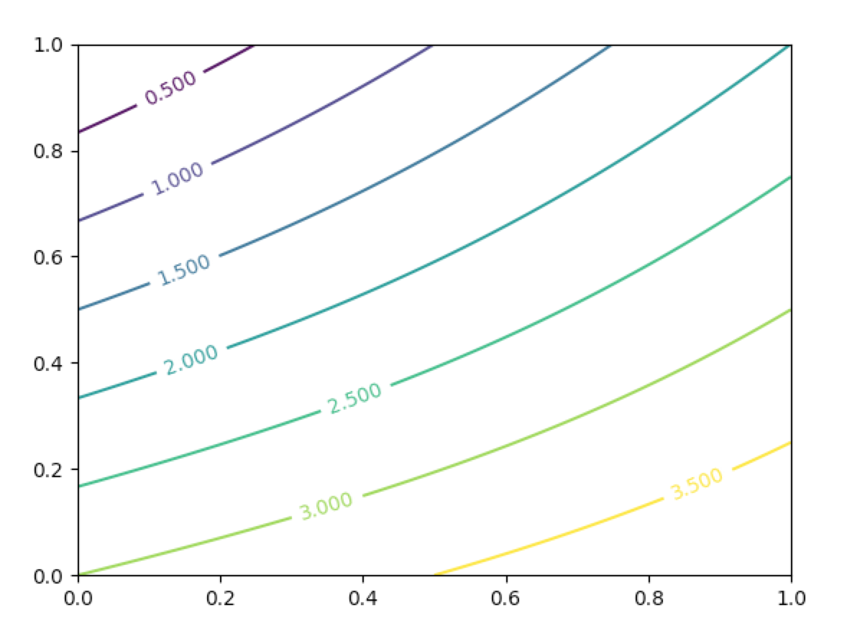

Example
u(x,0) = 2*x
u(x,1) = 3+x
u(0,y) = 3+y
u(1,y) =2*y
Error term
$\sum_{i=0}^{n}{\sum_{j=0}^{n}{||aij{−a}^{′}ij ||2}}$
0.000679298300794

Slide 5
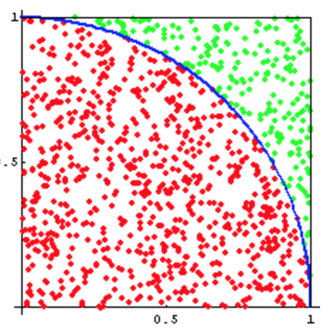
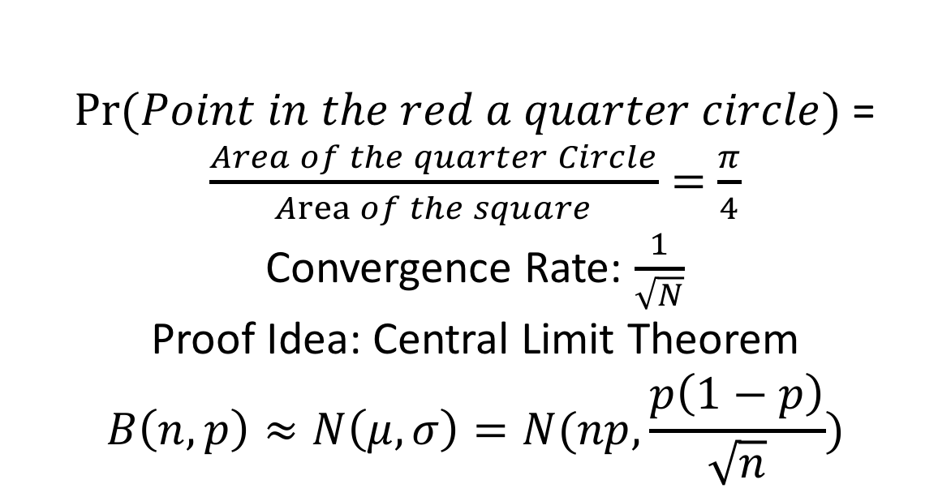
Monte Carlo Estimating Pi
$Pr⁡(Point in the red a quarter circle)$=$\frac{Area of the quarter Circle}{Area of the square}=$ $\frac{π}{4}$
Convergence Rate: $\frac{1}{\sqrt{N}}$
Proof Idea: Central Limit Theorem
$$B\left(n,p\right)≈N\left(μ,σ\right)=N(np,\frac{p\left(1−p\right)}{\sqrt{n}})$$

Slide 6
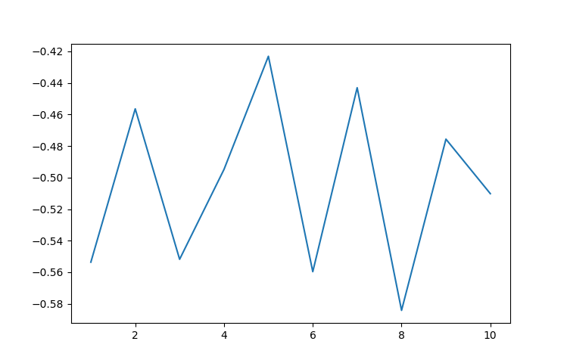

Slide 7
Monte Carlo Solve Laplace
u_{xx} + u_{yy} = 0
Initial Value given on [0,1]²:
u(x,0) = f₁(x)
u(x,1) = f₂(x)
u(0,y) = f₃(y)
u(1,y) = f₄(y)
Numerical Solution
u(x,y) = E(f((x,y)+ B(x,y)))
B: Brownian motion
Rough Idea on Proof
1d:
U_{xx} = 0 u(0) = a, u(1) = b
Deterministic Solution
→ u(x) = (b-a)x + a
Probabilistic on given point x:
Each Step: Left Right
Probability 0.5 0.5
Touch boarder: Left Right
Probability 1-x x
u(x) = x*b + (1-x)*a =(b-a)*x + a

Slide 8
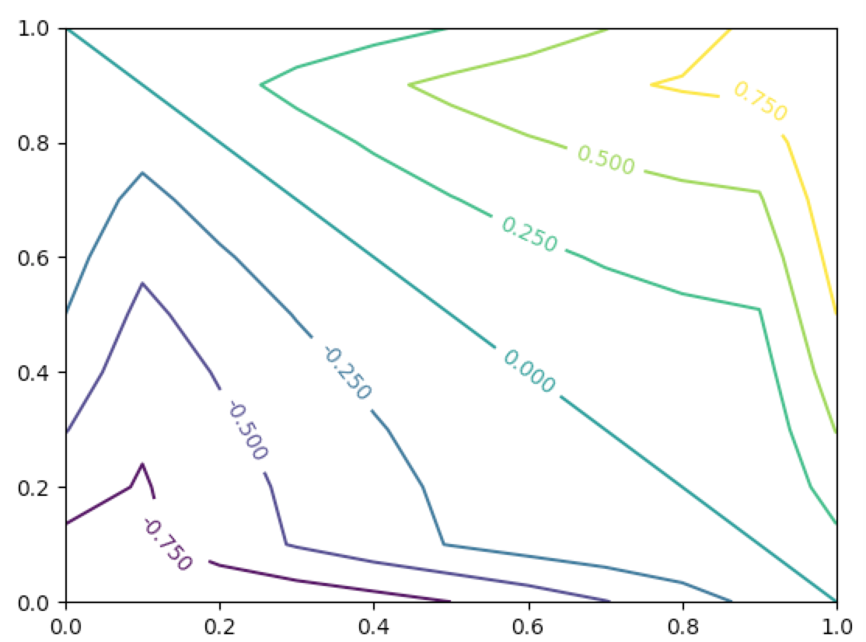
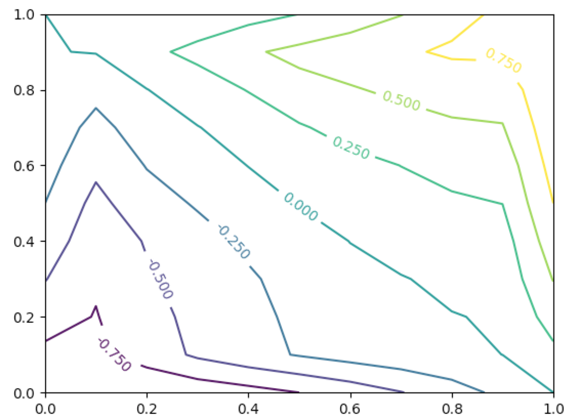
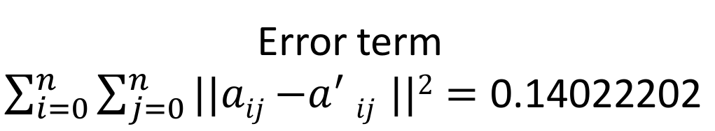
Example:
Analytical Solution: u(x, y) = x²-y²
u(x,0) = x²
u(x,1) = x²-1
u(0,y) = -y²
u(1,y) = 1- y²
Error term $\sum_{i=0}^{n}{\sum_{j=0}^{n}{||aij{−a}^{′}ij ||2}=\text{0.14022202 }}$

Slide 9
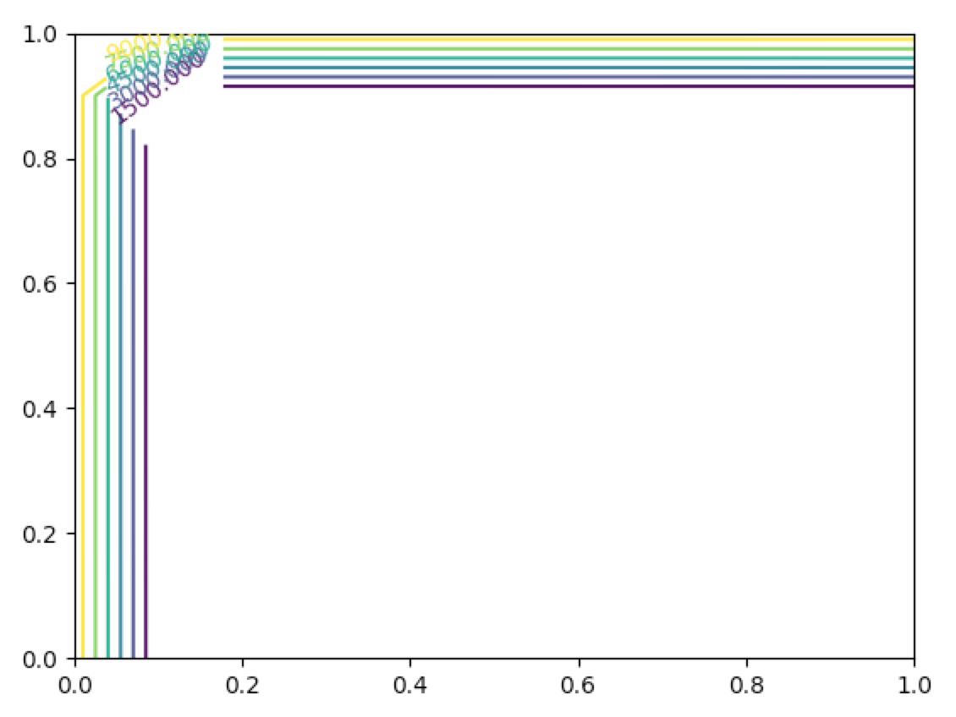
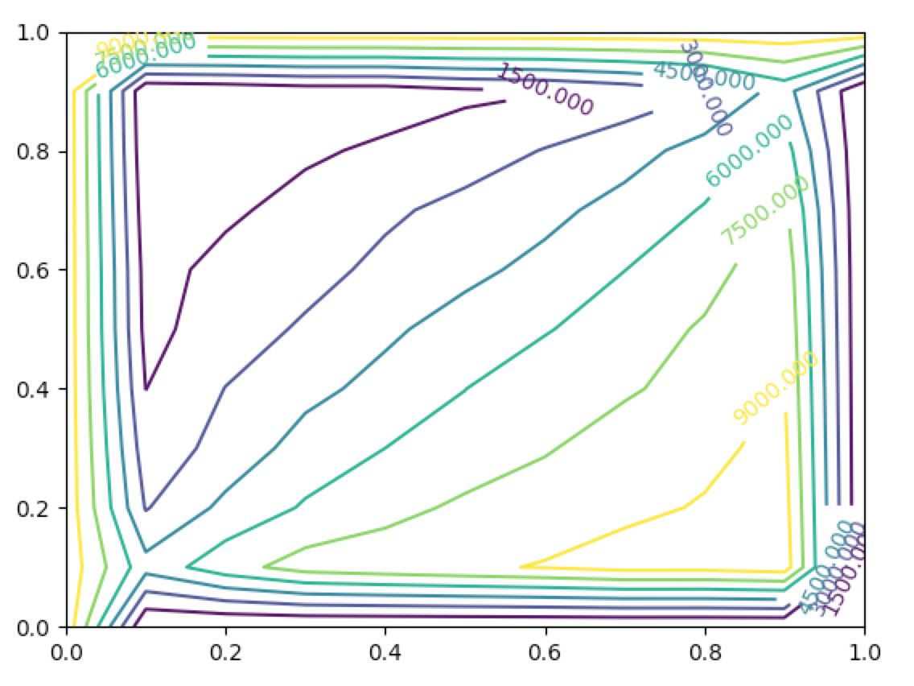
Importance of 0 = u_{xx} + u_{yy}
Actual Solution: $u\left(x, y\right)=\frac{1}{xy}$
Error term:51898.4903672

Slide 10
Stochastic Processes Solving Black Schole

Slide 11
Result

