Slide 1
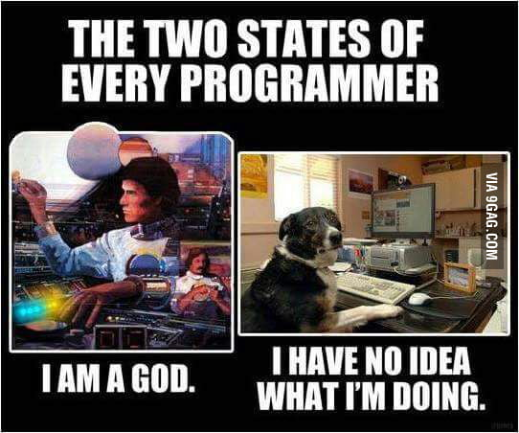
CQRS + Event Sourcing
Notes:
Ask questions as I go, but I reserve the right to punt, but if I do, call me on it.

Slide 2
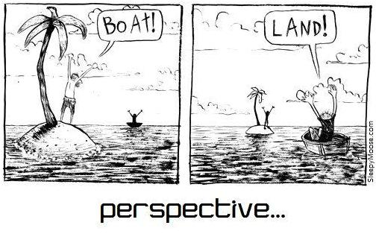
Why learn CQRS
Notes:
Paradigm, not architecture
Like Functional Programming, or MVC, different way to approach your problem
This is not a sales pitch, it’s a chance to think differently
Where would this fit? Where is it a bad idea?

Slide 3
Command = Intention to change the world
Query = A request to know something about the world
Notes:
I often call these reads and writes

Slide 4
Applications are made of Commands and Queries
Buy those shoes.
shoes.com
What shoes do you have?

Slide 5
CQRS: Command Query Responsibility Segregation
Read and write needs aren’t always the same
Exercise: How is a blog post’s read and write needs different?
Scheduling a patient vs pulling up an appointment?
Depositing money in a bank vs viewing your balance?

Slide 6
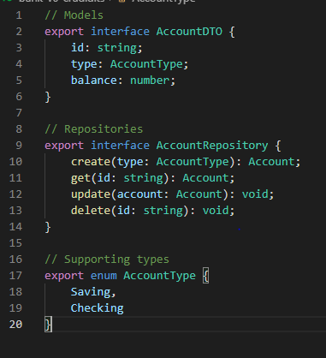
CRUD: We’re a bank
Create
Read
Update
Delete
Notes:
What an unsegregated application looks like. REST
Very simple and straight forward… but NO BUSINESS LOGIC!
Invoker handles Business Logic
Works for some problems. But not form banking! Can spoof!
Solution will be the domain model

Slide 7
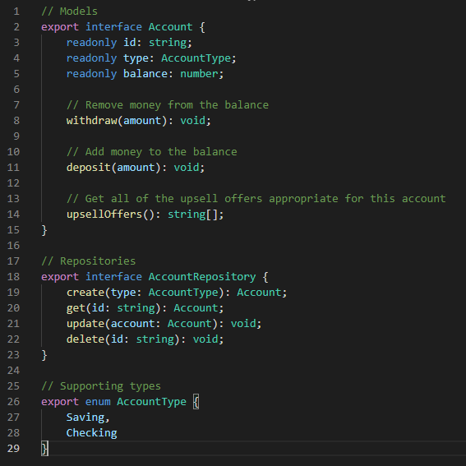
Domain Model
Notes:
Added the operations

Slide 8
Domain Model
UI
Business Logic (Controller)
DomainModel (Account)
DB
POST
ORM
GET
Image inspired by MATEUSZ STASCH. https://www.future-processing.pl

Slide 9
Domain Model
State
Execution of command
Params
Change
Notes:
Identify commands and queries
Commands are not just writes, they need to do some reads as well
Commands still need to read from the database:
Validation
Business logic (if flows)

Slide 10
New Requirements: Regulation D
(2) The term “savings deposit” ..., from which, under the terms of the deposit contract … the depositor is permitted or authorized to make no more than six transfers and withdrawals, … per calendar month …, to another account … by means of a preauthorized or automatic transfer, or telephonic (including data transmission) agreement, order or instruction, or by check, draft, debit card, or similar order made by the depositor and payable to third parties. … Such an account is not a transaction account … when such transfers or withdrawals are made by mail, messenger, automated teller machine, or in person or when such withdrawals are made by telephone (via check mailed to the depositor) regardless of the number of such transfers or withdrawals.

Slide 11
New Requirements: Regulation D
(2) The term “savings deposit” ..., from which, under the terms of the deposit contract … the depositor is permitted or authorized to make no more than six transfers and withdrawals, … per calendar month …, to another account … by means of a preauthorized or automatic transfer, or telephonic (including data transmission) agreement, order or instruction, or by check, draft, debit card, or similar order made by the depositor and payable to third parties. … Such an account is not a transaction account … when such transfers or withdrawals are made by mail, messenger, automated teller machine, or in person or when such withdrawals are made by telephone (via check mailed to the depositor) regardless of the number of such transfers or withdrawals.
Command

Slide 12
New Requirements: Regulation D
(2) The term “savings deposit” ..., from which, under the terms of the deposit contract … the depositor is permitted or authorized to make no more than six transfers and withdrawals, … per calendar month …, to another account … by means of a preauthorized or automatic transfer, or telephonic (including data transmission) agreement, order or instruction, or by check, draft, debit card, or similar order made by the depositor and payable to third parties. … Such an account is not a transaction account … when such transfers or withdrawals are made by mail, messenger, automated teller machine, or in person or when such withdrawals are made by telephone (via check mailed to the depositor) regardless of the number of such transfers or withdrawals.
State Needed:
- How many other transactions were made this month on the applicable modalities?

Slide 13
New Requirements: Bank Secrecy Act
(a) …A person… shall file a report under subsection (b) of this section when the person …—
(1) transports, is about to transport, or has transported, monetary instruments of more than $10,000 at one time
(2) receives monetary instruments of more than $10,000 …
Notes:
What makes this tricky is you've also got to submit if someone appears to be trying to work around the BSA
Exceeds $10,000
Near to the $10,000 to apparently evade
Several recent transactions in an attempt to evade
Attempt, then back away

Slide 14
New Requirements: Bank Secrecy Act
(a) …A person… shall file a report under subsection (b) of this section when the person …—
(1) transports, is about to transport, or has transported, monetary instruments of more than $10,000 at one time
(2) receives monetary instruments of more than $10,000 …
Command
Notes:
What makes this tricky is you've also got to submit if someone appears to be trying to work around the BSA
Exceeds $10,000
Near to the $10,000 to apparently evade
Several recent transactions in an attempt to evade
Attempt, then back away

Slide 15
New Requirements: Bank Secrecy Act
State Needed:
How many other transactions were made this month on the applicable modalities?
Sum of withdrawals in the past day
Last withdrawal amount (prevents zeroing in)
(a) …A person… shall file a report under subsection (b) of this section when the person …—
(1) transports, is about to transport, or has transported, monetary instruments of more than $10,000 at one time
(2) receives monetary instruments of more than $10,000 …

Slide 16
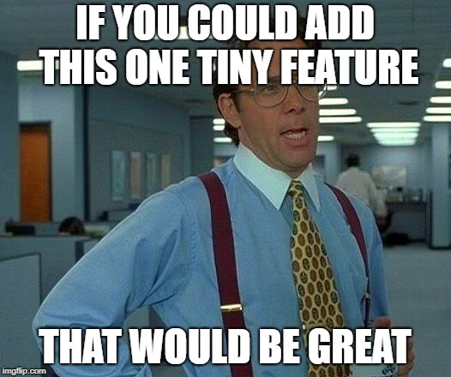
New Requirement: Upsells!
If your account has over $3,000 and you've received no more than 5 fees in the last year, we'll try to upsell you to a premium checking account.

Slide 17
New Requirement: Upsells!
If your account has over $3,000 and you've received no more than 5 fees in the last year, we'll try to upsell you to a premium checking account.
Query

Slide 18
New Requirement: Upsells!
State Needed:
How many other transactions were made this month on the applicable modalities?
Sum of withdrawals in the past day
Last withdrawal amount (prevents zeroing in)
Account balance
Number of fees in the last year
If your account is a checking account, and you have over $3,000 and you've received no more than 5 fees in the last year, we'll try to upsell you to a premium checking account.

Slide 19
New Requirement: Upsells!
If you have a linked savings account, and the monthly turnover on your checking account is above the amount in your savings account, we'll try to upsell an automatic transfer to savings

Slide 20
New Requirement: Upsells!
If you have a linked savings account, and the monthly turnover on your checking account is above the amount in your savings account, we'll try to upsell an automatic transfer to savings
Query

Slide 21
New Requirement: Upsells!
State Needed:
How many other transactions were made this month on the applicable modalities?
Sum of withdrawals in the past day
Last withdrawal amount (prevents zeroing in)
Account balance
Number of fees in the last year
Has linked account?
Monthly turnover on account
If your account is a checking account, and you have over $3,000 and you've received no more than 5 fees in the last year, we'll try to upsell you to a premium checking account.

Slide 22
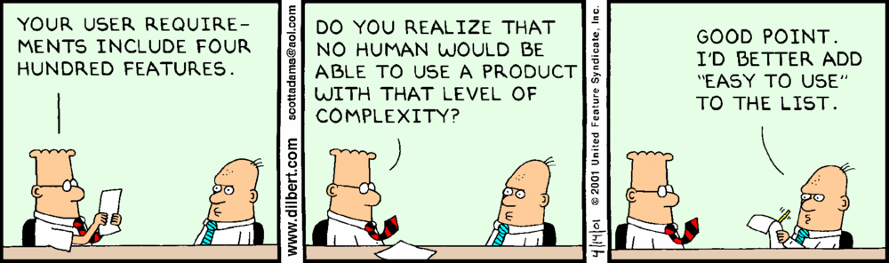
Many new requirements!

Slide 23
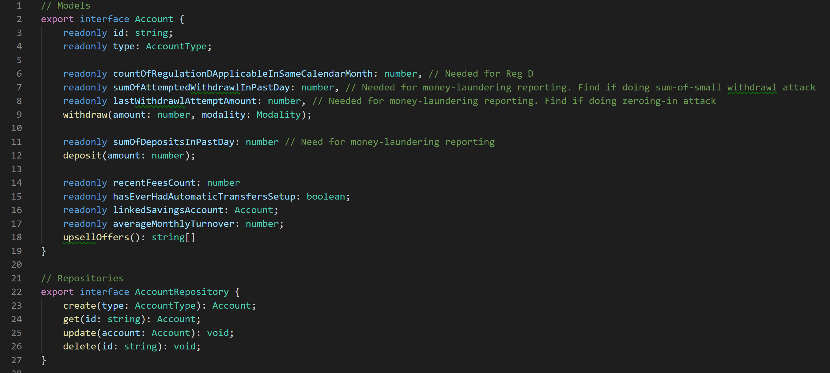
Domain Model with needed state

Slide 24
Domain Model with needed state
Ick!

Slide 25
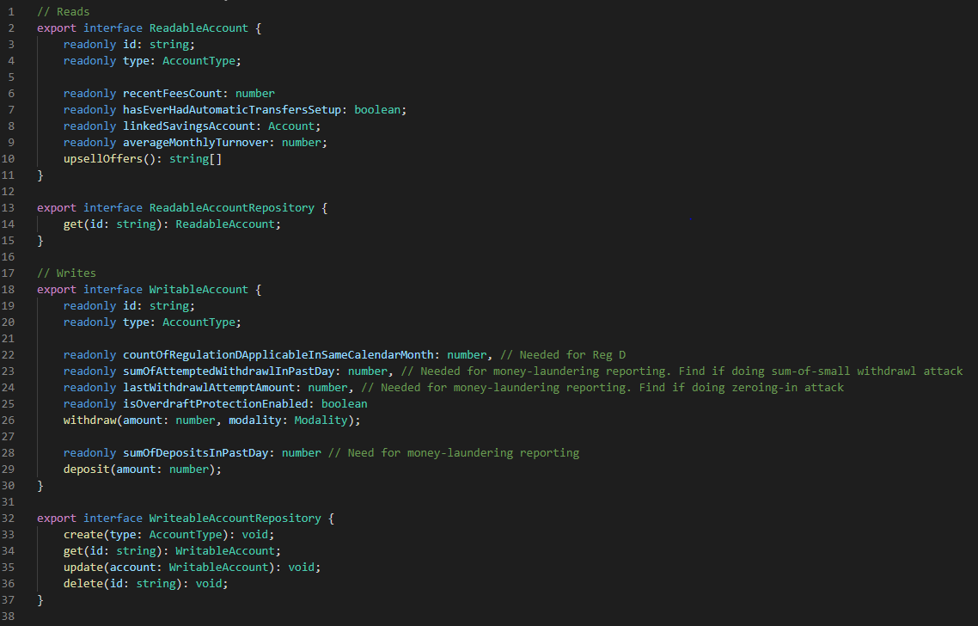
One tiny step into CQRS
Queries
Commands

Slide 26
Separate Command and Query models
Models are simpler
Less unnecessary fetching
Separate deployments possible
Separate teams possible
Frees us up to address read/write needs separately…
Notes:
Separate nodes to isolate failure independently, and for read-replicas to the DB
Why do this? It frees us up to treat them separately

Slide 27
Command Object Architecture
UI
Command Business Logic
Command
Domain Model
DB
Command
ORM
Query
Query Business Logic
Query Domain Model
ORM
Image inspired by MATEUSZ STASCH. https://www.future-processing.pl
Notes:
Didn’t actually change much, but now we can bend things to be more configurable for each side

Slide 28
Command: An intention to change something
Notes:
Our application is full of commands. Every time a method is called that will change state. These are actions in Redux (kinda)

Slide 29
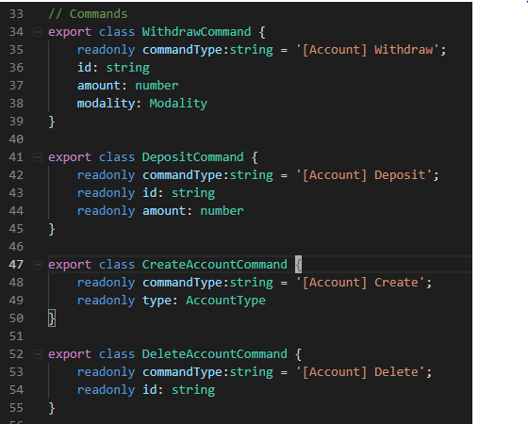
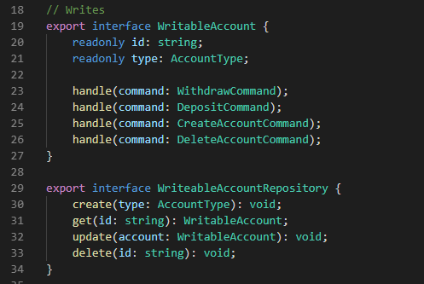
Command Object

Slide 30
Why command objects?
Self documents application operations
Cross cutting concerns for writes
Auth
Auditing
Throttling
Circuit breaking
Schedulable

Slide 31
Command Object

Slide 32
Command Object Architecture
UI
Command Dispatch
Domain Model
DB
Command
ORM
Query
Query Model
ORM
Image inspired by MATEUSZ STASCH. https://www.future-processing.pl

Slide 33
That’s nice… but we still have a single point where read and write needs conflict…
UI
Command Dispatch
Domain Model
DB
Command
ORM
Query
Query Model
ORM
Where?
Image inspired by MATEUSZ STASCH. https://www.future-processing.pl

Slide 34
That’s nice… but we still have a single point where read and write needs conflict…
UI
Command Dispatch
Domain Model
DB
Command
ORM
Query
Query Model
ORM
Here!
Image inspired by MATEUSZ STASCH. https://www.future-processing.pl
Notes:
We could generate a separate database

Slide 35
Event: An announcement that something has occurred
Notes:
Our application is full of commands. Every time a method is called that will change state. These are actions in Redux (kinda)

Slide 36
emit
AccountWithdrawn
AccountCommandHandler
AccountOverdrafted
WithdrawCommand
emit
dispatch
AccountSuspiciousWithdrawAttempted
emit
AccountRegDViolated
emit
Notes:
0 to many events
Pure functional!
Commands in the imperative tense, and event in the past tense.
CommandHandler does NOT update the database directly. A Projection does it.
Essential: The Handler is responsible for determining data integrity, NOT THE DATABASE. Once it’s emitted, it has happened.

Slide 37
Events + Projections
UI
Command Dispatch
Domain Model
Command DB
Command
Project
Project
Query
Query Model
Query
DB
SELECT * FROM …
Image inspired by MATEUSZ STASCH. https://www.future-processing.pl

Slide 38
Events + Projections
Denormalized!
UI
Command Dispatch
Write Model
Command DB
Command
Commit
Project
Query
Read Model
Read
DB
SELECT * FROM …
Image inspired by MATEUSZ STASCH. https://www.future-processing.pl

Slide 39
Normalized Database
questionId | questionText | askerUserId
123 | How to code? | 897
SELECT q.*, u.userName FROM Questions q
JOIN Users u
ON q.askerUserId = user.id
userId | userName
897 | Mitchell

Slide 40
Denormalized Database
questionId | questionText | askerUserId | askerUserName
123 | How to code? | 897 | Mitchell
SELECT * FROM Questions
Notes:
What is good about this? What is bad about this?

Slide 41
QuestionCreated
INSERT INTO Questions (quetionId, ….) VALUES(…)
questionId | questionText | askerUserId | askerUserName
123 | How to code? | 897 | Mitchell
UPDATE Questions SET … WHERE askUserId = 897
RenameUser (Mitchell => Heneryvile)
questionId | questionText | askerUserId | askerUserName
123 | How to code? | 897 | Mitchell Heneryville
Notes:
Imagine that we’re stack overflow… We’ve got 10 million visits a day.
Example of keeping the database up-to-date when denormalized
Why do this? Look at what it would take to do a read. Computationally AND cognitively easy

Slide 42
Event Sourcing
AccountCreated
Time
AccountWithdrawn
AccountWithdrawn
AccountDeposited
AccountOverdrafted
Notes:
The state of your application can be reproduced by replaying all of your events

Slide 43
Events + Projections
UI
Command Dispatch
Domain Model
Events
Command
Commit
Project
Query
Query Model
Query
DB
SELECT * FROM …
Image inspired by MATEUSZ STASCH. https://www.future-processing.pl

Slide 44
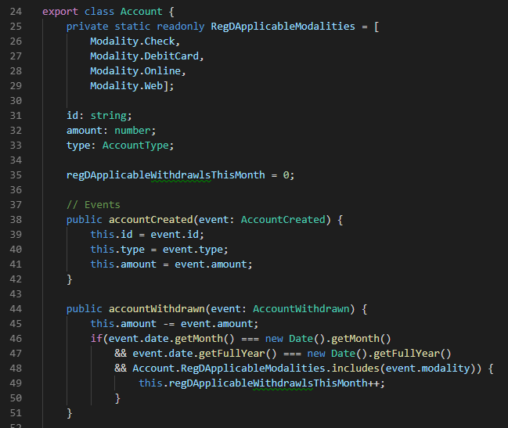
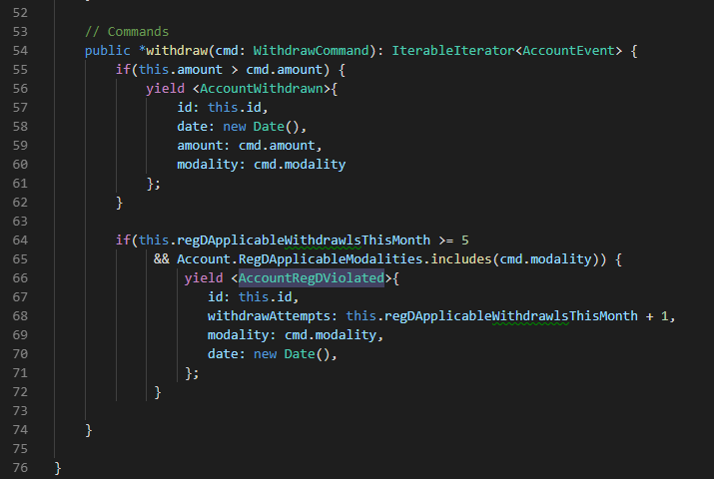

Slide 45
Harness
Fetch prior events for domain model
Run prior events on model
Run command on model
Capture events emitted by model
Announce events via a bus
Command Dispatcher
Domain Model
Event Emitter

Slide 46
What happens when the schema changes?
Change History
It’s a part of history
Modify all prior events to the new schema
Requires extensive data changes
Must be synchronized with code
Destroys history
Make new versions of your events
Old events stay around in your app (more complexity)
Lose nothing, ever.
Computationally simple, just push new code and events

Slide 47
What if I have a lot of events?
Don’t read behind a snapshot
+ $10
- $3
Snapshot:
$11
Time
+ $13
- $8
Apply events after a snapshot
+ $3

Slide 48
How does Redux figure into this?
Is Redux using the CQRS paradigm?
Notes:
Does Redux use CQRS? VOTE
Do your command different than you read?

Slide 49
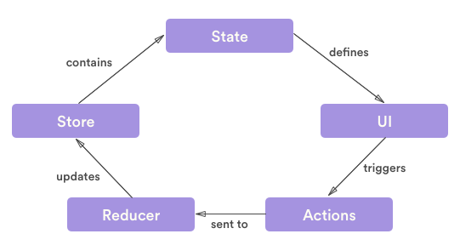
How does Redux figure into this?
Notes:
Do you command different than you query? YES!
Which part is the query, which part is the command, which part is the database?
Vote: Is an action a command or an event?

Slide 50
How does Redux figure into this?
Query
Database
Command
Notes:
Division of the reducer is on purpose, we’ll talk about that.
Does it express an intention to act, or report on something that has happened?
This is debatable
Where does the business logic sit?
Reducer? Can it be rejected? Can it trigger other business events? It’s more like a projection.
State:
Are we able to think about the state differently for command and query purposes?
Not really-no.

Slide 51
When do I use CQRS?
Command and Query responsibilities look different
Simplicity gained by separation is greater than the complexity introduced
Notes:
Remember, it’s a paradigm
Examples of CQRS you know about:
Elastic Search
Redux pattern
Eventually consistent databases
GraphQL (kinda)
Analytics

Slide 52
Questions
Notes:
First, are there any questions I punted on and didn’t get to?

