Slide 1

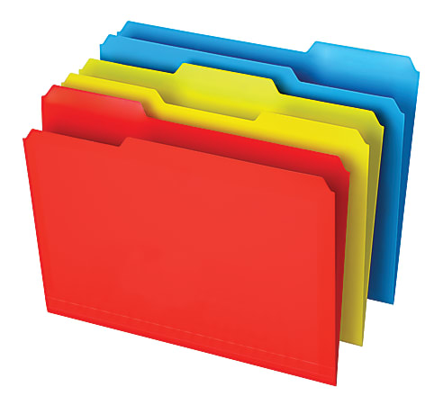
Avoid delete file accidentally
$MYGROUP/trash
clean go
clean bin
clean back

