Slide 1

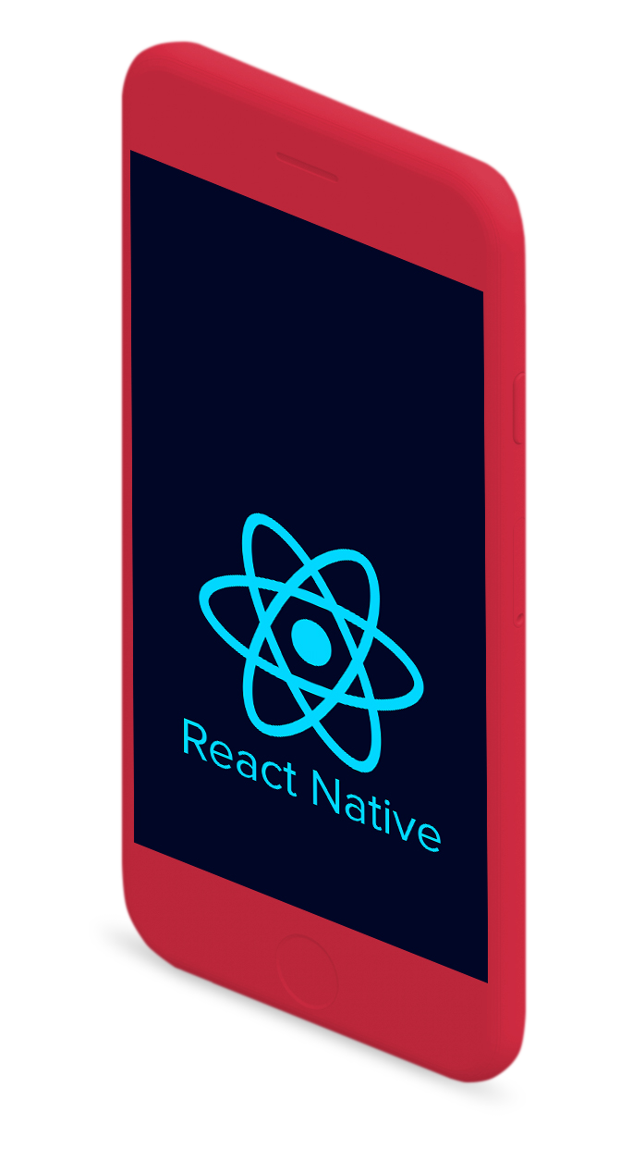
Gap Analysis-
Presented by Hanna Chen

Slide 2

What will be covered in the presentation?
What is React Native and how is it different from React
Core concepts of React Native
4
3
Mobile application sample from a React Native Tutorial
2
Brief Learning Reflection of this topic
1
Notes:
Notes to presenter:
What steps will you be taking as a result of this learning experience?
Did you learn from any failed experiences? How will you do things differently?
What advice will you give to others so they can learn from your experiences?
How can you share what you learned with a real-world audience?
Some examples of next steps might be:
After delivering my first persuasive presentation, I am thinking about joining the debate team.
After making my first film, I’m considering entering it in our school film festival or local film festival.
After connecting with this career expert, I’d like to do some research on that career field because it sounds interesting to me.
This SmartArt allows you add images and text to help outline your process. If a picture is worth a thousand words, then pictures and words should help you communicate this reflection on learning perfectly! You can always click on Insert>SmartArt to change this graphic or select the graphic and click on the Design contextual menu to change the colors.
Feel free to use more than one slide to share your next steps. It also helps to add some video content to explain your message.

Slide 3

React Native: What is it? and, Why is it used?
Notes:
Notes to presenter:
What is your purpose for sharing this reflection?
Is it at the end of a unit or project?
Are you sharing this reflection, at the attainment of a learning goal you set for yourself?
Is it at the end of a course?
State your purpose for the reflection or even the purpose of the learning experience or learning goal. Be clear and be specific in stating your purpose.

Slide 4

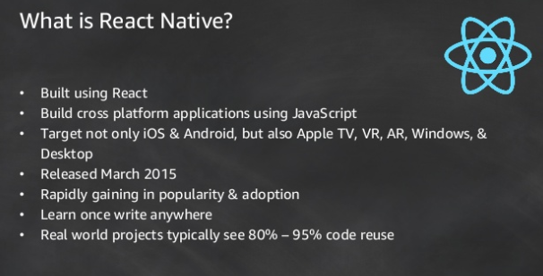
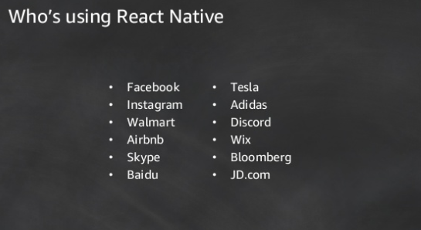
Notes:
Notes to presenter:
Description of what you learned in your own words on one side.
Include information about the topic
Details about the topic will also be helpful here.
Tell the story of your learning experience. Just like a story there should always be a beginning, middle and an end.
On the other side, you can add a graphic that provides evidence of what you learned.
Feel free to use more than one slide to reflect upon your process. It also helps to add some video of your process.

Slide 5
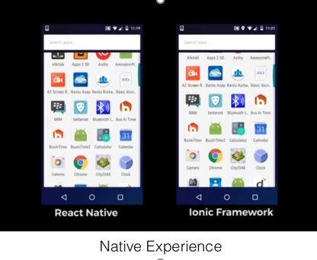
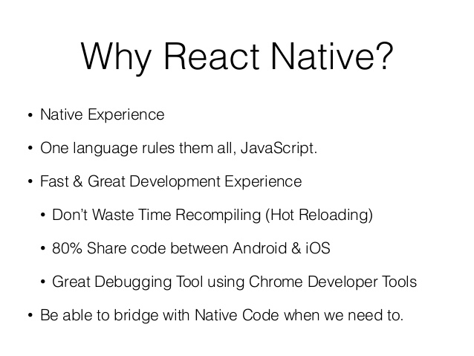
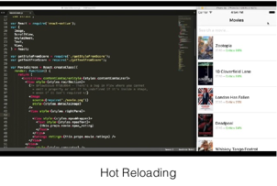
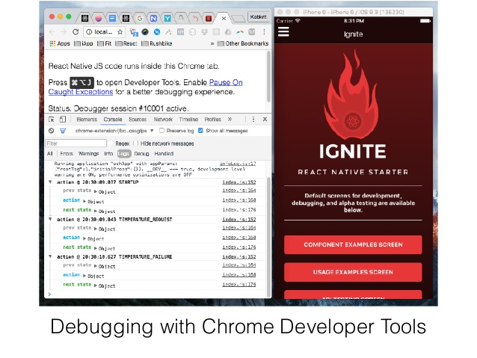
Notes:
Notes to presenter:
Description of what you learned in your own words on one side.
Include information about the topic
Details about the topic will also be helpful here.
Tell the story of your learning experience. Just like a story there should always be a beginning, middle and an end.
On the other side, you can add a graphic that provides evidence of what you learned.
Feel free to use more than one slide to reflect upon your process. It also helps to add some video of your process.

Slide 6
Major Differences between React and React Native
Notes:
Notes to presenter:
What is your purpose for sharing this reflection?
Is it at the end of a unit or project?
Are you sharing this reflection, at the attainment of a learning goal you set for yourself?
Is it at the end of a course?
State your purpose for the reflection or even the purpose of the learning experience or learning goal. Be clear and be specific in stating your purpose.

Slide 7
What to know from React to React Native?
1.Basic Difference: Used for different purposes
ReactJS is a JavaScript library for creating user-interface for large web applications.
- useful for creating dynamic web pages that process data in real-time and can display the changes without needing to reload- like the Facebook/Instagram feed we all love.
React Native is a framework consisting of native libraries for creating mobile applications.
- develop applications for all platforms where the React Native code compiles into native mobile app components.
So, as a simple rule of thumb, ReactJS is for web development and React Native for mobile app development.
Notes:
Notes to presenter:
Description of what you learned in your own words on one side.
Include information about the topic
Details about the topic will also be helpful here.
Tell the story of your learning experience. Just like a story there should always be a beginning, middle and an end.
On the other side, you can add a graphic that provides evidence of what you learned.
Feel free to use more than one slide to reflect upon your process. It also helps to add some video of your process.

Slide 8
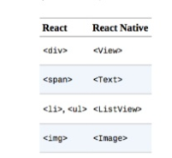
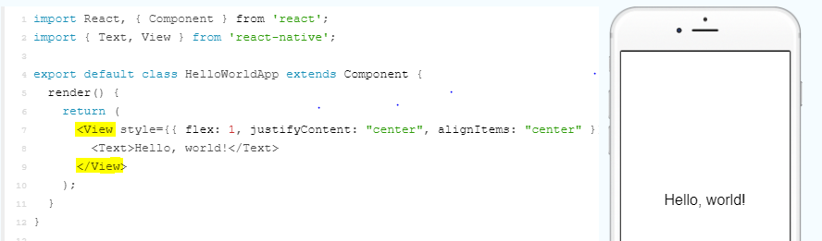
What to know from React to React Native?
2.Other main differences: native components
React Native is like React (also using JSX, components, state, props etc.), but it uses built-in native components(React-Native-specific stuff) instead of web components(virtual DOM) to render UI elements on the page.
Notes:
Notes to presenter:
Description of what you learned in your own words on one side.
Include information about the topic
Details about the topic will also be helpful here.
Tell the story of your learning experience. Just like a story there should always be a beginning, middle and an end.
On the other side, you can add a graphic that provides evidence of what you learned.
Feel free to use more than one slide to reflect upon your process. It also helps to add some video of your process.

Slide 9
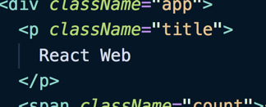

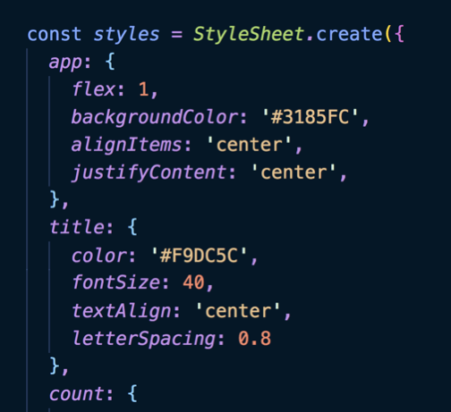
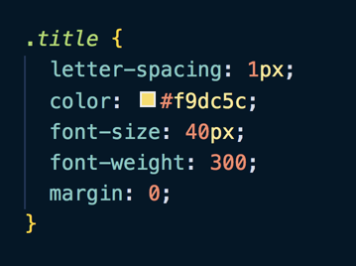
What to know from React to React Native?
3.Other main differences: Styling
Unlike React, the styling of React Native isn’t done with CSS, however syntax is quite similar except that React Native creates a stylesheet object and apply to a component’s style attribute.
VS
Notes:
Notes to presenter:
Description of what you learned in your own words on one side.
Include information about the topic
Details about the topic will also be helpful here.
Tell the story of your learning experience. Just like a story there should always be a beginning, middle and an end.
On the other side, you can add a graphic that provides evidence of what you learned.
Feel free to use more than one slide to reflect upon your process. It also helps to add some video of your process.

Slide 10
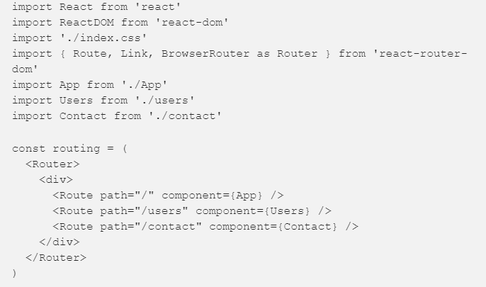
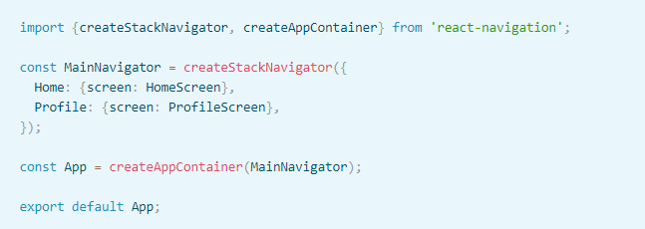
What to know from React to React Native?
4.Other main differences: Navigation
This is one aspect where though both of them take a different approach, Web pages built in ReactJS use React-router for navigation, while React Native has an entirely different library- Navigator from react-navigation to navigate between screens.
VS
Notes:
Notes to presenter:
Description of what you learned in your own words on one side.
Include information about the topic
Details about the topic will also be helpful here.
Tell the story of your learning experience. Just like a story there should always be a beginning, middle and an end.
On the other side, you can add a graphic that provides evidence of what you learned.
Feel free to use more than one slide to reflect upon your process. It also helps to add some video of your process.

Slide 11
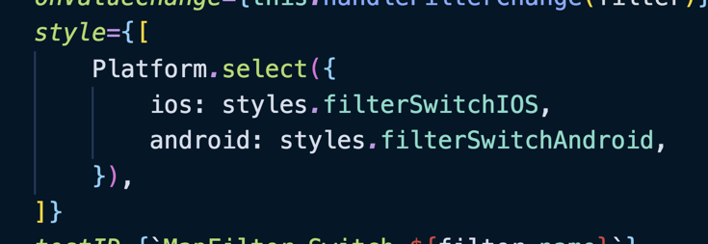
What to know from React to React Native?
4.Other main differences: Platform Specific Code
React Native can detect which platform an application is running on (iOS or Android) and serve a different set of code based on that platform.
Notes:
Notes to presenter:
Description of what you learned in your own words on one side.
Include information about the topic
Details about the topic will also be helpful here.
Tell the story of your learning experience. Just like a story there should always be a beginning, middle and an end.
On the other side, you can add a graphic that provides evidence of what you learned.
Feel free to use more than one slide to reflect upon your process. It also helps to add some video of your process.

Slide 12
Core Concepts in React Native
Notes:
Notes to presenter:
What is your purpose for sharing this reflection?
Is it at the end of a unit or project?
Are you sharing this reflection, at the attainment of a learning goal you set for yourself?
Is it at the end of a course?
State your purpose for the reflection or even the purpose of the learning experience or learning goal. Be clear and be specific in stating your purpose.

Slide 13
Basic React Concepts Used in React Native
JSX: JavaScript XML, an extension for XML-like code for elements and components
Props: Inputs to a React component, data passed down from a parent component to a child component, Unchangeable.
State: Contains data specific to this component that may change over time
Component: Small, reusable pieces of code that return a React element to be rendered
Lifecycle methods: custom functionality that gets executed during the different phases of a component.

Slide 14
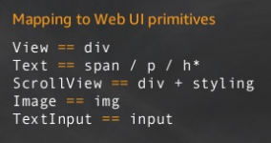
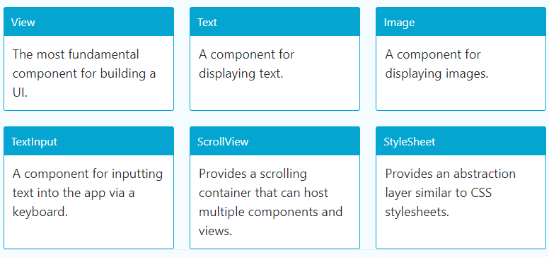
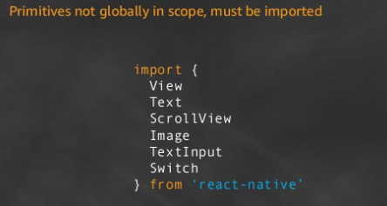
React-Native-specific concept: Basic Components in React Native
Notes:
Notes to presenter:
What did you think at first?
What obstacles did you encounter along the way?
How did you overcome those obstacles?
What images can you add to support your process?
This SmartArt allows you add images and text to help outline your process. If a picture is worth a thousand words, then pictures and words should help you communicate this reflection on learning perfectly! You can always click on Insert>SmartArt to change this graphic or select the graphic and click on the Design contextual menu to change the colors.
Feel free to use more than one slide to reflect upon your process. It also helps to add some video of your process.

Slide 15
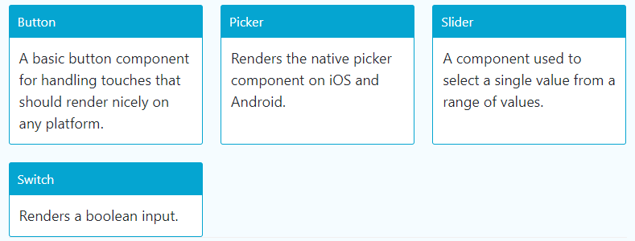
React-Native-specific concept: Components for Rendering User Interface in React Native
To get familiar with the usage of the above and iOS/Android Components and APIs:
https://facebook.github.io/react-native/docs/components-and-apis
Notes:
Notes to presenter:
What did you think at first?
What obstacles did you encounter along the way?
How did you overcome those obstacles?
What images can you add to support your process?
This SmartArt allows you add images and text to help outline your process. If a picture is worth a thousand words, then pictures and words should help you communicate this reflection on learning perfectly! You can always click on Insert>SmartArt to change this graphic or select the graphic and click on the Design contextual menu to change the colors.
Feel free to use more than one slide to reflect upon your process. It also helps to add some video of your process.

Slide 16
Mobile application from a React Native Tutorial
Notes:
Notes to presenter:
What is your purpose for sharing this reflection?
Is it at the end of a unit or project?
Are you sharing this reflection, at the attainment of a learning goal you set for yourself?
Is it at the end of a course?
State your purpose for the reflection or even the purpose of the learning experience or learning goal. Be clear and be specific in stating your purpose.

Slide 17
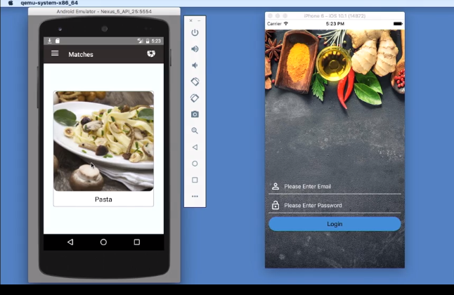
Learning Lynda Tutorial: React Native: Building Mobile Apps
App Description: (called Dinder)
A meal discovery app, where users can dine somewhere, take a picture of their meal and share it, so other users can know how good the dish is that you posted.
Technologies &libraries used for this app:
React Native, Firebase(for storage and authentication),NativeBase (UI component library for RN),MobX (state management library)
Notes:
Notes to presenter:
Description of what you learned in your own words on one side.
Include information about the topic
Details about the topic will also be helpful here.
Tell the story of your learning experience. Just like a story there should always be a beginning, middle and an end.
On the other side, you can add a graphic that provides evidence of what you learned.
Feel free to use more than one slide to reflect upon your process. It also helps to add some video of your process.

Slide 18
What have I learned from the tutorial?
Building and running a react-native app for IOS (Installing all dependencies and setting up on macOS)
Understanding of how a react Native app is structured (the usage of different folders and files)
Creating and connecting the app navigator, app screens and screens’ config store
Getting more familiar with how React Native Specific Components render UI elements on the page and how styling is applied.
Notes:
Notes to presenter:
Description of what you learned in your own words on one side.
Include information about the topic
Details about the topic will also be helpful here.
Tell the story of your learning experience. Just like a story there should always be a beginning, middle and an end.
On the other side, you can add a graphic that provides evidence of what you learned.
Feel free to use more than one slide to reflect upon your process. It also helps to add some video of your process.

Slide 19
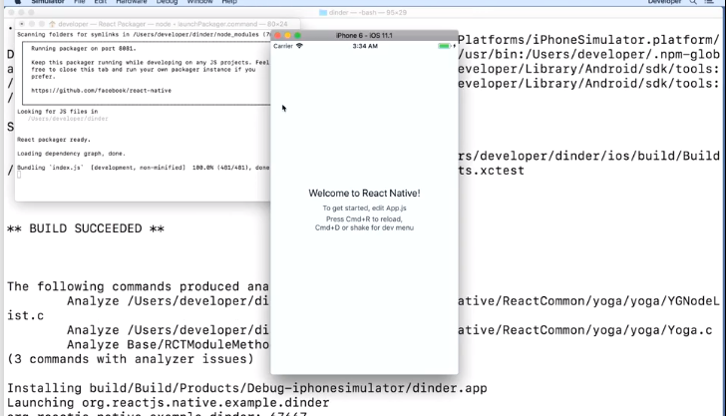
Building and running a react-native app for IOS
Dependencies:
Node, Watchman, the React Native command line interface, and Xcode ( iOS Simulator and all the necessary tools ) on Mac
To build a new project:
react-native init YourProjectName --version X.XX.X
To run react native app:
cd YourProjectName
react-native run-ios
* The above command will automatically run your app on the iOS Simulator by default.

Slide 20
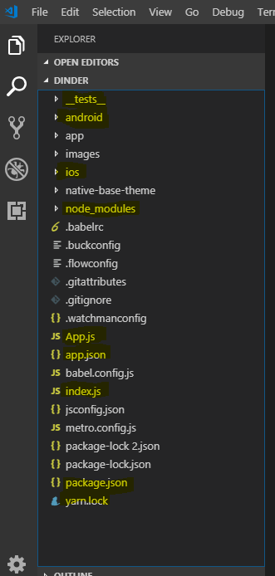
React Native Application File/Folder Structure
App.js - is main entry point to our application
index.js - is where the application gets registered for React Native
android folder - contains all of the Android specific Java
ios folder - contains all the iOS specific swift code
_test_ folder – contains our tests
node_modules - contains all of our dependencies
app.json - contains some React Native specific configuration
package.json - contains our package configuration
yarn.lock - contains all of the versions for all of our dependencies

Slide 21
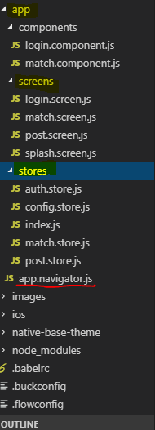
App Navigator, App Screens and Screens’ Config Store
Like many other mobile apps ,the app in the tutorial has more than one screen. In order to navigate between multiple screens, it uses a navigator from react-navigation library for this purpose.
As is shown on the left, under the app folder I created, there is a screens folder which contains all four screens used in the application, and there is a file -app.navigator.js, which sets up a basic shell for navigation, and this navigator component will be called in app.js (entry point to our app)
Under app folder, there is another folder called stores which will hold the information each screen requires, for example, the first screen of the app is a splash screen, and the information for rendering its image and its time will be defined here.
In this app, it uses mobX-react to connect screen with configuration store, how it works? it uses a provider to provide screen components with store in app.js. And uses inject that takes that store and inject it into our class in the screen.

Slide 22
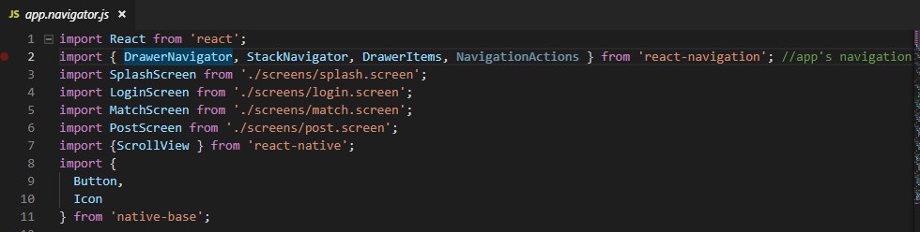
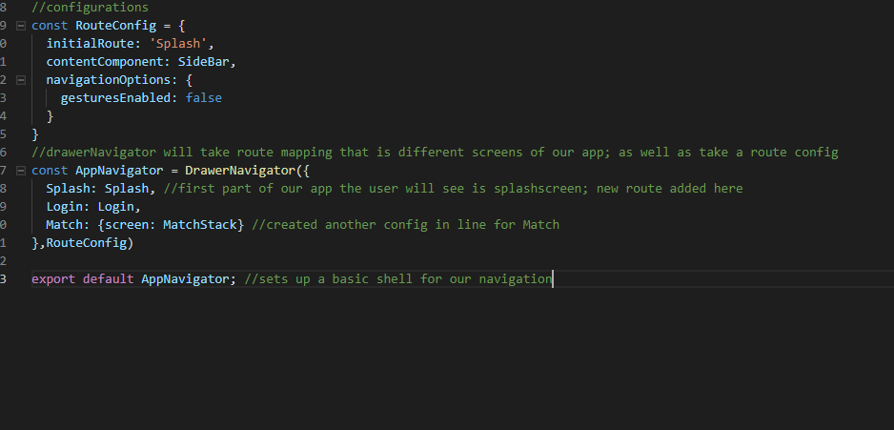
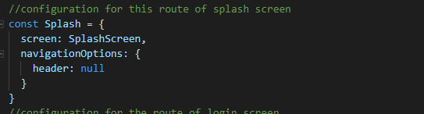
App Navigator, App Screens and Screens’ Config Store
app.navigator.js

Slide 23
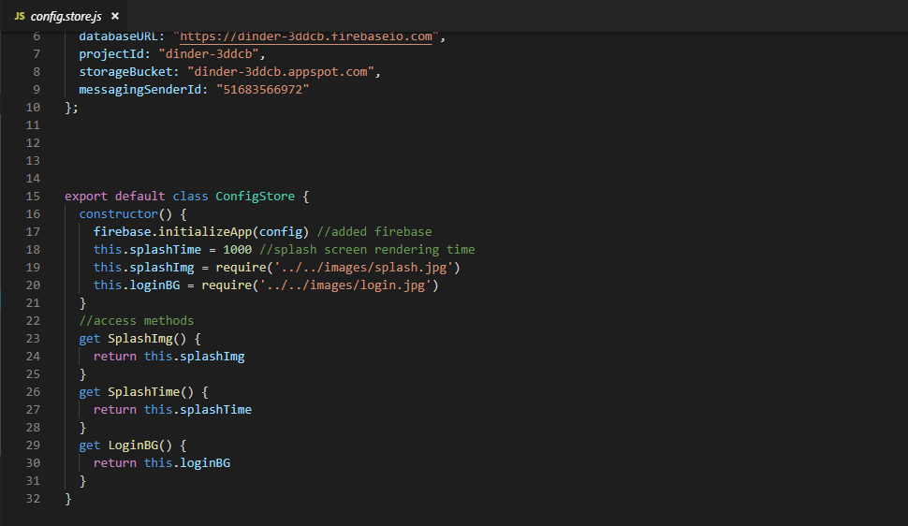
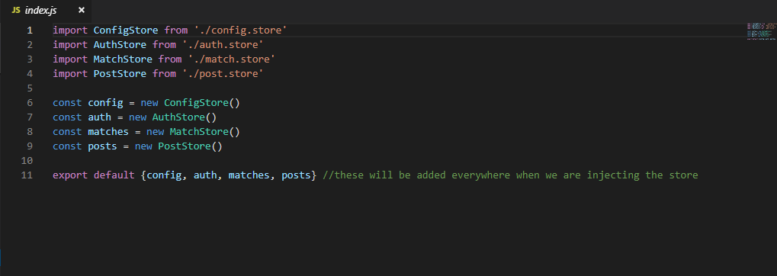
App Navigator, App Screens and Screens’ Config Store
config.store.js in stores folder
index.js in stores folder

Slide 24
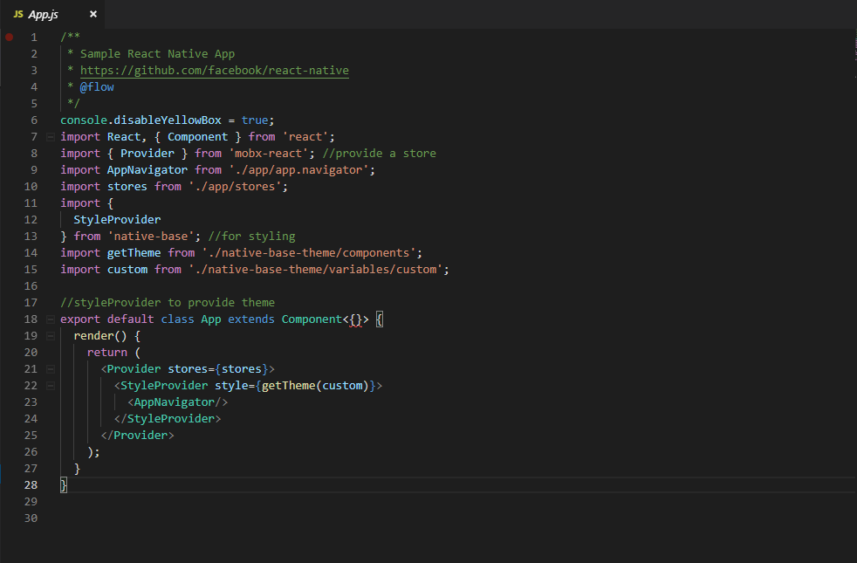
App Navigator, App Screens and Screens’ Config Store
App.js

Slide 25
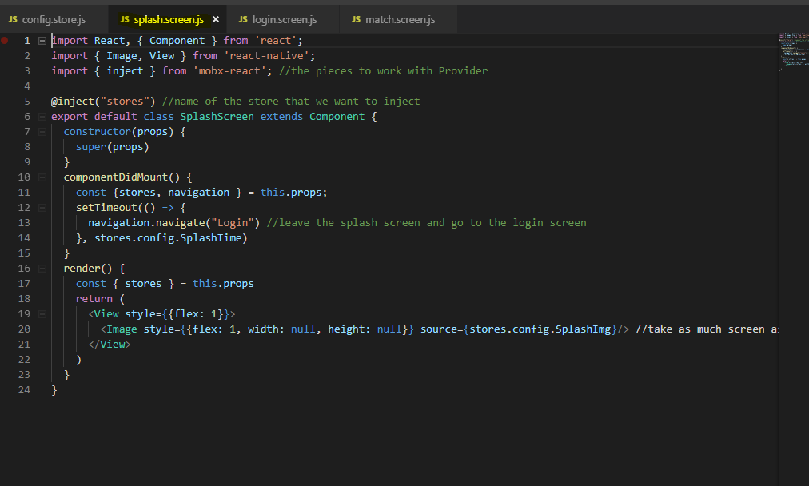
App Navigator, App Screens and Screens’ Config Store
Splash.screen.js

Slide 26
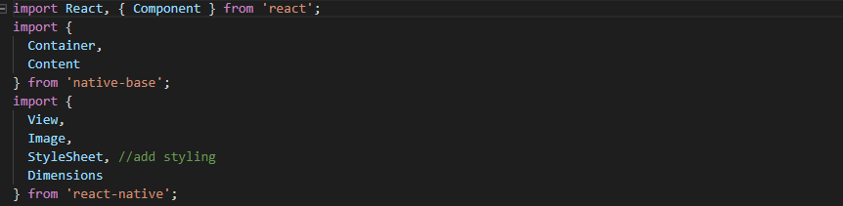
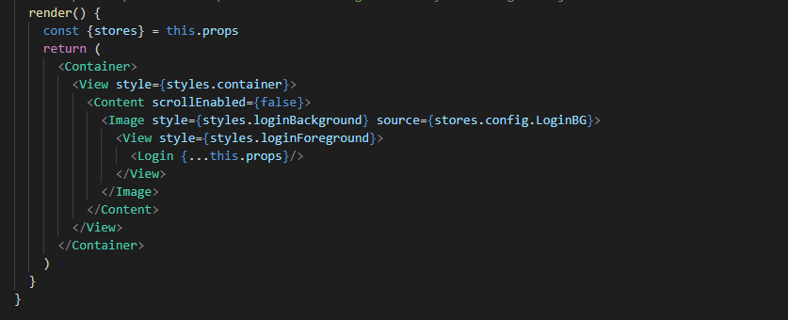
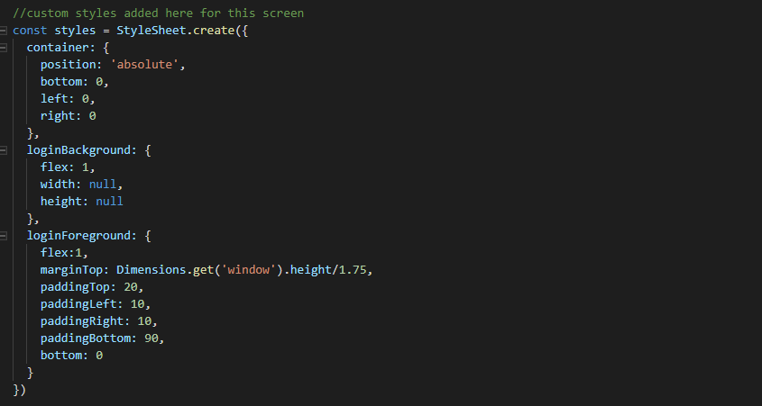
UI Element Rendering and Styling in Login Screen

Slide 27
What are the challenges in learning the tutorial?
React Native has some compatibility issues with its packages and libraries if choosing wrong versions. Had to spend a lot of time in fixing building errors or making changes to the sample code when following the steps in the tutorial.
Some parts of the tutorial are demonstrated very fast and not explained in detail, and it has covered the usage of various technologies and libraries (mobX, Native Base), I need more time to fully understand how it works.
Notes:
Notes to presenter:
Description of what you learned in your own words on one side.
Include information about the topic
Details about the topic will also be helpful here.
Tell the story of your learning experience. Just like a story there should always be a beginning, middle and an end.
On the other side, you can add a graphic that provides evidence of what you learned.
Feel free to use more than one slide to reflect upon your process. It also helps to add some video of your process.

Slide 28
Brief reflection of Learning React Native
Notes:
Notes to presenter:
What is your purpose for sharing this reflection?
Is it at the end of a unit or project?
Are you sharing this reflection, at the attainment of a learning goal you set for yourself?
Is it at the end of a course?
State your purpose for the reflection or even the purpose of the learning experience or learning goal. Be clear and be specific in stating your purpose.

Slide 29
Some of my ideas/suggestions in learning React Native
Familiarity with the basic concepts in React is really important and helps to learn and understand React Native.
Read more React Native documentations before starting online tutorials is suggested. Start with basics and beginner course.
Check out the updates in the new version of react native first when creating a project.
It is worth learning further as react native is a good extension of our previous knowledge in React, which allows us to build the skills of mobile app development.
Notes:
Notes to presenter:
Description of what you learned in your own words on one side.
Include information about the topic
Details about the topic will also be helpful here.
Tell the story of your learning experience. Just like a story there should always be a beginning, middle and an end.
On the other side, you can add a graphic that provides evidence of what you learned.
Feel free to use more than one slide to reflect upon your process. It also helps to add some video of your process.

