Slide 1
Graph Neural Networks NIC LAB Chen-Hao Hsiao

Slide 2
Outline
Graph Neural Networks
GCN
GraphSAGE
GN Block
How powerful are GNNs

Slide 3












What is GNN?
Use graph structure as the NN architecture
B
Layer 1
Layer 2
Layer 3
A
$$σ$$
$$σ$$
$$σ$$
A
A
A
A
C
$$σ$$
$$σ$$
$$σ$$
D
B
B
B
B
$$σ$$
$$σ$$
$$σ$$
C
C
C
C
$$σ$$
$$σ$$
$$σ$$
D
D
D
D

Slide 4
What can GNN do?
Node classification
Graph classification
Edge prediction
Graph Representation Learning

Slide 5
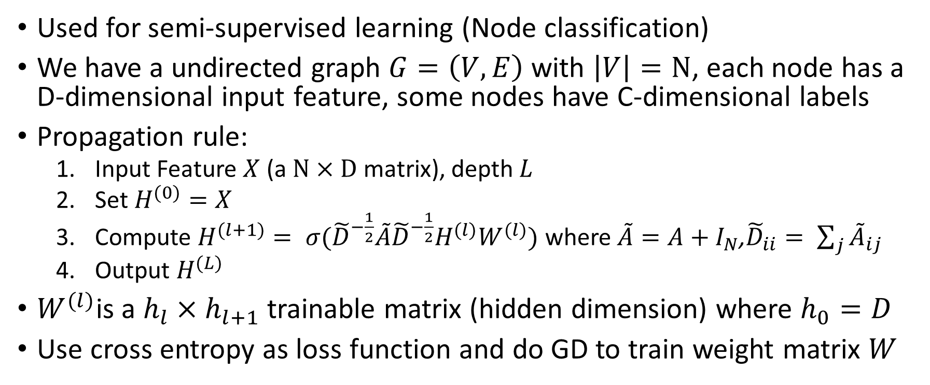
Graph Convolutional Network(GCN)
Used for semi-supervised learning (Node classification)
We have a undirected graph $G=\left(V,E\right)$ with $\left|V\right|=N$, each node has a D-dimensional input feature, some nodes have C-dimensional labels
Propagation rule:
Input Feature $X$ (a $N×D$ matrix), depth $L$
Set $H^{(0)}=X$
Compute $H^{(l+1)}= σ({\tilde{D}}^{−\frac{1}{2}}\tilde{A}{\tilde{D}}^{−\frac{1}{2}}H^{(l)}W^{(l)})$ where$\tilde{A}=A+I_{N}$,${\tilde{D}}_{ii}= \sum_{j}{{\tilde{A}}_{ij}}$
Output $H^{(L)}$
$W^{(l)}$is a $h_{l}×$ $h_{l+1}$ trainable matrix (hidden dimension) where $h_{0}=D$
Use cross entropy as loss function and do GD to train weight matrix $W$

Slide 6
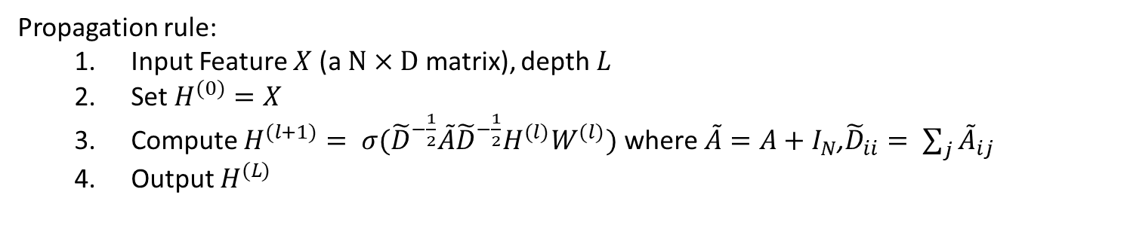
Convolution?
Propagation rule:
Input Feature $X$ (a $N×D$ matrix), depth $L$
Set $H^{(0)}=X$
Compute $H^{(l+1)}= σ({\tilde{D}}^{−\frac{1}{2}}\tilde{A}{\tilde{D}}^{−\frac{1}{2}}H^{(l)}W^{(l)})$ where$\tilde{A}=A+I_{N}$,${\tilde{D}}_{ii}= \sum_{j}{{\tilde{A}}_{ij}}$
Output $H^{(L)}$
Aggregate with neighbors and itself
B
A
A
B
A
C
C
D
A
B
C
D
A
B
C
A
B
C

Slide 7
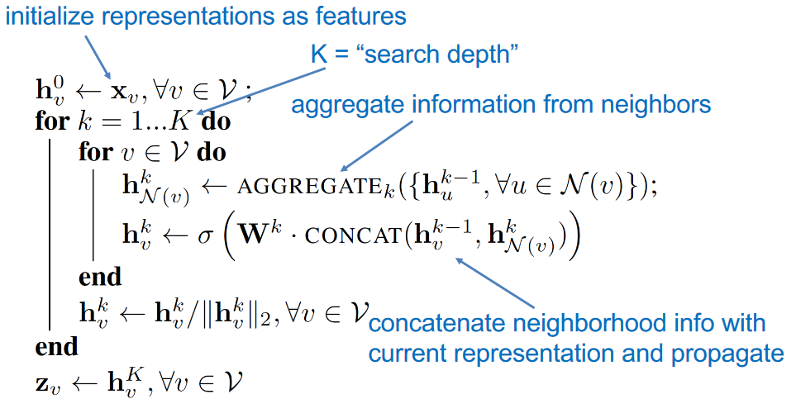









GraphSAGE Algorithm
B
A
C
D
$$σ$$
$$σ$$
$$σ$$
A
A
A
A
Aggregator
$$σ$$
$$σ$$
B
B
B
B
$$σ$$
$$σ$$
C
C
C
C
$$σ$$
$$σ$$
D
D
D
D
Main difference with GCN:
Sampling
Aggregation

Slide 8
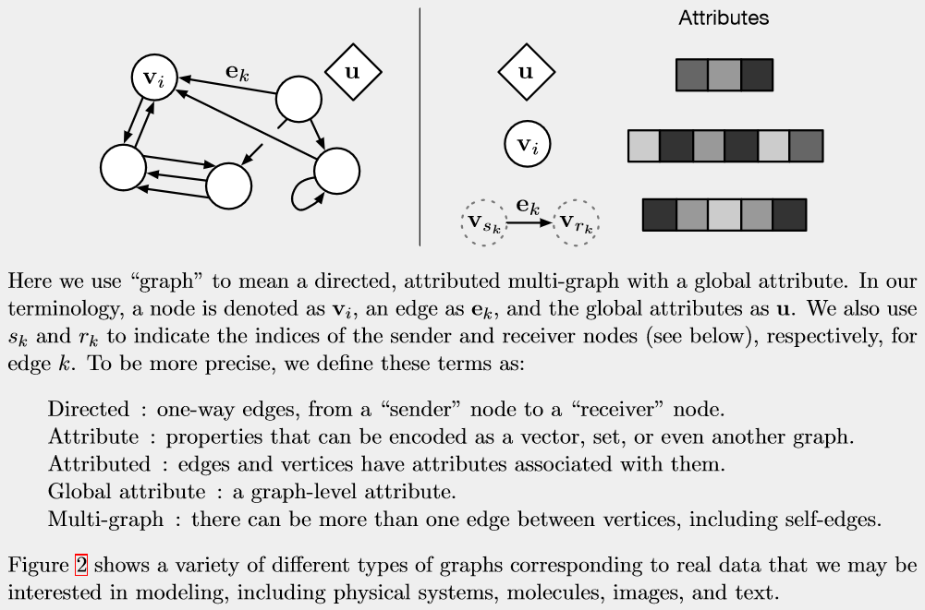
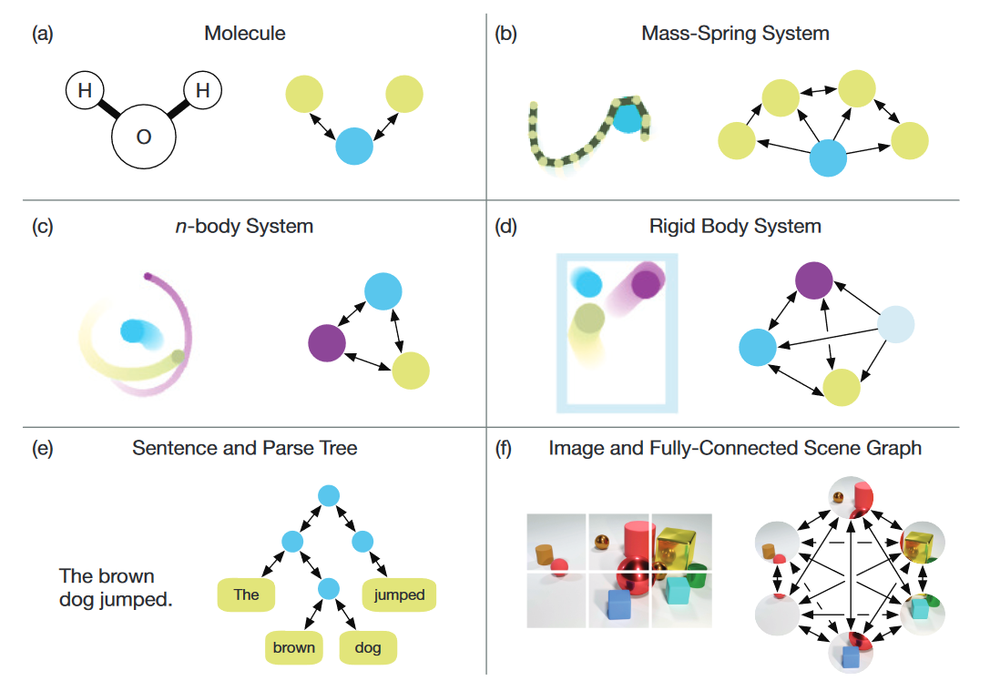
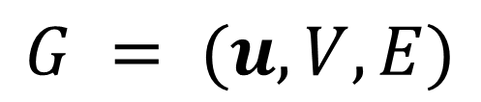
GN-Definition of Graph
$$G = (u,V,E)$$

Slide 9
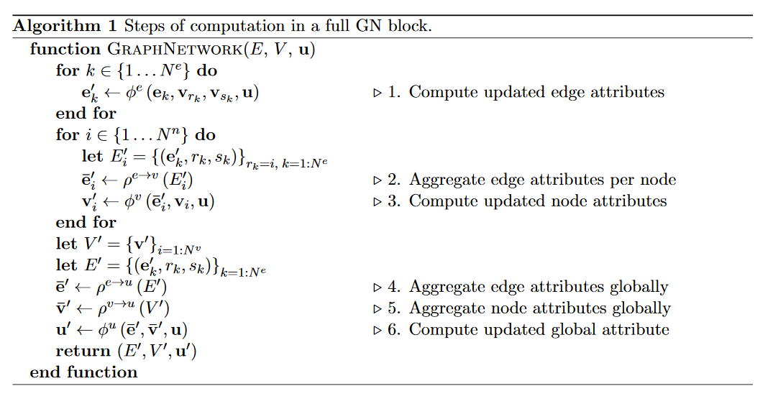
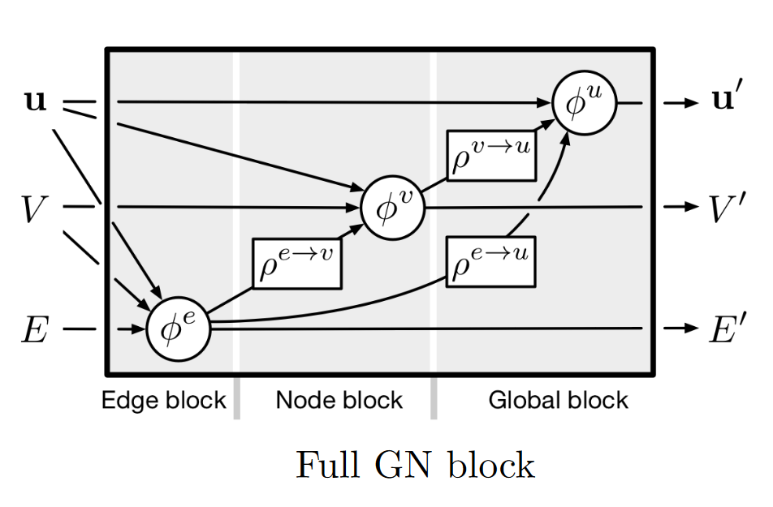
GN-Algorithm
Main Contribution:
GN library

Slide 10

How powerful are GNNs?
From previous examples, modern GNNs follow a neighborhood aggregation strategy:
For graph classification task:
Intuitively, the most powerful GNN maps two nodes to the same location only if they have identical subtree structures with identical features on the corresponding nodes.

Slide 11
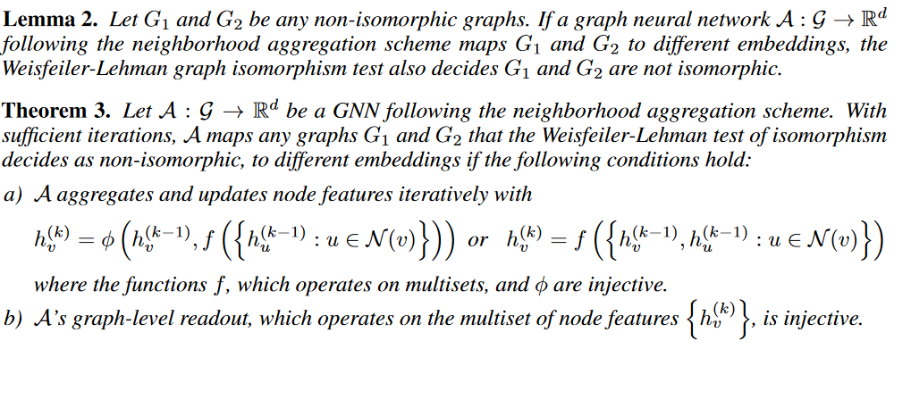
Compare with WL isomorphism test

Slide 12

Approximate the injective function using UAT
So they derived a new message passing method and it is at least good as WL
Notes:
One may ask:
How about GCN and GraphSAGE?

Slide 13
Conclusions
GNN model performs well on many tasks like node classification, edge prediction, graph classification…
There are variants of GNN structure, but modern GNNs follow the aggregation scheme
We can explore more GNN scheme in the future
We can do some theoretical analysis on node classification (semi-supervised learning problem)

Slide 14
References
Kipf, Thomas N., and Max Welling. "Semi-supervised classification with graph convolutional networks." arXiv preprint arXiv:1609.02907 (2016).
Hamilton, Will, Zhitao Ying, and Jure Leskovec. "Inductive representation learning on large graphs." Advances in Neural Information Processing Systems. 2017.
Peter W. Battaglia, et al. " Relational inductive biases, deep learning, and graph networks . " arXiv preprint arXiv:1806.01261
Xu, Keyulu, et al. "How Powerful are Graph Neural Networks?." arXiv preprint arXiv:1810.00826 (2018).
Notes:
One important criterion of graph neural network design is
that the network should map isomorphic graphs to the same
representation and output the same prediction

Slide 15
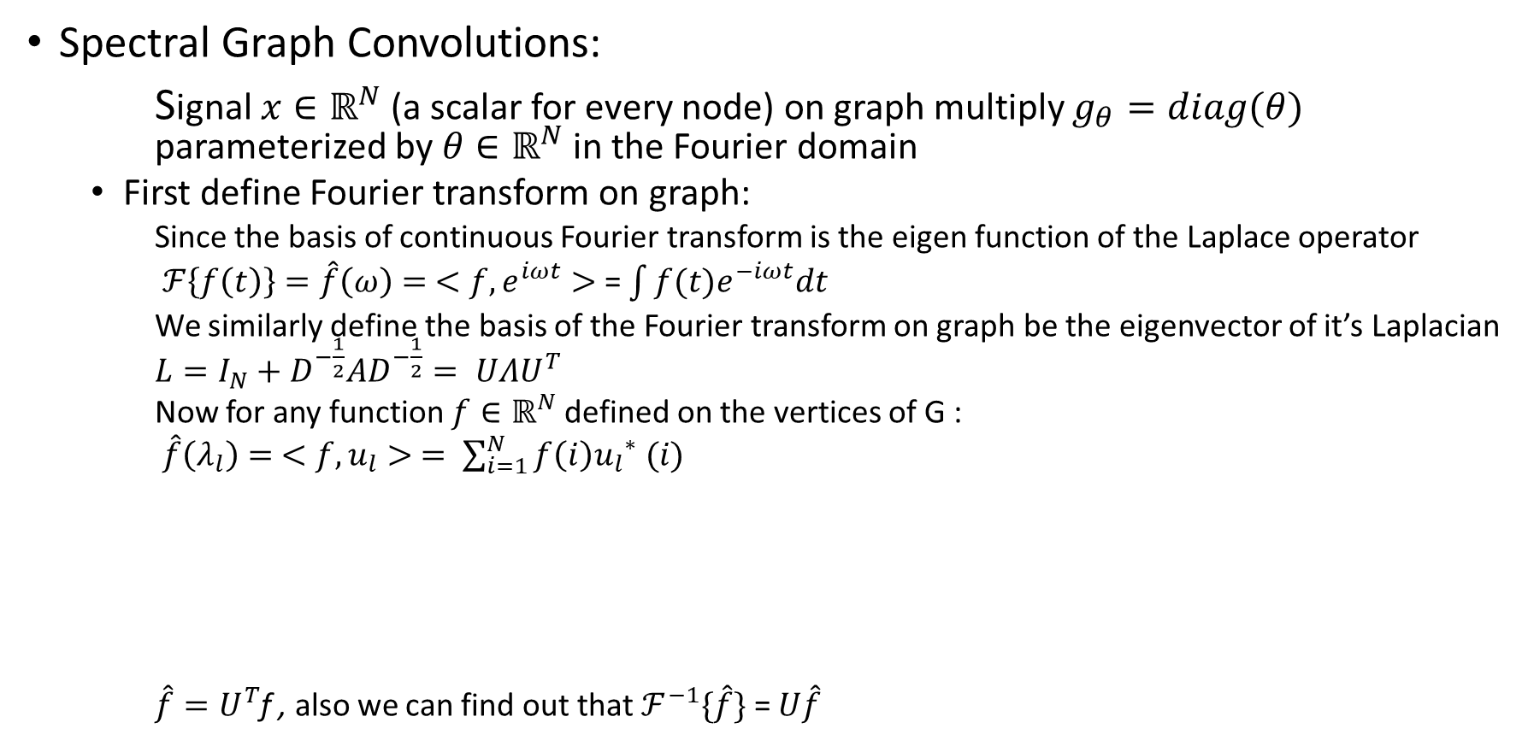
Appendix
Spectral Graph Convolutions:
Signal $x∈ℝ^{N}$ (a scalar for every node) on graph multiply $g_{θ}=diag(θ)$ parameterized by $θ∈ℝ^{N}$ in the Fourier domain
First define Fourier transform on graph:
Since the basis of continuous Fourier transform is the eigen function of the Laplace operator
$ℱ\left\{f\left(t\right)\right\}=\hat{f}\left(ω\right)= <f,e^{iωt}>$ = $\int{f(t)e^{−iωt}dt}$
We similarly define the basis of the Fourier transform on graph be the eigenvector of it’s Laplacian $L=I_{N}+D^{−\frac{1}{2}}AD^{−\frac{1}{2}}= UΛU^{T}$
Now for any function $f∈ℝ^{N}$defined on the vertices of G :
$\hat{f}\left(λ_{l}\right)= <f,u_{l}> = \sum_{i=1}^{N}{f\left(i\right){u_{l}}^{∗} (i)}$
$\hat{f}=U^{T}$f , also we can find out that $ℱ^{−1}\{\hat{f}\}$ = $U\hat{f}$

Slide 16
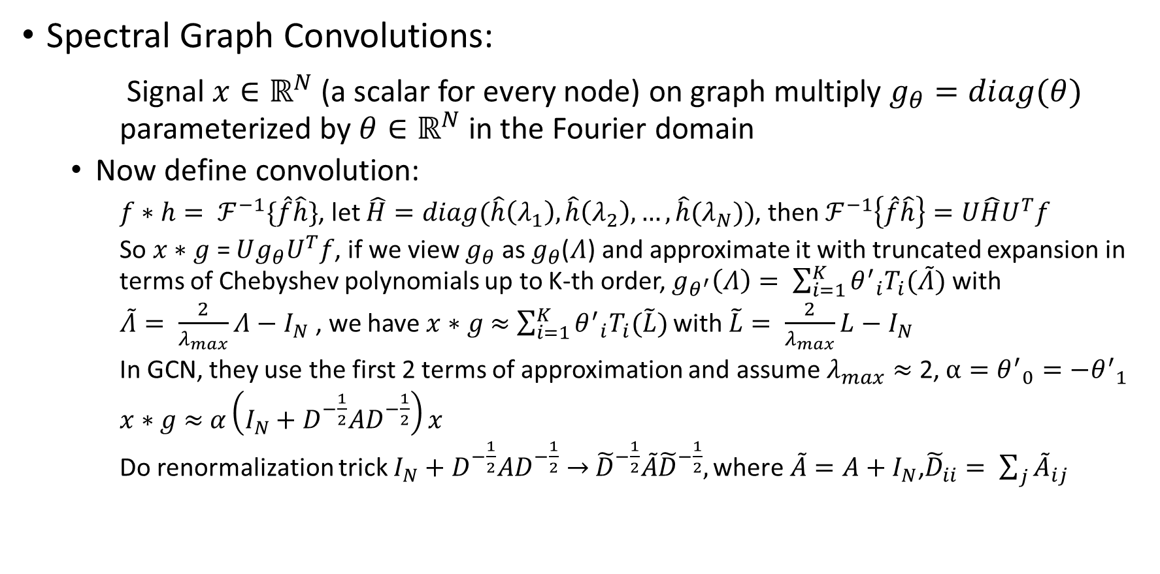
Appendix
Spectral Graph Convolutions:
Signal $x∈ℝ^{N}$ (a scalar for every node) on graph multiply $g_{θ}=diag(θ)$ parameterized by $θ∈ℝ^{N}$ in the Fourier domain
Now define convolution:
$f∗h= ℱ^{−1}\{\hat{f}\hat{h}\}$, let $\hat{H}=diag(\hat{h}\left(λ_{1}\right),\hat{h}\left(λ_{2}\right),…,\hat{h}(λ_{N}))$, then $ℱ^{−1}\left\{\hat{f}\hat{h}\right\}=U\hat{H}U^{T}f$
So $x∗$ $g$ = $Ug_{θ}U^{T}f$, if we view $g_{θ}$ as $g_{θ}$($Λ$) and approximate it with truncated expansion in terms of Chebyshev polynomials up to K-th order, $g_{θ^{′}}\left(Λ\right)= \sum_{i=1}^{K}{{θ^{′}}_{i}T_{i}(\tilde{Λ})}$ with
$\tilde{Λ}= \frac{2}{λ_{max}}Λ−$ $I_{N}$ , we have $x∗$ $g$ $≈$ $\sum_{i=1}^{K}{{θ^{′}}_{i}T_{i}(\tilde{L})}$ with $\tilde{L}= \frac{2}{λ_{max}}L−$ $I_{N}$
In GCN, they use the first 2 terms of approximation and assume $λ_{max}≈$ 2, $α={θ^{′}}_{0}=−{θ^{′}}_{1}$
$x∗$ $g$ $≈$ $α\left(I_{N}+D^{−\frac{1}{2}}AD^{−\frac{1}{2}}\right)x$
Do renormalization trick $I_{N}+D^{−\frac{1}{2}}AD^{−\frac{1}{2}}→$ ${\tilde{D}}^{−\frac{1}{2}}\tilde{A}{\tilde{D}}^{−\frac{1}{2}},\text{where} \tilde{A}=A+I_{N}\text{,} {\tilde{D}}_{ii}= \sum_{j}{{\tilde{A}}_{ij}}$

