Slide 1
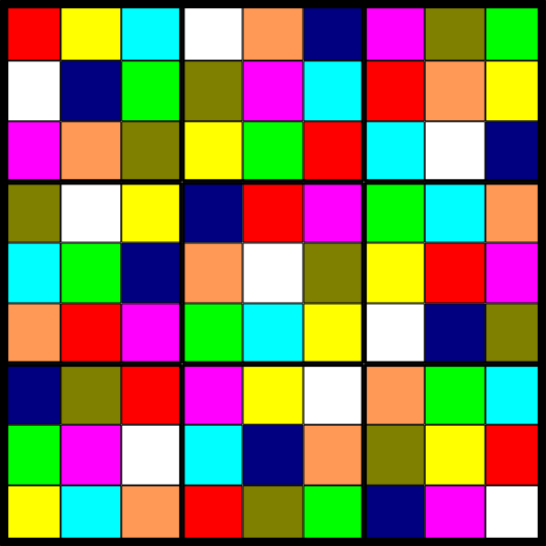
The Mathematics of Sudoku
Joshua Cooper
Department of Mathematics, USC

Slide 2
Rules: Place the numbers 1 through 9 in the 81 boxes, but do not let any number
appear twice in any row, column, or 33 “box”.
Usually you start with a subset of the cells labeled, and try to finish it.
1
6
5
4
3
9
7
2
8
7
8
3
2
6
1
4
5
9
9
2
4
8
5
7
6
1
3
4
7
9
5
2
8
1
3
6
3
1
2
9
4
6
5
8
7
6
5
8
7
1
3
2
9
4
5
9
6
1
8
4
3
7
2
2
3
7
6
9
5
8
4
1
8
4
1
3
7
2
9
6
5

Slide 3
Seemingly innocent question: How many sudoku boards are there?
The same?
We could define a group of symmetries – flips, rotations, color permutations, etc. – and
only count orbits.
Let’s just say that two boards are the same if and only if they agree on every square.
Recast the question as a “hypergraph” coloring problem.

Slide 4
Graph: A set (called “vertices”) and a set of pairs of vertices (called “edges”).
Example. V = {1,2,3,4,5}, E = {{1,2},{2,3},{3,4},{4,5},{1,5},{1,4},{2,4}}.
2
1
3
5
4
Hypergraph: A set (called “vertices”) and a set of sets of vertices (called “edges”
or sometimes “hyperedges”).
If all the edges have the same size k, then the hypergraph is said to be k-uniform.
In particular, a 2-uniform hypergraph is just a graph.

Slide 5
Example of a 3-uniform hypergraph: The “Fano Plane”, V = {1,2,3,4,5,6,7} and
E = {{1,2,4},{2,3,5},{3,4,6},{4,5,7},{5,6,1},{6,7,2},{7,1,3}}.
1
6
2
3
5
7
4
A k-coloring of a graph G is an assignment of one of k colors to the vertices of G
so that no edge has two vertices of the same color.
Alternatively: A k-coloring of a graph G is an assignment of one of k colors to the
vertices of G so that no edge is monochromatic (i.e., has only one color on it).

Slide 6
Typical Graph Coloring Questions:
Does there exists a coloring of G with k colors?
What is the fewest number of colors one can color G with?
(“Chromatic Number”, denoted (G).)
How many colorings are there of G with k colors?
(“Chromatic Polynomial”, often denoted P_{G}(k).)
For hypergraphs, colorings are more complicated. Our previous definitions split!
A strong k-coloring of a hypergraph G is an assignment of one of k colors to each
of the vertices of G so that no edge has two vertices of the same color.
A weak k-coloring of a hypergraph G is an assignment of one of k colors to each
of the vertices of G so that no edge is monochromatic.
(Then there are colorings in which each edges has an even number of colors,
colorings where no edge gets exactly 7 colors, etc.)

Slide 7
Every strong coloring is a weak coloring, but not vice versa:
Weak Chromatic Number = 3
Strong Chromatic Number = 7
Note that any strong coloring of a k-uniform hypergraph must use at least k colors,
since each edge needs at least that many.
What does this have to do with Sudoku?

Slide 8
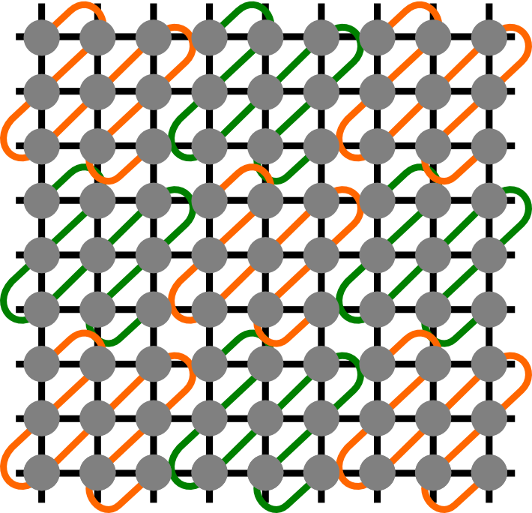
A completed Sudoku is a strong 9-coloring of the following 9-uniform hypergraph H
on 81 vertices:
Removing the
squiggly edges
gives a “Latin
Square.”
A Sudoku puzzle is a partial coloring of H that the player is supposed to complete to
a strong coloring of the entire hypergraph. It is proper if there is exactly one way to
do this.
So, our enumeration question becomes: How many strong colorings of H are there?

Slide 9
Consider 44 generalized Sudoku:
Can we just check all the possible 4-colorings,
and count only those that are strong?
4² = 16 cells, 4 colors, means 4¹⁶ = 4294967296
colorings.
At 10000 a second, it would take 5 days to do this.
But we can cut it down by quite a bit with some cleverness. First of all, it is safe
to fix the upper left block – and then multiply the number of total strong colorings
by 4! = 24, the number of ways to permute the colors.
Now the count is 4¹² = 16777216, which would take 28 minutes to do.

Slide 10
Note that swapping two columns or rows in the same block preserves the property
of being a strong coloring:
This means we can assume that the
yellow square in the lower right block is
in the upper right corner… and then multiply
by 4.
Total number of colorings to check:
4¹¹ = 4194304 = 7 min.

Slide 11
Here’s what we can assume now, and the multiplier is 24·4 = 96.
0 options
96·3 =
1 option
288
2 options

Slide 12
Okay, how about 99 real Sudoku?
Number of colorings : 9⁸¹ = 196627050475552913618075908526912116283103450944214766927315415537966391196809
≈ 2 10⁷⁷
Even if we fix the colors of the upper left block (i.e., divide by 9! = 362880), at 1000000
colorings per second, this would still take 1.7 10⁵⁸ years. (The universe is 13.7 10⁹
years old.)
But, we can permute the rows and
columns of each block…
I
And permute block-rows I, II, and III,
and block-columns, A, B, and C…
II
So, with careful counting, it is possible
to reduce the number of combinatorially
distinct triples of top block-rows to 44.
III
For each one, the number of ways to
complete the table is “reasonable”.
A
B
C

Slide 13
Number | Column 4 | Column 5 | Column 6 | Column 7 | Column 8 | Column 9 | Number of equivalent configurations | Number of completions to a full grid
1 | 1,2,4 | 3,5,7 | 6,8,9 | 1,2,5 | 3,6,7 | 4,8,9 | 2484 | 97961464
2 | 1,2,4 | 3,5,7 | 6,8,9 | 1,2,5 | 3,6,8 | 4,7,9 | 2592 | 97539392
3 | 1,2,4 | 3,5,7 | 6,8,9 | 1,2,5 | 3,6,9 | 4,7,8 | 1296 | 98369440
4 | 1,2,4 | 3,5,7 | 6,8,9 | 1,2,5 | 3,7,8 | 4,6,9 | 1512 | 97910032
5 | 1,2,4 | 3,5,7 | 6,8,9 | 1,2,6 | 3,4,8 | 5,7,9 | 2808 | 96482296
6 | 1,2,4 | 3,5,7 | 6,8,9 | 1,2,6 | 3,4,9 | 5,7,8 | 684 | 97549160
7 | 1,2,4 | 3,5,7 | 6,8,9 | 1,2,6 | 3,5,7 | 4,8,9 | 1512 | 97287008
8 | 1,2,4 | 3,5,7 | 6,8,9 | 1,2,6 | 3,5,8 | 4,7,9 | 1944 | 97416016
9 | 1,2,4 | 3,5,7 | 6,8,9 | 1,2,6 | 3,5,9 | 4,7,8 | 2052 | 97477096
10 | 1,2,4 | 3,5,7 | 6,8,9 | 1,2,7 | 3,4,8 | 5,6,9 | 288 | 96807424
11 | 1,2,4 | 3,5,7 | 6,8,9 | 1,2,7 | 3,5,8 | 4,6,9 | 864 | 98119872
12 | 1,2,4 | 3,5,7 | 6,8,9 | 1,2,8 | 3,4,7 | 5,6,9 | 1188 | 98371664
13 | 1,2,4 | 3,5,7 | 6,8,9 | 1,2,8 | 3,5,7 | 4,6,9 | 648 | 98128064
14 | 1,2,4 | 3,5,7 | 6,8,9 | 1,2,8 | 3,6,9 | 4,5,7 | 2592 | 98733568
15 | 1,2,4 | 3,5,7 | 6,8,9 | 1,3,5 | 2,6,9 | 4,7,8 | 648 | 97455648
16 | 1,2,4 | 3,5,7 | 6,8,9 | 1,3,5 | 2,7,8 | 4,6,9 | 360 | 97372400
17 | 1,2,4 | 3,5,7 | 6,8,9 | 1,3,6 | 2,5,9 | 4,7,8 | 3240 | 97116296
18 | 1,2,4 | 3,5,7 | 6,8,9 | 1,3,8 | 2,6,7 | 4,5,9 | 540 | 95596592
19 | 1,2,4 | 3,5,7 | 6,8,9 | 1,3,8 | 2,6,9 | 4,5,7 | 756 | 97346960
20 | 1,2,4 | 3,5,7 | 6,8,9 | 1,4,5 | 2,6,9 | 3,7,8 | 324 | 97714592
21 | 1,2,4 | 3,5,7 | 6,8,9 | 1,4,5 | 2,7,8 | 3,6,9 | 432 | 97992064
22 | 1,2,4 | 3,5,7 | 6,8,9 | 1,4,6 | 2,3,9 | 5,7,8 | 756 | 98153104

Slide 14
Number | Column 4 | Column 5 | Column 6 | Column 7 | Column 8 | Column 9 | Number of equivalent configurations | Number of completions to a full grid
23 | 1,2,4 | 3,5,7 | 6,8,9 | 1,4,7 | 2,6,9 | 3,5,8 | 864 | 98733184
24 | 1,2,4 | 3,5,7 | 6,8,9 | 1,4,8 | 2,6,9 | 3,5,7 | 108 | 98048704
25 | 1,2,4 | 3,5,7 | 6,8,9 | 1,5,6 | 2,3,9 | 4,7,8 | 756 | 96702240
26 | 1,2,4 | 3,5,8 | 6,7,9 | 1,2,5 | 3,6,8 | 4,7,9 | 516 | 98950072
27 | 1,2,4 | 3,5,8 | 6,7,9 | 1,2,6 | 3,4,8 | 5,7,9 | 576 | 97685328
28 | 1,2,4 | 3,5,8 | 6,7,9 | 1,2,7 | 3,5,8 | 4,6,9 | 432 | 98784768
29 | 1,2,4 | 3,5,8 | 6,7,9 | 1,3,7 | 2,6,9 | 4,5,8 | 324 | 98493856
30 | 1,2,4 | 3,5,8 | 6,7,9 | 1,4,7 | 2,5,8 | 3,6,9 | 72 | 100231616
31 | 1,2,4 | 3,5,8 | 6,7,9 | 1,4,7 | 2,6,9 | 3,7,8 | 216 | 99525184
32 | 1,2,4 | 3,5,8 | 6,7,9 | 1,5,6 | 2,3,7 | 4,8,9 | 252 | 96100688
33 | 1,2,4 | 3,5,9 | 6,7,8 | 1,2,7 | 3,5,6 | 4,8,9 | 288 | 96631520
34 | 1,2,4 | 3,5,9 | 6,7,8 | 1,2,7 | 3,5,9 | 4,6,8 | 864 | 97756224
35 | 1,2,4 | 3,5,9 | 6,7,8 | 1,4,7 | 2,5,8 | 3,6,9 | 216 | 99083712
36 | 1,2,4 | 3,5,9 | 6,7,8 | 1,4,7 | 2,6,8 | 3,5,9 | 432 | 98875264
37 | 1,2,4 | 3,6,9 | 5,7,8 | 1,2,5 | 3,6,9 | 4,7,8 | 216 | 102047904
38 | 1,2,4 | 3,6,9 | 5,7,8 | 1,2,7 | 3,6,9 | 4,5,8 | 144 | 101131392
39 | 1,2,4 | 3,6,9 | 5,7,8 | 1,3,5 | 2,6,7 | 4,8,9 | 324 | 96380896
40 | 1,2,4 | 3,6,9 | 5,7,8 | 1,4,7 | 2,5,8 | 3,6,9 | 108 | 102543168
41 | 1,2,4 | 3,7,9 | 5,6,8 | 1,4,6 | 2,3,9 | 5,7,8 | 12 | 99258880
42 | 1,2,6 | 3,4,8 | 5,7,9 | 1,3,5 | 2,4,9 | 6,7,8 | 20 | 94888576
43 | 1,2,6 | 3,7,8 | 4,5,9 | 1,4,7 | 2,5,8 | 3,6,9 | 24 | 97282720
44 | 1,4,7 | 2,5,8 | 3,6,9 | 1,4,7 | 2,5,8 | 3,6,9 | 4 | 108374976

Slide 15
44
Take Σ (# equivalent configurations)·(# ways to complete the table), i.e., the dot
product of the blue and red columns…
i=1
Then multiply by 1881169920 = 9!·72² (the number of elements in each orbit under
the relevant permutation group), and you get…
6,670,903,752,021,072,936,960.
(6.7 sextillion)
For the details of the reduction, see:
and Frazer, Jarvis, Enumerating Possible Sudoku Grids, 2005.
http://www.afjarvis.staff.shef.ac.uk/sudoku/ed44.html
(If you don’t count two Sudoku tables as different when one can be obtained from
the other by permuting in-block columns, permuting in-block rows, permuting
block-columns, permuting block-rows, permuting colors, rotation, or reflection,
there are exactly 5,472,730,538 different tables.)

Slide 16
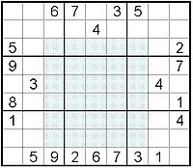
Some Open Questions
1. What is the fewest number of cells in any proper Sudoku puzzle?
Conjecture: 17. As of September 2008, there are 47793 such puzzles known
(Gordon Royle maintains a list), and none with 16 known.
2. How many 1616 Sudoku boards are there?
Conjecture: About 5.9584×10⁹⁸.
3. How many n²n² Sudoku boards are there, asymptotically?
4. What fraction of Latin squares are Sudoku boards?
5. What’s the largest rectangular “hole” in a proper
Sudoku puzzle? (Conjecture: 56.)
Happy Sudokuing!

