Slide 1
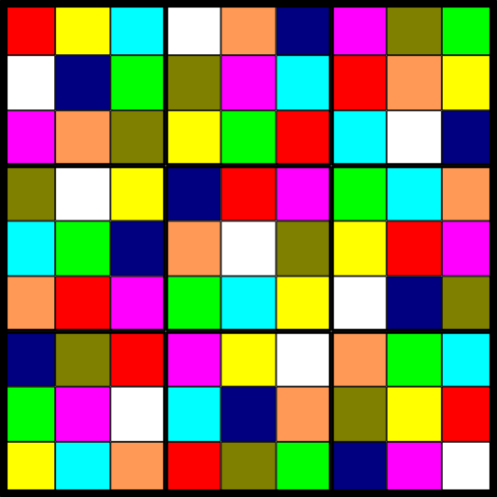
How to Choose a Random Sudoku Board
Joshua Cooper
USC Department of Mathematics

Slide 2
Rules: Place the numbers 1 through 9 in the 81 boxes, but do not let any number
appear twice in any row, column, or 33 “box”.
You start with a subset of the cells labeled, and try to finish it.
1
6
5
4
3
9
7
2
8
7
8
3
2
6
1
4
5
9
9
2
4
8
5
7
6
1
3
4
7
9
5
2
8
1
3
6
3
1
2
9
4
6
5
8
7
6
5
8
7
1
3
2
9
4
5
9
6
1
8
4
3
7
2
2
3
7
6
9
5
8
4
1
8
4
1
3
7
2
9
6
5

Slide 3
A Sudoku puzzle designer has two main tasks:
1. Come up with a board to use as the solution state.
2. Designate some subset of the board’s squares as the initially exposed
numbers (“givens”).
For example:
COLUMN
STACK
1
6
5
4
3
9
7
2
8
1
3
9
7
8
BOX
7
8
3
2
6
1
4
5
9
7
4
BAND
9
2
4
8
5
7
6
1
3
8
5
4
7
9
5
2
8
1
3
6
9
2
8
1
6
ROW
3
1
2
9
4
6
5
8
7
6
5
8
7
1
3
2
9
4
6
8
7
1
2
GIVEN
CELL
5
9
6
1
8
4
3
7
2
8
4
2
3
7
6
9
5
8
4
1
7
1
8
4
1
3
7
2
9
6
5
8
1
3
7
5
BOARD
PUZZLE
We’re going to focus on task #1: How to choose a good Sudoku board?

Slide 4
Not all boards are created equal. Some make lousy puzzles:
1
2
3
4
5
6
7
8
9
4
5
6
7
8
9
1
2
3
7
8
9
1
2
3
4
5
6
2
3
4
5
6
7
8
9
1
5
6
7
8
9
1
2
3
4
8
9
1
2
3
4
5
6
7
3
4
5
6
7
8
9
1
2
6
7
8
9
1
2
3
4
5
9
1
2
3
4
5
6
7
8
It would be preferable to generate random Sudoku boards when designing a puzzle.

Slide 5
Furthermore, there are many mathematical questions one can ask about the
“average” Sudoku board that require that we be able to generate random ones.
For example:
1. How often are the 1 and 2 in the upper-left 3X3 box in the same column?
2. What is the average length of the longest increasing sequence of numbers
that appear in any row?
3. What is the probability that the permutation of {1,…,9} that the first two rows
provide is cyclic?
1
1
6
5
4
3
9
7
2
8
9
7
7
8
3
2
6
1
4
5
9
8
4
1
2
3
4
5
6
7
8
9
6
2
1
2
3
4
5
6
7
8
9
3
5

Slide 6
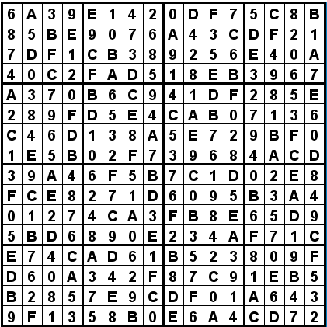
Furthermore, there are many mathematical questions one can ask about the
“average” Sudoku board that require that we be able to generate random ones.
For example:
1. How often are the 1 and 2 in the upper-left 3X3 box in the same column?
2. What is the average length of the longest increasing sequence of numbers
that appear in any row?
3. What is the probability that the permutation of {1,…,9} that the first two rows
provide is cyclic?
4. What about the “generalized Sudoku board”? For example, 16X16:

Slide 7
Furthermore, there are many mathematical questions one can ask about the
“average” Sudoku board that require that we be able to generate random ones.
For example:
1. How often are the 1 and 2 in the upper-left 3X3 box in the same column?
2. What is the average length of the longest increasing sequence of numbers
that appear in any row?
3. What is the probability that the permutation of {1,…,9} that the first two rows
provide is cyclic?
4. What about the “generalized Sudoku board”? For example, 16X16:
In order to get an approximate answer to these questions, one could:
a.) Generate lots of random examples.
b.) Compute the relevant statistic for each of them.
c.) Average the answers.
This general technique is called the “Monte Carlo” method. It is very useful for
mathematical experimentation, and it comes up all the time in applied mathematics
(usually to approximate some sort of integral).

Slide 8
Attempt #1: Fill an empty board with random numbers between 1 and 9. If the
result is not a valid Sudoku board, discard the result and try again.
Problem #1: The chances that a random board is actually a Sudoku board is
about 3 X 10⁻⁵⁶. Even if we could check a trillion examples every
second, it would still take 7 X 10²⁵ times longer than the universe
has been around before we expect to see a single valid board.
Attempt #1b: Each row is actually a permutation (i.e., no number occurs twice), so
generate 9 random permutations until a valid Sudoku board results.
Problem #1: The chances that a random board is actually a Sudoku board is
about 6 X 10⁻²⁹. Again, even if we could check a trillion examples
every second, it would still take 500 billion years before we expect to
see a single valid board.
Attempt #1c: Start with an empty board. Randomly choose an unoccupied location
and fill it with a random number, chosen from among those that can
legally live there.
Problem #1: We may run out of legal moves!
Attempt #1c addendum: Okay, so just start over if you get stuck.
Problem #2: Not every board is equally likely to emerge from this process.
Despite this fact, most board generating software out there uses this
strategy.

Slide 9
Attempt #2: Generate all Sudoku boards and pick one uniformly at random from the
list of all of them.
Problem #1: There are 6,670,903,752,021,072,936,960 (~6.7×10²¹ = 6.7 sextrillion)
different Sudoku boards (Felgenhauer-Jarvis 2005).
Even at 4 bits per symbol, this translates to about 270 billion terabytes
= approx. $18 trillion ($68 per 1TB hard drive, says Google)
= approx. 130% of US annual GDP
Problem #2: This generalizes very poorly to larger boards. (There are about
6×10⁹⁸ 16X16 boards >> number of atoms in the known universe.)

Slide 10
Attempt #3: Generate a list of one representative of each orbit of Sudoku boards
under the natural symmetries: rotation, transposition, permuting symbols,
permuting rows within a horizontal band, permuting columns within a
vertical band, permuting horizontal bands, and permuting vertical bands.

Slide 11
Attempt #3: Generate a list of one representative of each orbit of Sudoku boards
under the natural symmetries: rotation, transposition, permuting symbols,
permuting rows within a horizontal band, permuting columns within a
vertical band, permuting horizontal bands, and permuting vertical bands.
The operations:
1. Permuting the rows and
columns of each band/stack (X 3!⁶)
2. Permuting bands I, II, and III, and
and stacks A, B, and C (X 3!²)
I
3. Permuting the numbers/colors (X 9!)
II
III
A
B
C

Slide 12
Attempt #3: Generate a list of one representative of each orbit of Sudoku boards
under the natural symmetries: rotation, transposition, permuting symbols,
permuting rows within a horizontal band, permuting columns within a
vertical band, permuting horizontal bands, and permuting vertical bands.
The operations:
1. Permuting the rows and
columns of each band/stack (X 3!⁶)
2. Permuting bands I, II, and III,
and stacks A, B, and C (X 3!²)
I
3. Permuting the numbers/colors (X 9!)
II
4. Rotating the board (X 2)
III
A
B
C

Slide 13
Attempt #3: Generate a list of one representative of each orbit of Sudoku boards
under the natural symmetries: rotation, transposition, permuting symbols,
permuting rows within a horizontal band, permuting columns within a
vertical band, permuting horizontal bands, and permuting vertical bands.
The operations:
1. Permuting the rows and
columns of each band/stack (X 3!⁶)
2. Permuting bands I, II, and III,
and stacks A, B, and C (X 3!²)
I
3. Permuting the numbers/colors (X 9!)
II
4. Rotating the board (X 2)
generate a group of order
1,218,998,108,160.
III
A
B
C
The number of orbits of this group (i.e., the number of “truly distinct” boards)
= 5,472,706,619.

Slide 14
Attempt #3: Generate a list of one representative of each orbit of Sudoku boards
under the natural symmetries: rotation, transposition, permuting symbols,
permuting rows within a horizontal band, permuting columns within a
vertical band, permuting horizontal bands, and permuting vertical bands.
Problem #1: You can’t just pick a uniformly random choice of orbit: some orbits are
bigger than others. In fact, you have to choose them with probability
proportional to their sizes. This means doing a big computation using
“Burnside’s Lemma.”
Problem #2: Again, this scales very poorly. The number of orbits for the 16X16
board is approximately 2.25 × 10⁷¹. Still ridiculously large.
Attempt #4: Start with some Sudoku board and make small, random changes for a
while. The result should be close to uniformly random.
This general strategy is known as a “random walk” or “Markov chain.” When paired
with Monte-Carlo type calculations, we have “Markov Chain Monte Carlo”, or MCMC.

Slide 15
Why is it called a “random walk”?

Slide 16
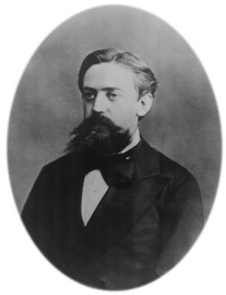
Why is it called a “random walk”?
Why is it called a “Markov chain”?
Andrey Markov
(Андрей Андреевич Марков)
1856 – 1922

Slide 17
Consider the 4X4 case (there are 288 boards, but only 2 essentially distinct ones!)
1
2
3
4
1
2
3
4
3
4
1
2
3
4
1
2
2
3
4
1
2
1
4
3
4
1
2
3
4
3
2
1
What “small changes” can we make to get between them?

Slide 18
Consider the 4X4 case (there are 288 boards, but only 2 essentially distinct ones!)
1
2
3
4
1
2
3
4
3
4
1
2
3
4
1
2
2
3
4
1
2
1
4
3
4
1
2
3
4
3
2
1
What “small changes” can we make to get between them?
1
2
2
3
4
2
1
3
4
2
1
3
4
3
4
1
2
3
4
1
2
3
4
1
2
2
3
4
1
1
3
4
1
1
3
4
2
4
1
2
3
4
1
2
3
4
2
2
3

Slide 19
1
2
2
3
4
2
1
3
4
2
1
3
4
3
4
1
2
3
4
1
2
3
4
1
2
2
3
4
1
1
3
4
1
1
3
4
2
4
1
2
3
4
1
2
3
4
2
2
3

Slide 20
1
2
2
3
4
2
1
3
4
2
1
3
4
3
4
1
2
3
4
1
2
3
4
1
2
2
3
4
1
1
3
4
1
1
3
4
2
4
1
2
3
4
1
2
3
4
2
2
3
2
1
3
4
2
1
3
4
3
4
2
1
3
4
1
1
1
3
4
2
1
3
4
2
4
2
1
3
4
2
1
3
All we did was relabel the board by switching 1’s and 2’s!

Slide 21
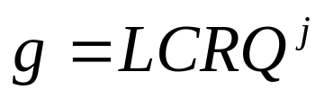
1
2
3
4
3
2
3
4
3
2
1
4
3
4
1
2
3
4
1
2
1
4
1
2
2
3
4
1
2
3
4
1
2
3
4
1
4
1
2
3
4
1
2
3
4
1
2
3
Prop. If the sequence of moves terminates
before reaching every vertex, the result is a
truly different sudoku board.
3
2
1
4
Proof. Let G be the group of Latin square isotopies:
the group generated by relabelings, rotations, and
all row and column permutations (not just in-band or
in-stack).
1
4
3
2
2
3
4
1
4
1
2
3
It’s not hard to see that each element g of G can be factored uniquely into a
product of a relabeling L, a column permutation C, a row permutation R, and
(possibly) a quarter-turn Q:
where j = 0 or 1.

Slide 22
Note that the Sudoku isotopy group G₀ is a subgroup of G.
Suppose that g in G₀ exchanges some reds and blues, but not all – and otherwise
fixes the content of every cell.
Write g as
By permuting rows and columns to group together cycles of reds and blues, we get
that the action of g looks something like:
g
Suppose j = 0. Whether or not L flips the colors red and blue, some one of these
cycles is flipped, while another is not.

Slide 23
o
n
m
c
b
a
f
e
d
a
b
c
h
g
j
d
e
f
k
l
i
j
g
h
k
l
i
b
c
f
m
n
o
e
h
o
n
i
n
l
d
m
a
o
g
The sequence of row and column permutations required to flip the colors either
reverses rows or columns.
Therefore, the relabeling L must permute symbols a—o.
But this changes the contents of other cells – a contradiction.
It’s easy to check the j = 1 case as well (and deal with the cases
where the cycles are only 4 or 6 in length).

Slide 24
But, does every Sudoku board have a cycle that terminates “early”?
To restate: Define a graph H on the set of cells with a complete subgraph in each
row, column, and box. Color vertices according to the contents of the cells.
Define H_{ij} to be the subgraph of H induced by vertices of color i and j.
Conjecture: For any Sudoku board, there are an i and a j so that H_{ij} is disconnected.

Slide 25
But, does every Sudoku board have a cycle that terminates “early”?
To restate: Define a graph H on the set of cells with a complete subgraph in each
row, column, and box. Color vertices according to the contents of the cells.
Define H_{ij} to be the subgraph of H induced by vertices of color i and j.
Conjecture: For any Sudoku board, there are an i and a j so that H_{ij} is disconnected.
Question: Can one get from any Sudoku board to any other via a sequence of such
moves? (If so, then this MCMC strategy will work!)

Slide 26
Attempt #5: Relax a linear program. Use the edges of the resulting polytope as
the “moves” to make in the random walk.
Write x_{ijk} for a variable that indicates whether or not cell (i, j) is occupied by color k.
(So x_{ijk} = 1 if so, x_{ijk} = 0 if not.)
Then, letting i, j, and k vary over {1,…,9} we have the following constraints that
describe a valid Sudoku board.

Slide 27
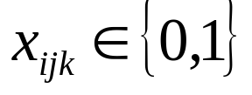
Attempt #5: Relax a linear program. Use the edges of the resulting polytope as
the “moves” to make in the random walk.
Write x_{ijk} for a variable that indicates whether or not cell (i, j) is occupied by color k.
(So x_{ijk} = 1 if so, x_{ijk} = 0 if not.)
Then, letting i, j, and k vary over {1,…,9} we have the following constraints that
describe a valid Sudoku board.

Slide 28
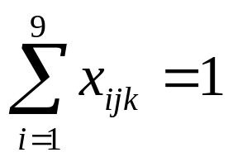
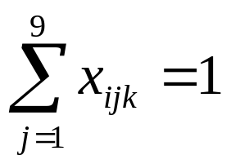

Attempt #5: Relax a linear program. Use the edges of the resulting polytope as
the “moves” to make in the random walk.
Write x_{ijk} for a variable that indicates whether or not cell (i, j) is occupied by color k.
(So x_{ijk} = 1 if so, x_{ijk} = 0 if not.)
Then, letting i, j, and k vary over {1,…,9} we have the following constraints that
describe a valid Sudoku board.
for j,k = 1,…,9
for i,k = 1,…,9
for i, j = 1,…,9

Slide 29
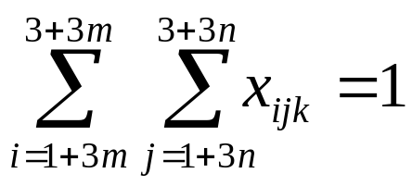
Attempt #5: Relax a linear program. Use the edges of the resulting polytope as
the “moves” to make in the random walk.
Write x_{ijk} for a variable that indicates whether or not cell (i, j) is occupied by color k.
(So x_{ijk} = 1 if so, x_{ijk} = 0 if not.)
Then, letting i, j, and k vary over {1,…,9} we have the following constraints that
describe a valid Sudoku board.
for j,k = 1,…,9
for i,k = 1,…,9
for i, j = 1,…,9
for m,n = 0,1,2; k = 1,…,9
The set of these equations defines an integer program, the set of whose solutions
correspond exactly to valid Sudoku boards.

Slide 30
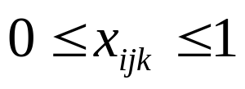
Attempt #5: Relax a linear program. Use the edges of the resulting polytope as
the “moves” to make in the random walk.
Write x_{ijk} for a variable that indicates whether or not cell (i, j) is occupied by color k.
(So x_{ijk} = 1 if so, x_{ijk} = 0 if not.)
Then, letting i, j, and k vary over {1,…,9} we have the following constraints that
describe a valid Sudoku board.
for j,k = 1,…,9
for i,k = 1,…,9
for i, j = 1,…,9
for m,n = 0,1,2; k = 1,…,9
The set of these equations defines an integer program, the set of whose solutions
correspond exactly to valid Sudoku boards.
If we “relax” the first constraint, the result is a linear program, the set of whose
solutions include all valid Sudoku boards.

Slide 31
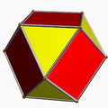
Note that there are indeed solutions to the linear program which are not solutions to
the integer program. For example, set x_{ijk} = 1/9 for all i, j, and k.
The set of solutions (which lives in 729-dimensional space, since there are 9X9X9
variables x_{ijk}) is a “polytope”, the higher-dimensional analogue of 2-D polygons and 3-D polyhedra.
?

Slide 32
All valid Sudoku boards lie at vertices of this polyhedron.
Each vertex is connected to some other vertices via edges of the polyhedron.
Using standard linear programming techniques, it is not hard to compute these
“neighboring” vertices.
If we take a random walk along the resulting (automatically connected) graph, we have MCMC!
Problem #1: Are there any other vertices than “proper” Sudoku boards?
Problem #2: What is the diameter and expansion constant of the resulting graph?
In other words, how long must one wander around the graph to ensure something
close to a uniform distribution?
Interested in studying any of these questions?
Email me at cooper@math.sc.edu.

