Slide 1
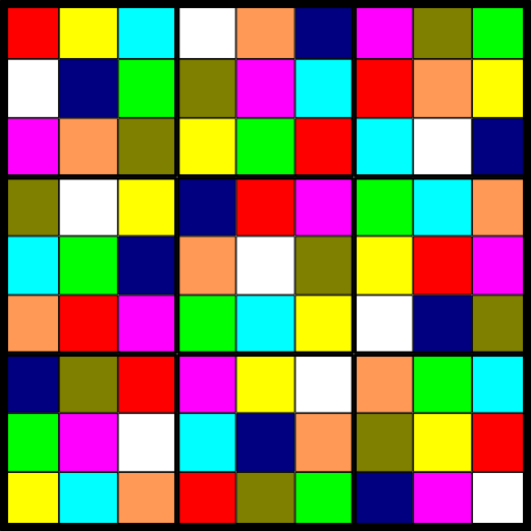
Playing Fair at Sudoku
Joshua Cooper
USC Department of Mathematics

Slide 2
Rules: Place the numbers 1 through 9 in the 81 boxes, but do not let any number
appear twice in any row, column, or 33 “box”.
You start with a subset of the cells labeled, and try to finish it.
1
6
5
4
3
9
7
2
8
7
8
3
2
6
1
4
5
9
9
2
4
8
5
7
6
1
3
4
7
9
5
2
8
1
3
6
3
1
2
9
4
6
5
8
7
6
5
8
7
1
3
2
9
4
5
9
6
1
8
4
3
7
2
2
3
7
6
9
5
8
4
1
8
4
1
3
7
2
9
6
5

Slide 3
A Sudoku puzzle designer has two main tasks:
1. Come up with a board to use as the solution state.
2. Designate some subset of the board’s squares as the initially exposed
numbers (“givens”).
For example:
COLUMN
STACK
1
6
5
4
3
9
7
2
8
1
3
9
7
8
BOX
7
8
3
2
6
1
4
5
9
7
4
BAND
9
2
4
8
5
7
6
1
3
8
5
4
7
9
5
2
8
1
3
6
9
2
8
1
6
ROW
3
1
2
9
4
6
5
8
7
6
5
8
7
1
3
2
9
4
6
8
7
1
2
GIVEN
CELL
5
9
6
1
8
4
3
7
2
8
4
2
3
7
6
9
5
8
4
1
7
1
8
4
1
3
7
2
9
6
5
8
1
3
7
5
BOARD
PUZZLE
We’re going to focus on task #1: How to choose a “fair” Sudoku board?

Slide 4
For a Sudoku puzzle, i.e., a set of givens, to be “fair”, it must have two properties:
1. It has a solution. (Solvability)
2. There is only one solution. (Uniqueness)
Question: What is the fewest number of givens in a fair puzzle?
Possible solution (“Brute Force”):
1. Enumerate all possible sets of givens.
2. Check each one to see if it is solvable.
3. Check the solvable ones to see if they are unique.
4. Count up the number of givens in the smallest uniquely solvable
puzzle, and output the minimum such number.

Slide 5
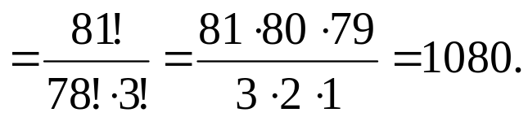
Why Brute Force Is Impractical:
1. Enumerate all possible sets of givens.
With 81 cells, there are 2⁸¹ ≈ 2.4 ∙ 10²⁴ sets of cells one could fill in.
Actually, the situation is even worse, because we have 9 options for the contents of
each cell. That means a total number
of possible sets of givens.
1 + 9 ∙ 81 + 9² ∙ ( ) + 9³ ∙ ( ) + … + 9⁸⁰ ∙ ( ) + 9⁸¹ ∙ ( )
81
81
81
81
2
3
80
81
“81 choose 3” = the number of
ways to choose 3 objects from
a collection of 81

Slide 6
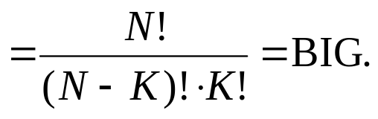
Why Brute Force Is Impractical:
1. Enumerate all possible sets of givens.
With 81 cells, there are 2⁸¹ ≈ 2.4 ∙ 10²⁴ sets of cells one could fill in.
Actually, the situation is even worse, because we have 9 options for the contents of
each cell. That means a total number
of possible sets of givens.
1 + 9 ∙ 81 + 9² ∙ ( ) + 9³ ∙ ( ) + … + 9⁸⁰ ∙ ( ) + 9⁸¹ ∙ ( )
81
81
81
81
2
3
80
81
“N choose K” = the number of
ways to choose K objects from
a collection of N

Slide 7
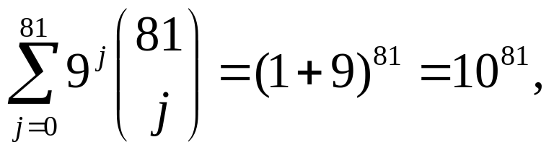
Why Brute Force Is Impractical:
1. Enumerate all possible sets of givens…
With 81 cells, there are 2⁸¹ ≈ 2.4 ∙ 10²⁴ sets of cells one could fill in.
Actually, the situation is much worse, because we have 9 options for the contents of
each cell. That means a total number
of possible sets of givens.
1 + 9 ∙ 81 + 9² ∙ ( ) + 9³ ∙ ( ) + … + 9⁸⁰ ∙ ( ) + 9⁸¹ ∙ ( )
81
81
81
81
2
3
80
81
By the Binomial Theorem,
which is approximately the number of atoms in the observable universe.

Slide 8
Let’s be a little smarter about this…
1. Enumerate all sets of 81 givens, and if a uniquely satisfiable puzzle is
found, enumerate all sets of 80 givens, and if a uniquely satisfiable
puzzle is found, enumerate all sets of 79 givens…
In fact, we can start much lower than 81, since there are many uniquely satisfiable
puzzles known with fewer than 81 givens.
Indeed, there are uniquely satisfiable puzzles known which have only 17 givens.
1
4
2
5
4
7
8
3
1
9
3
4
2
5
1
8
6
Gordon Royle has compiled a list of 49151 (!) inequivalent ones at:
http://mapleta.maths.uwa.edu.au/~gordon/sudokumin.php

Slide 9
What does it mean for two Sudoku boards/puzzles to be equivalent?
Two boards are considered equivalent if it is possible to transform one into the other
by a sequence of operations of the form:
1. Permuting the rows and
columns of each band/stack (X 3!⁶)
2. Permuting bands I, II, and III, and
and stacks A, B, and C (X 3!²)
I
3. Permuting the numbers/colors (X 9!)
II
This generates a group of 3,359,232
different possible operations.
III
A
B
C

Slide 10
So, start with 16 givens:
1. Enumerate all sets of 16 givens…
How many such sets are there?
81
9¹⁶ ∙ ( ) ≈ 6.22 ∙ 10³¹
16
It would be silly to look at all of these, though:
1. We can rule out anything that has two of the same symbol in any
column, row, or box.
2. Once we examine one, we don’t have to look at all the ones equivalent
to it.
By what factor does each of these reduce the number of sets to examine?
Effect of #1: This is nearly impossible to compute exactly, so we Poissonize: pretend
as if each cell “turns on” with probability 16/81, and then chooses a number 1 through
9 uniformly at random.

Slide 11
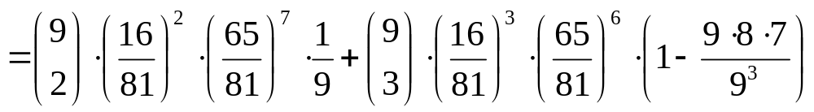
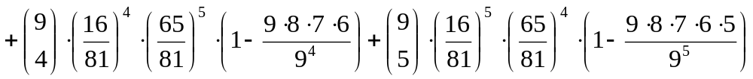
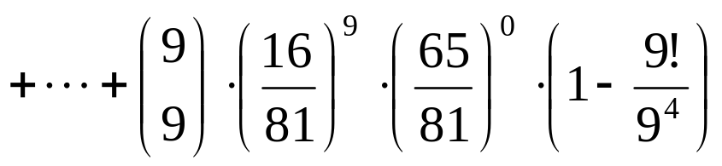
Probability that two cells in the same row get turned on and set to the same number =
= Pr(exactly 2 cells get turned on and they are set to the same number) +
Pr(exactly 3 cells get turned on and at least 2 are set to the same number) +
Pr(exactly 9 cells get turned on and at least 2 are set to the same number)
= 0.135469925561528…
Thanks, SAGE!

Slide 12
Probability that no two cells in the same row get turned on and set to the same number:
= 1 - 0.135469925561528… = 0.864530074438472…
Probability that no two cells in any row get turned on and set to the same number:
= (0.864530074438472…)⁹ = 0.269786958…
Probability that no two cells in any row, column, or box get turned on and set to the same number:
≈ 0.269786958…³ = 0.0196364445…
Approximate total number of inequivalent configurations of 16 non-conflicting givens:
6.22 ∙ 10³¹ ∙ 0.0196364445 / 3359232 ≈ 3.64 × 10²³
Still way too big.
Even if we could enumerate all of these, and even if we knew how to generate a list of
one representative of each equivalence class (= orbit under the Sudoku group)…
}
2. Check each one to see if it is solvable.
3. Check the solvable ones to see if they are unique.
Use backtracking.

Slide 13
What about lower bounds?
State of the art: At least 8 givens are needed.
Proof: Suppose fewer givens are provided. Then at least two numbers do not appear
among the givens. Those two numbers could be switched in any completion of the
board, so the solution is not unique.
Theorem (C’ tomorrow?): At least 9 givens are needed.
Proof: Suppose only 8 givens are provided. First of all, note that no two of them
are the same number, since otherwise there would be at least two numbers not
appearing among the givens. Then, in any completion of the board, those two
numbers could be swapped.
Next, set up a bipartite graph with the stack numbers and the band numbers as the
color classes:
STACK 1
BAND 1
Now, put an edge from STACK A to BAND B if the box shared by them has a given in it.
STACK 2
BAND 2
STACK 3
BAND 3

Slide 14
When is there a perfect matching?
Definition. A perfect matching in a bipartite graph is a set of edges that connect
each element of one color class to exactly one element of the other.
Theorem (Hall 1935): There is a perfect matching if and only if every subset of
vertices in one color class has at least as many neighbors in the other color class
as its size.
So, if there isn’t a perfect matching, then there has to be either (a) one band containing
no givens, (b) two bands with givens in only one stack, or (c) three bands with givens
in only two stacks.
(a)
(b)
(c)
Permute the rows
in the bottom band.
Not so easy.
Permute the columns
in the left-hand band.

Slide 15
Case 1
Case 2
Swap these two columns.
Since all four black boxes contain at least
two givens, and there are only 8 givens in
all, the gray square is empty as well.

Slide 16
Case 2
Since all four black boxes contain at least
two givens, and there are only 8 givens in
all, the gray square is empty as well.
In fact, each black square has to have
exactly two givens in it. So the picture is
now this.

Slide 17
Case 2
Since all four black boxes contain at least
two givens, and there are only 8 givens in
all, the gray square is empty as well.
By permuting columns and rows, we can
even assume more.
There are only 3⁴ = 81 choices for where
The remaining four givens go.

Slide 18
If there is a perfect matching, then we may permute rows, columns, stacks, and bands
so that the result looks like:
Out of the remaining 59 cells, 5 givens must be placed.
Each bracket must contain at least one given.
At least one of the boxes is empty, and there are essentially two ways to choose
which one it is.

Slide 19
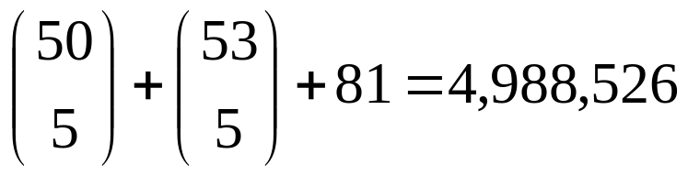
If there is a perfect matching, then we may permute rows, columns, stacks, and bands
so that the result looks like:
Out of the remaining 59 cells, 5 givens must be placed.
Each bracket must contain at least one given.
At least one of the boxes is empty, and there are essentially two ways to choose
which one it is.

Slide 20
How to test if a puzzle is fair?
Define a graph Sud on the set of cells with a complete subgraph in each
row, column, and box.
Definition. A graph G is said to be k-colorable if it is possible to assign k colors to the
vertices in such a way that no edge has both its vertices colored the same.
Definition. The chromatic number χ(G) of a graph G is the smallest integer k so
that G is k-colorable.

Slide 21
Definition. A graph G is said to be uniquely colorable if, other than permuting the
colors, there is only one coloring of G with exactly χ(G) colors.
Uniquely Colorable
Not Uniquely Colorable
Theorem. At least 9 givens are required if, for all sets S of 8 givens, the graph obtained
from Sud by adding a complete graph on the vertex set corresponding to S is not
uniquely colorable.
Proof. A coloring of Sud is exactly the same thing as a solution to the puzzle. When
a complete graph is added, we are simply requiring that the 8 givens be assigned
different colors. We may assign numbers uniquely to the cells exactly when the graph
is uniquely colorable.

Slide 22
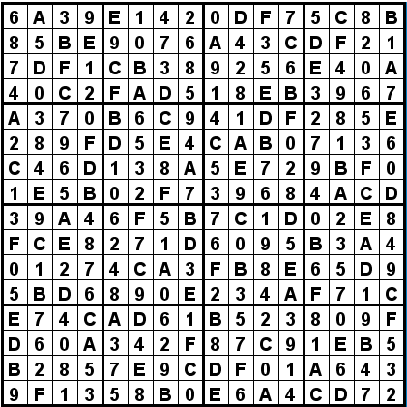
The gap between 9 and 17 is still huge!
Open Problems:
1. Close the gap!
2. How many fair puzzles are there with k givens, 9 ≤ k ≤ 81?
3. What about the “generalized Sudoku board”? For example, 16X16:

Slide 23
Thanks!
P.S. If you are interested in doing some research, contact me at cooper@math.sc.edu.

