Slide 1

Token Entry: A First Pass at MTA Turnstile Data Team 5
ANDREW VLAHUTIN
HENG-RU MAY TAN
MIKE JOHNS
STEVE CHOI
SEPTEMBER 22ND, 2016

Slide 2
Background and Goals
Background
Goals
WomenTechWomenYes (WTWY) holds its annual gala each summer
Interested in placing street teams at subway stations to collect email addresses
Those providing email address are sent an invitation to the annual gala
Provide guidance on where and when to deploy staff to collect emails for gala invite blast
Take a first pass pinpoint stations to based on traffic
Identify useful entrances for selected subway stations where staff should be stationed

Slide 3
Assumptions & Approach
Assumptions
Approach
10 street team members available 5 days a week for up to 8 hours a day
5 teams of 2
Gala taking place in June; WTWY collecting emails in the months prior
Maximization: Go to areas with the greatest traffic; rely on volume to make up for lower levels of receptivity
Soft Targeting: Provide starting list of 15 stations with the greatest traffic flow in months before Gala (as starting point)
Among selected stations identify days of the week and times of day with the greatest traffic
Base estimates in months prior to Gala (e.g. April and May)

Slide 4


Methods
Data Sources
Methodology
MTA turnstile data: 4/3/2016 - 6/4/2016 (1,747,742 records)
Estimate total traffic flow at each station based on entries only
Traffic calculated contiguously within station (across turnstile)
Trim negative values and extremes (> 99.9 percentile)
Ignored data recorded at midnight
Subway entrances
Subway station geographical coordinates
Notes:
NYC Open Data – counts of subway entrances + Lat + Long GeoCoords

Slide 5
Results

Slide 6
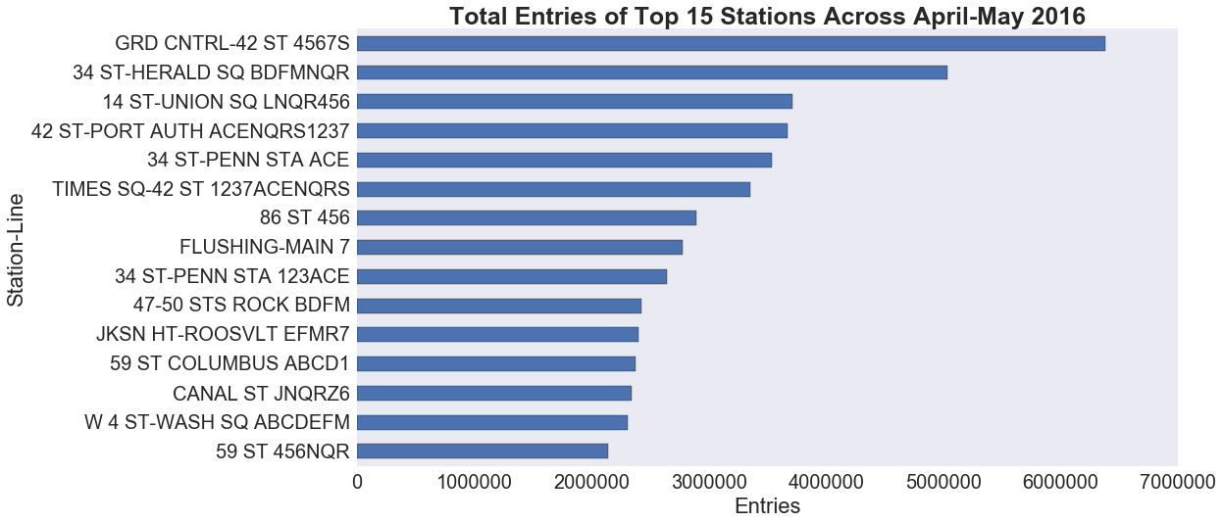
Top Stations
Notes:
LineNames --

Slide 7
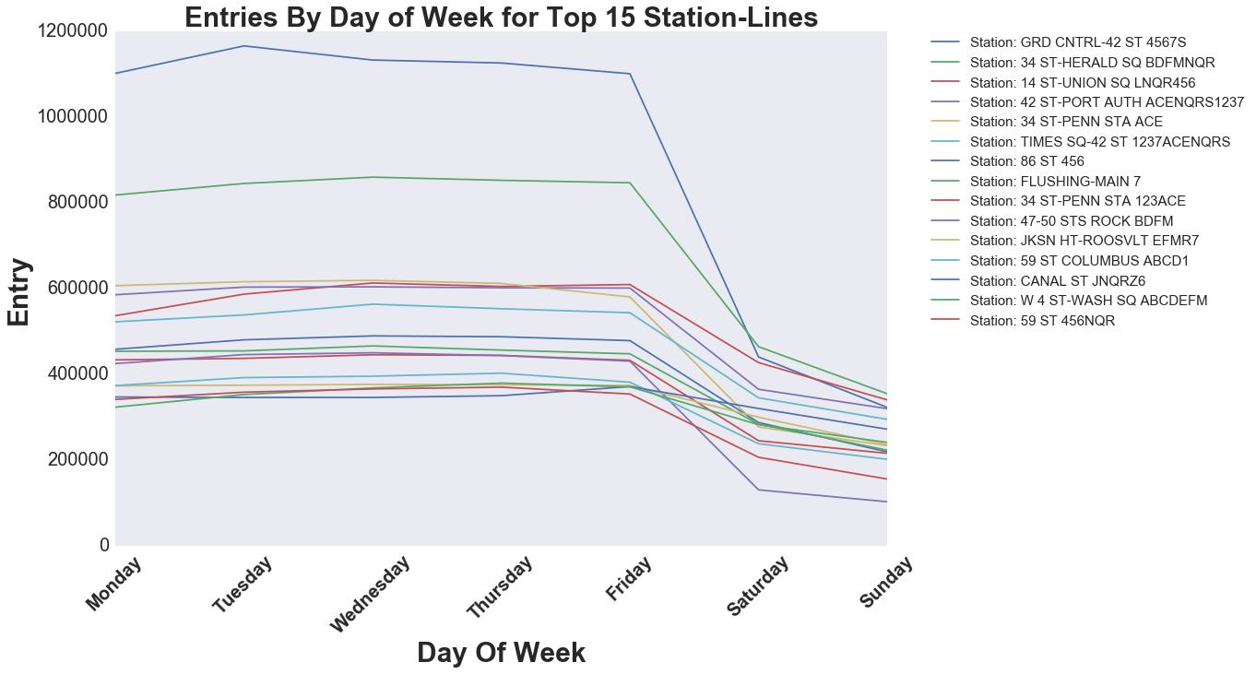
Daily Entries

Slide 8
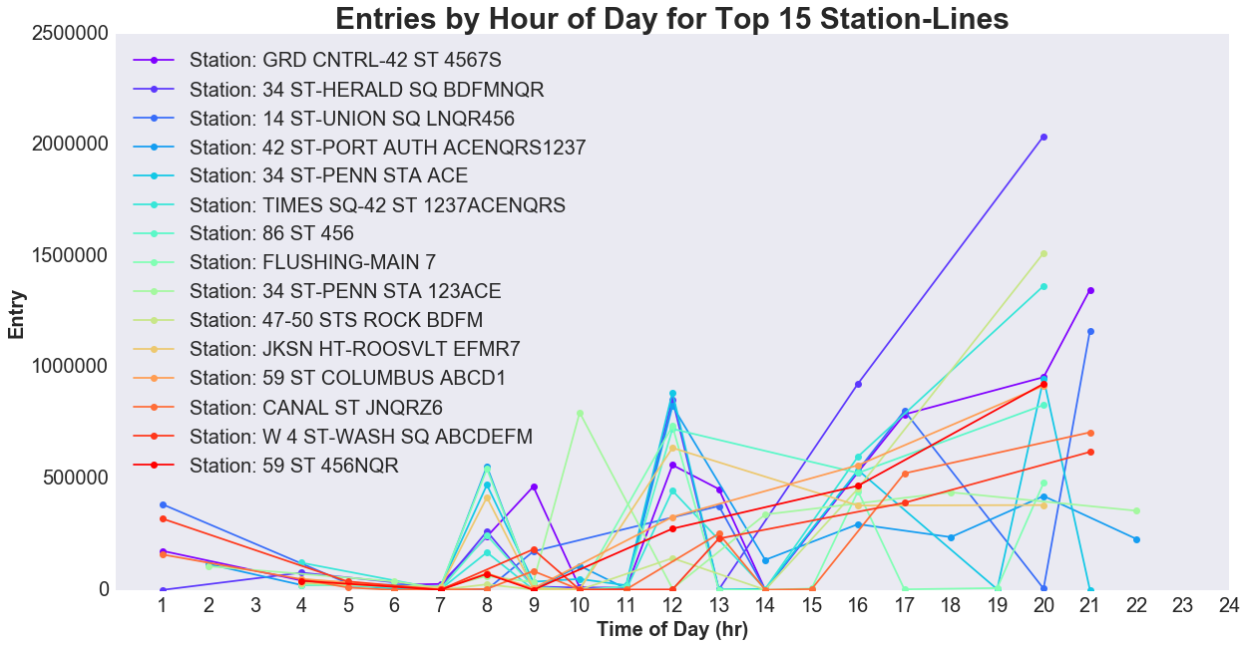
Hourly Entries
Notes:
HIGHLIGHT the things without pointing

Slide 9
Traffic Density = Flow/Entry#
Station Names | Flow | Count of Entrances | Flow/Entrances
34 ST-HERALD SQ BDFMNQR | 5035010 | 11 | 457,728.18
GRD CNTRL-42 ST 4567S | 6384809 | 15 | 425,653.93
42 ST-PORT AUTH ACENQRS1237 | 3674337 | 9 | 408,259.67
W 4 ST-WASH SQ ABCDEFM | 2311829 | 6 | 385,304.83
14 ST-UNION SQ LNQR456 | 3711978 | 10 | 371,197.80
86 ST 456 | 2894762 | 8 | 361,845.25
JKSN HT-ROOSVLT EFMR7 | 2403158 | 7 | 343,308.29
FLUSHING-MAIN 7 | 2778742 | 10 | 277,874.20
TIMES SQ-42 ST 1237ACENQRS | 3354597 | 13 | 258,045.92
34 ST-PENN STA ACE | 3538270 | 16 | 221,141.88
59 ST COLUMBUS ABCD1 | 2379059 | 12 | 198,254.92
CANAL ST JNQRZ6 | 2346221 | 14 | 167,587.21
34 ST-PENN STA 123ACE | 2647402 | 16 | 165,462.63
59 ST 456NQR | 2145341 | 13 | 165,026.23
47-50 STS ROCK BDFM | 2422287 | 17 | 142,487.47

Slide 10
Subway Station Locations Weighted by Traffic Density

Slide 11
Conclusions & Future Work
Conclusions
Next Steps
Stations with the highest traffic are what you would expect!
Highest traffic: weekdays during morning and evening commute
Lunch time increase in some areas
Incorporate additional data to identify high-traffic stations in areas with most receptive populations
Median income
Charitable giving
Tech Industry
Estimate traffic flow by time for specific station exits

Slide 12
Questions

