Slide 1

MTA Turnstile Presentation
ANDREW VLAHUTIN
HENG-RU MAY TAN
MIKE JOHNS
STEVE CHOI
SEPTEMBER 22ND, 2016

Slide 2
Initial Thoughts
Brainstorming
Project Approach
Focus on hours with most obvious traffic times
  (e.g. 8am/9am to 12pm/1pm, 12pm/1pm to 4pm/5pm, 4pm/5pm to 8pm/9pm)
Identify locations most likely to generate foot traffic
Focus on the months most relevant to the gala date
  (e.g. April and May data was used for previous 4 years)
Motivations (e.g. school areas)
Ability (e.g. Wall Street)
Identify clusters of stations
Possible seasonality effects
Focus on hours with most obvious traffic times
  (e.g. 8am/9am to 12pm/1pm, 12pm/1pm to 4pm/5pm, 4pm/5pm to 8pm/9pm)
Identify locations most likely to generate foot traffic
Focus on the months most relevant to the gala date
  (e.g. April and May data was used for previous 4 years)
Motivations (e.g. school areas)
Ability (e.g. Wall Street)
Identify clusters of stations
Possible seasonality effects

Slide 3
Methodology
MTA Turnstile Data
NYC Subway Data
Methodology
Entry Counts + Subway Counts
Geographic + Entrance Counts
Upload MTA turnstile data into Panda Dataframe
Cross referencing geographical (e.g. longitude, latitude) package ____ with MTA turnstile data to identify geographical clusters of stations
Calculate total count of entries and exits by station
Group by (or pivot table)
Identify distribution of foot traffic by station by time groupings
Data joining + Cleaning
Total Dataset

Slide 4
Assumptions
Resource Assumptions
Time Assumptions
Limited resources (e.g. 10 people, 5 day period, 2 people per group)
Focus on hours with most obvious traffic times
  (e.g. 8am/9am to 12pm/1pm, 12pm/1pm to 4pm/5pm, 4pm/5pm to 8pm/9pm)
Identify locations most likely to generate foot traffic
Focus on the months most relevant to the gala date
  (e.g. April and May data was used for previous 4 years)
Motivations (e.g. school areas)
Ability (e.g. Wall Street)
Identify clusters of stations
Possible seasonality effects

Slide 5
Statistical Results
Insert statistical output

Slide 6
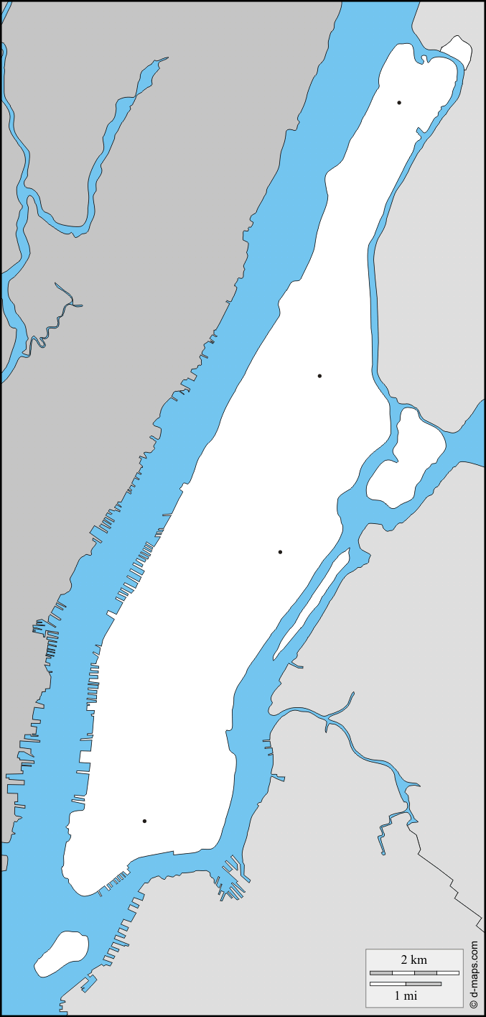
Conclusions
Recommendation
Station individuals on xyz station due to abc statistical output
insert geographic map of manhattan and visualize the station locations

Slide 7
Appendix

Slide 8
Additional Statistical Results
Insert additional graphs/describe()/etc.

