Slide 1
Return on Investment: Movie Genre & Studio Options
Heng-Ru May Merkle-Tan, PhD

Slide 2
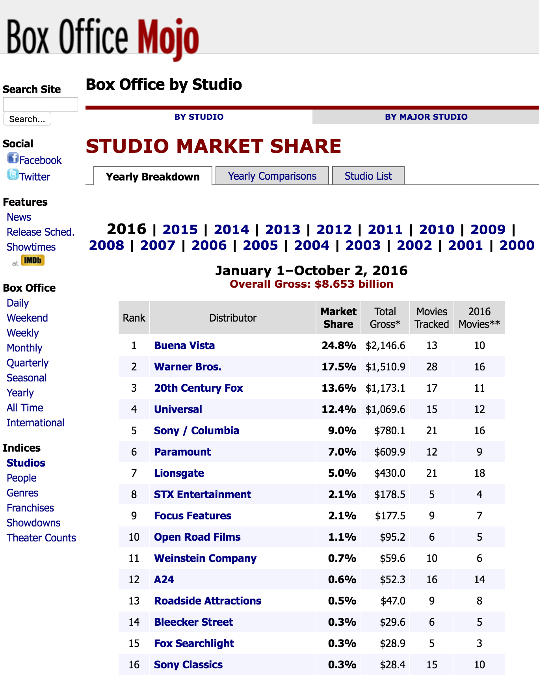
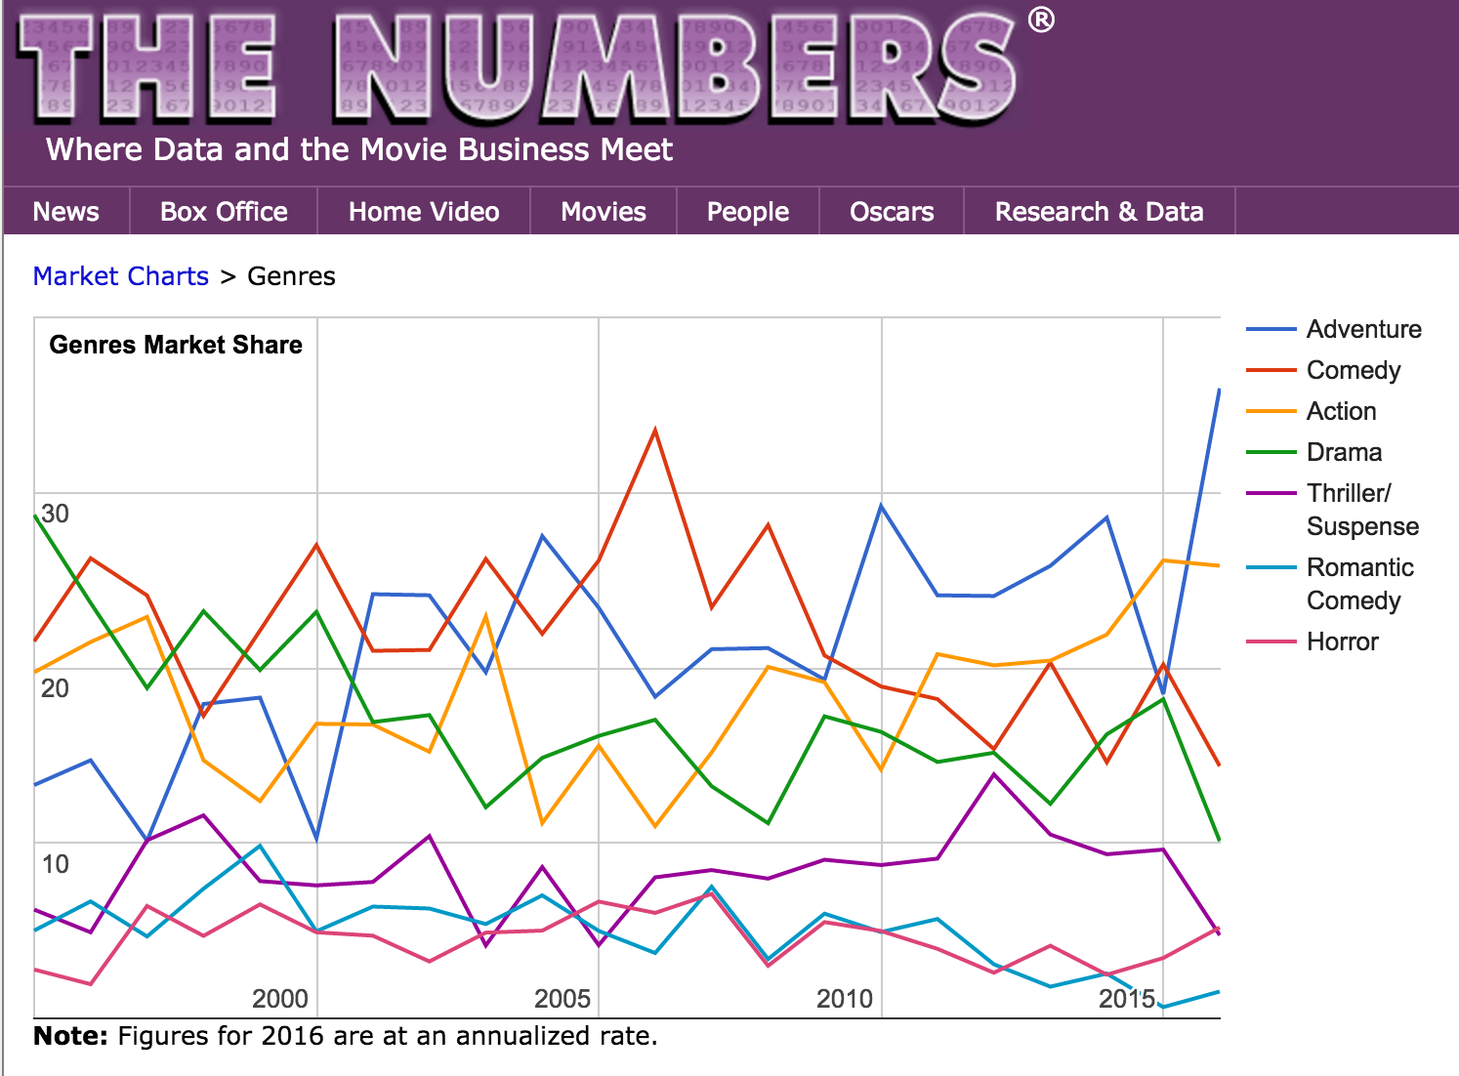
Genres | Studios & Market Share

Slide 3
Return on Investment?
Ln(ROI) = Ln(World Gross / Production Budget )
Data Sources:
Box Office Mojo
Release Details; Theatres; Duration; Oscar Nominations
The Numbers
Budget, Gross + inflation correction

Slide 4
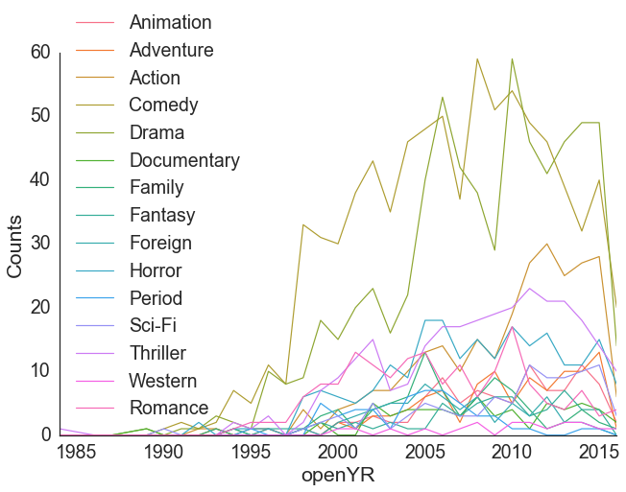
Movie Genre Over Time

Slide 5
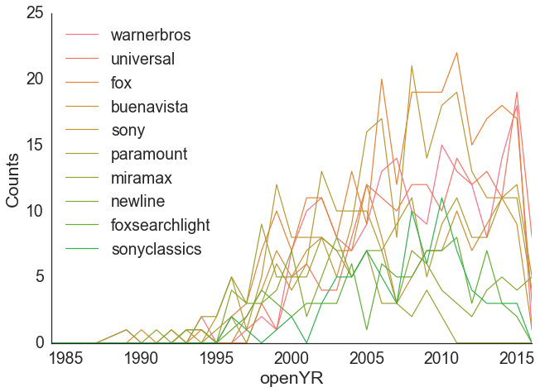
Movie Production by Studio Over Time

Slide 6
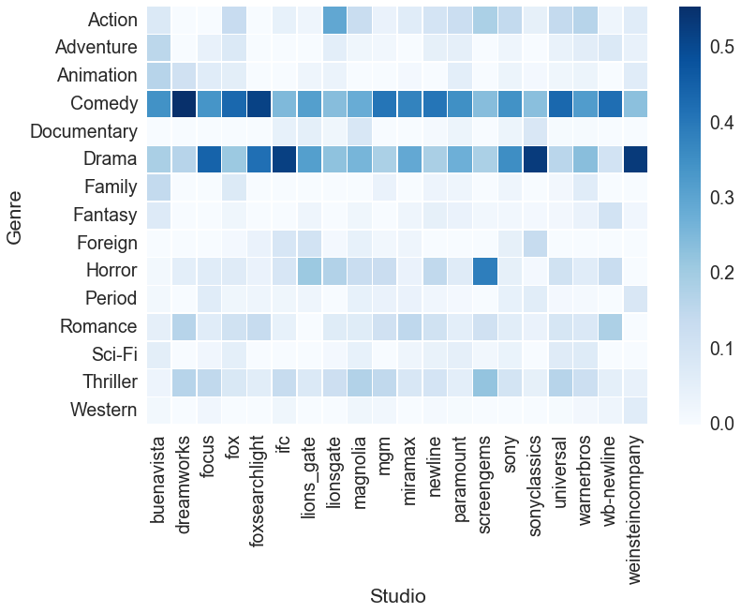
% Movie Production: Genre & Studio
Notes:
Percent of movie genre would be more helpful – for normalizing before comparing

Slide 7
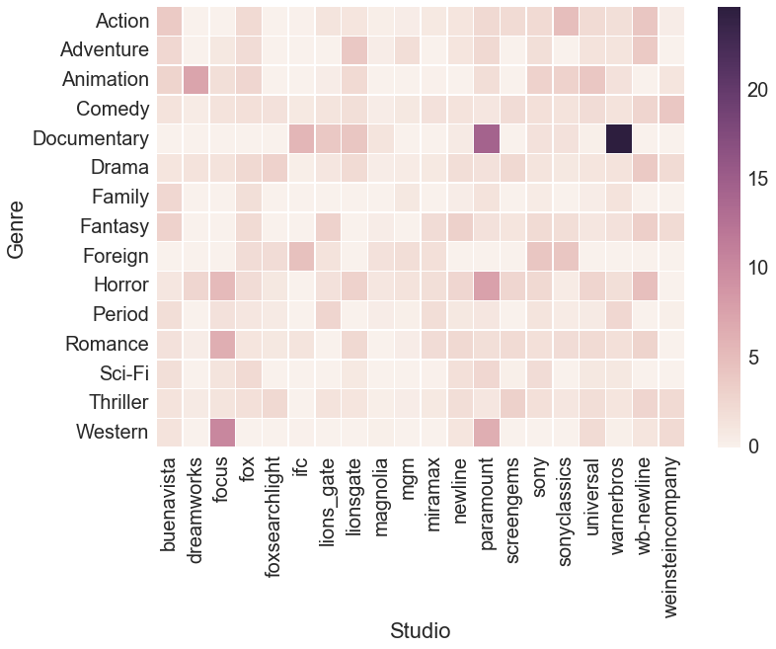
Ln(ROI) : Genre & Studio

Slide 8
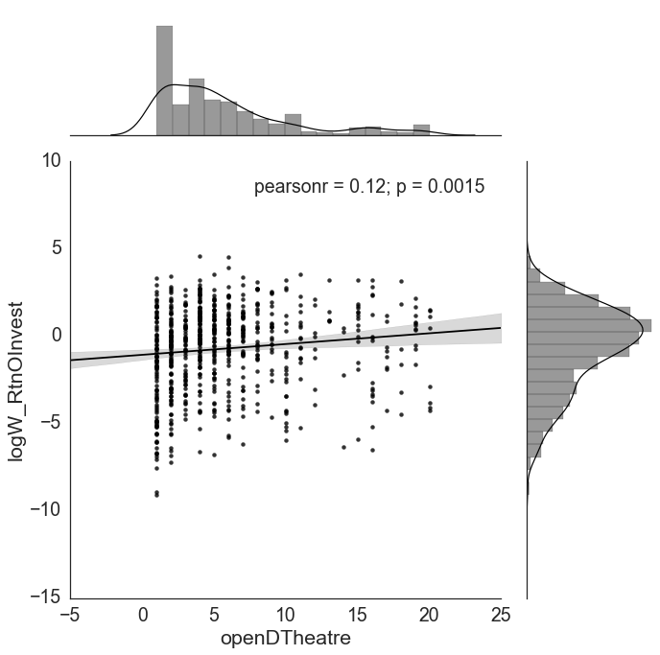
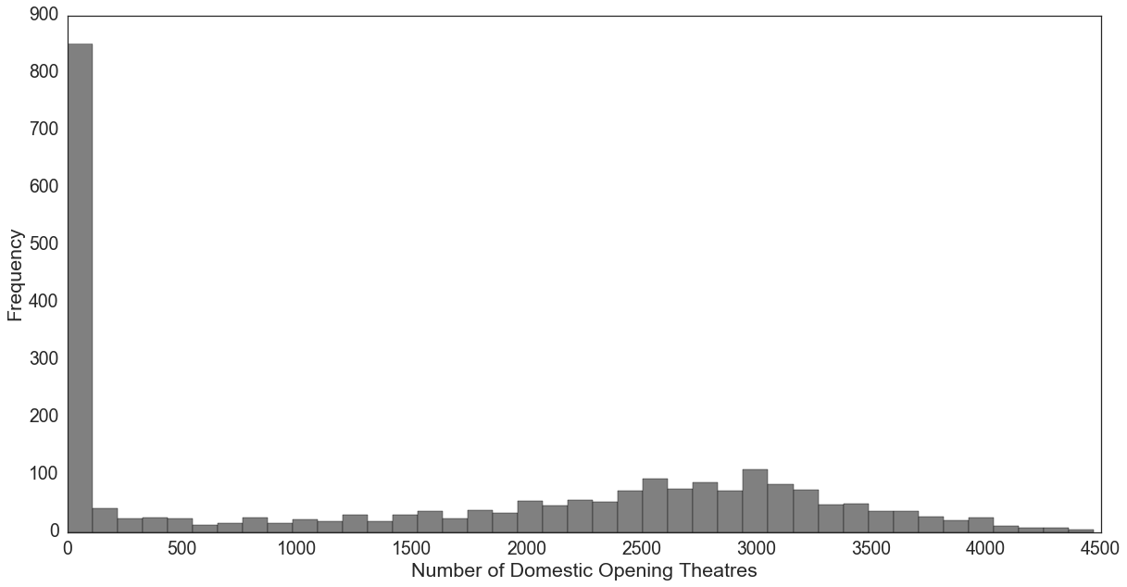
Opening Theatres

Slide 9
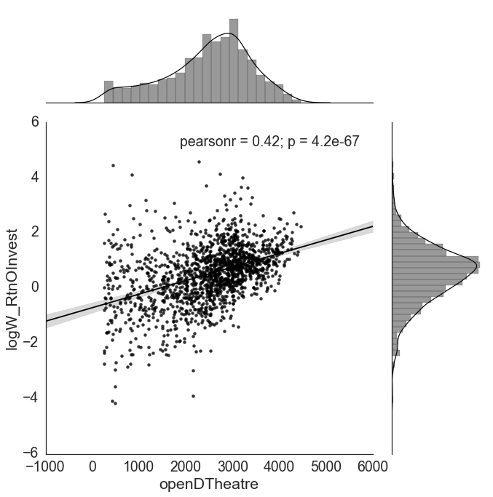
Opening Theatres

Slide 10
Methodology Overview
Assessing Features (Genre | Studio):
OLS | Lasso | Ridge | Decision Trees | Interactions
K-Folds Cross Validation; K=5
Final Model via OLS
2 Partial Models :
ln(ROI) ~ Genre
ln(ROI) ~ Studio
Notes:
Dummy Vars –”Family” | “Sony”
+ openDTheatre + mv_runtime + DURrelease + 'OscarNom’

Slide 11
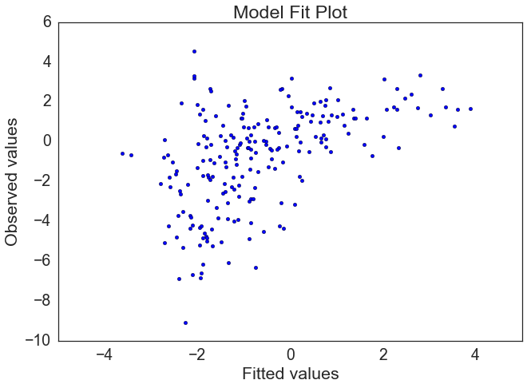
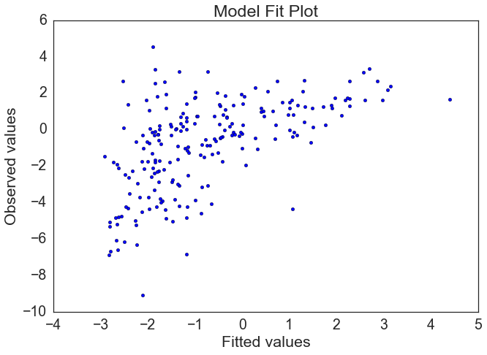
Opening Theatres <= 20
Genres (r_sq ~ 0.33)
Duration of Release (e^0.01)
Oscar Nomination (e^1.72)
Comedy (e^0.90)
Drama (e^0.62)
Foreign (e^1.13)
Studios (r_sq ~ 0.35)
Duration of Release (e^0.01)
Oscar Nomination (e^1.57)
Miramax (e^1.41)
FoxSearchlight (e^2.41)
LionsGate (e^1.38)
WeinsteinCo (e^1.61)
Focus (e^1.21)
Notes:
Relative to “Family” Genre baseline: - 2.97
Relative to “Sony” baseline: - 2.65
Period (e^-0.87)

Slide 12
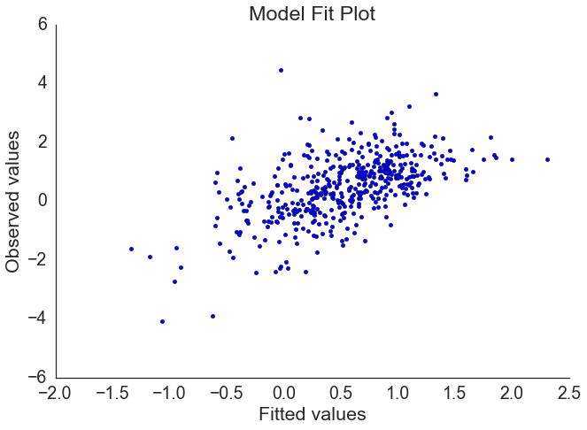
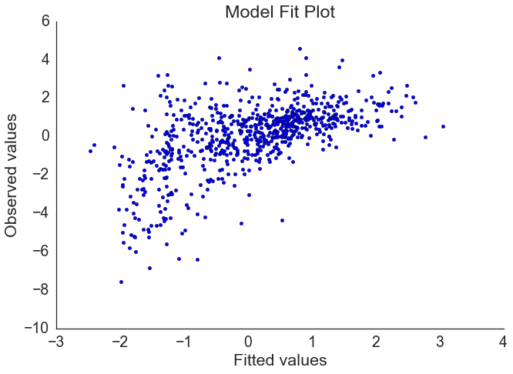
Opening Theatres >> 250
Genres (r_sq ~0.3)
Duration of Release (e^0.009)
Oscar Nomination (e^3.1)
Documentary (e^1.67)
Horror (e^0.42)
Studios (r_sq ~0.3)
Duration of Release (e^0.01)
Oscar Nomination (e^0.23)
Universal (e^0.26)
Screengems (e^0.53)
LionsGate (e^0.34)
WB-Newline (e^0.58)
Notes:
Relative to “Family” Genre baseline: - 0.99
Relative to “Sony” baseline: - 0.95
Animation, Adventure, Sci-Fi (e^- : decay)

Slide 13
Models capture different aspects of data
Comedy | Drama vs Documentary | Horror
Studios and their relative market share

Slide 14
Return on Investment: Movie Genre & Studio Options
Heng-Ru May Merkle-Tan, PhD
hengrumay@gmail.com

