Slide 1

Bridge

Slide 2
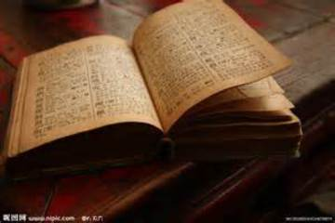
book

Slide 3
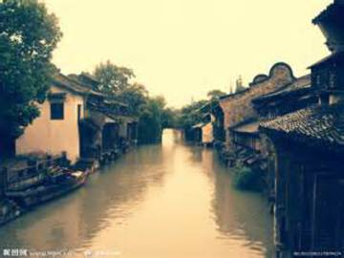
The acient torn

Slide 4
Bridge

Slide 5
book

Slide 6
The acient torn

