Slide 1
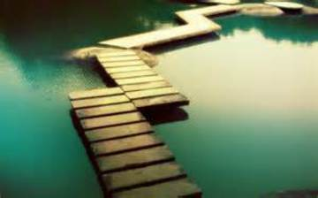
Bridge

Slide 2

Paper

Slide 3
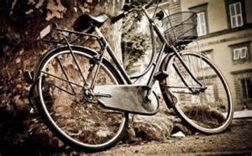
Bycicle

