Slide 1

Bridge

Slide 2
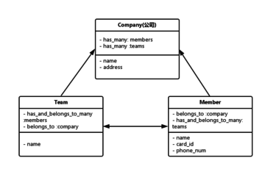
test

