Slide 1

Paper

Slide 2
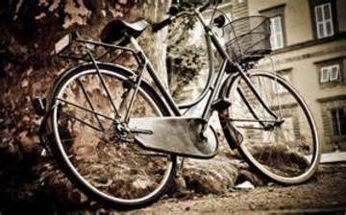
Bycicle

Slide 3
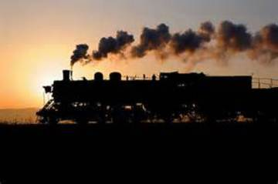
Steam train

