Slide 1
title1
image_path1

Slide 2
title
Its cool!
Its light.

Slide 3
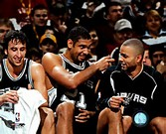
三驾马车

Slide 4
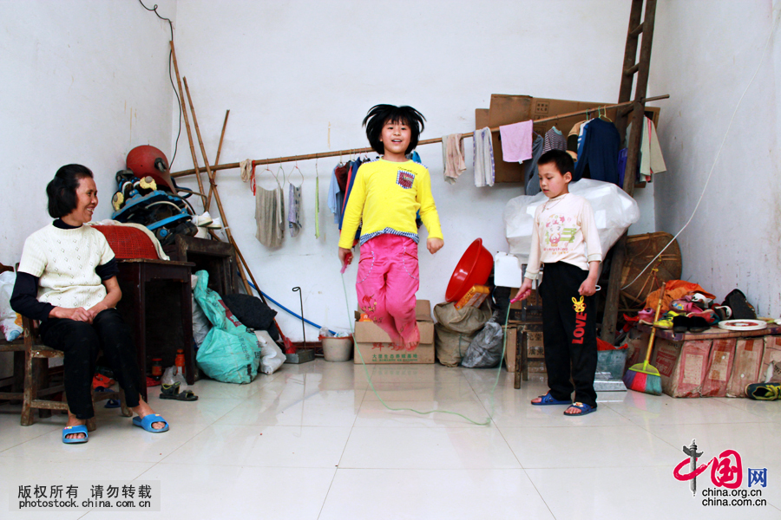
陪读老人

Slide 5
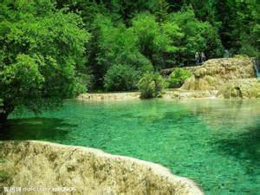
九寨沟

