Slide 1
Logic in Coq
易星辰
2019.5.30

Slide 2
目录
Logic in Coq
Logical Connectives
Conjunction, Disjunction
Falsehood and Negation, Truth
Logical Equivalence
Existential Quantification
Application
Programming with propositions
Apply theorems to arguments
Coq vs. Set Theory

Slide 3
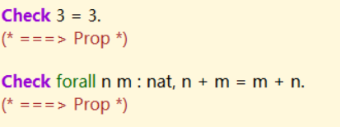
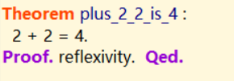
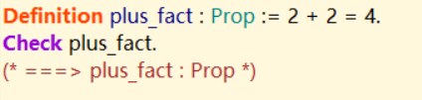
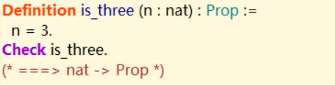
Logic in Coq
Propositions
Type: Prop
First-Class Object
Used in Theorem
Used in Definition
Parameterized

Slide 4
Logical Connectives

Slide 5
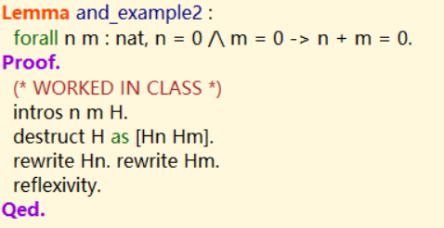
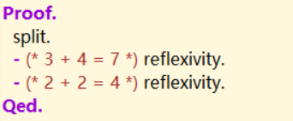
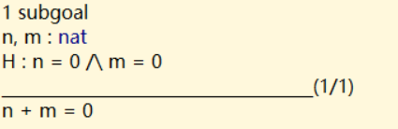
Conjunction
Prove conjunction
Use split
Conjunctive hypothesis
Destruct, intros

Slide 6
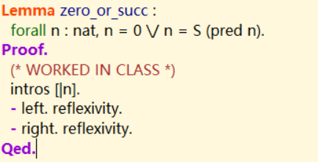
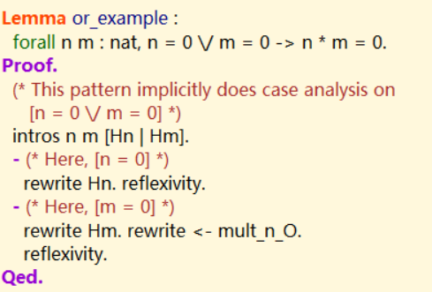

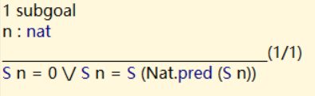
Disjunction
Prove disjunction
left、right
Disjunction hypothesis
Intros、destruct

Slide 7

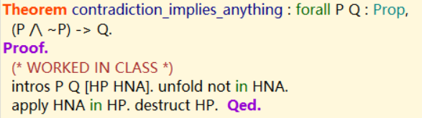
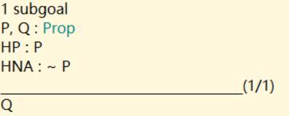
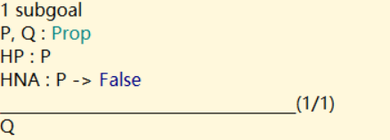

Falsehood and Negation
Principle of explosion
Assert a contradictory hypothesis entail anything.
$¬P: ∀Q, P→Q$

Slide 8

True
Definition
Used rarely
Trivial to prove
No useful information as a hypothesis

Slide 9

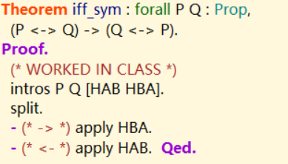
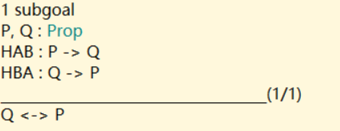
Logical Equivalence
Definition
Prove and Use
Split、intros [A1 A2]

Slide 10
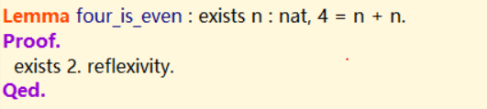
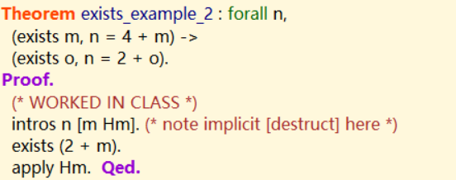
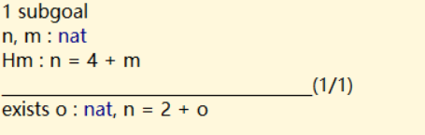
Existential Quantification
Prove
Specific choice
Use
Destruct、intros

Slide 11
Application

Slide 12
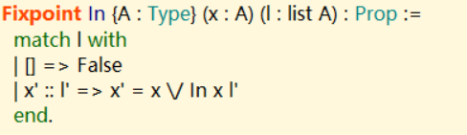
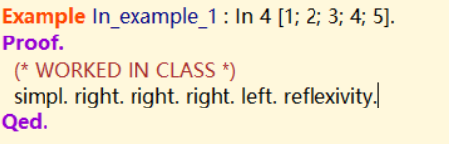

Programming with propositions
Recursive function

Slide 13


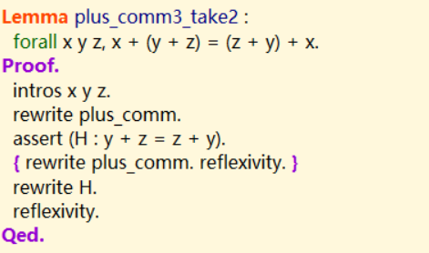
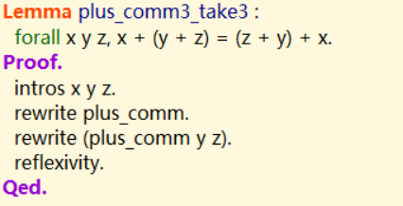
Apply Theorem to Arguments
Using theorem or lemma like a function
One way
A more elegant way

Slide 14
Coq vs. Set Theory

Slide 15
Coq vs. Set Theory
Differences
Functional Extensionality
Propositions and Booleans
Classical vs. Constructive Logic

Slide 16
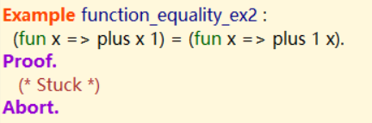
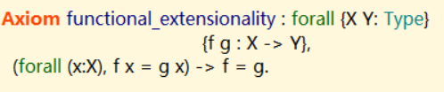

Functional Extensionality
Definition in mathematics
$\left(∀x, f x=g x\right)→f=g$
Not available in Coq
Axiom

Slide 17




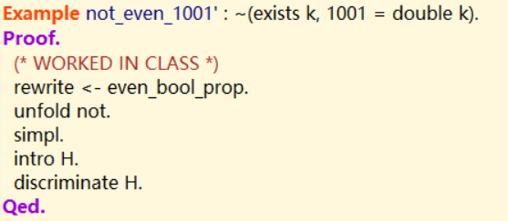
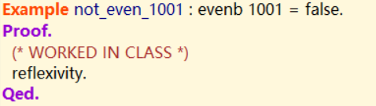
Propositions and Booleans
Similar in Logic
Difference
Operation
Negation
Type: Prop instead bool

Slide 18

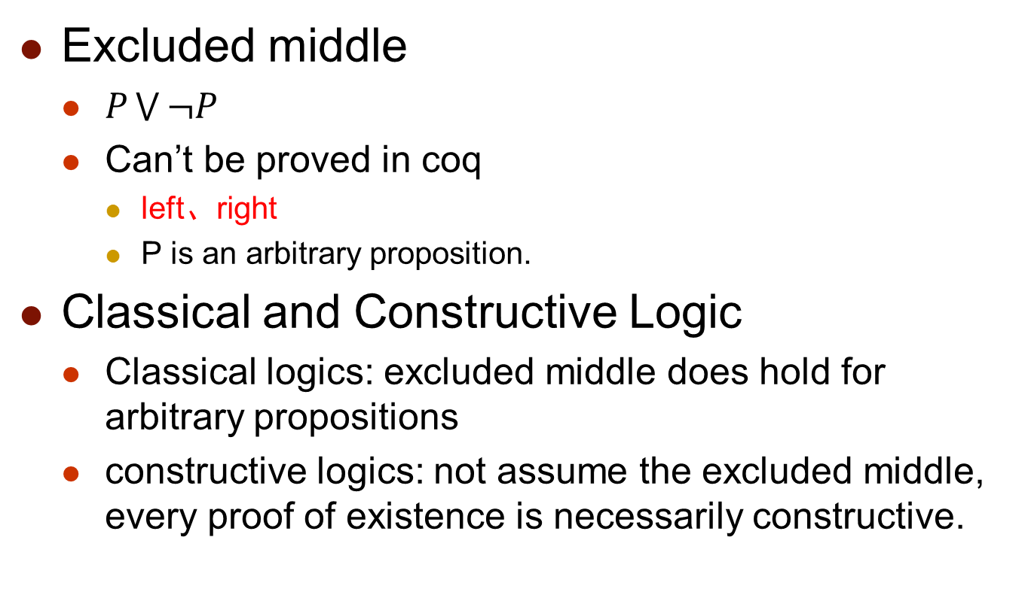
Classical vs. Constructive Logic
Excluded middle
$P\bigvee{¬P }$
Can’t be proved in coq
left、right
P is an arbitrary proposition.
Classical and Constructive Logic
Classical logics: excluded middle does hold for arbitrary propositions
constructive logics: not assume the excluded middle, every proof of existence is necessarily constructive.

Slide 19
Thanks
& Questions

