Slide 1



Finding Invariants of Distributed Systems: It’s a Small (Enough) World After All
Xiaosong Gu
2022年03月14日

Slide 2
Contents
Introduction
Background
Overview: The SWISS Algorithm
Optimizations
Evaluation
Conclusions & Future Work

Slide 3
Introduction

Slide 4
Invariant Discovery of Distributed Systems
Identifying system invariants is a core requirement of specifying and verifying the safety of distributed systems
Relying on human labor and ingenuity
Challenging even for researchers^{[1]}
General automation of invariant discovery
Undecidable^{[2]}
Domain-specific insights
Specific distributed protocols in practice
[1] Ma, H., Goel, A., Jeannin, J. B., Kapritsos, M., Kasikci, B., & Sakallah, K. A. (2019, October). I4: incremental inference of inductive invariants for verification of distributed protocols. In Proceedings of the 27th ACM Symposium on Operating Systems Principles (pp. 370-384).
[2] Padon, O., Immerman, N., Shoham, S., Karbyshev, A., & Sagiv, M. (2016). Decidability of inferring inductive invariants. ACM SIGPLAN Notices, 51(1), 217-231.
Notes:
分布式系统重要，难以验证
多种证明技术，共同的核心要求

Slide 5
Existing Work & Limitations
I4^{[1],} Koenig^{[2]}
Severe restrictions on the form of invariants
I4 cannot discover invariants with existential quantifiers
No benefit when system fails
I4 runs as a blackbox
Inapplicability for large complex systems
No existing work can handle Paxos
[1] Ma, H., Goel, A., Jeannin, J. B., Kapritsos, M., Kasikci, B., & Sakallah, K. A. (2019, October). I4: incremental inference of inductive invariants for verification of distributed protocols. In Proceedings of the 27th ACM Symposium on Operating Systems Principles (pp. 370-384).
[2] Koenig, J. R., Padon, O., Immerman, N., & Aiken, A. (2020, June). First-order quantified separators. In Proceedings of the 41st ACM SIGPLAN Conference on Programming Language Design and Implementation (pp. 703-717).
Notes:
思路与本文不同 I4是在小模型上搜索，然后用一些启发性的规则推广到任意规模

Slide 6
A Key Hypothesis
“Small world” hypothesis
In many practical systems, the invariants should be relatively concise
Protocols are designed by humans who have intuition for why the protocol is correct
Finite space of possible invariants
Exhaustive search
Various optimizations

Slide 7
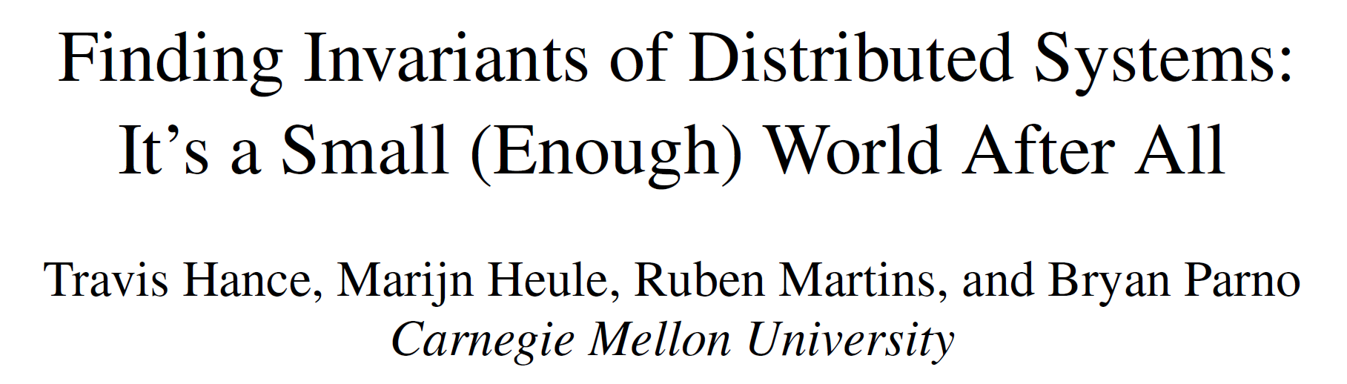
SWISS: Small World Invariant Search System
Exhausting the space of succinct invariants using SMT solver
Learning from counterexample model from failed invariant candidates
Exploiting various symmetries and parallelism
Supporting user-supplied guidance
Beneficial even when verification fails
The first approach that can automatically prove the safety of Paxos
Notes:
Swiss 一种methodology

Slide 8
Background

Slide 9
Proving Safety Conditions Via Inductive Invariants
Formalization of distributed system: standard practice^{[1]}
Initial condition, state transition
Safety condition: predicate on single state
Typical proving strategy
Prove that the safety condition is an inductive invariant
Find one inductive invariant which implies the safety condition
[1] Lamport, L. (1994). The temporal logic of actions. ACM Transactions on Programming Languages and Systems (TOPLAS), 16(3), 872-923.
Notes:
状态机，tla
关注安全性，而不是Liveness，liveness通常是对一个trace的predicate

Slide 10
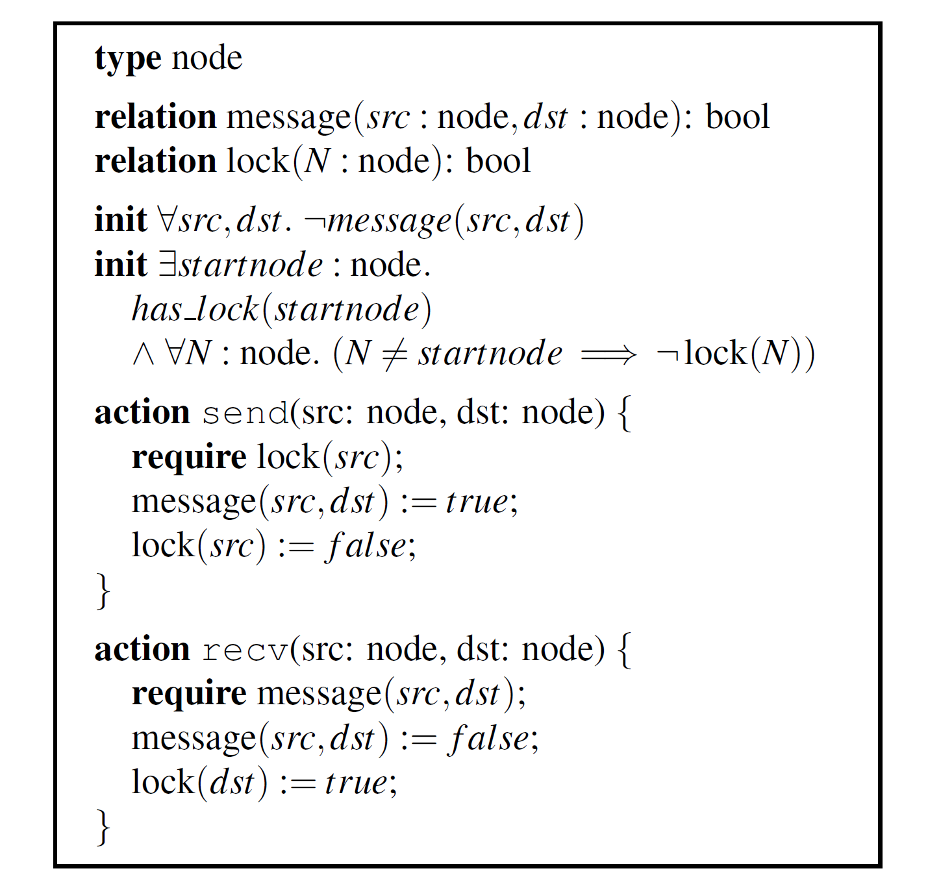
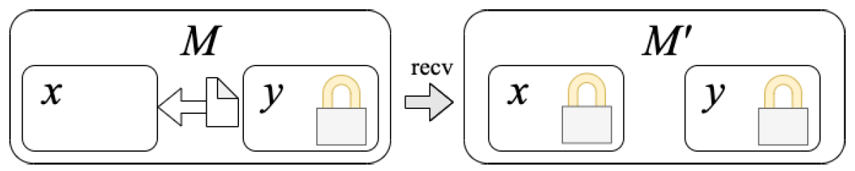
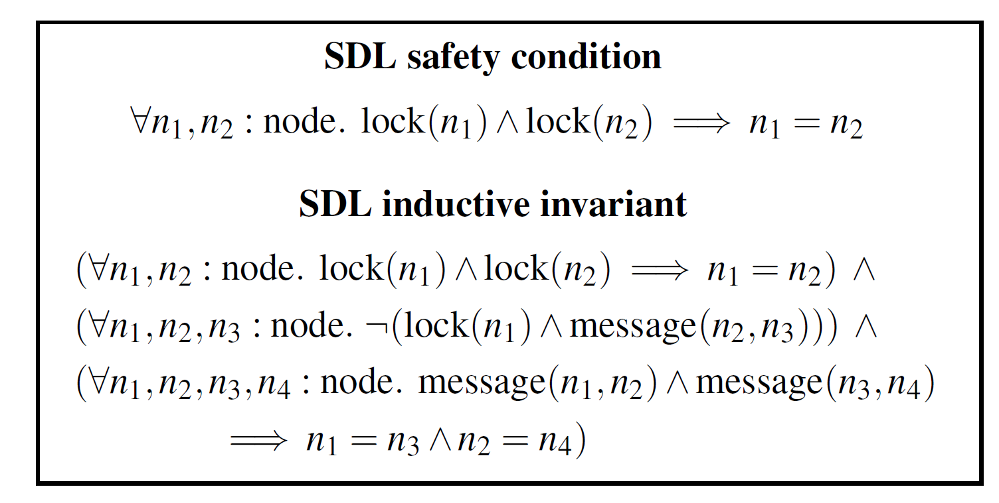
An Example

Slide 11
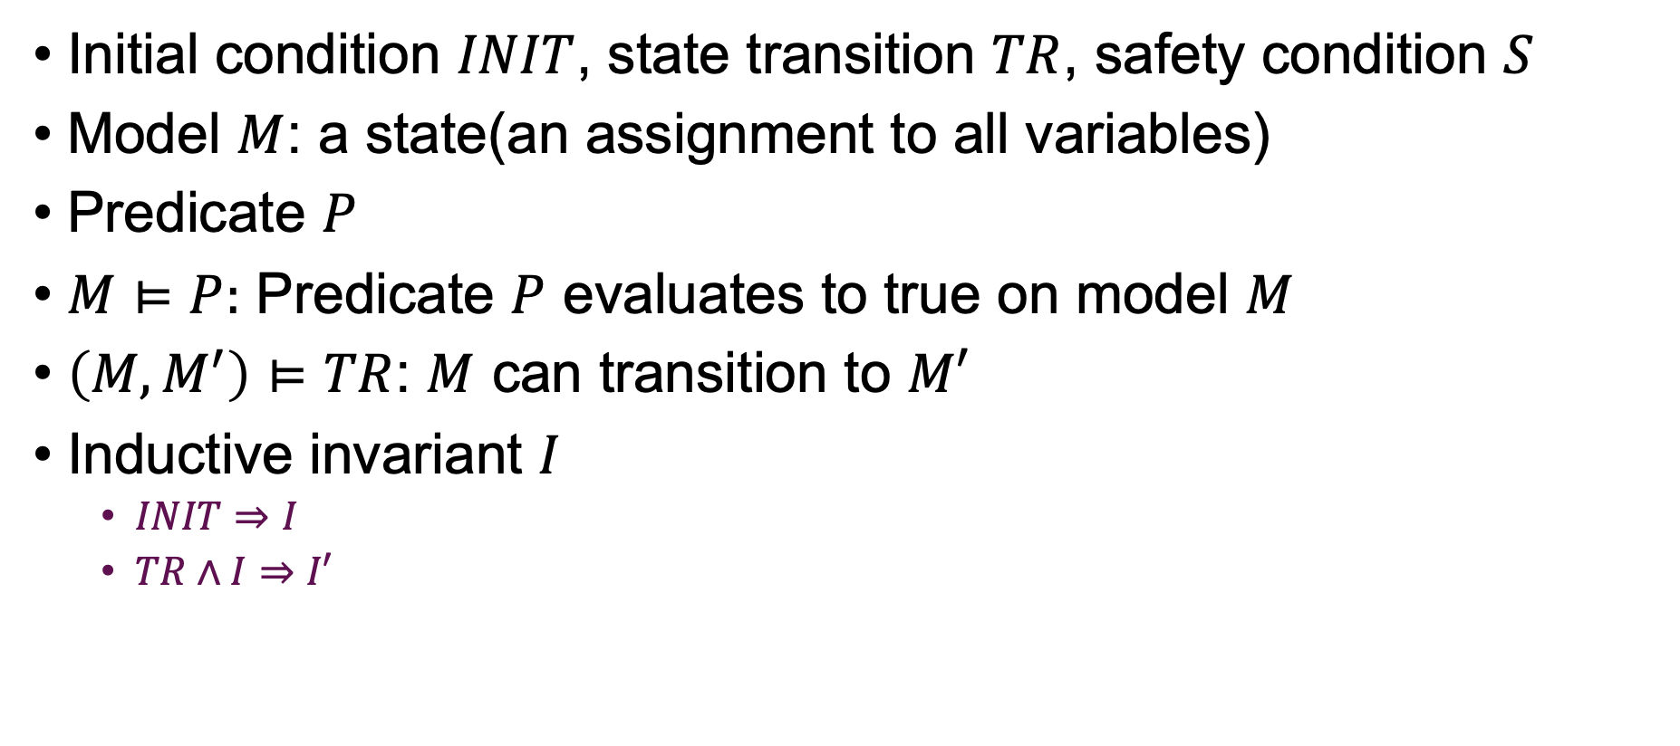
Some Notations
Initial condition $INIT$, state transition $TR$, safety condition $S$
Model $M$: a state(an assignment to all variables)
Predicate $P$
$M⊨P:$ Predicate $P$ evaluates to true on model $M$
$\left(M,M^{′}\right)⊨TR$: $M$ can transition to $M′$
Inductive invariant $I$
$INIT⇒I$
$TR∧I⇒I′$

Slide 12
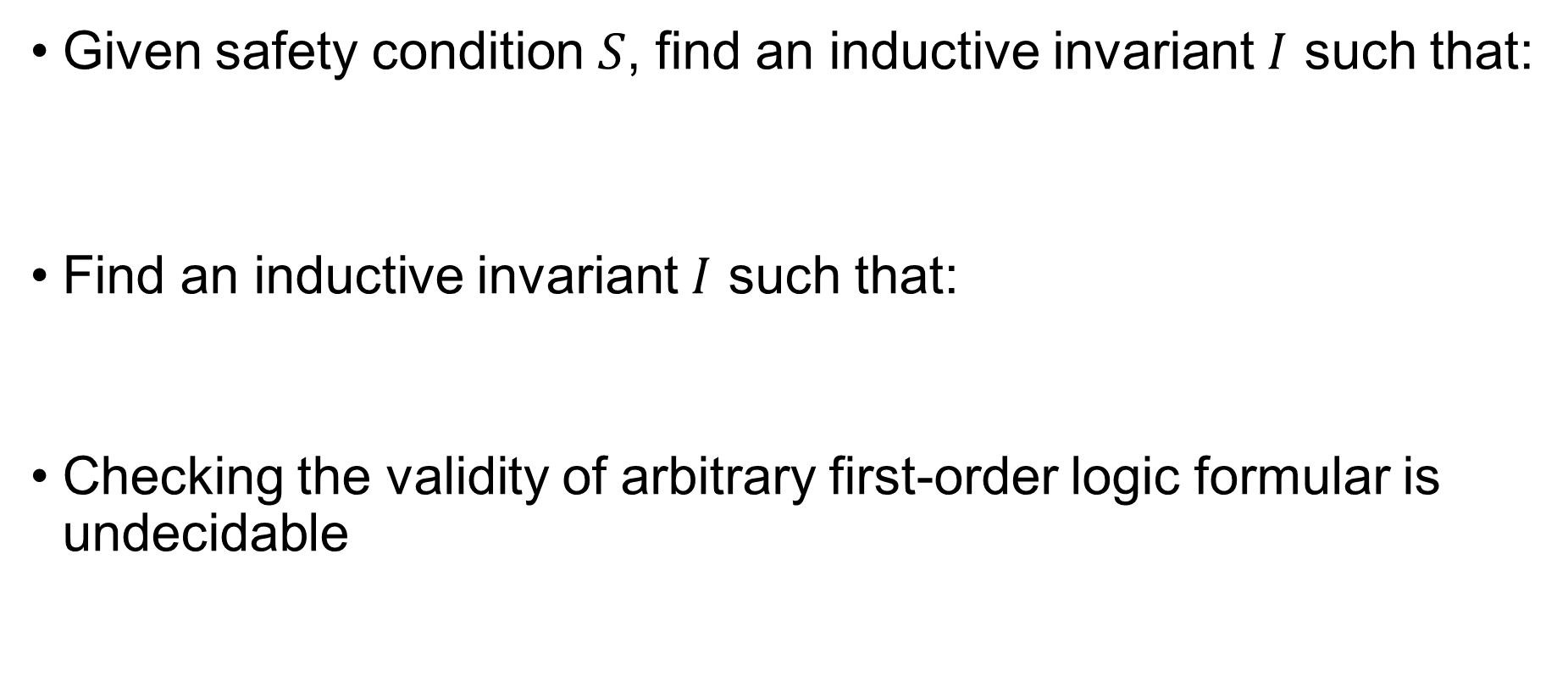
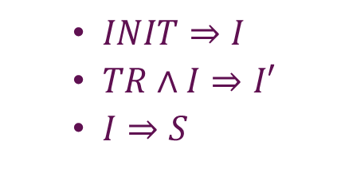

Decidability of Inductiveness
Given safety condition $S$, find an inductive invariant $I$ such that:
Find an inductive invariant $I$ such that:
Checking the validity of arbitrary first-order logic formular is undecidable
$INIT⇒I$
$TR∧I⇒I′$
$I⇒S$
$INIT⇒I∧S$
$TR∧I∧S⇒I^{′}∧S′$
Notes:
需要保证 验证的不变量符合某些限制，符合这些限制的验证在epr中，是可判定的。
这种限制跟想要证明的协议的规约有关，本文假定规约满足这种限制，如何规约以满足限制使得需要考虑的公式可判定不在本文考虑的范围内。 本文提到了，有些情况下，这种规约并不容易

Slide 13
Decidability of Inductiveness
Many distributed systems encoded in RML^{[1]} can be translated to a restricted class of formulas where satisfiability is decidable
EPR: effectively propositional formulas
Imposing restrictions on system specifications
[1] Padon, O., McMillan, K. L., Panda, A., Sagiv, M., & Shoham, S. (2016, June). Ivy: safety verification by interactive generalization. In Proceedings of the 37th ACM SIGPLAN Conference on Programming Language Design and Implementation (pp. 614-630).
Notes:
包括paxos的许多变体
需要保证 验证的不变量符合某些限制，符合这些限制的验证在epr中，是可判定的。
这种限制跟想要证明的协议的规约有关，本文假定规约，如何规约以满足限制使得需要考虑的公式可判定不在本文考虑的范围内。 本文提到了，有些情况下，这种规约并不容易

Slide 14
Overview: The SWISS Algorithm

Slide 15
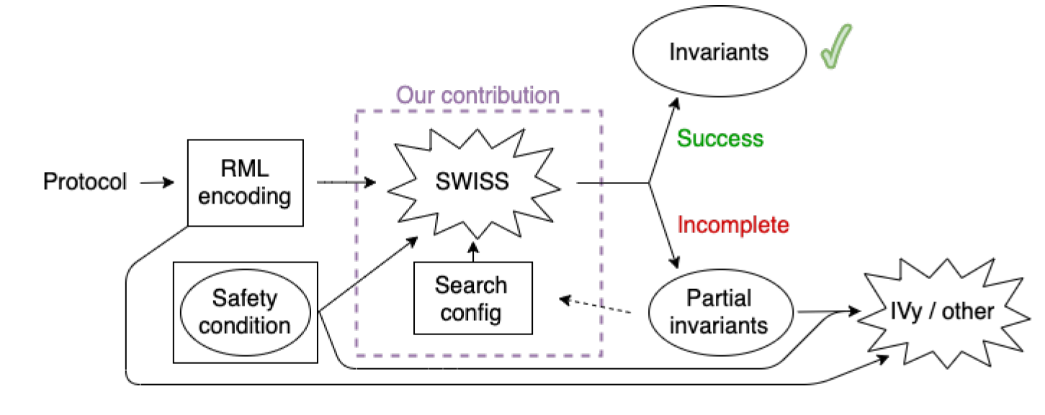
SWISS Overview

Slide 16
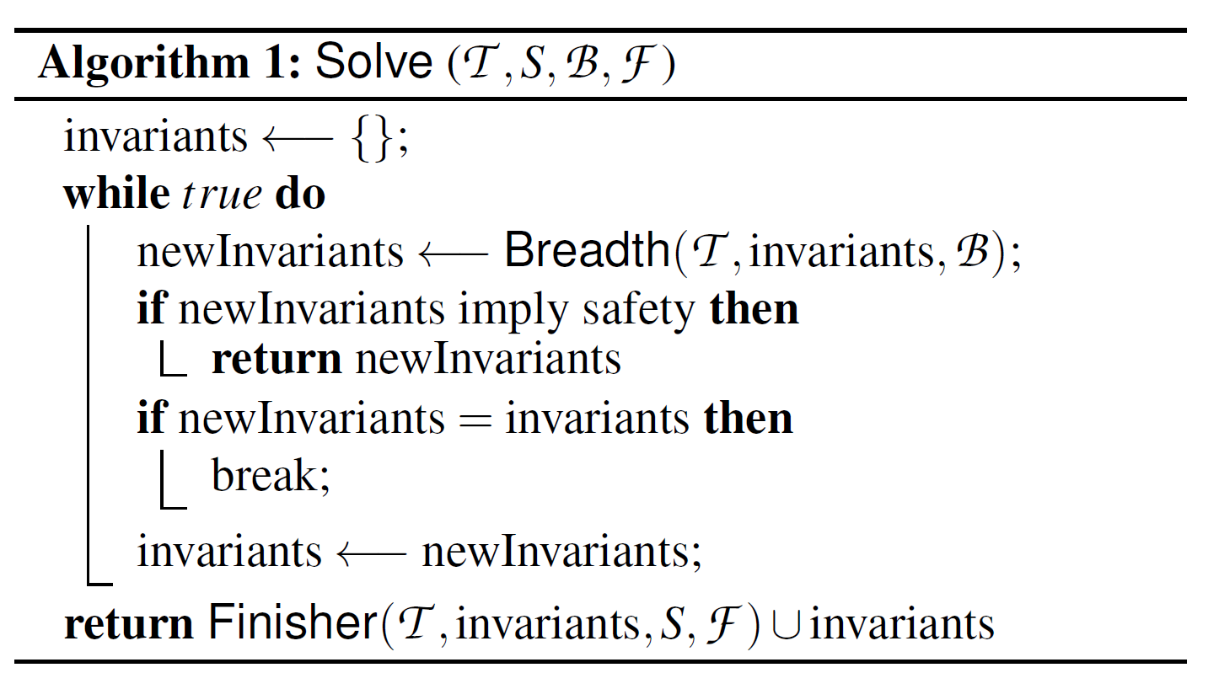
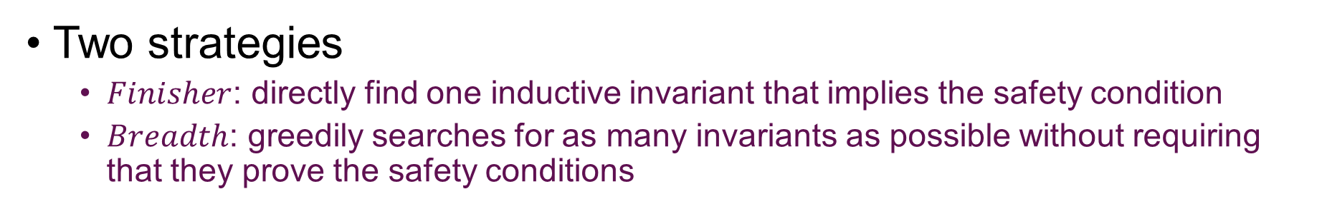
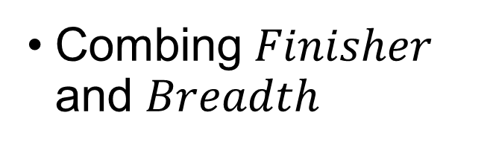
High-Level Algorithm
Two strategies
$Finisher$: directly find one inductive invariant that implies the safety condition
$Breadth$: greedily searches for as many invariants as possible without requiring that they prove the safety conditions
Combing $Finisher$ and $Breadth$
Notes:
对于复杂的系统，需要搜索的空间很大，正确的不变量很复杂，直接搜索很困难
Breadth: 增量的构造一个复杂的不变量
使用breadth

Slide 17
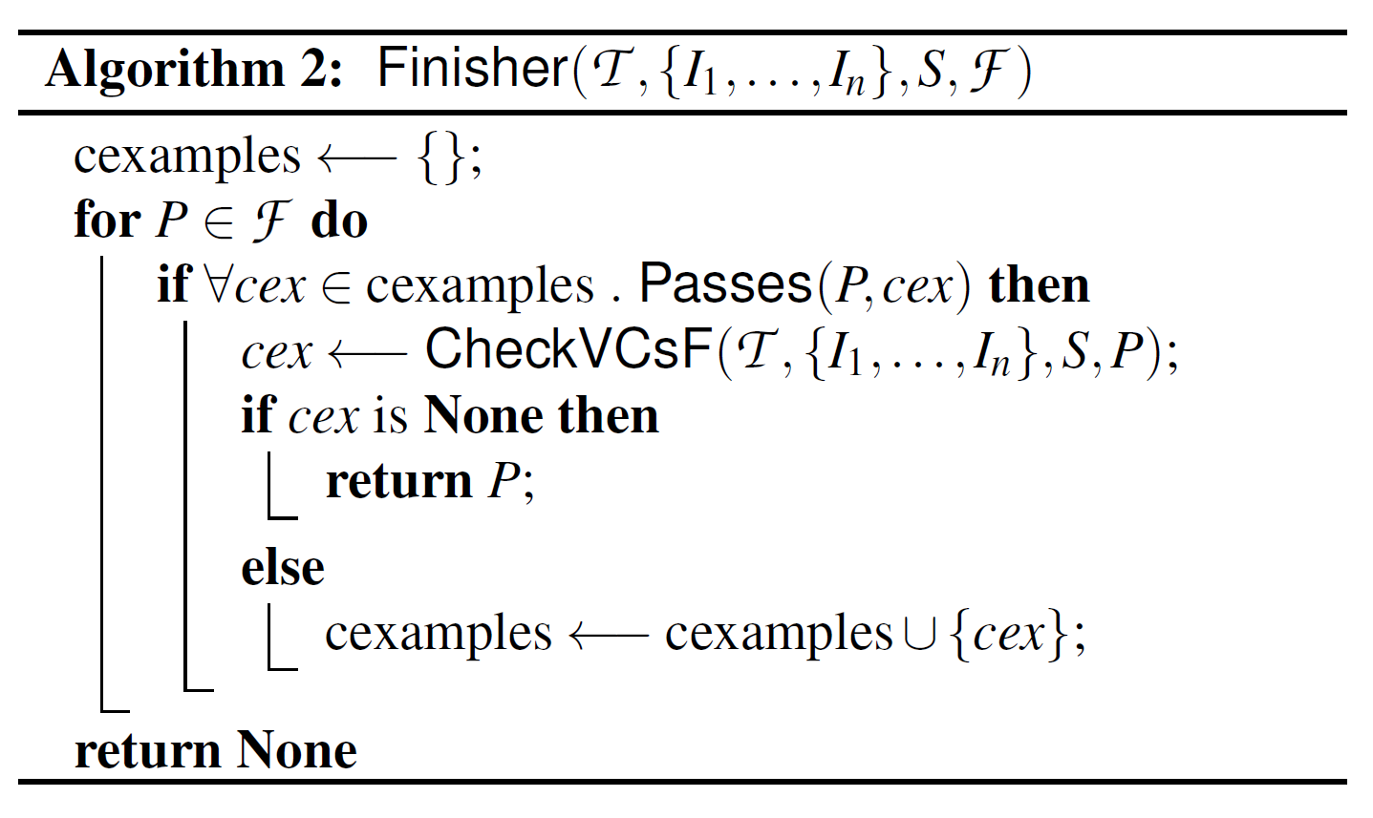
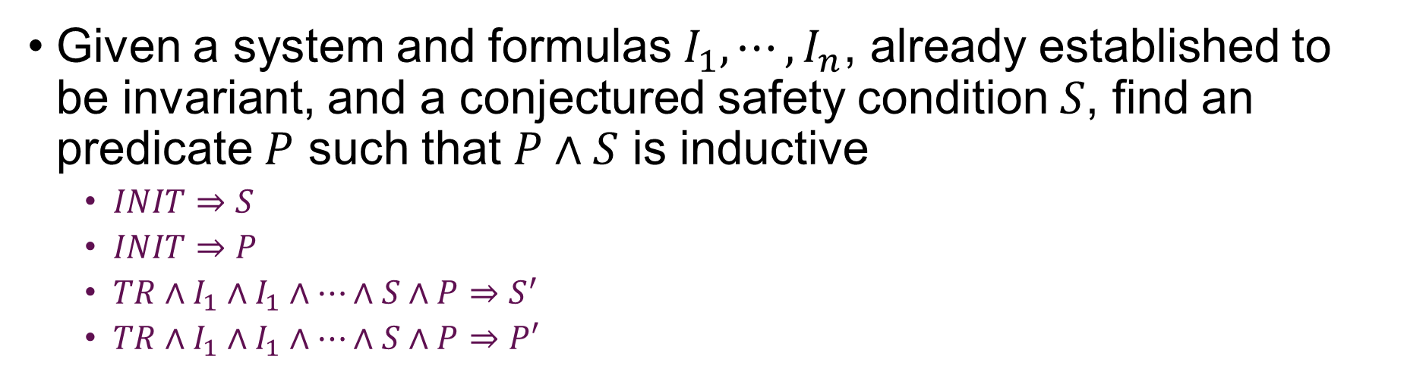
The Finisher Algorithm
Given a system and formulas $I_{1},⋯,I_{n}$, already established to be invariant, and a conjectured safety condition $S$, find an predicate $P$ such that $P∧S$ is inductive
$INIT⇒S$
$INIT⇒P$
$TR∧I_{1}∧I_{1}∧⋯∧S∧P⇒S^{′}$
$TR∧I_{1}∧I_{1}∧⋯∧S∧P⇒P′$
Use counter examples to filter invariants efficiently
Accumulate counter examples from failed invariants
Notes:
这些称为verification condition，验证条件，就是smt求解器需要求解的条件
实践中这些vc能够很快求解出来

Slide 18
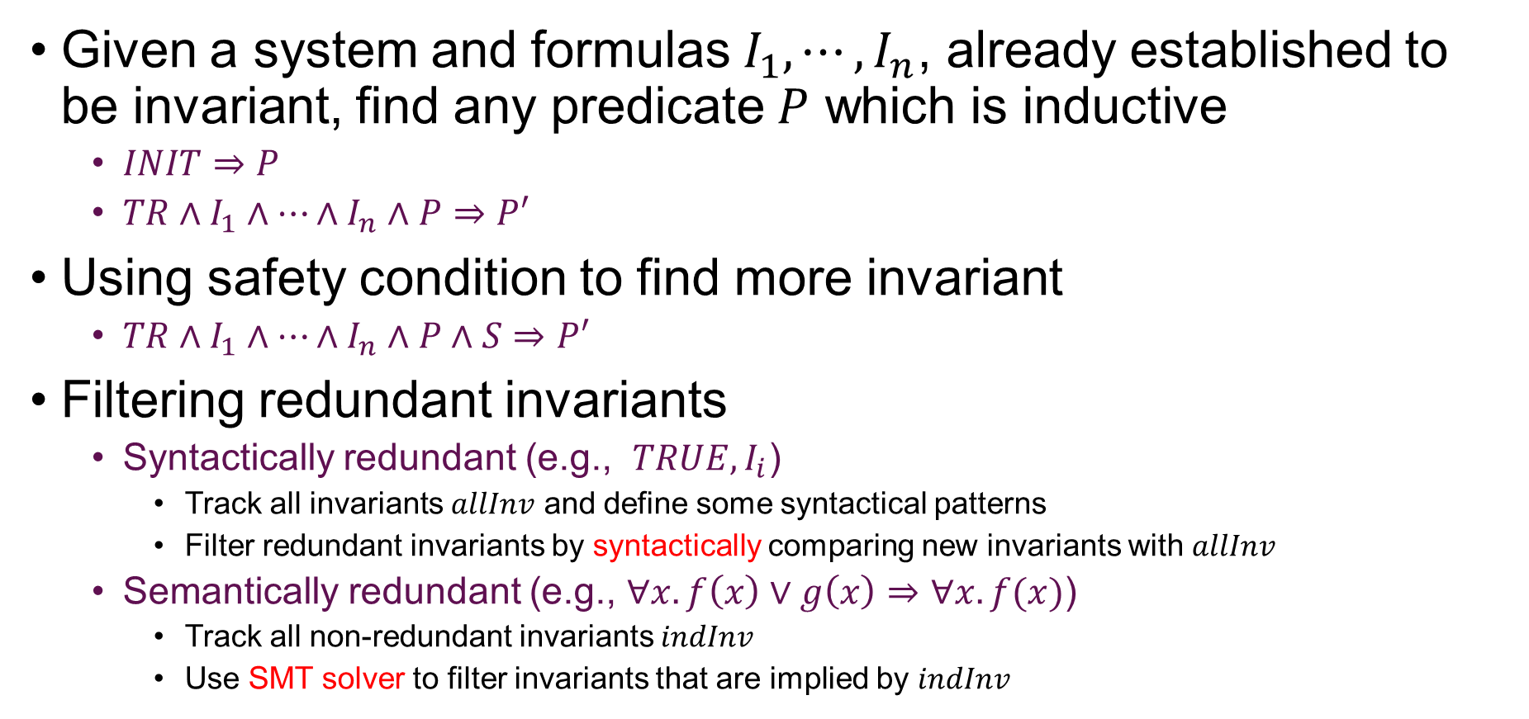
The Breadth Algorithm
Given a system and formulas $I_{1},⋯,I_{n}$, already established to be invariant, find any predicate $P$ which is inductive
$INIT⇒P$
$TR∧I_{1}∧⋯∧I_{n}∧P⇒P′$
Using safety condition to find more invariant
$TR∧I_{1}∧⋯∧I_{n}∧P∧S⇒P′$
Filtering redundant invariants
Syntactically redundant (e.g., $TRUE, I_{i}$)
Track all invariants $allInv$ and define some syntactical patterns
Filter redundant invariants by syntactically comparing new invariants with $allInv$
Semantically redundant (e.g., $∀x.f\left(x\right)∨g\left(x\right)⇒∀x.f(x)$)
Track all non-redundant invariants $indInv$
Use SMT solver to filter invariants that are implied by $indInv$
Notes:
P 和 I之间螺旋归纳
这种通过比较语法来判断重复 比 smt调用效率高很多，实践中还进行了高效实现

Slide 19
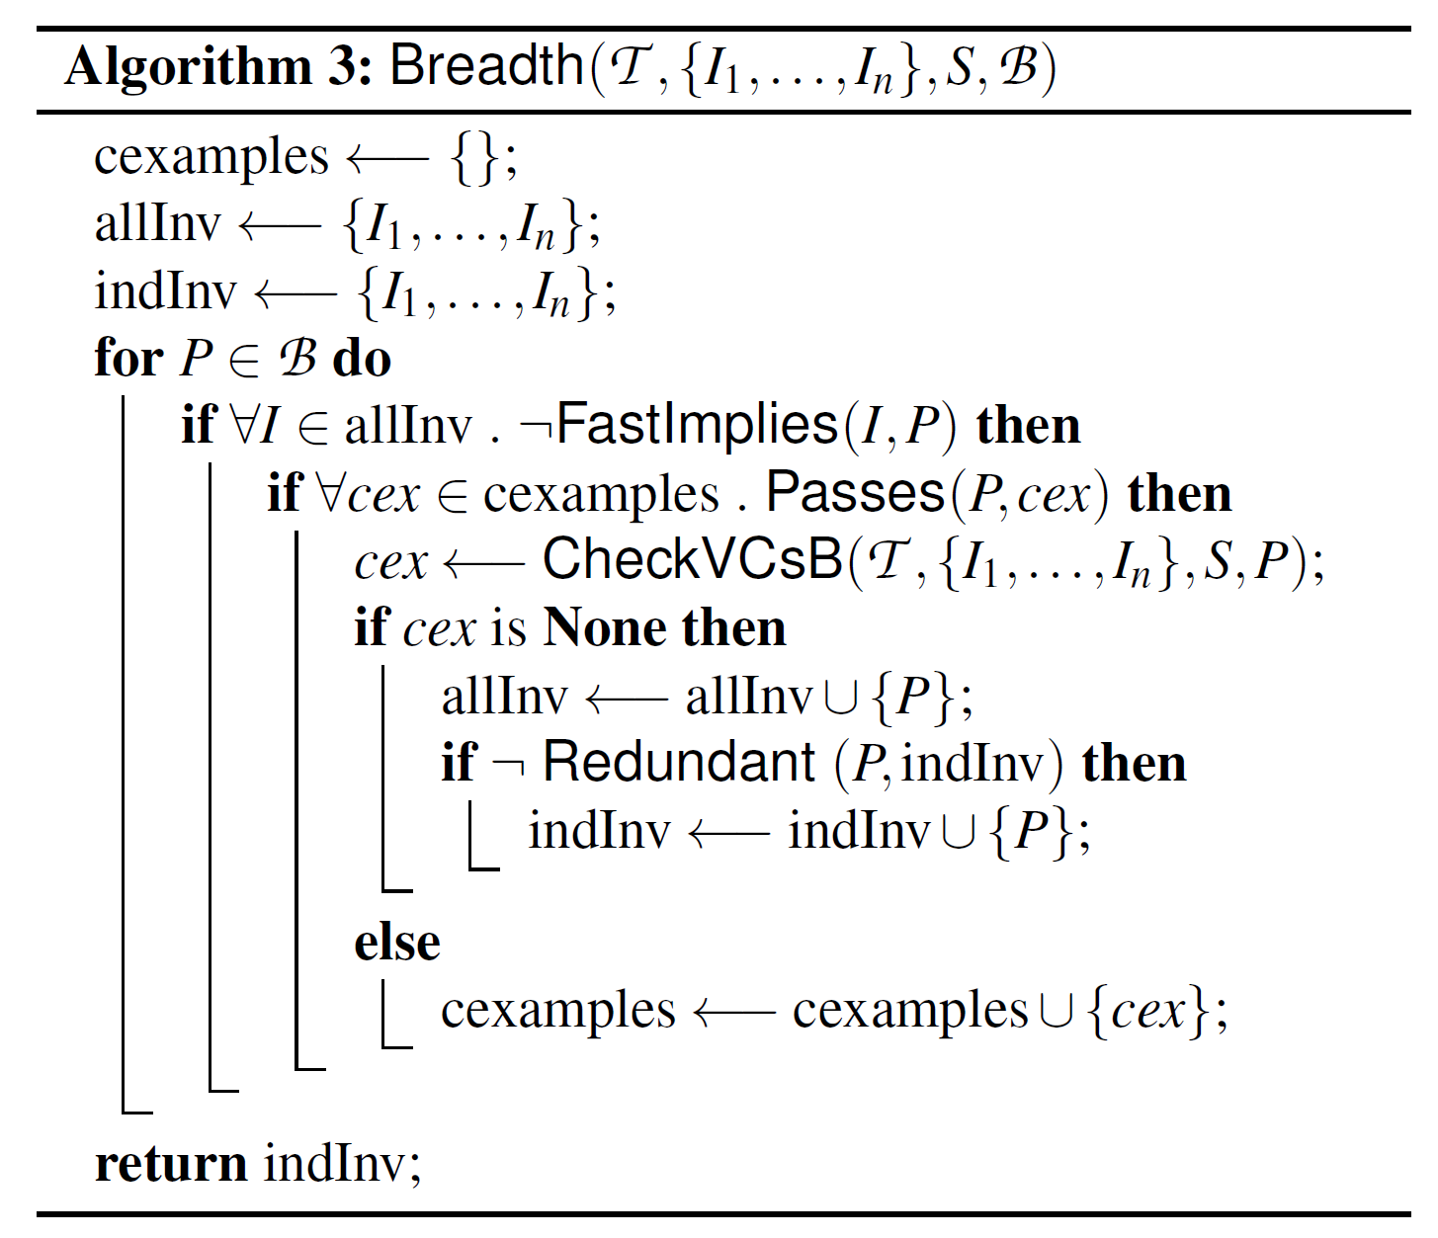
The Breadth Algorithm
Filter syntactically redundant invariants
Use counter examples to filter invariants efficiently
Filter semantically redundant invariants

Slide 20
Optimizations
Notes:
之前已经介绍过一些优化技术，现在还有更多的优化技术

Slide 21
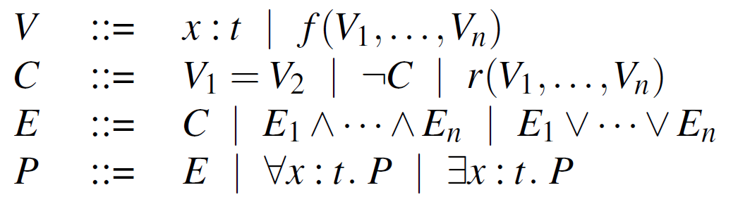
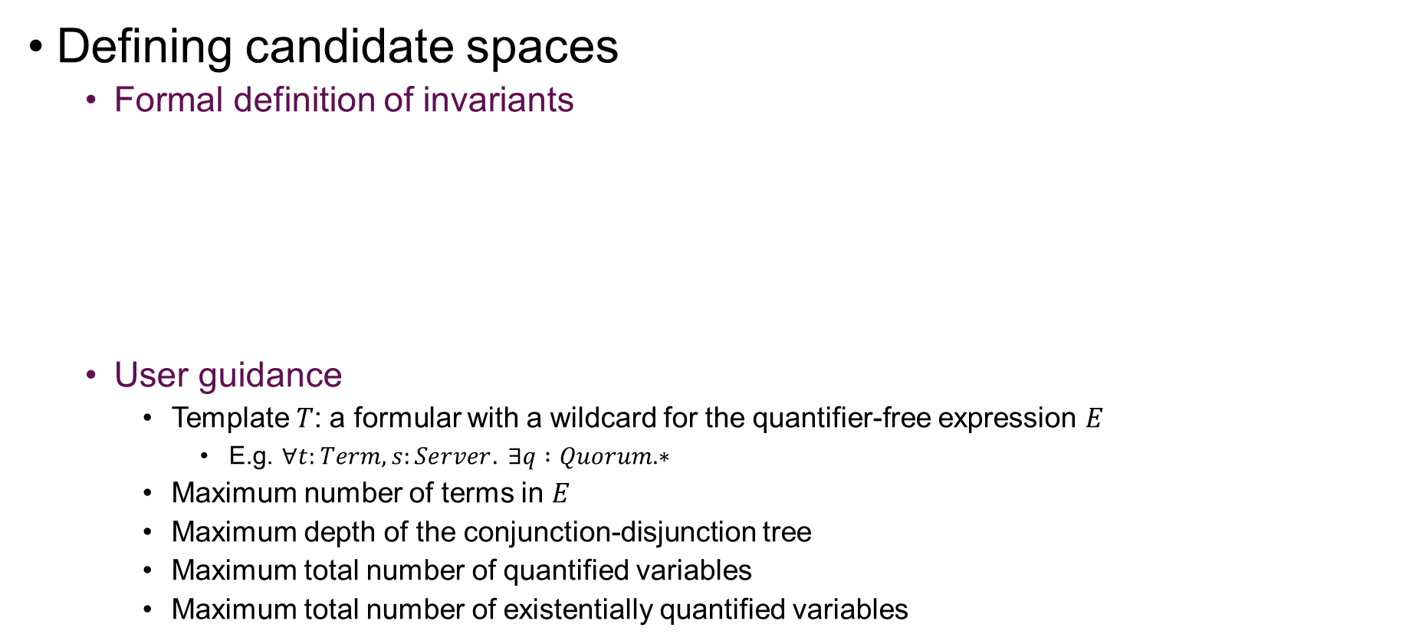
Exploiting User Guidance & Candidate Symmetries
Defining candidate spaces
Formal definition of invariants
User guidance
Template $T$: a formular with a wildcard for the quantifier-free expression $E$
E.g. $∀t:Term, s:Server. ∃q :Quorum. ∗$
Maximum number of terms in $E$
Maximum depth of the conjunction-disjunction tree
Maximum total number of quantified variables
Maximum total number of existentially quantified variables
Notes:
通过利用对称性与用户的领域知识来限制搜索空间的大小
没有逻辑蕴含与逻辑等价

Slide 22
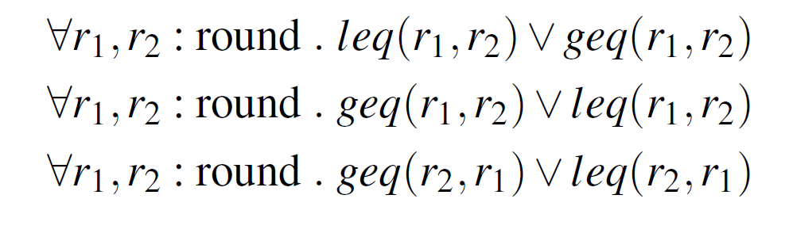
Exploiting User Guidance & Candidate Symmetries
Symmetry breaking of candidate space using syntactic constraints instead of SMT calls
Assigning an order to all base terms
Assigning an order to all interchangeable variables
Notes:
Smt call比较昂贵
只搜索符合顺序约束的公式集合
实验表明，搜索空间的大小降低了两个数量级

Slide 23
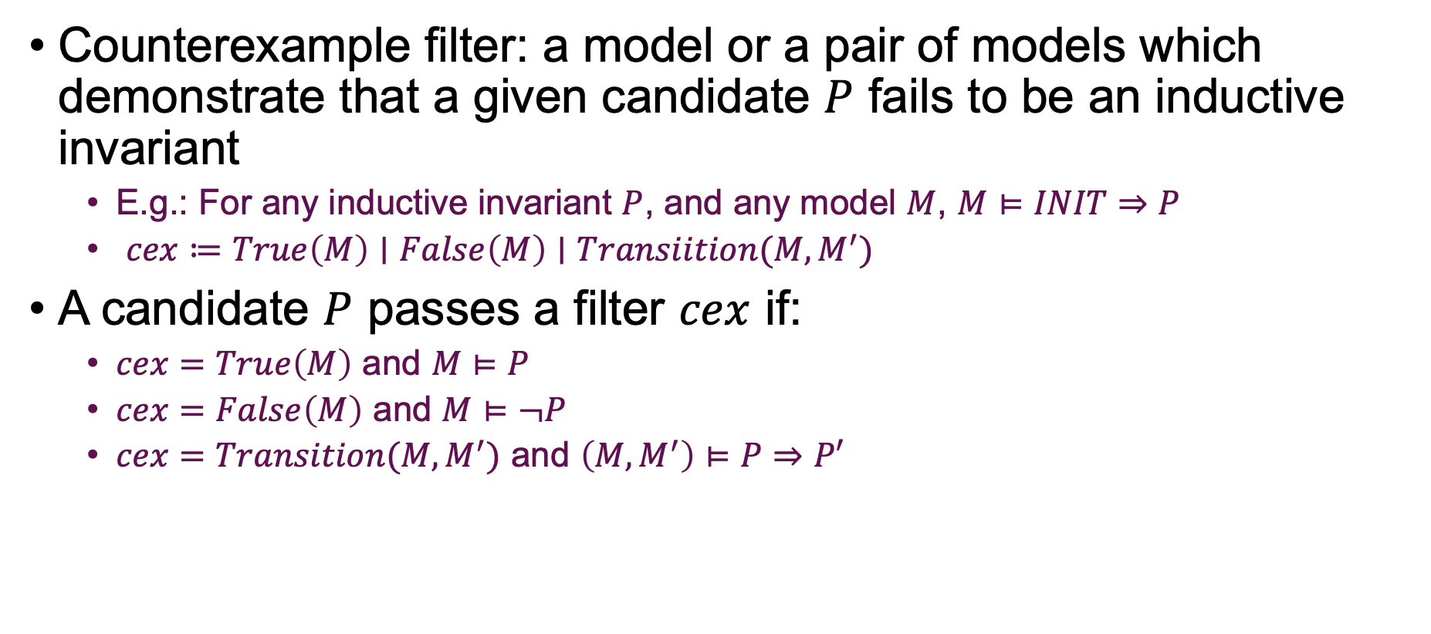
Filtering Based on Counterexamples
Counterexample filter: a model or a pair of models which demonstrate that a given candidate $P$ fails to be an inductive invariant
E.g.: For any inductive invariant $P$, and any model $M$, $M⊨INIT⇒P$
$cex≔True\left(M\right)∣False\left(M\right)∣Transiition(M,M^{′})$
A candidate $P$ passes a filter $cex$ if:
$cex=True\left(M\right)$ and $M⊨P$
$cex=False\left(M\right)$ and $M⊨¬P$
$cex=Transition(M,M^{′})$ and $\left(M,M^{′}\right)⊨P⇒P′$
Notes:
需要满足 通过vc的一定能通过ctex，但是通过ctex不一定是ind inv
思想在于，一个不变量要求在某些模型上必须为真或者假

Slide 24

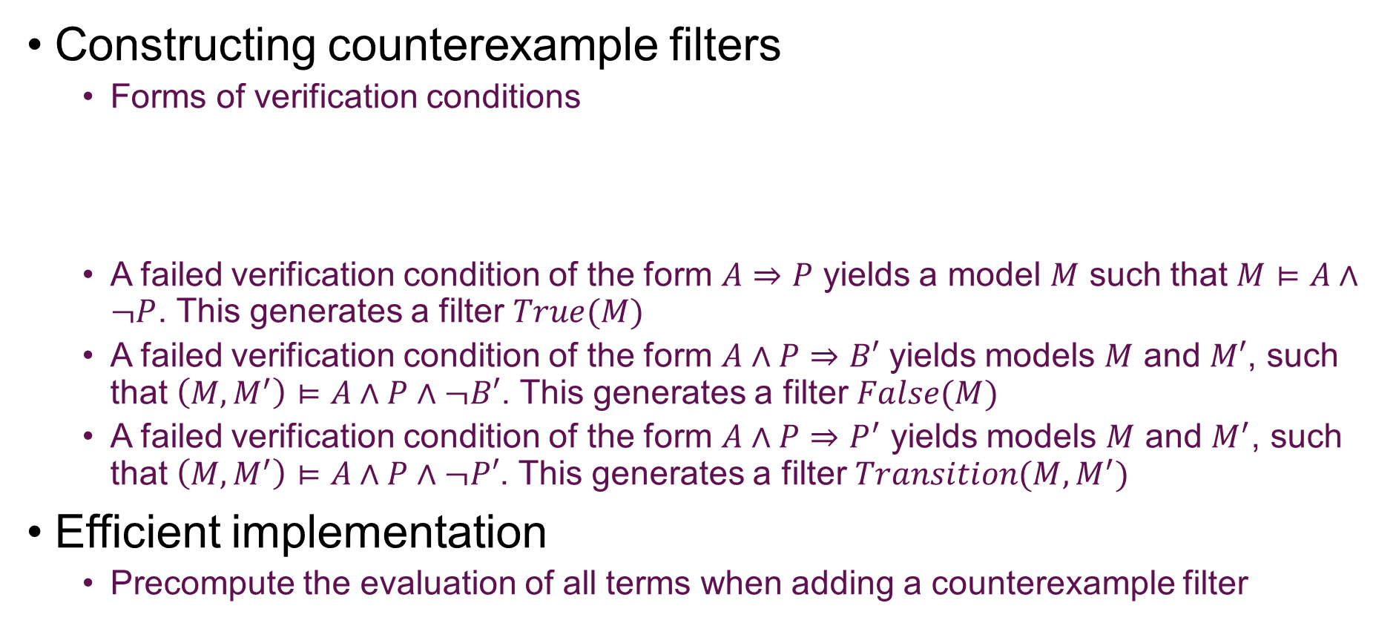
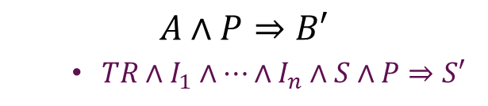
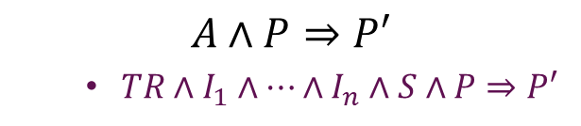
Filtering Based on Counterexamples
Constructing counterexample filters
Forms of verification conditions
A failed verification condition of the form $A⇒P$ yields a model $M$ such that $M⊨A∧¬P$. This generates a filter $True(M)$
A failed verification condition of the form $A∧P⇒B′$ yields models $M$ and $M′$, such that $\left(M,M^{′}\right)⊨A∧P∧¬B′$. This generates a filter $False(M)$
A failed verification condition of the form $A∧P⇒P^{′}$ yields models $M$ and $M^{′}$, such that $\left(M,M^{′}\right)⊨A∧P∧¬P′$. This generates a filter $Transition(M,M^{′})$
Efficient implementation
Precompute the evaluation of all terms when adding a counterexample filter
$$A⇒P$$
$INIT⇒P$
$$A∧P⇒B′$$
$TR∧I_{1}∧⋯∧I_{n}∧S∧P⇒S′$
$$A∧P⇒P′$$
$TR∧I_{1}∧⋯∧I_{n}∧S∧P⇒P′$

Slide 25
Other Optimizations
Checking verification conditions
Encoding verification conditions into SMT formulars^{[1]} so that evaluating the validity of formulas is rapidly decidable
Using hybrid SMT solvers
Minimizing models
When extracting counterexamples form failed verification, SWISS tries to find a model that is as small as possible
Parallelism
Splitting the search space into randomly-permuted multiple parts, each thread searching one part independently
Finer granularity?
[1] Padon, O., McMillan, K. L., Panda, A., Sagiv, M., & Shoham, S. (2016, June). Ivy: safety verification by interactive generalization. In Proceedings of the 37th ACM SIGPLAN Conference on Programming Language Design and Implementation (pp. 614-630).
Notes:
由于社区的优化
在复杂的程序验证中，这个优化尽管简单，但是至关重要
作者还尝试了一些之前工作中的优化，但是发现它们效果不理想，因此没有采用。可供未来实验参考

Slide 26
Evaluation

Slide 27
Experimental Setup and Implementation Details
Benchmark suit from prior works^{[1][2][3]}
Optimizations
Symmetry breaking, filtering by counterexamples, hybrid SMT solvers, filtering redundant invariants, model minimization, parallelism
Implementation details
Approximately 14000 lines of C++ codes
[1] Ma, H., Goel, A., Jeannin, J. B., Kapritsos, M., Kasikci, B., & Sakallah, K. A. (2019, October). I4: incremental inference of inductive invariants for verification of distributed protocols. In Proceedings of the 27th ACM Symposium on Operating Systems Principles (pp. 370-384).
[2] Koenig, J. R., Padon, O., Immerman, N., & Aiken, A. (2020, June). First-order quantified separators. In Proceedings of the 41st ACM SIGPLAN Conference on Programming Language Design and Implementation (pp. 703-717).
[3] Padon, O., Losa, G., Sagiv, M., & Shoham, S. (2017). Paxos made EPR: decidable reasoning about distributed protocols. Proceedings of the ACM on Programming Languages, 1(OOPSLA), 1-31.

Slide 28
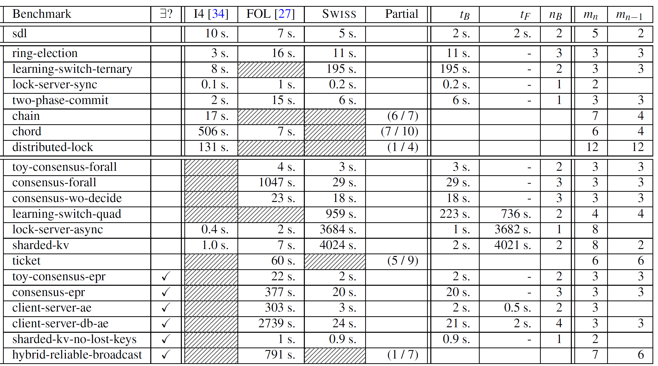
Top-Level Protocol Results
Notes:
从实验结果上，SWISS和之前的系统各有优劣，没有哪个完全比其他强

Slide 29
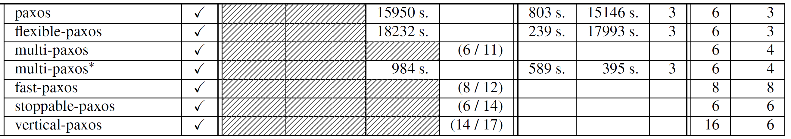
Top-Level Protocol Results
SWISS solves verification for Paxos, Flexibale Paxos and Multi-Paxos
Fast Paxos, Stoppable Paxos, Vertical Paxos remain unsolved
Notes:
但是SWISS是第一个自动验证paxos和它的一些变体的系统

Slide 30
Partial Progress
When an execution of SWISS exceeds its time limit, it still generates many useful invariants
No partially solved invariants for the other tools in comparison
Notes:
另外，作者分析了他们的small world hypothesis，结果证明，分析的协议中，大部分的不变式都比较短，是符合假设的。

Slide 31
Conclusion & Future Work

Slide 32
Conclusion & Future Work
SWISS
Novel optimizations
The hypothesis hold form many protocols
Future work
Combine SWISS and its recent predecessors in novel ways, which have complementary coverage of the benchmarks

Slide 33
Thank You

