Slide 1


工作进展汇报
赵嘉铖、蔡文俊
2022年05月22日

Slide 2
Ivy协议整理
出现的逻辑运算符和量词
& | -> = ~
forall
都是非常容易转化的
重点在于布尔值转换回TLA+语法
转换策略
基于Apalache的类型检查

Slide 3
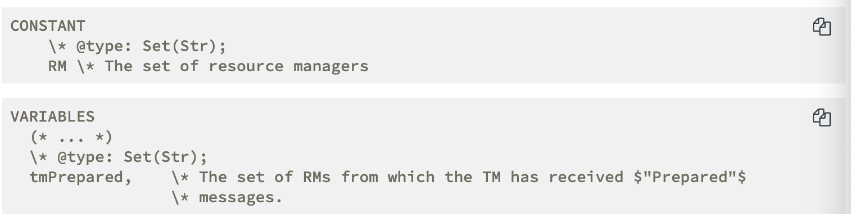
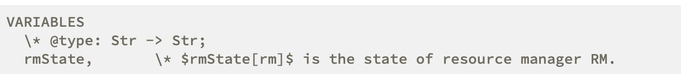
Apalache相关
Apalache Type Checker
可以直接使用type checker独立进行检查
在TLA+注释中引入了类似Java的注释
类型检查器会自动查找许多操作符号的类型

Slide 4
注释详解
Type annotations for the built-in operators
+,-,*,\div have the signature (Int,Int) => Int
{e1} and {e1,e2} have a => Set(a) and (b,b) => Set(b)
<<e1,e2>> have (a,b) => <<a,b>> | (a,a) => Seq(a)
{x∈S:P} becomes ((a => Bool ) => Set(a))

Slide 5
注释详解
注释
Recipe variables
@type:Int;
Constants
Operators
\* @type: (Set(Int), Int -> Int) => Set(Int); Image(S, B) == {B[x] : x \in S}
Records
msgs is a set contains records of two types:[type: Str] and [type: Str, rm: RM]
\* @type: Set([type: Str, rm: RM]); msgs
an incorrect field access

Slide 6
注释详解
注释
Functions as sequences
\* @type: (Seq(Int), Int, Int) => Bool; Attacks(queens,i,j) == ...
Type Aliases
\* @typeAlias: ALIAS = <type>;
Multi-line
Comments
大多数注释都是在关键字和变量之间
LOCAL的注释在LOCAL关键字之前
参考文档:https://apalache.informal.systems/docs/HOWTOs/howto-write-type-annotations.html
https://apalache.informal.systems/docs/adr/002adr-types.html

Slide 7
注释详解
uninterpreted types
CONSTANT RM \* The set of resource managers
RM = 1..3 or RM = {“a”,”b”,”c”}
Int <,>,>=,<=
注释方法 \* @type: UTNAME;
如何解释一个值属于uninterpreted types
"identifier_OF_TYPENAME"
“1_OF_UT”
“abc_OF_UT”
"abc" = "bc_OF_A" /false
"1_OF_A" = "1_OF_B"
"1_OF_A" = "2_OF_A"
"1_OF_A" = "1_OF_A"

Slide 8
Tools(untyped->typed)
Type checker
Local analysis of operator definitions.Need for annotations
Type Inferer
Global analysis of the spec.No annotations.
Both of them are independent of the model checker

Slide 9
Type checker
Type syntax
Bool | Int | Str | Real basic types
IDENTIFIER123 | [_A-Z][_A-Z0-9]* uninterpreted type
Like types of model values in TLC
Often, CONSTANTS are parameterized sets
T -> T | set(T) | Seq(T) functions,sets,sequences
<<T,...T>> | [h1: T,...,hk: T] tuples,records
(T,...T) => T operators
a | ... | z type variables

Slide 10
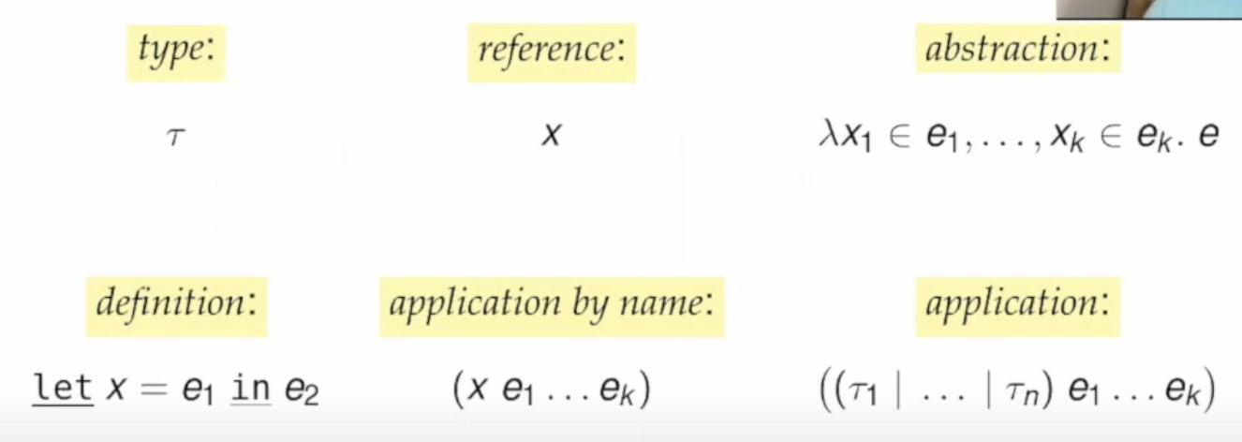
Type checker
simple lamda-calculus over types

Slide 11

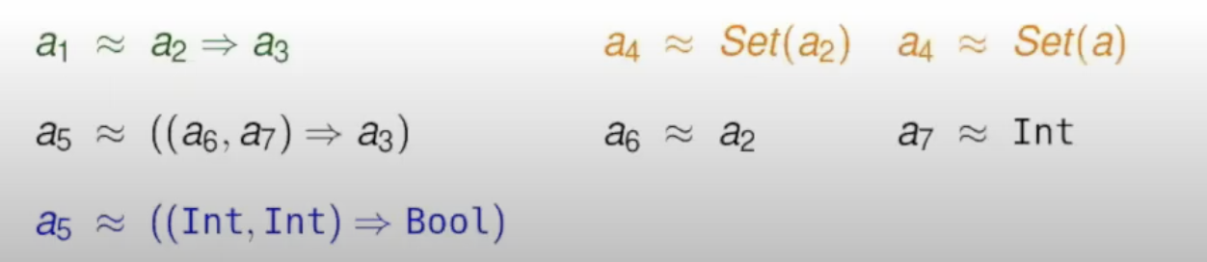
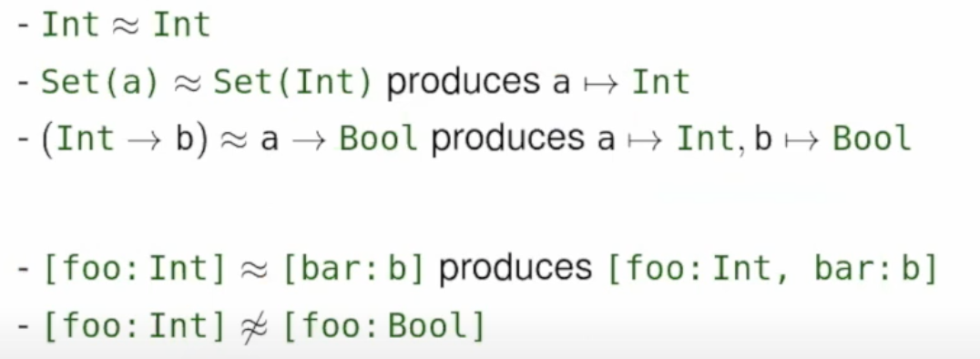
Type checker
Type checking becomes equation solving

Slide 12
Type inferer
Approach
Use TLA+ specification to infer bounds on types
Create SMT constraints from TLA+ expressions
Reconstruct types from an SMT model
Post-processing
Determine type error
https://conf.tlapl.us/2020/07-Kukovec_and_Konnov-Type_Inference_for_TLA_+_in_Apalache.pdf
https://www.youtube.com/watch?v=hnp25hmCMN8

Slide 13
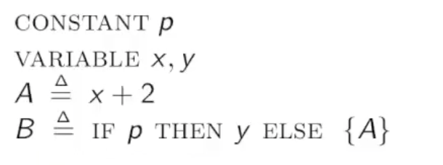
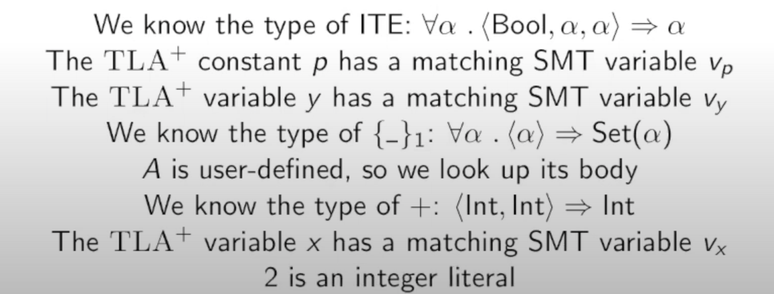
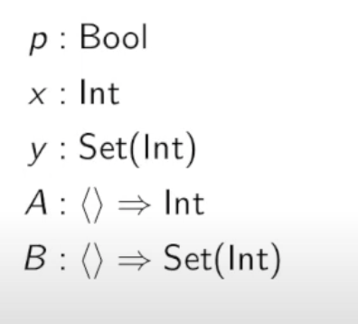
Type inferer
t1 = c1 /\ t2 = bool /\ t3 = c1/\ t4 = c1
/\ t2 = Vp
/\ t3 = Vy
/\ t4 = set(c2) /\ t5 = c2
/\ t5 = c3
/\ c3 = int /\ t6 = int /\ t7 = int
/\ t6 = Vx
/\ t7 = int
Example

Slide 14
TLA+中不变式常用的语法单元
基本逻辑（与或非，推导，if..then..else）
let..in..(可能产生局部变量问题）
函数（获取函数运算值）
集合运算
交并集，获取集合大小，判定元素是否在集合内，集合比较，…
可能产生无名集合
元组（获取元组的某个元素）
Record（获取某个字段）
有关liveness的判定

Slide 15
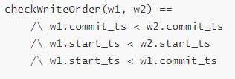


整数的处理
整数可能出现的场景
时间比较
集合大小（Cardinality）
字符串长度
…
大部分场景都是进行比较
可能的解决方式
变量与已知整数进行比较
变量与变量进行比较

Slide 16
比较的处理
用户为需要进行变量-常量比较的变量标注其可能值
我们可以为这些变量-常量对生成几个谓词
对于需要进行变量-变量比较的，用户需要标注可能发生比较的变量集合和需要进行比较的符号（=,<,>,/=,…）
我们可以对该集合中所有元素两两生成谓词

Slide 17
Thank You

