Slide 1









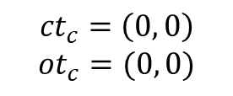














${ct}_{c}$:客户端所知的最大集群时间
Client
由HLC(sec, counter)格式表示。
$${ct}_{c}=\left(0, 0\right)$$
$${ot}_{c}=(0, 0)$$
${ot}_{c}$:客户端最近操作时间
Shard 1
Shard 2
${ct}_{s}$:服务端集群时间
Primary
Primary
$${ct}_{s}=\left(0, 0\right)$$
$${ct}_{s}=\left(0, 0\right)$$
$${aot}_{s}=\left(0, 0\right)$$
${aot}_{s}$:服务端最近应用的操作时间
$${aot}_{s}=\left(0, 0\right)$$
$${clock}_{s}=0$$
$${clock}_{s}=0$$
${clock}_{s}$:服务端当前物理时钟
Secondary
Secondary
Secondary
Secondary
$${ct}_{s}=\left(0, 0\right)$$
$${ct}_{s}=\left(0, 0\right)$$
$${ct}_{s}=\left(0, 0\right)$$
$${ct}_{s}=\left(0, 0\right)$$
$${aot}_{s}=\left(0, 0\right)$$
$${aot}_{s}=\left(0, 0\right)$$
$${aot}_{s}=\left(0, 0\right)$$
$${aot}_{s}=\left(0, 0\right)$$
$${clock}_{s}=0$$
$${clock}_{s}=0$$
$${clock}_{s}=0$$
$${clock}_{s}=0$$

Slide 2
Client
$${ct}_{c}=\left(0, 0\right)$$
$${ot}_{c}=(0, 0)$$
Shard 1
Shard 2
Primary
Primary
$${ct}_{s}=\left(0, 0\right)$$
$${ct}_{s}=\left(0, 0\right)$$
$${aot}_{s}=\left(0, 0\right)$$
$${aot}_{s}=\left(0, 0\right)$$
$${clock}_{s}=0$$
$${clock}_{s}=0$$
Secondary
Secondary
Secondary
Secondary
$${ct}_{s}=\left(0, 0\right)$$
$${ct}_{s}=\left(0, 0\right)$$
$${ct}_{s}=\left(0, 0\right)$$
$${ct}_{s}=\left(0, 0\right)$$
$${aot}_{s}=\left(0, 0\right)$$
$${aot}_{s}=\left(0, 0\right)$$
$${aot}_{s}=\left(0, 0\right)$$
$${aot}_{s}=\left(0, 0\right)$$
$${clock}_{s}=0$$
$${clock}_{s}=0$$
$${clock}_{s}=0$$
$${clock}_{s}=0$$

Slide 3

PUT
Client
$${ct}_{c}=\left(0, 0\right)$$
$${ot}_{c}=(0, 0)$$
$${ct}_{c}=(0, 0)$$
Shard 1
Shard 2
Primary
Primary
$${ct}_{s}=\left(0, 0\right)$$
$${ct}_{s}=\left(0, 0\right)$$
$${aot}_{s}=\left(0, 0\right)$$
$${aot}_{s}=\left(0, 0\right)$$
$${clock}_{s}=0$$
$${clock}_{s}=0$$
Secondary
Secondary
Secondary
Secondary
$${ct}_{s}=\left(0, 0\right)$$
$${ct}_{s}=\left(0, 0\right)$$
$${ct}_{s}=\left(0, 0\right)$$
$${ct}_{s}=\left(0, 0\right)$$
$${aot}_{s}=\left(0, 0\right)$$
$${aot}_{s}=\left(0, 0\right)$$
$${aot}_{s}=\left(0, 0\right)$$
$${aot}_{s}=\left(0, 0\right)$$
$${clock}_{s}=0$$
$${clock}_{s}=0$$
$${clock}_{s}=0$$
$${clock}_{s}=0$$

Slide 4


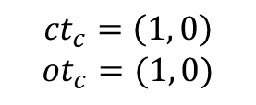



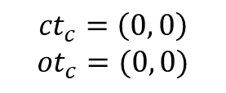





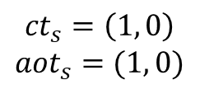





PUT
Client
Client
$${ct}_{c}=\left(0, 0\right)$$
$${ot}_{c}=(0, 0)$$
$${ct}_{c}=\left(0, 0\right)$$
$${ot}_{c}=(0, 0)$$
$${ct}_{c}=\left(1, 0\right)$$
$${ot}_{c}=(1, 0)$$
$${ct}_{s}=\left(1, 0\right)$$
$${aot}_{s}=(1, 0)$$
$${ct}_{c}=(0, 0)$$
Primary
Primary
Primary
$${ct}_{s}=\left(0, 0\right)$$
$${ct}_{s}=\left(0, 0\right)$$
$${ct}_{s}=\left(1, 0\right)$$
$${ct}_{s}=\left(1, 0\right)$$
$${aot}_{s}=\left(0, 0\right)$$
$${aot}_{s}=\left(0, 0\right)$$
$${aot}_{s}=\left(0, 0\right)$$
$${aot}_{s}=\left(1, 0\right)$$
$${clock}_{s}=1$$
$${clock}_{s}=1$$
$${clock}_{s}=0$$
$${clock}_{s}=1$$
$$k:{aot}_{s}=(1, 0)$$
$${aot}_{s}=\left(0, 0\right)$$
PUT-REQUEST流程

Slide 5


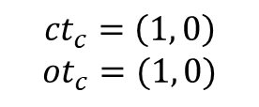


Client
$${ct}_{c}=\left(1, 0\right)$$
$${ot}_{c}=(1, 0)$$
Shard 1
Primary
Shard 2
$${ct}_{s}=\left(1, 0\right)$$
Primary
$${aot}_{s}=\left(1, 0\right)$$
$${ct}_{s}=\left(0, 0\right)$$
$${clock}_{s}=1$$
$${aot}_{s}=\left(0, 0\right)$$
$${clock}_{s}=0$$
$$k:{aot}_{s}=(1, 0)$$
Secondary
Secondary
Secondary
Secondary
$${ct}_{s}=\left(0, 0\right)$$
$${ct}_{s}=\left(0, 0\right)$$
$${ct}_{s}=\left(0, 0\right)$$
$${ct}_{s}=\left(0, 0\right)$$
$${aot}_{s}=\left(0, 0\right)$$
$${aot}_{s}=\left(0, 0\right)$$
$${aot}_{s}=\left(0, 0\right)$$
$${aot}_{s}=\left(0, 0\right)$$
$${clock}_{s}=0$$
$${clock}_{s}=0$$
$${clock}_{s}=0$$
$${clock}_{s}=0$$

Slide 6
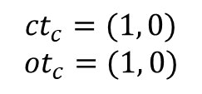
GET
Client
$${ct}_{c}=\left(1, 0\right)$$
$${ot}_{c}=(1, 0)$$
$${ct}_{c}=(1, 0)$$
$${ot}_{c}=(1, 0)$$
Shard 1
Primary
Shard 2
$${ct}_{s}=\left(1, 0\right)$$
Primary
$${aot}_{s}=\left(1, 0\right)$$
$${ct}_{s}=\left(0, 0\right)$$
$${clock}_{s}=1$$
$${aot}_{s}=\left(0, 0\right)$$
$${clock}_{s}=0$$
$$k:{aot}_{s}=(1, 0)$$
Secondary
Secondary
Secondary
Secondary
$${ct}_{s}=\left(0, 0\right)$$
$${ct}_{s}=\left(0, 0\right)$$
$${ct}_{s}=\left(0, 0\right)$$
$${ct}_{s}=\left(0, 0\right)$$
$${aot}_{s}=\left(0, 0\right)$$
$${aot}_{s}=\left(0, 0\right)$$
$${aot}_{s}=\left(0, 0\right)$$
$${aot}_{s}=\left(0, 0\right)$$
$${clock}_{s}=0$$
$${clock}_{s}=0$$
$${clock}_{s}=0$$
$${clock}_{s}=0$$

Slide 7


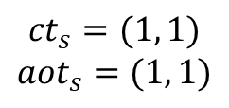



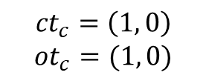

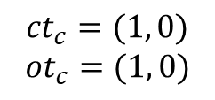




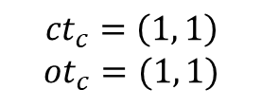



GET
Client
Client
$${ct}_{c}=\left(1, 0\right)$$
$${ot}_{c}=(1, 0)$$
$${ct}_{c}=\left(1, 0\right)$$
$${ot}_{c}=(1, 0)$$
$${ct}_{c}=\left(1, 1\right)$$
$${ot}_{c}=(1, 1)$$
$${ct}_{c}=(1, 0)$$
$${ot}_{c}=(1, 0)$$
$${ct}_{s}=(1, 1)$$
$${aot}_{s}=(1, 1)$$
Primary
Primary
Primary
$${ct}_{s}=\left(1, 0\right)$$
$${ct}_{s}=\left(1, 1\right)$$
$${ct}_{s}=\left(1, 1\right)$$
$${ct}_{s}=\left(0, 0\right)$$
$${ct}_{s}=\left(1, 0\right)$$
$${aot}_{s}=\left(0, 0\right)$$
$${aot}_{s}=\left(1, 1\right)$$
$${aot}_{s}=\left(1, 1\right)$$
$${aot}_{s}=\left(0, 0\right)$$
$${clock}_{s}=0$$
$${clock}_{s}=0$$
$${clock}_{s}=0$$
$$NOOP:{aot}_{s}=(1, 1)$$
$$NOOP:{aot}_{s}=(1, 1)$$

Slide 8



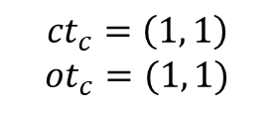





Client
$${ct}_{c}=\left(1, 1\right)$$
$${ot}_{c}=(1, 1)$$
Shard 1
Primary
Shard 2
$${ct}_{s}=\left(1, 0\right)$$
Primary
$${aot}_{s}=\left(1, 0\right)$$
$${ct}_{s}=\left(1, 1\right)$$
$${clock}_{s}=1$$
$${aot}_{s}=\left(1, 1\right)$$
$${clock}_{s}=0$$
$$k:{aot}_{s}=(1, 0)$$
$$NOOP:{aot}_{s}=(1, 1)$$
Secondary
Secondary
Secondary
Secondary
$${ct}_{s}=\left(1, 0\right)$$
$${ct}_{s}=\left(0, 0\right)$$
$${ct}_{s}=\left(0, 0\right)$$
$${ct}_{s}=\left(0, 0\right)$$
$${aot}_{s}=\left(1, 0\right)$$
$${aot}_{s}=\left(0, 0\right)$$
$${aot}_{s}=\left(0, 0\right)$$
$${aot}_{s}=\left(0, 0\right)$$
$${clock}_{s}=1$$
$${clock}_{s}=2$$
$${clock}_{s}=0$$
$${clock}_{s}=0$$
$$k:{aot}_{s}=(1, 0)$$

Slide 9
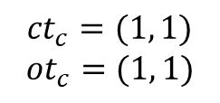
GET
Client
$${ct}_{c}=\left(1, 1\right)$$
$${ot}_{c}=(1, 1)$$
Shard 1
$${ct}_{c}=(1, 1)$$
$${ot}_{c}=(1, 1)$$
Primary
Shard 2
$${ct}_{s}=\left(1, 0\right)$$
Primary
$${aot}_{s}=\left(1, 0\right)$$
$${ct}_{s}=\left(1, 1\right)$$
$${clock}_{s}=1$$
$${aot}_{s}=\left(1, 1\right)$$
$${clock}_{s}=0$$
$$k:{aot}_{s}=(1, 0)$$
$$NOOP:{aot}_{s}=(1, 1)$$
Secondary
Secondary
Secondary
Secondary
$${ct}_{s}=\left(1, 0\right)$$
$${ct}_{s}=\left(0, 0\right)$$
$${ct}_{s}=\left(0, 0\right)$$
$${ct}_{s}=\left(0, 0\right)$$
$${aot}_{s}=\left(1, 0\right)$$
$${aot}_{s}=\left(0, 0\right)$$
$${aot}_{s}=\left(0, 0\right)$$
$${aot}_{s}=\left(0, 0\right)$$
$${clock}_{s}=1$$
$${clock}_{s}=2$$
$${clock}_{s}=0$$
$${clock}_{s}=0$$
$$k:{aot}_{s}=(1, 0)$$

Slide 10










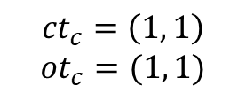

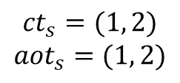


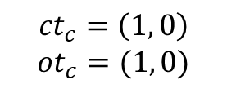


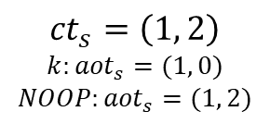



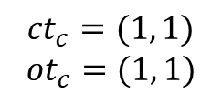
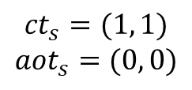

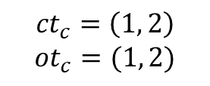
GET
Primary
Client
Client
$${ct}_{s}=\left(1, 2\right)$$
$${ct}_{c}=\left(1, 1\right)$$
$${ot}_{c}=(1, 1)$$
$${ct}_{c}=\left(1, 0\right)$$
$${ot}_{c}=(1, 0)$$
$${aot}_{s}=\left(1, 2\right)$$
$${ct}_{c}=\left(1, 2\right)$$
$${ot}_{c}=(1, 2)$$
$${clock}_{s}=1$$
$$k:{aot}_{s}=\left(1, 0\right)$$
$${NOOP:aot}_{s}=(1, 2)$$
$${ct}_{c}=(1, 1)$$
$${ot}_{c}=(1, 1)$$
$${ct}_{s}=(1, 2)$$
$${aot}_{s}=(1, 2)$$
$${ct}_{s}=\left(1, 2\right)$$
$$k:{aot}_{s}=(1, 0)$$
$${NOOP:aot}_{s}=(1, 2)$$
$${ct}_{s}=(1, 1)$$
$${aot}_{s}=(0, 0)$$
Secondary
Secondary
Secondary
$${ct}_{s}=\left(0, 0\right)$$
$${ct}_{s}=\left(1, 1\right)$$
$${ct}_{s}=\left(1, 1\right)$$
$${ct}_{s}=\left(1, 2\right)$$
$${ct}_{s}=\left(1, 2\right)$$
$${aot}_{s}=\left(0, 0\right)$$
$${aot}_{s}=\left(1, 0\right)$$
$${aot}_{s}=\left(0, 0\right)$$
$${aot}_{s}=\left(1, 2\right)$$
$${aot}_{s}=\left(1, 2\right)$$
$${clock}_{s}=2$$
$${clock}_{s}=2$$
$${clock}_{s}=2$$
$$k:{aot}_{s}=\left(1, 0\right)$$
$$NOOP:{aot}_{s}=(1, 2)$$
$$k:{aot}_{s}=\left(1, 0\right)$$
$$NOOP:{aot}_{s}=(1, 2)$$

Slide 11
















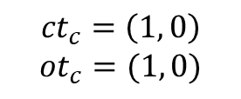


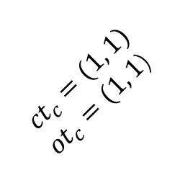



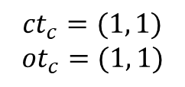
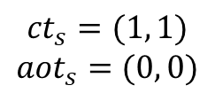

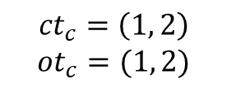

GET
补充版本
Client
Primary
Client
$${ct}_{s}=\left(1, 1\right)$$
$${ct}_{s}=\left(1, 2\right)$$
$${ct}_{c}=\left(1, 1\right)$$
$${ot}_{c}=(1, 1)$$
$${ct}_{c}=\left(1, 0\right)$$
$${ot}_{c}=(1, 0)$$
$${aot}_{s}=\left(1, 2\right)$$
$${ct}_{c}=\left(1, 2\right)$$
$${ot}_{c}=(1, 2)$$
$${aot}_{s}=\left(1, 1\right)$$
$${ct}_{c}=(1, 1)$$
${ot}_{c}=(1, 1$)
$${clock}_{s}=1$$
$$k:{aot}_{s}=\left(1, 0\right)$$
$${NOOP:aot}_{s}=(1, 2)$$
PRIMARY().NOOP()
$${ct}_{c}=(1, 1)$$
$${ot}_{c}=(1, 1)$$
$${ct}_{s}=(1, 2)$$
$${aot}_{s}=(1, 2)$$
$${ct}_{s}=\left(1, 2\right)$$
$$k:{aot}_{s}=(1, 0)$$
$${NOOP:aot}_{s}=(1, 2)$$
$${ct}_{s}=(1, 1)$$
$${aot}_{s}=(0, 0)$$
Secondary
Secondary
Secondary
$${ct}_{s}=\left(0, 0\right)$$
$${ct}_{s}=\left(1, 1\right)$$
$${ct}_{s}=\left(1, 1\right)$$
$${ct}_{s}=\left(1, 2\right)$$
$${ct}_{s}=\left(1, 2\right)$$
$${aot}_{s}=\left(0, 0\right)$$
$${aot}_{s}=\left(1, 0\right)$$
$${aot}_{s}=\left(0, 0\right)$$
$${aot}_{s}=\left(1, 2\right)$$
$${aot}_{s}=\left(1, 2\right)$$
$${clock}_{s}=2$$
$${clock}_{s}=2$$
$${clock}_{s}=2$$
$$k:{aot}_{s}=\left(1, 0\right)$$
$$NOOP:{aot}_{s}=(1, 2)$$
$$k:{aot}_{s}=\left(1, 0\right)$$
$$NOOP:{aot}_{s}=(1, 2)$$
REPLICATE流程

Slide 12

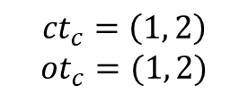







Client
$${ct}_{c}=\left(1, 2\right)$$
$${ot}_{c}=(1, 2)$$
Shard 1
Primary
Shard 2
$${ct}_{s}=\left(1, 2\right)$$
Primary
$${aot}_{s}=\left(1, 2\right)$$
$${ct}_{s}=\left(1, 1\right)$$
$${clock}_{s}=1$$
$${aot}_{s}=\left(1, 1\right)$$
$${clock}_{s}=0$$
$$k:{aot}_{s}=\left(1, 0\right)$$
$${NOOP:aot}_{s}=(1, 2)$$
$$NOOP:{aot}_{s}=(1, 1)$$
Secondary
Secondary
Secondary
Secondary
$${ct}_{s}=\left(1, 0\right)$$
$${ct}_{s}=\left(1, 2\right)$$
$${ct}_{s}=\left(0, 0\right)$$
$${ct}_{s}=\left(0, 0\right)$$
$${aot}_{s}=\left(1, 0\right)$$
$${aot}_{s}=\left(1, 2\right)$$
$${aot}_{s}=\left(0, 0\right)$$
$${aot}_{s}=\left(0, 0\right)$$
$${clock}_{s}=1$$
$${clock}_{s}=2$$
$${clock}_{s}=0$$
$${clock}_{s}=0$$
$$k:{aot}_{s}=(1, 0)$$
$$k:{aot}_{s}=\left(1, 0\right)$$
$${NOOP:aot}_{s}=(1, 2)$$

Slide 13
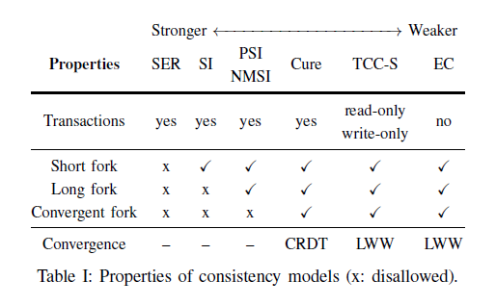
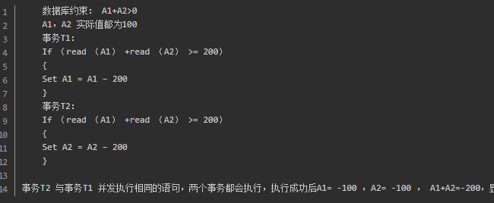
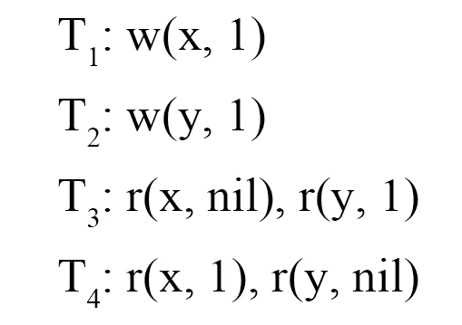
2.Cure:一种满足高可用和低延迟的强大语义
A、事务因果一致性 (TCC) 模型：
论文贡献：
1、一种新颖的编程模型，提供具有高级、融合数据类型的因果一致的交互式事务
2、一种高性能协议，支持这种用于地理复制数据存储的编程模型
3、综合评估，将我们的方法与最先进的数据存储进行了比较。
write skew（short fork）：
事务t1读取了一个被事务t2修改的对象，事务t2读取了一个被事务t1修改的对象。
Long fork：事务t1，t2分别修改的两个对象，事务t3，t4读取是发现只能正确读取到一个被修改的对象。

