Slide 1
Automated Synthesis of Comprehensive
Memory Model Litmus Test Suites
[Lustig et al. @ASPLOS’17]
Name: Xue Jiang

Slide 2

Memory Consistency Models
Thread 1
Thread 2
r
w
w
…
w
w
r
r
Java Memory Model
Modern weak memory models are difficult to implement correctly
Notes:
描述了在多线程代码中，哪些行为是正确的、合法的，以及多线程之间如何进行通信，代码中变量的读写行为如何反应到内存、CPU缓存的底层细节。

Slide 3
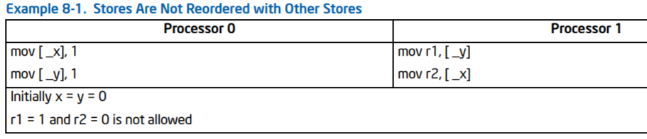
Memory Model Verification
Relying heavily on testing with litmus test

Slide 4
Litmus Test
Small programs designed to stress certain behaviors of the model
Thread 1
Thread 2
1
X = 1
3
r1 = Y
= 1
r2 = X
TSO (total store order): no
2
Y
4
PSO (partial store order): yes
Init: r1 = r2 = 0
Outcome: r1 = 1 ? r2 = 0
A suite of litmus tests is fully useful only if it is comprehensive
Notes:
为了更好地理解处理器的行为，即需要知道哪些是它允许的，哪些是不允许的，就需要给出

Slide 5
Existing Generation Techniques
Cannot provide comprehensiveness litmus tests
Impractical to exhaustively consider all programs
Memory models becomes increasingly sophisticated
Combining manual effort with randomization
Manual effort is errorprone
Certain behaviors only appear in rare circumstances

Slide 6
Contribution
Automatically generating comprehensive litmus test suites specific to any axiomatic memory model
Axiomatic
memory models
The system
Litmus test suits

Slide 7
Axiomatic Memory Model
An axiomatic memory model is a set of relational logic sentences that constrain relations of operations
Axiom: sequential consistency per Location
rf: reads from relation co: coherence fr: from reads
po_loc: program order & same memory location

Slide 8
Contribution
Automatically generating comprehensive litmus test suites specific to any axiomatic memory model
Axiomatic
memory models
The system
Litmus test suits

Slide 9
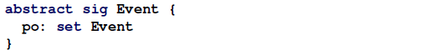
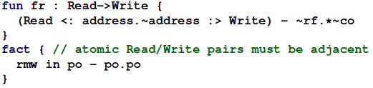
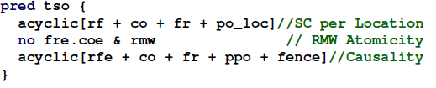
Memory Model in Alloy
Alloy modeling language is designed for relational models
Set, relations, and first order logic
Each sig defines the set of relations that originate from atoms of that type
Each fact defines basic memory model constraints
Each pred returns boolean truth values
TSO Fragment

Slide 10
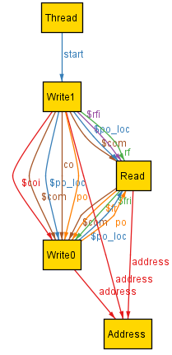
Memory Model in Alloy
run

Slide 11
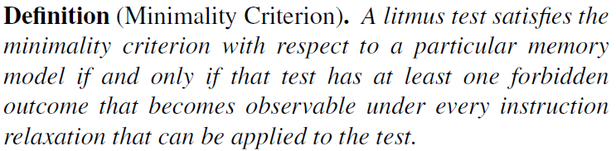
Minimality Criterion
Such a suite would contain a large amount of redundancy
A test may contain operations which have no effect
A test may duplicate a pattern already covered by another test
Minimality criterion is defined in terms of instruction relaxations

Slide 12
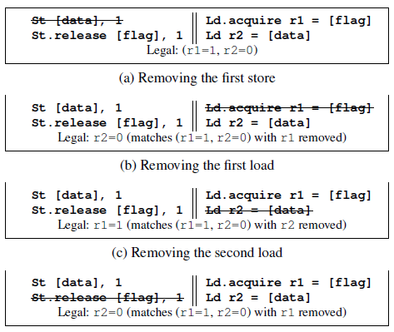
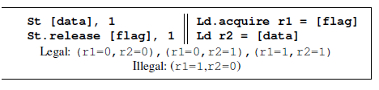
Instruction Relaxations
RI (Remove Instruction)
DRMW(Decompose Atomic Read-Modify-Write)
RD (Remove Dependency)
etc.
RI

Slide 13
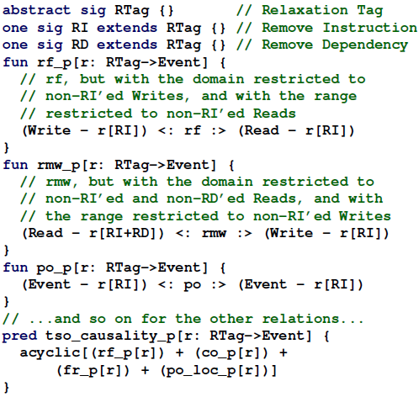
Instruction Relaxations in Alloy
Instruction Relaxations

Slide 14
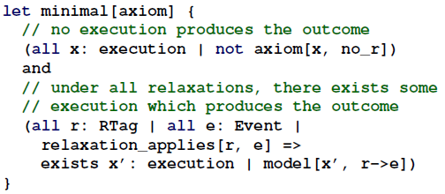
Minimality Criterion in Alloy
Generating minimal litmus tests

Slide 15
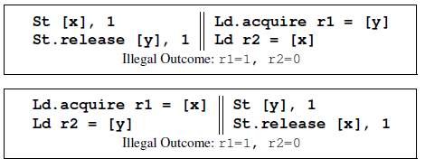

Synthesising Test Suites
Alloy emits redundant copies of each test satisfying the minimality criterion.
Canonicalizing
A post-processor which collects and canonicalizes the tests emitted by Alloy

Slide 16
Synthesising Test Suites
Producing a single canonical form of every test
Approach in Mador-Haim@CAV’10
Assigning a unique register to each read
Assigning a unique value for each write
etc.
Threads in a test are hashed and sorted alphabetically
Addresses are reassigned in sorted-sequential order
Only one test producing any given hash is emitted
ASPLOS’2017 Automated Synthesis of Comprehensive Memory Model Litmus Test Suites (https://github.com/nvlabs/litmustestgen)

Slide 17
Conclusion
Axiomatic memory model
Alloy
Minimal litmus tests
Post-processor
Final litmus test suits

Slide 18
Thank you !

