Slide 1
Can a Given Litmus Test
Pass Under a Given MCM?
Name: Xue Jiang

Slide 2
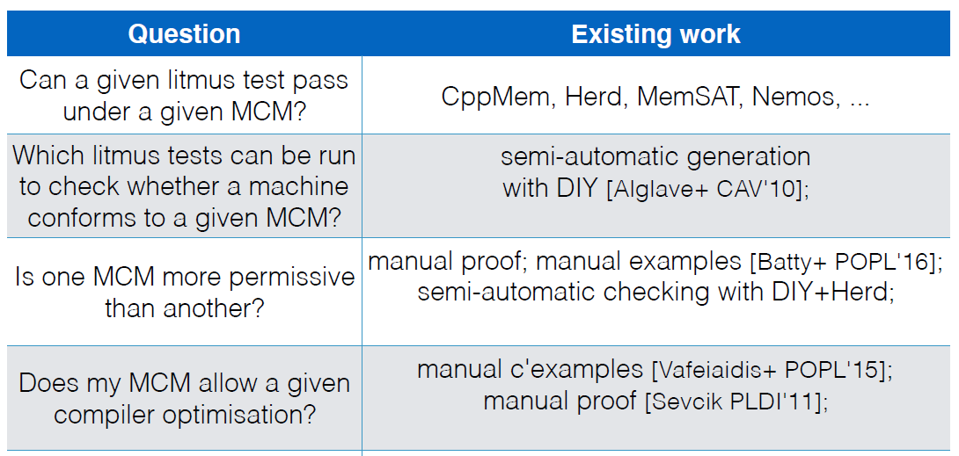
[Wickerson et al. @POPL’17]
[1] Automatically Comparing Memory Consistency Models

Slide 3
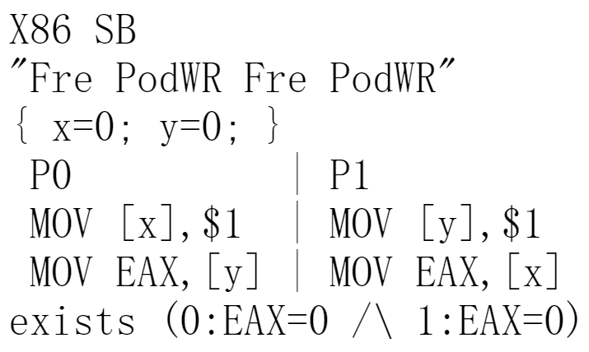
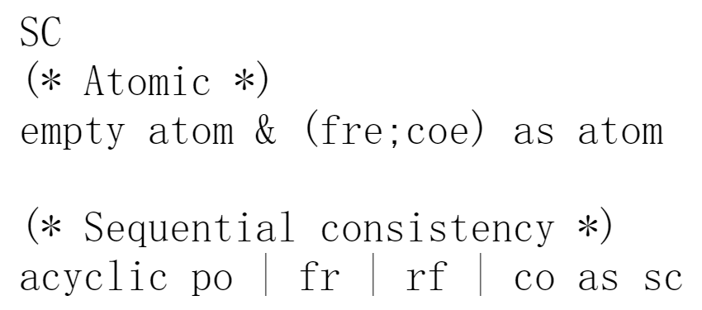
Herd
SC model
Litmus test (store buffering)
[1] Herding Cats: Modelling, Simulation, Testing, and Data Mining for Weak Memory

Slide 4
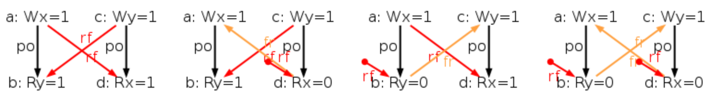
Herd
Generating all executions of a given test
A choice of events, po, rf, and co

Slide 5
Herd
The SC model gets executed on each execution

Slide 6
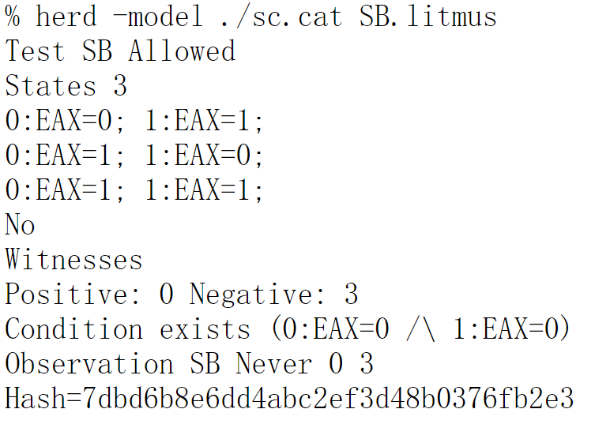
Herd

Slide 7
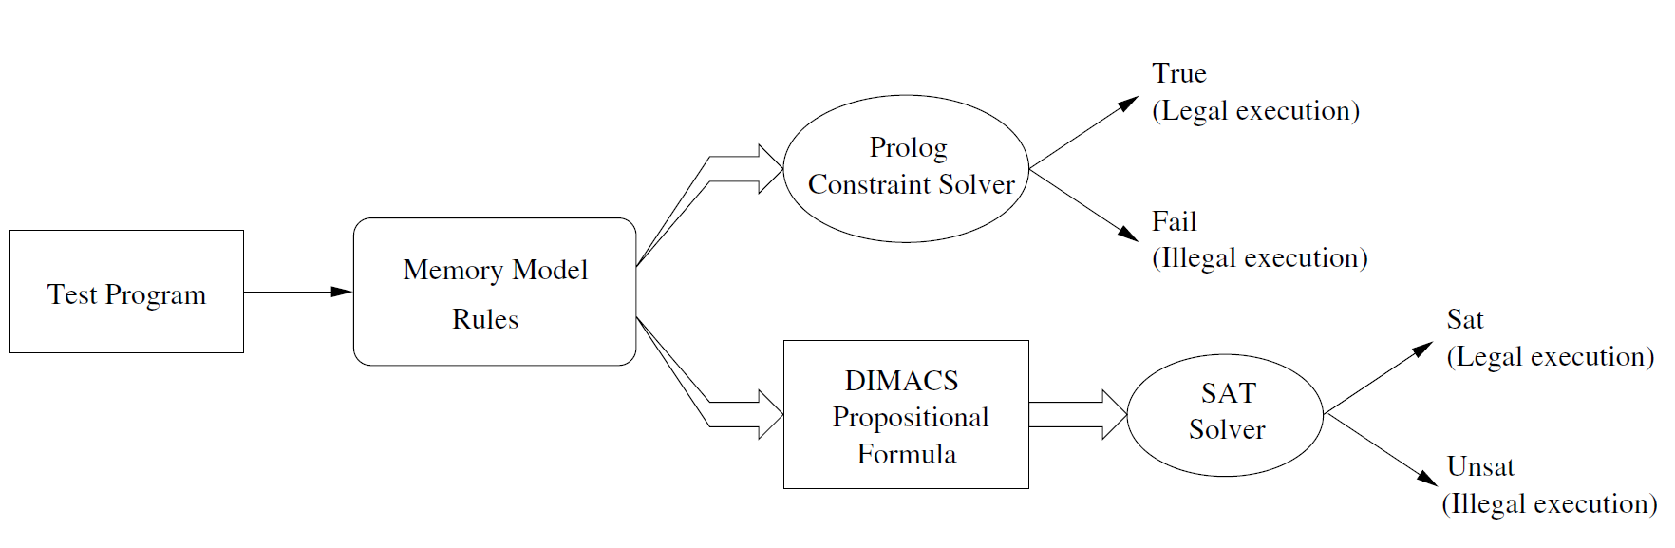
Nemos
[2] Nemos: A Framework for Axiomatic and Executable Specifications of Memory Consistency Models

Slide 8
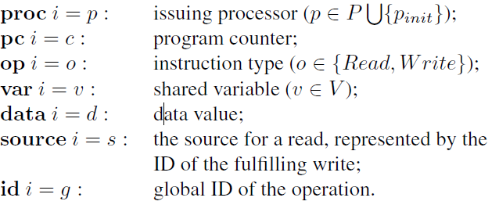
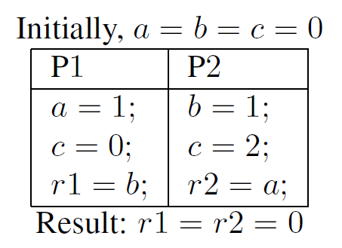
Nemos
Memory operation i:

Slide 9
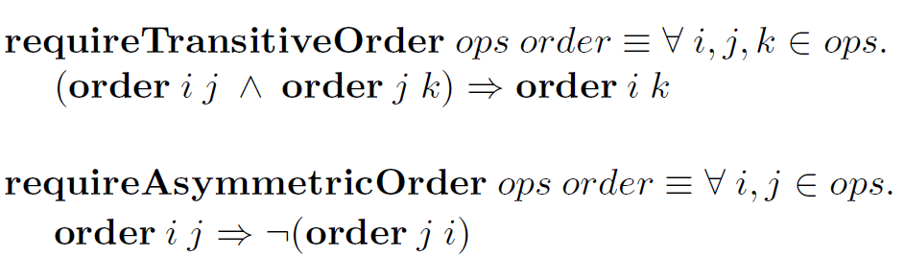
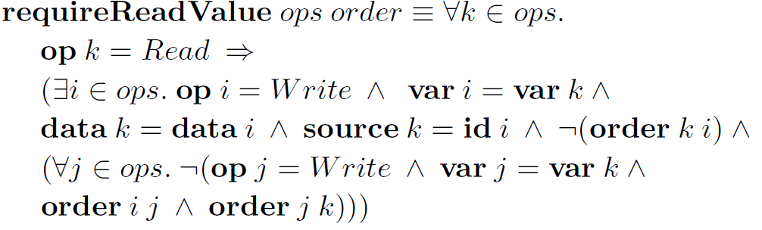
Nemos
An ordering relation order: ordering constraints over operations
d
Common memory consistency properties

Slide 10
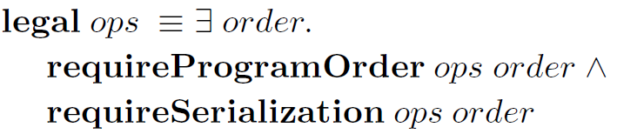
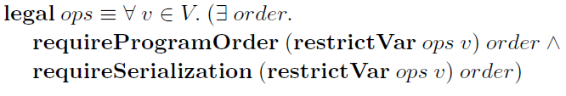
Nemos
Classical memory models
SC
Coherence

Slide 11
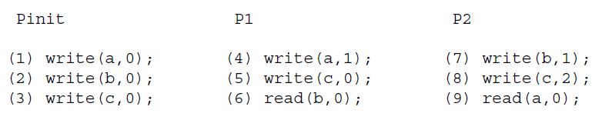
Nemos
An ordering relation order: ordering constraints over operations
d
Depicted by adjacency matrix

Slide 12
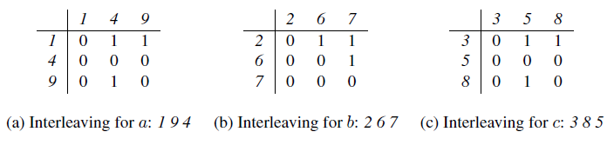
Nemos
Possible adjacency matrix
Check the satisfiability of the conjunction
of all ordering requirements

Slide 13
Nemos
Adjacency matrices for the execution under coherence

Slide 14
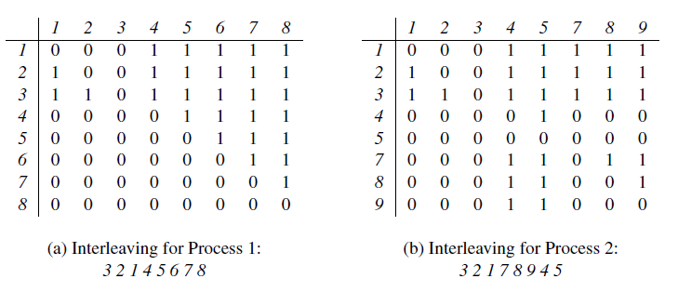
Nemos
Adjacency matrices for the execution under PRAM

Slide 15
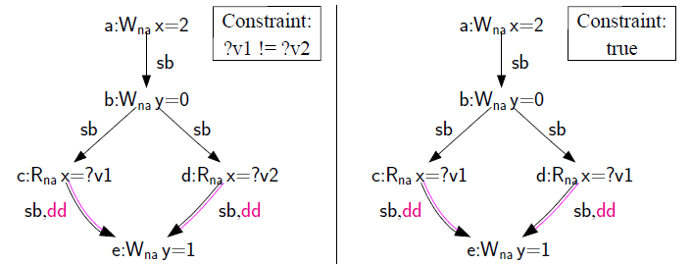
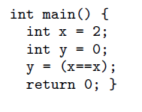
CppMem
Building all candidate executions of a C++ program (litmus tests)
Exhaustively considering all possible witnesses (rf, mo etc.)
Checking each one with Isabelle/HOL axiomatic model

Slide 16
Thank you !

