Slide 1
MemSAT: Checking Axiomatic
Specifications of Memory Models
[Torlak et al. @PLDI’10]
Name: Xue Jiang

Slide 2
MemSAT
Axiomatic
memory models
A trace of the program satisfying the memory model
MemSAT
or
Multi-threaded
test program
(with assertions)
A minimal subset of the memory model and program constraints
that are unsatisfiable

Slide 3
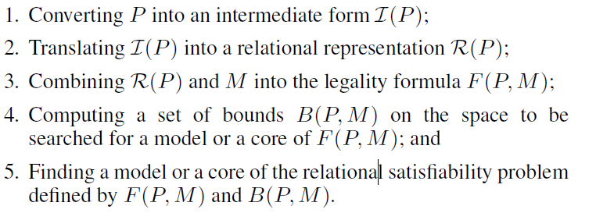
Approaches

Slide 4
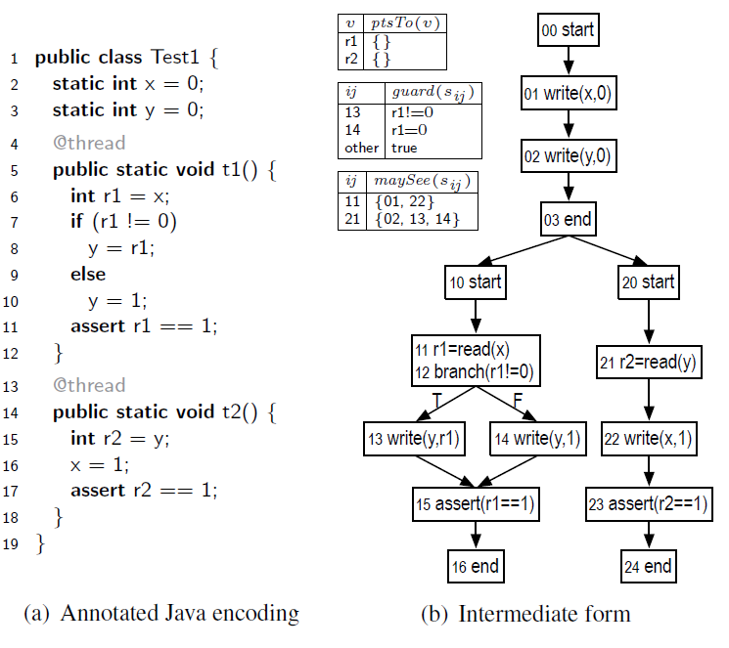
Preprocessing
By WALA analyses

Slide 5


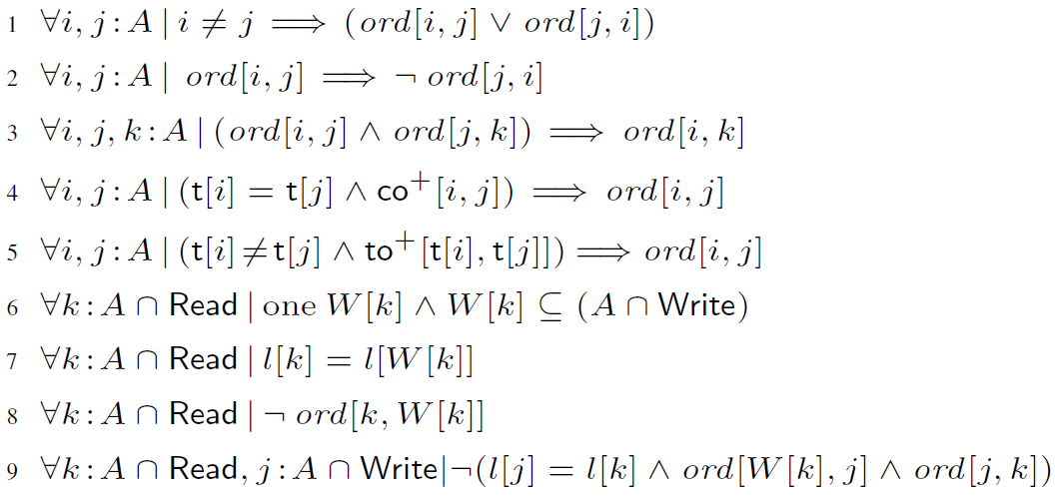
Memory Model

Slide 6
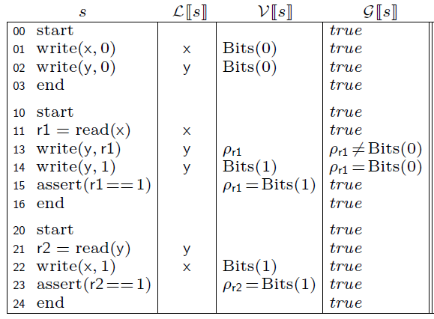
Translation
Translating a preprocessed program to its relational representation

Slide 7
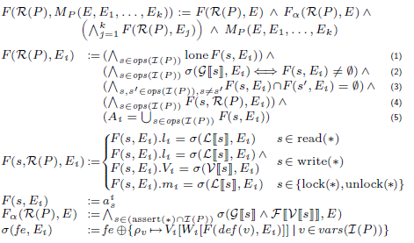
Constraint Assembly

Slide 8
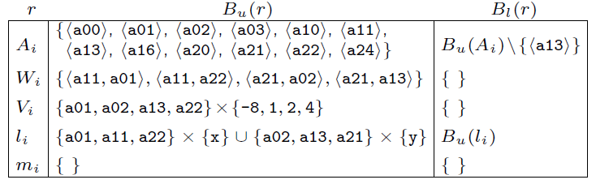
Bounds Assembly
A lower and upper bound on the value of each relation in the formula

Slide 9
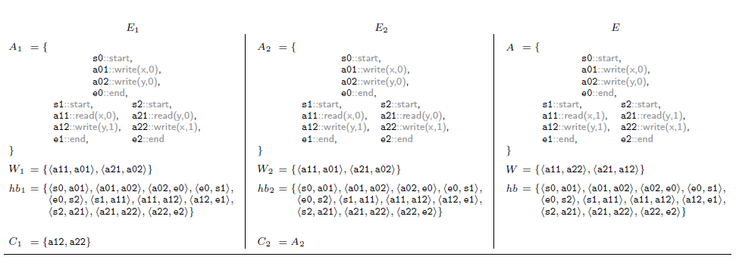
Finding A Trace (or A Core)
Delegated to the Kodkod constraint solver

Slide 10
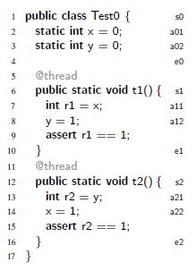
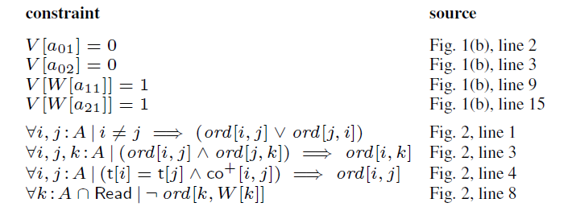
A Minimal Core

Slide 11
Thank you !

