Slide 1
Herding cats: modelling, simulation,
testing, and data mining
for weak memory
Name: Xue Jiang

Slide 2
Contributions
A generic axiomatic specification framework
for weak memory models
Instantiate memory models
Offer a simulation tool (herd)
Present an analysis tool (mole)

Slide 3
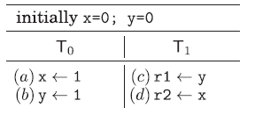
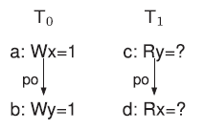
Multithreaded Programs

Slide 4
Litmus Tests
1
0
How to determine whether the results of a litmus test can be generated w.r.t an architecture (a language)?

Slide 5
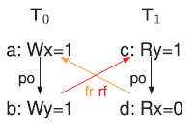
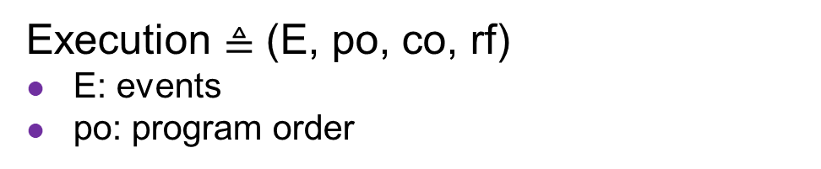
Candidate Executions
Execution $≜$ (E, po, co, rf)
E: events
po: program order
co: coherence
rf: read-from relation
1
0
Determine whether possible relations satisfy the requirements for a memory model

Slide 6
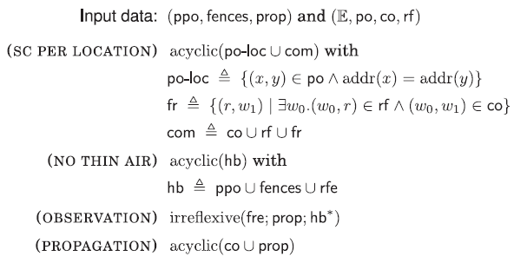
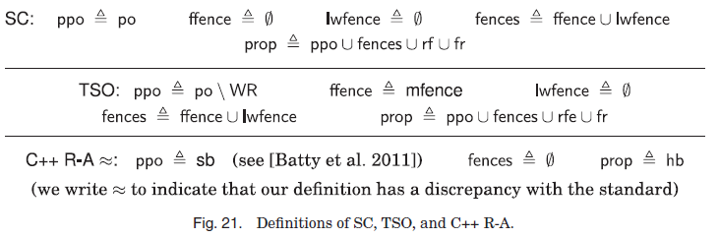
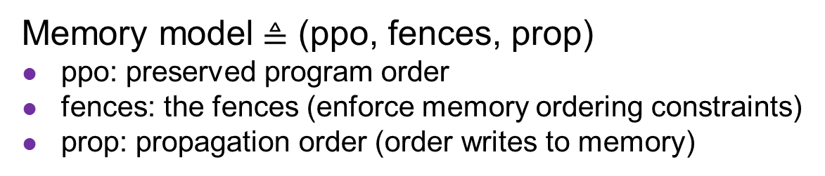
Memory Models
Memory model$≜$ (ppo, fences, prop)
ppo: preserved program order
fences: the fences (enforce memory ordering constraints)
prop: propagation order (order writes to memory)
model
execution

Slide 7
Framework
model
execution

Slide 8
Contributions
A generic axiomatic specification framework
for weak memory models
Instantiate memory models
Show equivalence between operational and axiomatic model (Power)

Slide 9
Instantiate Models

Slide 10
Contributions
A generic axiomatic specification framework
for weak memory models
Instantiate memory models
Show equivalence between operational and axiomatic model (Power)
Identificate and report 31 additional anomalies on ARM architecture through testing using the proposed models

Slide 11
Contributions
A generic axiomatic specification framework
for weak memory models
Instantiate memory models
Offer a simulation tool (herd)
Present an analysis tool (mole)

Slide 12
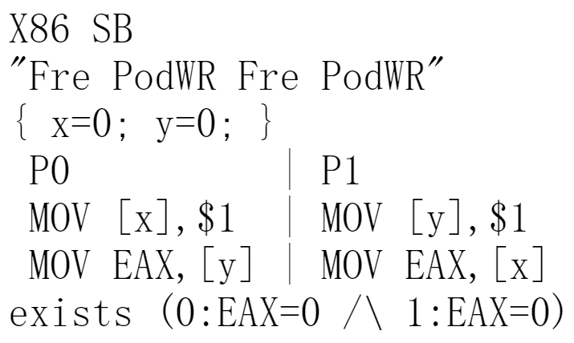
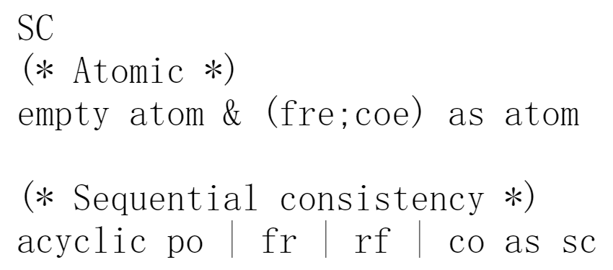
Herd
SC model
Litmus test (store buffering)

Slide 13
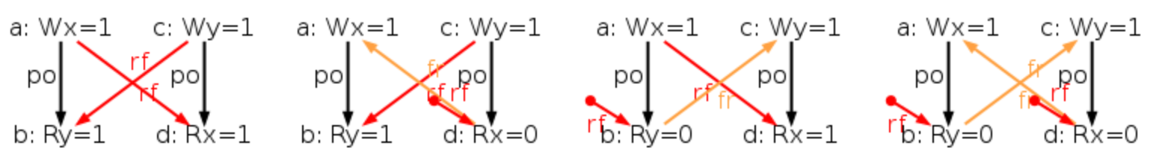
Herd
Generating all candidate executions of a given test
A choice of events, po, rf, and co

Slide 14
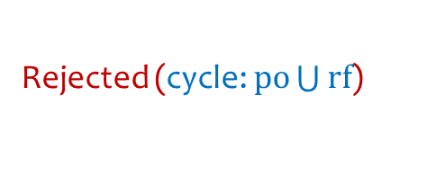
Herd
The SC model gets executed on each execution
Rejected (cycle: $po\bigcup{rf}$)

Slide 15
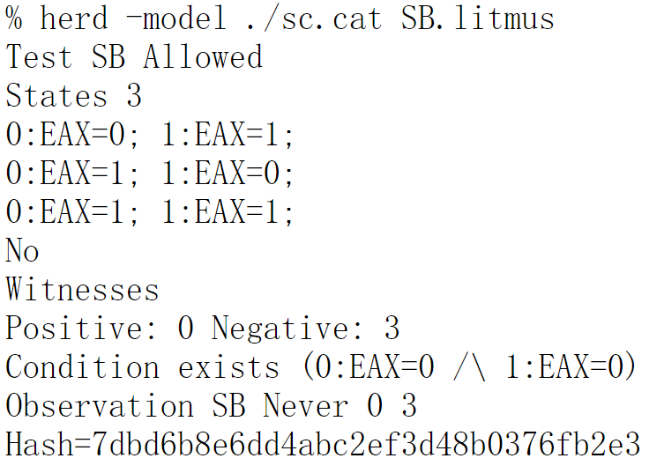
Herd

Slide 16

More
Prove the suitability of the model for the verification of high-level programs
Using cbmc (bounded model checker for C programs)

Slide 17
Contributions
A generic axiomatic specification framework
for weak memory models
Instantiate memory models
Offer a simulation tool (herd)
Present an analysis tool (mole)
Explore a piece of code to find the weak memory idioms that it uses (C and C++ code in a Debian Linux distribution)

Slide 18
Thank you !

Slide 19
Synthesising Test Suites
Producing a single canonical form of every test
Approach in Mador-Haim@CAV’10
Assigning a unique register to each read
Assigning a unique value for each write
etc.
Threads in a test are hashed and sorted alphabetically
Addresses are reassigned in sorted-sequential order
Only one test producing any given hash is emitted
ASPLOS’2017 Automated Synthesis of Comprehensive Memory Model Litmus Test Suites (https://github.com/nvlabs/litmustestgen)

Slide 20
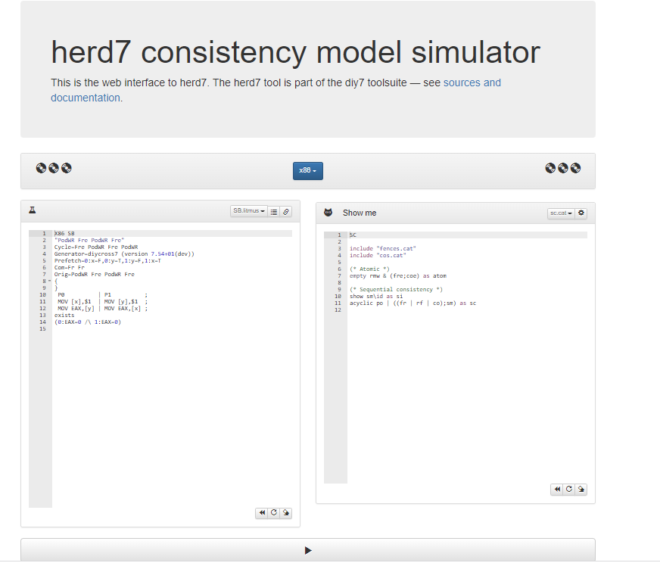
http://diy.inria.fr/www/#

