Slide 1
Die Hard Jugs Problem
唐瑞泽
151220100@smail.nju.edu.cn
2018年1月25日

Slide 2
问题描述
英雄们面临的挑战：
5分钟后炸弹爆炸。
解除炸弹的方法是不多不少4加仑水。
只有水源和两个没有刻度容量分别为3加仑和5加仑的壶。
只要找到一种可行方法即可。
情况紧急，条件苛刻。 英雄们也乱了手脚，如何拯救他们？？

Slide 3
问题分析
只有可能在5加仑的壶里装4加仑的水。
对两个壶的操作有：
倒出（清空）壶里的水。
将壶盛满水。
两个壶可以互相倾倒。
互相倾倒必须直到一个为空或者一个为满。
仅限于以上操作。

Slide 4
操作规范
不能装部分
不能转移部分
不能倒出部分
必须装满
直到一个为空或一个为满
必须全部倒出

Slide 5
操作规范
不能装部分
不能转移部分
不能倒出部分
必须装满
直到一个为空或一个为满
必须全部倒出

Slide 6
情景模拟

Slide 7
情景模拟
找到了一种可行的方法！

Slide 8
用TLA+拯救我们的英雄
上述推理方法的缺点：
没有普适性。
靠经验或者运气。
如果换成一个100加仑的壶呢？
过多冗余操作或者非最短路径造成超时呢？
人命关天的问题必须准确快速地解决！
使用TLA+来拯救我们的英雄。

Slide 9
抽象与建模
按下键盘按键对人来说是一个事件，而工程师要考虑按下和松开为两个事件。
计算天体的行为可以把天体当做一个点来代表它的质量，但却不能用于潮汐效应的计算。
如何抽象？
更少的事件使得抽象简单。更多的事件使得描述精确。
需要找到最简单但足够精确的抽象。
The Standard Model An abstract system is described as a collection of behaviors, each representing a possible execution of the system, where a behavior is a sequence of states and a state is an assignment of values to variables.

Slide 10
State Machine
A sequence of states: a behavior.
A state machine is described by:
All possible initial states.
What next states can follow any given state.
We must describe three things in TLA+:
What the variables are.
Possible initial values of variables.
A relation between their values in the current state and their possible values in the next state.

Slide 11
TLA+语言简介
The TLA stands for “Temporal Logic of Actions.” (Wikipedia)
声明变量： VARIABLES pc
变量名表示当前状态：pc
变量名加单引号表示下一状态：pc’
合取∧（逻辑与）：/\
析取∨（逻辑或）：\/
相等符号（不是赋值）：= 不等符号：/=
（集合）属于∈：\in 范围：0..100
定义规约：Init == (pc = "start") /\ (i = 0)

Slide 12
对问题建模
对英雄、炸弹、壶、水源组成的物理系统建模。
它们之间唯一的关联在于两个壶里有多少水。
使用两个变量对该系统建模：small, big. 代表两个壶盛有的水。
初始状态为两个壶都为空。
状态转移的行为描述：
清空小壶
清空大壶
装满小壶
装满大壶
小到大
大到小

Slide 13
使用TLA+描述
------------------------------ MODULE DieHard ------------------------------
EXTENDS Integers
(* 这是注释，定义两个变量 *)
VARIABLES small, big
(* 定义初始状态 *)
Init == /\ big = 0
/\ small = 0
(* 定义下一状态可采取的行为 *)
Next == \/ FillSmall
\/ FillBig
\/ EmptySmall
\/ EmptyBig
\/ SmallToBig
\/ BigToSmall
Notes:
------------------------------ MODULE DieHard ------------------------------
EXTENDS Integers
VARIABLES small, big
TypeOK == /\ small \in 0..3
/\ big \in 0..5
Init == /\ big = 0
/\ small = 0
FillSmall == /\ small' = 3
/\ big' = big
FillBig == /\ big' = 5
/\ small' = small
EmptySmall == /\ small' = 0
/\ big' = big
EmptyBig == /\ big' = 0
/\ small' = small
(* using IF-THEN-ELSE *)
(*
SmallToBig == IF big + small =< 5
THEN /\ big' = big + small
/\ small' = 0
ELSE /\ big' = 5
/\ small' = small - (5 - big)
BigToSmall == IF big + small =< 3
THEN /\ big' = 0
/\ small' = big + small
ELSE /\ big' = small - (3 - big)
/\ small' = 3
*)
(* using CNF *)
(*
SmallToBig == \/ /\ big + small =< 5
/\ big' = big + small
/\ small' = 0
\/ /\ big + small > 5
/\ big' = 5
/\ small' = big + small - 5
BigToSmall == \/ /\ big + small =< 3
/\ small' = big + small
/\ big' = 0
\/ /\ big + small > 3
/\ small' = 3
/\ big' = big + small - 3
*)
(* using LET/IN construct *)
Min(m, n) == IF m < n THEN m ELSE n
SmallToBig ==
LET poured == Min(big + small, 5) - big
IN /\ big' = big + poured
/\ small' = small - poured
BigToSmall ==
LET poured == Min(big + small, 3) - small
IN /\ big' = big - poured
/\ small' = small + poured
Next == \/ FillSmall
\/ FillBig
\/ EmptySmall
\/ EmptyBig
\/ SmallToBig
\/ BigToSmall
=============================================================================
\* Modification History
\* Last modified Thu Jan 25 11:40:42 CST 2018 by tangruize
\* Created Tue Jan 23 10:25:34 CST 2018 by tangruize

Slide 14
使用TLA+描述
(* 描述6个行为 *)
FillSmall == /\ small' = 3
/\ big' = big
FillBig == /\ big' = 5
/\ small' = small
EmptySmall == /\ small' = 0
/\ big' = big
EmptyBig == /\ big' = 0
/\ small' = small
SmallToBig == IF big + small =< 5
THEN /\ big' = big + small
/\ small' = 0
ELSE /\ big' = 5
/\ small' = small - (5 - big)
BigToSmall == IF big + small =< 3
THEN /\ big' = 0
/\ small' = big + small
ELSE /\ big' = small - (3 - big)
/\ small' = 3

Slide 15
使用TLA+描述
SmallToBig == IF big + small =< 5
THEN /\ big' = big + small
/\ small' = 0
ELSE /\ big' = 5
/\ small' = small - (5 - big)
BigToSmall == IF big + small =< 3
THEN /\ big' = 0
/\ small' = big + small
ELSE /\ big' = small - (3 - big)
/\ small' = 3
(* 可以改为合取范式 *)
SmallToBig == \/ /\ big + small =< 5
/\ big' = big + small
/\ small' = 0
\/ /\ big + small > 5
/\ big' = 5
/\ small' = big + small - 5
BigToSmall == \/ /\ big + small =< 3
/\ small' = big + small
/\ big' = 0
\/ /\ big + small > 3
/\ small' = 3
/\ big' = big + small - 3

Slide 16
使用TLA+描述
SmallToBig == \/ /\ big + small =< 5
/\ big' = big + small
/\ small' = 0
\/ /\ big + small > 5
/\ big' = 5
/\ small' = big + small - 5
BigToSmall == \/ /\ big + small =< 3
/\ small' = big + small
/\ big' = 0
\/ /\ big + small > 3
/\ small' = 3
/\ big' = big + small - 3
(* 可以分析其关系进一步改写 *)
Min(m, n) == IF m < n THEN m ELSE n
SmallToBig ==
LET poured == Min(big + small, 5) - big
IN /\ big' = big + poured
/\ small' = small - poured
BigToSmall ==
LET poured == Min(big + small, 3) - small
IN /\ big' = big - poured
/\ small' = small + poured

Slide 17
规约
A specification is a description of a system model.
A formal specification is one that is written in a precisely defined language.
TLA+没有type correctness，我们使用规约来约束small和big取值。
TypeOK == /\ small \in 0..3 /\ big \in 0..5
我们需要得到big = 4时的执行路径，规约big /= 4

Slide 18
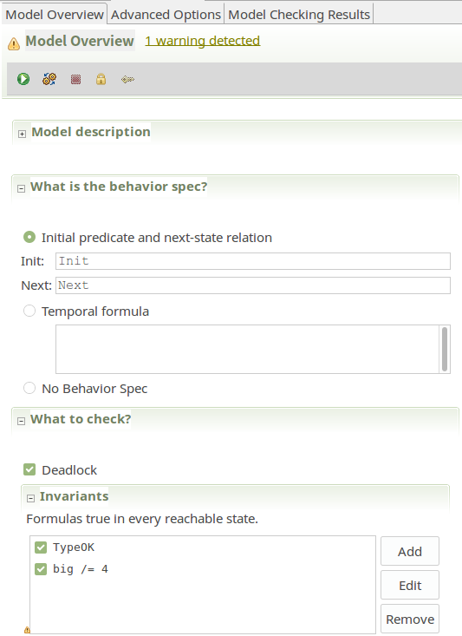
使用TLC验证
执行
初态和次态
系统是否不会停止
每个状态的不变量

Slide 19
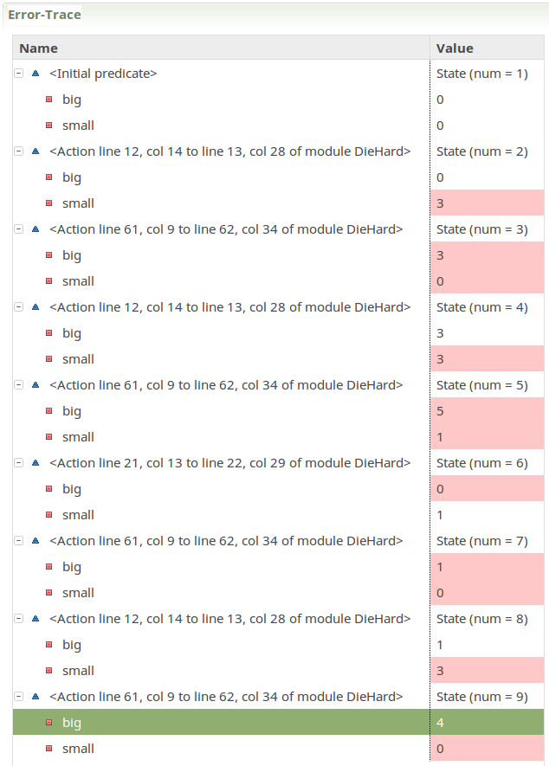
使用TLC验证
big = 0
small = 0
big = 0
small = 3
big = 3
small = 3
big = 3
small = 0
big = 5
small = 1
big = 0
small = 1
big = 1
small = 3
big = 1
small = 0
big = 4
small = 0

Slide 20
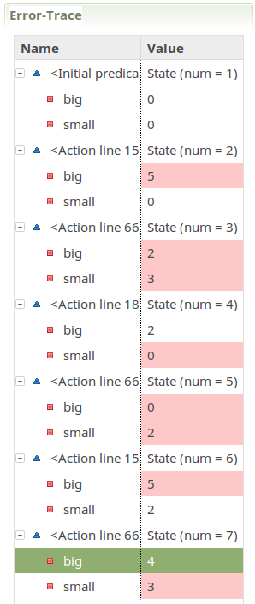

使用TLC验证
最优路径？
设为1
big = 0
small = 0
big = 5
small = 0
big = 2
small = 3
big = 5
small = 2
big = 0
small = 2
big = 2
small = 0
big = 4
small = 3

Slide 21
Thank you! Q & A
唐瑞泽
151220100@smail.nju.edu.cn
2018年1月25日

