Slide 1
The Alternating Bit Protocol
The TLA+ Video Course 9a and 9b
May 18, 2018
Ruize Tang
151220100@smail.nju.edu.cn

Slide 2
Content
Part 1: What the protocol should do?
Finite sequences
What the protocol should accomplish?
Specifying the protocol using TLA+
Safety and liveness
Weak fairness
Part 2: How it implements the liveness property?
The safety specification
Liveness

Slide 3
Finite sequences
What is a finite sequence?
What operations are supported by it?
What can be used for it?
Tuple
Length
Get i-th element
Head and tail
Concatenation
e.g. The Cartesian Product

Slide 4
EXTENDS Sequences
Supported operations:
A is defined as << -3, "xyz", {0,2} >>
Length of A: Len(A) equals 3
Get elements: A[1] = -3, A[2] = "xyz", A[3] = {0,2}
Tail(A) = <<"xyz", {0,2} >>
Head(A) = A[1] = -3
Concatenation: \o (backslash lowercase Oh) <<3,2,1>> \o A = <<3,2,1, -3, "xyz", {0,2}>> if seq # <<>> then seq = <<Head(seq)>> \o Tail(seq)
Indices start from 1
It’s a sequence.
It’s an element.

Slide 5
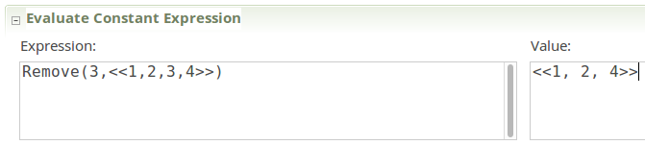
Let’s define Remove(i, seq) to be the sequence obtained by removing the i-th element from the sequence seq .
Remove(i, seq) == [j \in 1..(Len(seq)-1) |-> IF j < i THEN seq[j] ELSE seq[j+1]]
Let’s check it!

Slide 6
The Cartesian Product
For any sets S and T S×T = {<a,b> : a ∈ S, b ∈ T}
The operator ‘×’ is typed \X (backslash upper-case X)
Let TLC compute (1..3) × {“a”,“b”}. You cannot remove the parentheses of (1..3), since 1..3 × {“a”,“b”} is parsed as 1..(3 × {“a”,“b”})

Slide 7
The AB Protocol
AB is short for Alternating Bit.
There is a sender A who sends a sequence of data (or strings) to a receiver B.

Slide 8
An obvious way to represent it
What sequence of values was sent? “Fred”, “Mary”, “Ted”?
No! Actually “Fred”, “Fred”, “Mary”, “Mary”, “Ted” !
A | B
“” | “”
“Fred” | “”
“Fred” | “Fred”
“Mary” | “Fred”
“Mary” | “Mary”
“Ted” | “Mary”
“Ted” | “Ted”

Slide 9
In computer networks, we could add a variable ‘seq’ to indicate the value changes.
But in this case, we can make it simpler. Add an one-bit value element that is changed when a value chosen.
A | B
“”, 1 | “”, 1
“Fred”, 0 | “”, 1
“Fred”, 0 | “Fred”, 0
“Mary”, 1 | “Fred”, 0
“Mary”, 1 | “Mary”, 1
“Ted”, 0 | “Mary”, 1
“Ted”, 0 | “Ted”, 0

Slide 10
Specifying the protocol
------------------------------ MODULE ABSpec --------------------------------
EXTENDS Integers
CONSTANT Data \* The set of all possible data values.
VARIABLES AVar, \* The last <<value, bit>> pair A decided to send.
BVar \* The last <<value, bit>> pair B received.

Slide 11
(* Type correctness means that AVar and BVar are tuples <<d, i>> where *)
(* d \in Data and i \in {0, 1}. *)
TypeOK == /\ AVar \in Data \X {0,1} /\ BVar \in Data \X {0,1}
(* It's useful to define vars to be the tuple of all variables, for *)
(* example so we can write [Next]_vars instead of [Next]_<< ... >> *)
vars == << AVar, BVar >>
(* Initially AVar can equal <<d, 1>> for any Data value d, and BVar equals AVar *)
Init == /\ AVar \in Data \X {1} /\ BVar = AVar

Slide 12
(* When AVar = BVar, the sender can "send" an arbitrary data d item by setting AVar[1] to d and complementing AVar[2]. It then waits until the receiver "receives" the message by setting BVar to AVar before it can send its next message. Sending is described by action A and receiving by action B. *)
A == /\ AVar = Bvar /\ \E d \in Data: AVar' = <<d, 1 - AVar[2]>> /\ BVar' = BVar
B == /\ AVar # Bvar /\ BVar' = Avar /\ AVar' = AVar
Next == A \/ B
Spec == Init /\ [][Next]_vars

Slide 13
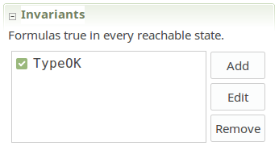
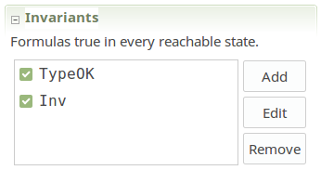
Check invariants：TypeOK
But TypeOK doesn’t mean that a specification is correct.
(* invariant Inv asserts that, if AVar and BVar have equal second components, then they are equal (which by the invariance of TypeOK implies that they have equal first components). *)
Inv == (AVar[2] = BVar[2]) => (AVar = BVar)

Slide 14
Safety and liveness
Informally, a safety property asserts that something bad does not happen. More precisely, a safety property is one that can be violated by a single step of a behavior, or by its first state. For example, the property
whenever x equals y, they both equal the gcd of M and N .
is a safety property because it can be violated by a step that makes x and y equal without making them equal to the gcd of M and N .
Informally, a liveness property asserts that something good eventually happens. More precisely, a liveness property is one that you cannot tell is violated without seeing the entire behavior. For example, the property that eventually x equals y is a liveness property because you need to see the entire behavior to know that x is never equal to y.

Slide 15
Safety Formula
Asserts what may happen.
Any behavior that violates it does so at some point.
Nothing past that point makes any difference.
Example: Init /\ [][Next]_vars can be violated either:
at an initial state not satisfying Init
or at a step not satisfying [Next] vars. The step neither satisfies Next nor leaves vars unchanged.

Slide 16
Liveness Formula
Asserts what must happen.
A behavior can not violate it at any point.
The rest of the behavior can always make it true.
Example: x = 5 on some state of the behavior.
At any point, it’s always possible for a later state to satisfy x=5.
(A behavior is any infinite sequence of states.)
Asserted by <>(x=5) (<> pronounced eventually)
The only liveness property sequential programs must satisfy is termination.

Slide 17
Liveness property for ABSpec :
If AVar = <<“hi”,0>> in some state (A is sending <<“hi”,0>>)
then BVar = <<“hi”,0>> in that state or a later state. (B has received <<“hi”,0>>)
(AVar = <<“hi”,0>>) ~> (BVar = <<“hi”,0>>)
~> pronounced leads to
More generally:
Any value being sent by A is eventually received by B.
∀v ∈ Data × {0, 1}: (AVar = v) ~> (BVar = v)

Slide 18
Weak fairness
Enabled
An action A is enabled in a state s iff there is a state t such that s→t is an A step.
A == /\ AVar = Bvar /\ \E d \in Data: AVar' = <<d, 1 - AVar[2]>> /\ BVar' = BVar
A is enabled iff AVar = BVar and Data # {}.
Weak fairness of action A asserts of a behavior:
If A ever remains continuously enabled,
then an A step must eventually occur.

Slide 19
→ s42 false → s43 true → s44 false
→ s45 true → s46 true → s47 true → s48 true → s49 true → s50 true → ··
Then an A step must occur in the second line of the behavior.
Or equivalently: A cannot remain enabled forever without another A step occurring.
Weak fairness of A is written as the temporal formula WF_vars(A) where vars is the tuple of all the spec’s variables.
It’s a liveness property.

Slide 20
A spec with liveness is written:
Init /\ [][Next]_vars /\ Fairness
Fairness: A conjunction of WF_vars(A) and SF_vars(A) formulas where each A is a subaction of Next.
Module ABSpec defines
FairSpec == Init /\ [][Next]_vars /\ WF_vars(Next)
Asserts that a behavior keeps taking Next steps as long as Next is enabled (not in a deadlocked/terminated state).
which means it keeps sending and receiving values forever.
For liveness checking, the model must not have any symmetry set.

Slide 21
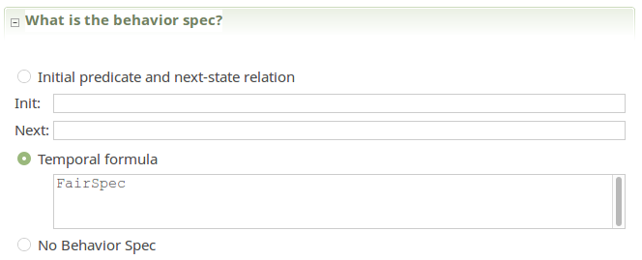
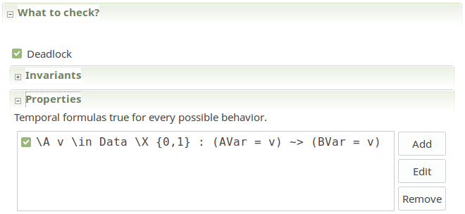
Have TLC check this temporal property:

Slide 22
Another possible high-level spec of the AB protocol:
FairSpec == Init /\ [][Next]_vars /\ WF_vars(B)
Action B is enabled when the sender has sent a value that hasn’t been received.
This spec requires every sent value to be received, but allows the sender to stop sending.

Slide 23
The safety specification
What the Protocol Accomplishes?
Sender A sends data to receiver B.
It ensures that no data is lost or duplicated.
How the Protocol Works?
Using <data, one-bit value> sequence.
A sends sequences of data to B. Then B updates its BVar and sends the new one-bit value to A after receiving.
Since messages can be lost, A and B both continuously send the same message until they received the other side’s response.

Slide 24
The TLA + Specification (Nothing new except the use of operations on sequences).
------------------------ MODULE AB ------------------------
EXTENDS Integers, Sequences
CONSTANT Data
Remove(i, seq) ==
[j \in 1..(Len(seq)-1) |-> IF j < i THEN seq[j]
ELSE seq[j+1]]
VARIABLES AVar, BVar, AtoB, BtoA
\* Messages are sent by appending them to the end of AtoB.
\* and received by removing them from the head of BtoA.
vars == << AVar, BVar, AtoB, BtoA >>

Slide 25
TypeOK == /\ AVar \in Data \X {0,1}
/\ BVar \in Data \X {0,1}
/\ AtoB \in Seq(Data \X {0,1})
/\ BtoA \in Seq({0,1})
Init == /\ AVar \in Data \X {1}
/\ BVar = AVar
/\ AtoB = << >>
/\ BtoA = << >>
(* The action of the sender sending a data message by appending AVar to *)
(* the end of the message queue AtoB. It will keep sending the same *)
(* message until it receives an acknowledgment for it from the receiver. *)
ASnd == /\ AtoB' = Append(AtoB, AVar)
/\ UNCHANGED <<AVar, BtoA, BVar>>

Slide 26
(* The action of the sender receiving an ack message. If that ack is for *)
(* the value it is sending, then it chooses another message to send and *)
(* sets AVar to that message. If the ack is for the previous value it *)
(* sent, it ignores the message. In either case, it removes the message *)
(* from BtoA. *)
ARcv == /\ BtoA # << >>
/\ IF Head(BtoA) = AVar[2]
THEN \E d \in Data : AVar' = <<d, 1 - AVar[2]>>
ELSE AVar' = AVar
/\ BtoA' = Tail(BtoA)
/\ UNCHANGED <<AtoB, BVar>>

Slide 27
(* The action of the receiver sending an acknowledgment message for the *)
(* last data item it received. *)
BSnd == /\ BtoA' = Append(BtoA, BVar[2])
/\ UNCHANGED <<AVar, BVar, AtoB>>
(* The action of the receiver receiving a data message. It sets BVar to *)
(* that message if it's not for the data item it has already received. *)
BRcv == /\ AtoB # << >>
/\ IF Head(AtoB)[2] # BVar[2]
THEN BVar' = Head(AtoB)
ELSE BVar' = BVar
/\ AtoB' = Tail(AtoB)
/\ UNCHANGED <<AVar, BtoA>

Slide 28
(* LoseMsg is the action that removes an arbitrary message from queue AtoB or BtoA. *)
LoseMsg == /\ \/ /\ \E i \in 1..Len(AtoB):
AtoB' = Remove(i, AtoB)
/\ BtoA' = BtoA
\/ /\ \E i \in 1..Len(BtoA):
BtoA' = Remove(i, BtoA)
/\ AtoB' = AtoB
/\ UNCHANGED << AVar, BVar >>
Next == ASnd \/ ARcv \/ BSnd \/ BRcv \/ LoseMsg
Spec == Init /\ [][Next]_vars

Slide 29
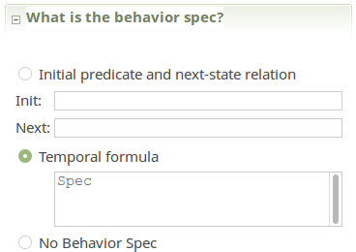
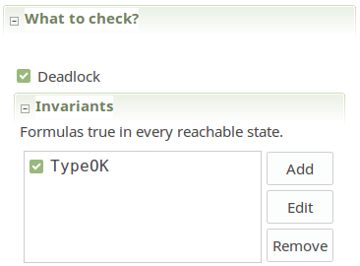
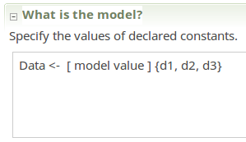
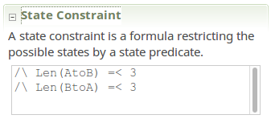
Checking safety

Slide 30
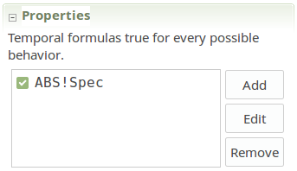
Formula Spec of module AB should imply formula Spec of module ABSpec.
It’s illegal to use INSTANCE ABSpec because it imports definitions of Spec, ... , which are already defined in AB.
ABS == INSTANCE ABSpec
Renamed as ABS!Spec

Slide 31
Liveness
The complete AB protocol specification should be
FairSpec == Spec ∧ fairness properties
Should imply that messages keep getting sent and received:
THEOREM FairSpec => ABS!FairSpec

Slide 32

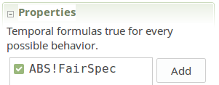
FairSpec == Spec /\ WF_vars (Next)
Next == ASnd \/ ARcv \/ BSnd \/ BRcv \/ LoseMsg
But we don’t want to require that messages have to be lost. So we specify weak fairness of the first four actions.
FairSpec == Spec /\ WF_vars(ARcv) /\ WF_vars(BRcv) /\ WF_vars(ASnd) /\ WF_vars(BSnd)
THEOREM FairSpec => ABS!FairSpec

Slide 33
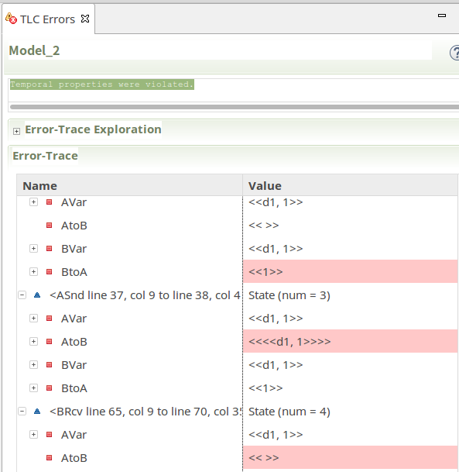

Slide 34
Temporal properties were violated!
From the counterexample we find that:
A sends its value, A’s message is lost, B’s message is lost, B sends a message, A sends a message, A’s message is lost, B’s message is lost, B sends a message, A sends a message, A’s message is lost, B’s message is lost…
The behavior satisfies FairSpec, but it doesn’t satisfy the high level fair spec in module ABSpec because no values are ever sent from A to B.
The problem is that: WF_vars (ARcv) /\ WF_vars (BRcv) don’t imply ARcv or BRcv steps ever occur.

Slide 35
Strong
Weak fairness of action A asserts of a behavior:
If A ever remains continuously enabled,
then an A step must eventually occur.
Or equivalently:
A cannot be repeatedly enabled forever without another A step occurring.
FairSpec == Spec /\ WF_vars(ARcv) /\ WF_vars(BRcv) /\ WF_vars(ASnd) /\ WF_vars(BSnd)
TLC will now find no error.
is repeatedly
SF_vars
SF_vars

Slide 36
Thank you! Q & A
The TLA+ Video Course 9a and 9b
May 18, 2018
Ruize Tang
151220100@smail.nju.edu.cn

