Slide 1
A Correct eXpressive Jupiter Makes It Better
--Powered by TLA+
tangruize97 at gmail.com
10/30/18
瑞泽
唐
Jupiter
Jupiter
C/S
OP
OT
C/S
OP
OT

Slide 2
Contents
Background and preliminaries
Review Co-editing and Jupiter
Why Correctness so important?
How to eXpress … in TLA+
The C/S model
The operations
The xform functions
(Some details of) A.C.X. Jupiter
What to check
Future work

Slide 3
Background and Preliminaries

Slide 4
Co-editing
Abbr. of Collaborative editing.
Editing of groups producing works together through individual contributions. [wikipedia]
It is a C/S model.
Each client and sever maintains a replica.
User
User
User
Low latency
Server
Client 1
Client 2
Client 3
replica
replica
replica
replica

Slide 5
Problems
How to handle conflicts?
Example: Init list ‘PLAN’, A del(1) while B del(2).
Is it eventually convergence?
As above, the results are ‘LN’ and ‘AN’ if no other processing.
(Transformation)
(Correctness)

Slide 6
Solutions (simple but infeasible)
User
User
User
Server
Client 1
Client 2
Client 3
replica
replica
replica
replica

Slide 7
Jupiter Protocol^{[1]}
Ops are applied locally so that it returned immediately.
Using xform functions to handle conflicts.
xform(del x, del y) = {del x-1, del y} if x > y {del x, del y-1} if x < y {no-op, no-op} if x = y
Client
Server
PLAN
PLAN
Del 1
Del 2
LAN
xform
PAN
Del 1
Del 1
AN
LN
AN
[1] Nichols, D., Curtis, P., Dixon, M. and Lamping, J. High-latency, low-bandwidth windowing in the Jupiter collaboration system. ACM UIST (1995), 111-120.

Slide 8
Jupiter Protocol Family(cont.)
Through the years, more Jupiters proposed.
2014 CSCW Jupiter (XJupiter): multi-client version. (2D state space) ^{[1]}
2016 Attiya Jupiter (AJupiter): conjecture Jupiter satisfying the weak list specification. ^{[2]}
2017 Compact Jupiter (CJupiter): n-ary ordered state space. ^{[3]}
[1] Yi Xu, Chengzheng Sun, and Mo Li. Achieving convergence in operational transformation: Conditions, mechanisms and systems. In Proceedings of the 17th ACM Conference on Computer Supported Cooperative Work, CSCW ’14, pages 505–518. ACM, 2014.
[2] Hagit Attiya, Sebastian Burckhardt, Alexey Gotsman, Adam Morrison, Hongseok Yang, and Marek Zawirski. Specification and complexity of collaborative text editing. In Proceedings of the 2016 ACM Symposium on Principles of Distributed Computing, PODC ’16, pages 259–268. ACM, 2016.
[3] Hengfeng Wei, Yu Huang, Jian Lu: Brief Announcement: Specification and Implementation of Replicated List: The Jupiter Protocol Revisited. PODC 2018: 81-83

Slide 9
Why Correctness so important?
We have seen so many distributed algorithms proposed and then another paper proved it incorrect.
Thank goodness! We can use TLA+ to verify specifications we want to check!

Slide 10
How to eXpress … in TLA+

Slide 11
Rise from the ground
Unlike programming languages, TLA+ doesn’t provide massive libraries.
From the ground, we construct the communicating channel of the C/S model, which is used by every Jupiter proto.
Notes:
Wheels and

Slide 12
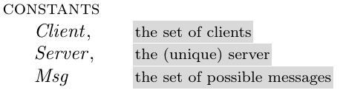

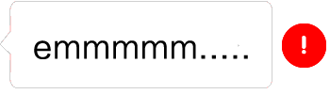
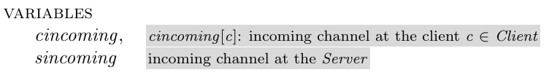

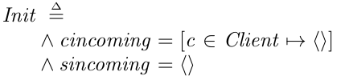
CSComm
C/S
FIFO

Slide 13
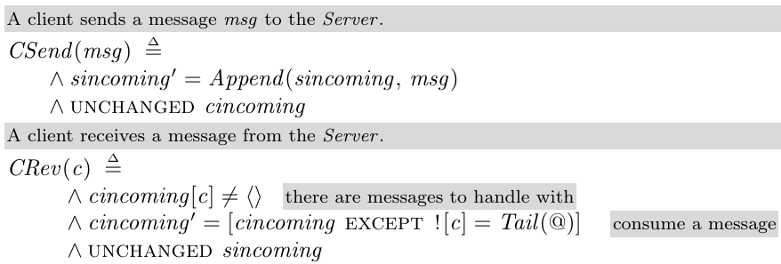
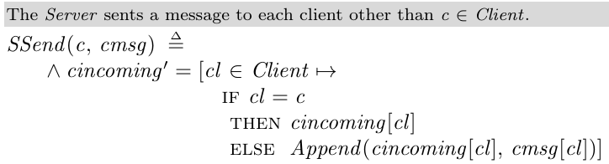
CSComm

Slide 14
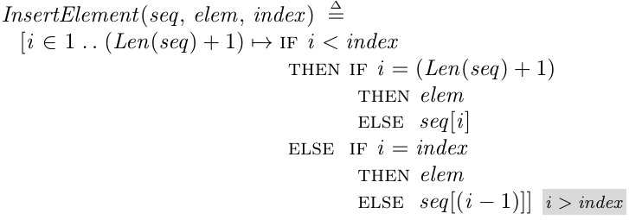
OpOperators
OP
Ops: Ins, Del, Nop
A bit like python… (But [] in TLA+ called function)
def DeleteElement(seq, index):
return [seq[i] if i < index else seq[i+1] for i in len(seq)]

Slide 15
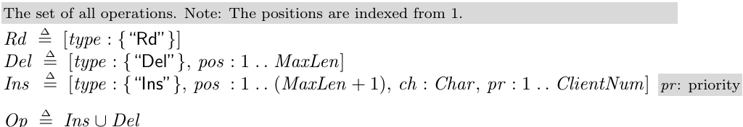
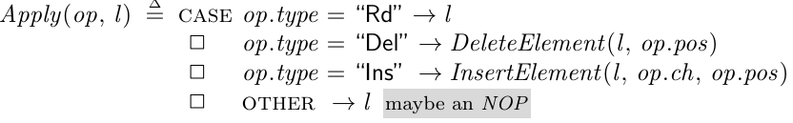
OpOperators
Define operations.
Apply an op to list l

Slide 16
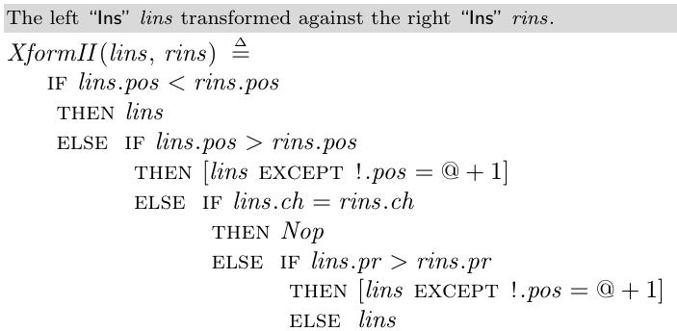
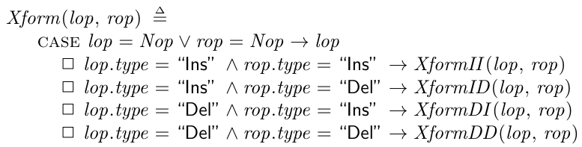
OT (xform)
OT
We show only ins against ins(II). Except this, there are ID, DI and DD.
Choose which to perform:

Slide 17
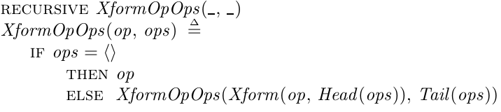
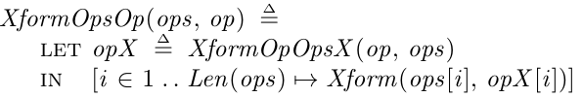
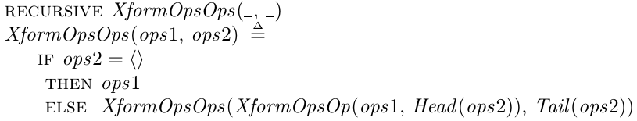
OT (xform)
Recursively transform op against ops and the reverse.
Ops against Ops:

Slide 18
The main begins…
Jupiter
We now have C/S communicating channel, op operators and op transform functions. Those are mechanisms or wheels.
To build the car, we need to specify the algorithms…
Three algorithms: AJupiter, CJupiter and XJupiter.

Slide 19
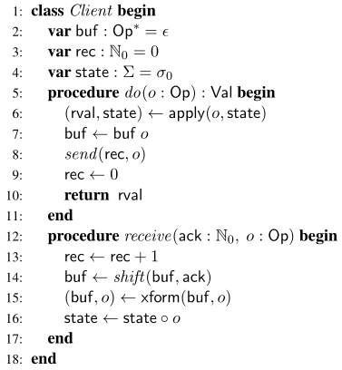
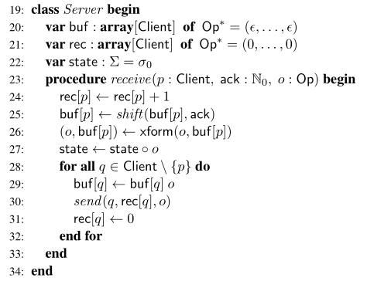

AJupiter
Client
Server
0,0
PLAN
C
S1
PLANE
1,0
0,1
PLANE
C’
S2
S1’
PLANE
1,1
0,2
PLANET
S2’
C’’
1,2
PLANET
It may look simple…
Notes:
Add example.

Slide 20

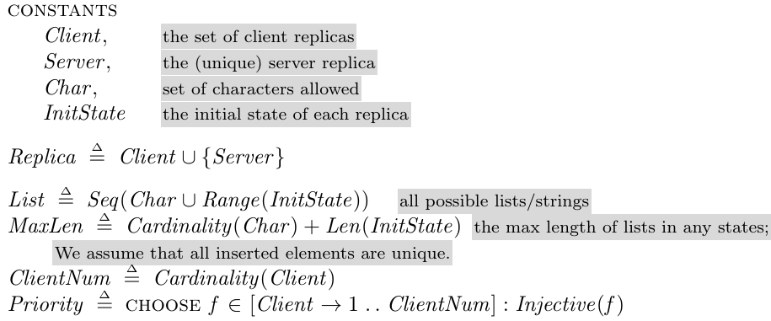
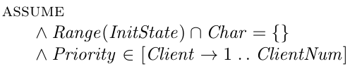
AJupiter
very complex
The truth is that…

Slide 21
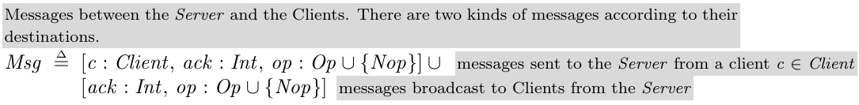
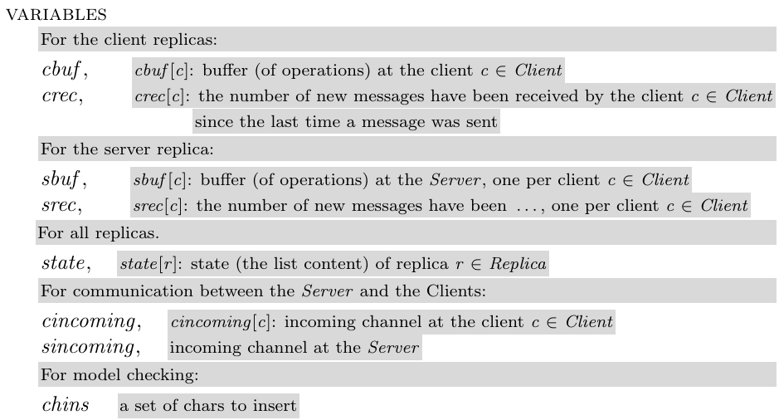
AJupiter

Slide 22

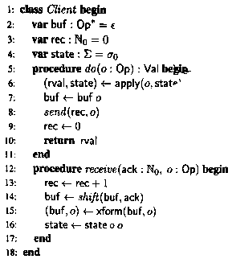
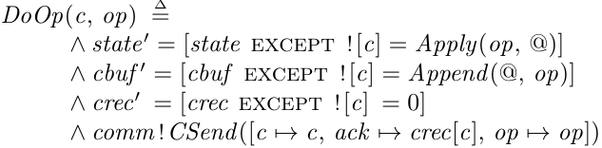
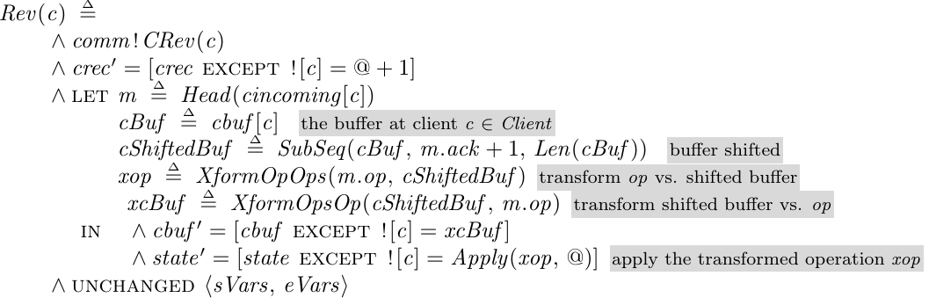
AJupiter

Slide 23
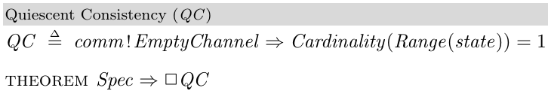

Check AJupiter
Quiescent Consistency
The communicating channels (i.e. sincoming and cincoming) are
empty (quiescent, may be initial state or all msgs are consumed)
implies =>
all replicas’ state are the same (cardinality of state’s codomain set is 1).
(I never thought that it can be expressed like this…Do you admire too?)

Slide 24
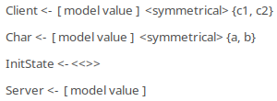
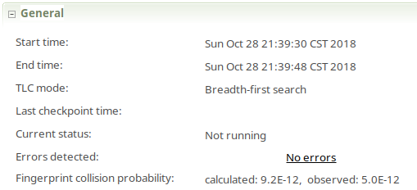

Check AJupiter
Check the two clients, two chars model:
It is said that TLC takes a week if increased to 3.
(Do you forget the weak list specification?)

Slide 25
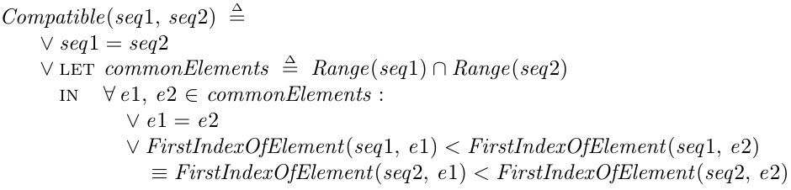
CJupiter
Jupiter maintains 2n 2D state space. 2D for local and global dimension.
The weak list specification requires that states across the system are pairwise compatible.
2D are not “compact” enough to capture all replica states in one.
CJupiter (Compact Jupiter) is proposed.
Hengfeng Wei, Yu Huang, Jian Lu: Brief Announcement: Specification and Implementation of Replicated List: The Jupiter Protocol Revisited. PODC 2018: 81-83

Slide 26
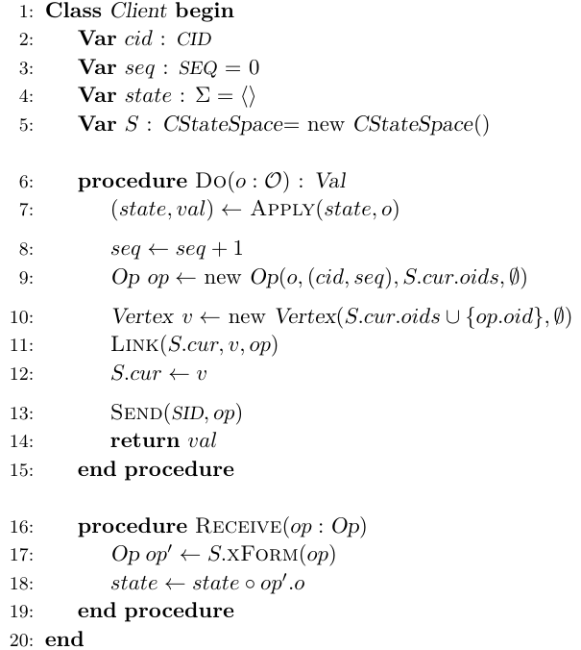
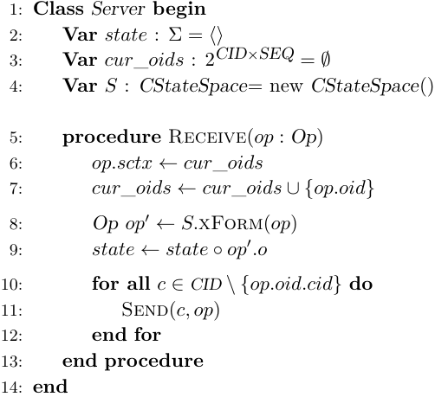
CJupiter

Slide 27
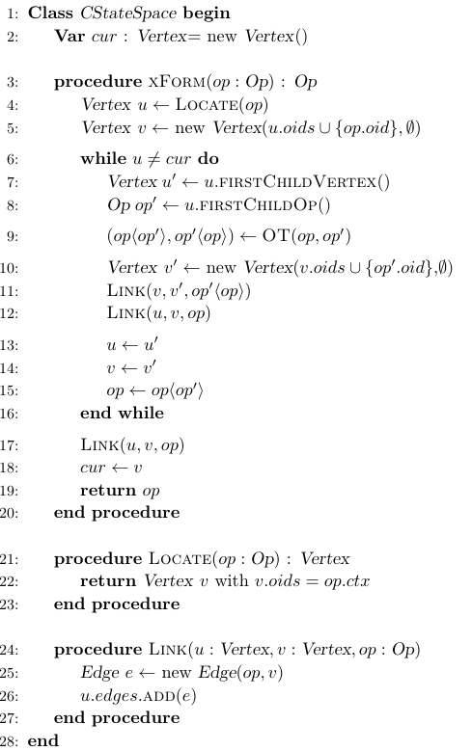
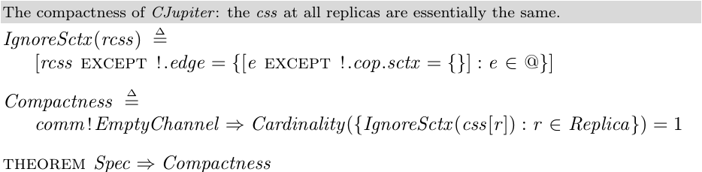
CJupiter
By doing this, the state space is compact.
We can check Compactness on the state space. (similar to QC of AJupiter, but the latter uses state)

Slide 28
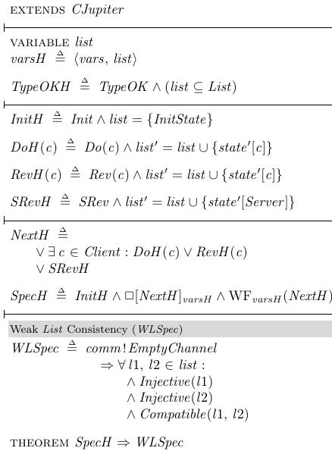
Adding history variables
To check the weak list consistency, we need to capture all history state space.
It’s easy to extend CJupiter and add history variables.

Slide 29
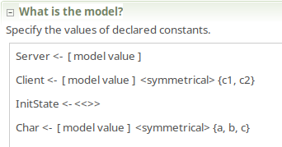
Check CJupiterH
(It consumes all my memory including swap…And I have to restart my computer…)

Slide 30
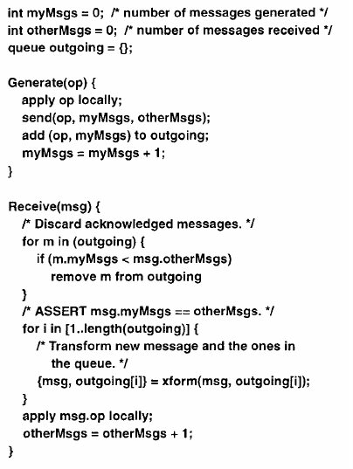
XJupiter
I think the AJupiter algorithm is very similar to this one.
1. AJupiter's server process inserts Generate in Receive.
2. AJupiter’s acknowledgement is by stock msgs count, which will be clear out after all msgs processed. While XJupiter’s uses seq to indicate msgs less than the seq are useless.
Nichols, D., Curtis, P., Dixon, M. and Lamping, J. High-latency, low-bandwidth windowing in the Jupiter collaboration system. ACM UIST (1995), 111-120.

Slide 31
XJupiter
XJupiter is a multi-client version of Jupiter.
Its 2D state space is similar to CJupiter's n-ary ordered state space.
So it is made by modifying CJupiter protocol.

Slide 32
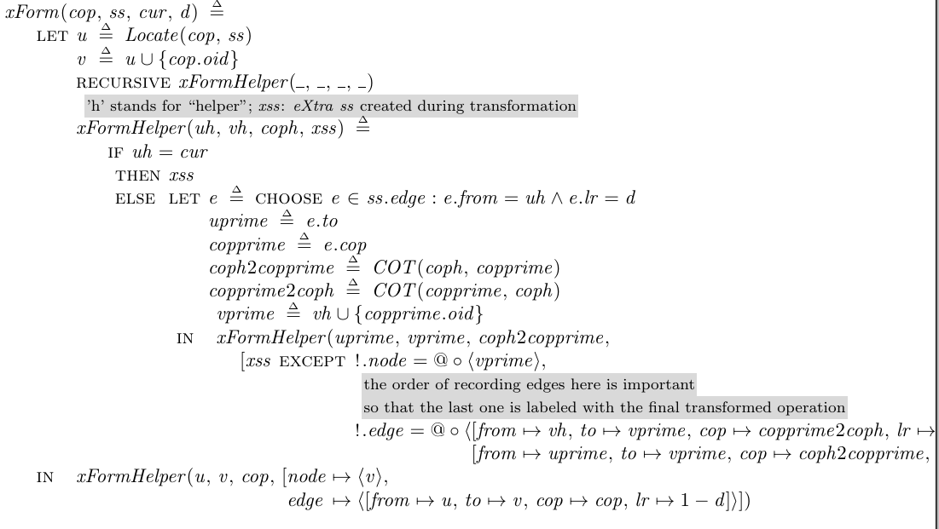
XJupiter
0,0
PLAN
C
S1
PLANE
1,0
0,1
PLANE
S2
S1’
C’
PLANE
1,1
0,2
PLANET
S2’
C’’
1,2
PLANET

Slide 33
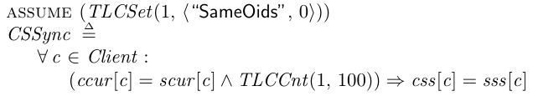
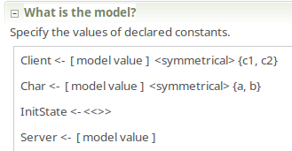

Check XJupiter
The pointers of client and its server to the state are the same implies their state spaces are the same.
Adding history variable is the same with CJupiter.
Restart my computer again.

Slide 34
Future work

Slide 35
Wait a minute!
Review the title ‘A Correct eXpressive…’.
Literal meanings also important.
Correctness, expressiveness…
‘A’ is missing?!
Ok, now I will talk about ‘A’.
Half an hour more!
A
C
X
Jupiter

Slide 36
A
‘A’ means ‘one’. We want one Jupiter.
Are we crazy? There are three algorithms. Everyone knows.
We are trying to make a refinement, which means the three algorithms implement a more abstract Jupiter protocol.
A C X Jupiter -> Abs Jupiter.

Slide 37
More future work
Improvement of codes.
More specifications to check.
Run large models.
More details: https://github.com/Disalg-ICS-NJU/tlaplus-lamport-projects/blob/master/tlaplus-projects/Hengfeng-Wei/Wei-jupiter-tla/README.md

Slide 38
Thank you!
--Powered by your applause+
tangruize97 at gmail.com
10/30/18
瑞泽
唐
Jupiter
Jupiter
C/S
OP
OT
C/S
OP
OT

