Slide 1

The TLA Proof System
Ruize Tang
151220100@smail.nju.edu.cn
2018-12-25

Slide 2

Contents
Background
Informal proof, formal proof and model checking
TLAPS
Example
Euclid’s informal proof (review)
Proving with the TLAPS
Summary

Slide 3

Background
Informal proof, formal proof and model checking
TLAPS

Slide 4
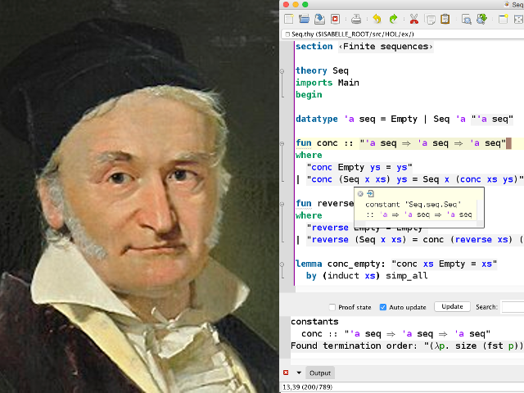
Informal Proof vs Formal Proof
Informal
Deep
Developed over centuries.
Ignore simple hypothesis
Corner case is OK.
Unreliable
May be totally wrong!
Formal
Shallow but wide
Simple mathematics.
Checking many details
Corner case means a bug.
Reliable
Machine is always right.

Slide 5
Informal Proof vs Formal Proof
Informal proof
Mathematics (Science)
Depend on social process to weed out incorrect results.
Handwrite proof for systems (Engineering)
Social process doesn’t work very well.
Example: Chord (a well-known network protocol).
We need formal proofs of systems or algorithms (instead of informal).
Notes:
Example:
Pamela Zave. Lightweight verification of network protocols: The case of Chord. AT&T Technical Report, January 2010.
“Three features that distinguish Chord from many other peer-to-peer lookup protocols are its simplicity, provable correctness, and provable performance.“
However, Zave reports:
[T]he Chord routing protocol is neither proven nor correct.

Slide 6
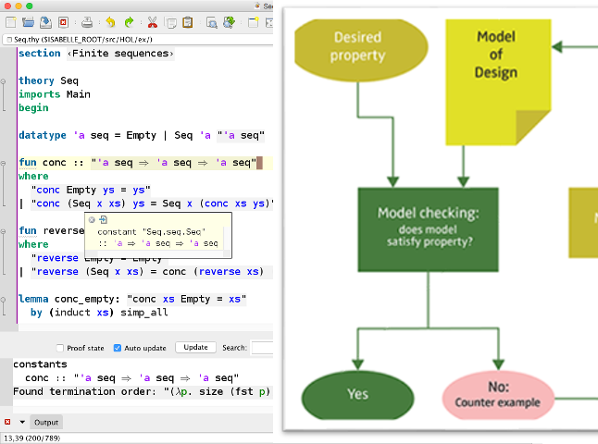
Formal Proof vs Model Checking
TLC checks whether specs can be satisfied.
Why still need TLAPS?
Checking an algorithm with TLC can give us some confidence that an algorithm is correct. How much confidence depends on the algorithm. It cannot show us why the algorithm is correct. For that, we need a proof.
--The TLA+ Hyper Book Ch4.9
Reasoning, not testing!

Slide 7
Formal Proof vs Model Checking
Formal proof (or theorem proving) assistant
Verifies that your proof is sound.
Verifies that any theorems you propose can (or cannot) be derived using axioms and previously proven results.
Model checker
Enumerates the state space.
Determines whether any of the verification conditions are violated.
Provides error trace.
https://stackoverflow.com/questions/24418448/can-coq-be-used-easily-as-a-model-checker

Slide 8

The TLAPS
A separate system
Called by the TLA+ Toolbox.
A proof assistant
Cannot generate proofs.
(Otherwise we will lose our jobs.)
Using other backend provers
Such as SMT, Zenon and Isabelle.
More like a wrapper or translator.
Still in development…
Has many limitations.
Notes:
Limitations:
Running again may fail even if nothing changed.
Many features of TLA+ are not supported yet. Such as Recursive operator definitions. INSTANCE Statement
Know nothing about operators defined in the TLC standard module.
…

Slide 9

Example
Euclid’s informal proof (review)
Proving with the TLAPS

Slide 10
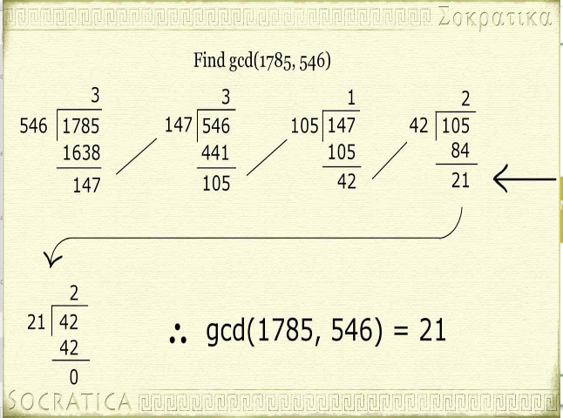
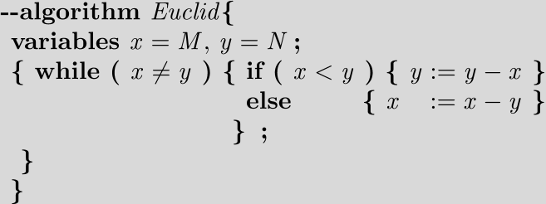
Euclid’s Algorithm
Safety property
If the algorithm terminates, it does so with x and y both equal to GCD(M , N ).
The algorithm has terminated iff pc equals “Done”.

Slide 11
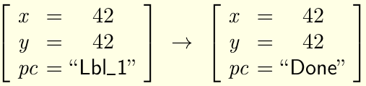
Euclid’s Informal Proof
Similar to mathematical induction.
To find an invariant Inv satisfying:
I1. Init ⇒ Inv
I2. Inv ∧ Next ⇒ Inv’
Inv is call an inductive invariant.
PartialCorrectness is not an inductive invariant.
It satisfies I1 but not I2.
Counterexample:
Notes:
PartialCorrectness is true, Next is true and PartialCorrectness’ is (42 = GCD(M, N))
true ∧ true ⇒ (42 = GCD(M, N))
But M, N can be anything!

Slide 12
Euclid’s Informal Proof
PartialCorrectness is an invariant.
Prove it by finding an Inv satisfying I1, I2 and I3.
I1. Init ⇒ Inv
I2. Inv ∧ Next ⇒ Inv’
I3. Inv ⇒ PartialCorrectness
I1, I2 implies Inv is true in all reachable states.
I3 implies PartialCorrectness is true in all reachable states.

Slide 13

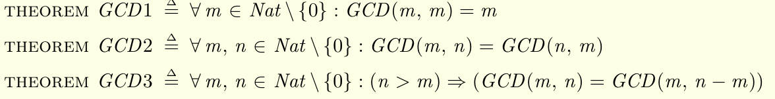

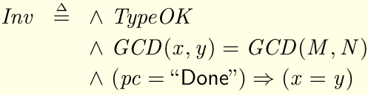
Euclid’s Informal Proof
The proof requires three facts about the gcd.
What if x is negative?

Slide 14
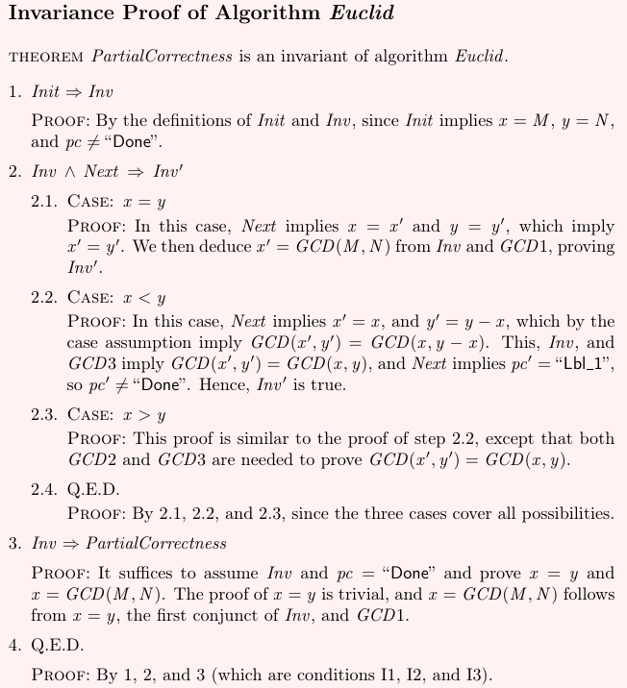

Slide 15
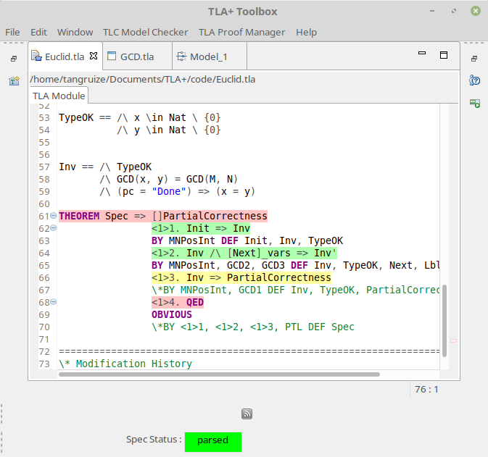
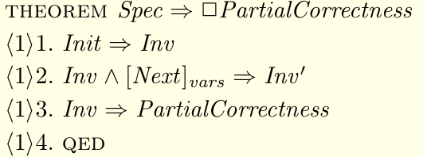
Proving with The TLAPS
I1. Init ⇒ Inv
I2. Inv ∧ Next ⇒ Inv’
I3. Inv ⇒ PartialCorrectness
(Stuttering)
I2. Inv ∧ [Next]_{vars} ⇒ Inv’
id
An assertion
Non-leaf proof
Level specifier
Name, can be empty
QED means which was to be proved.
Hierarchical structured.
Notes:
Which in this proof is Spec ⇒ □PartialCorrectness

Slide 16

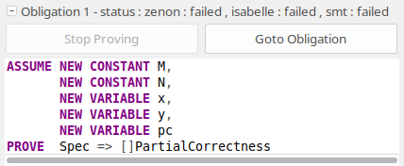
Proving QED
Steps can be proved in any order.
It is a good practice to start with QED.
Failed!
Leaf proof. Keywords are OBVIOUS, OMITTED, or a BY proof.
We think the proof is obvious.
Control + g control +g to execute the Prove Step or Module.
The backend provers know nothing about the spec or about anything else in the proof.

Slide 17


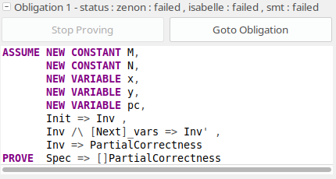
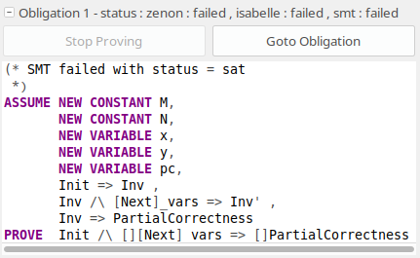
Proving QED
Still failed!
Failed again!
They do not know the symbol Spec.
They do not know temporal logic or TLA+.
Notes:
BY: tell the provers to use those facts
DEF: tell the provers to replace the symbol Spec with its definition.

Slide 18

Proving QED
Proved.
Use the PTL backend (ls4). (PTL stands for Propositional Temporal Logic.)

Slide 19

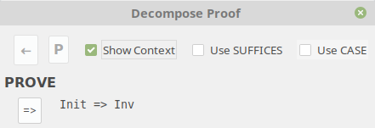
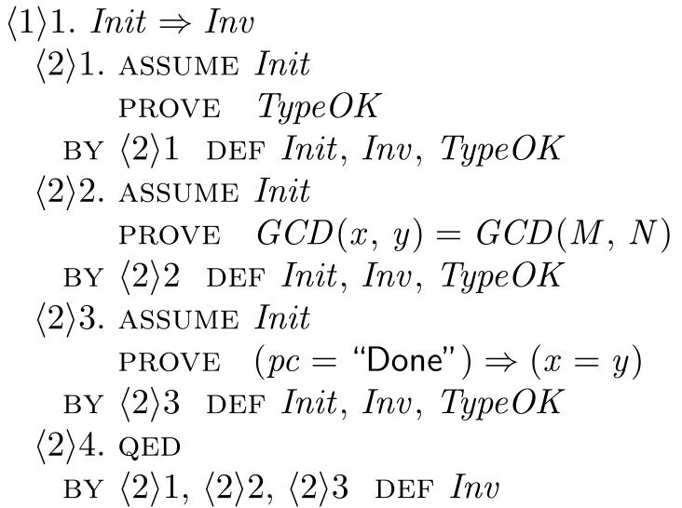


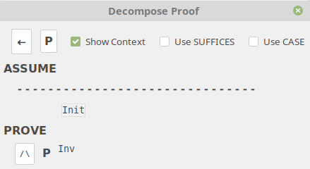
Proving I1. Init ⇒ Inv
Failed as usual.
ASSUME/PROVE form of an assertion.
Unchecked.
Failed in this step.
Using itself? No, only refers to ASSUME Init
Notes:
Making “Use SUFFICES” and “Use CASE” checked or unchecked generates different decompositions. But they equal each other.
The suffices proof usually has one fewer level. The main function of the suffices construct is to reduce the depth of proofs.
Lamport think that using both is the nicest one.
ASSUME Init
PROVE TypeOK
asserts
Init ⇒ TypeOK

Slide 20
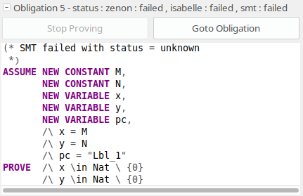
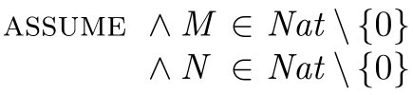


Proving I1. Init ⇒ Inv
Give it a name.
We did not tell the backend checkers what M and N are.
Proved.

Slide 21
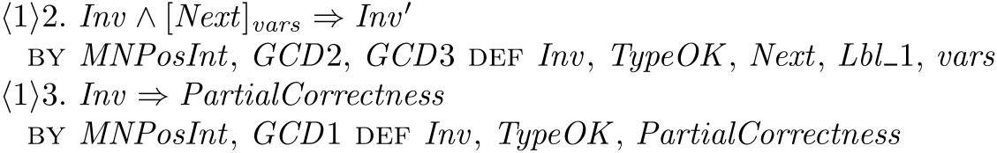
Proving I2. and I3.
Proved.
The proof uses GCD1-GCD3, but they have not been proved yet.
Normally, we should not have to check the correctness of mathematical theorems. To avoid errors in formalizing the result, we should check the theorem with TLC.

Slide 22

Summary

Slide 23
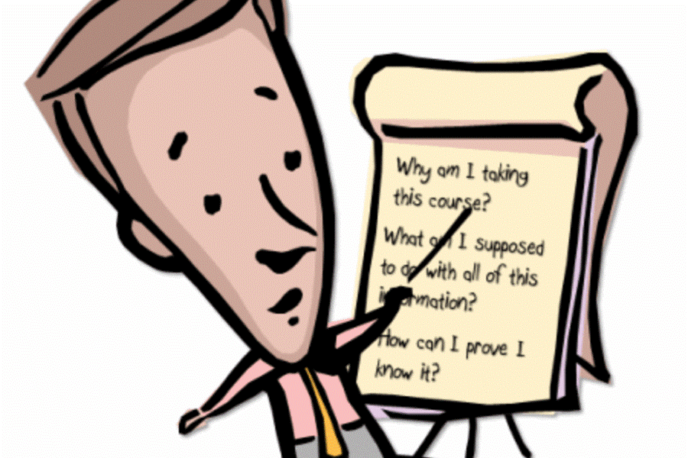
Summary
Comparison
Informal proof (mathematics): unreliable
Formal proof (reasoning): prove the informal one
Model checking (testing): enumerates the state space
TLAPS
A proof assistant
Many limitations
Many terminologies
Proved Euclid’s algorithm

Slide 24

Thank you!
Ruize Tang
151220100@smail.nju.edu.cn
2018-12-25

