Slide 1
TLAPS
--TLA+ Proofs^{[1]}
易星辰
2019.1.15
[1] Cousineau D, Doligez D, Lamport L, et al. TLA+ proofs[C]//International Symposium on Formal Methods. Springer, Berlin, Heidelberg, 2012: 147-154.

Slide 2
Contents
Modeling Peterson’s Algorithm
Model checking in TLA+
Proving Mutual Exclusion
Hierarchical proof
Summary

Slide 3
Modeling Peterson’s Algorithm

Slide 4
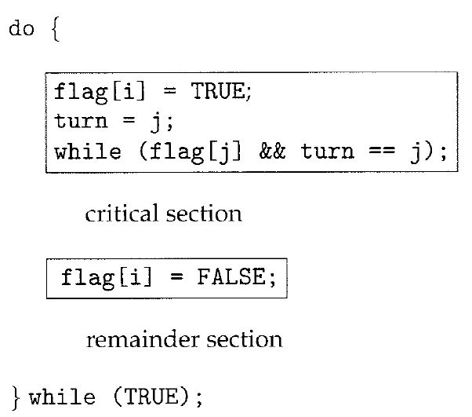
Peterson’s Algorithm
Famous
Simple
So simple that should not
use SMT solver to prove.
TLAPS: SMT -> Zenon ->
Isabelle
Most trusted

Slide 5
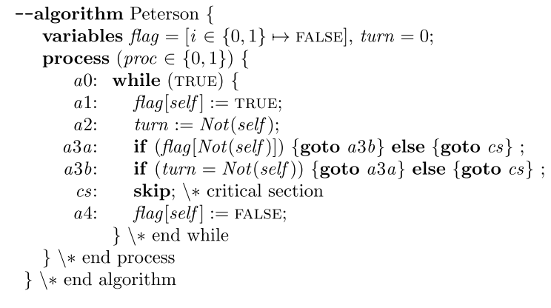
Model in TLA+
Safety
Mutual exclusion:

Slide 6
Proving Mutual Exclusion

Slide 7
Tips in TLAPS
Change prover
BY/USE Zenon/Isa/SMT
Command-line: --method
Output
TLAPS will output information to the console.
Check which prover is used.
proved/failed/timeout
EXTENDS TLAPS
https://tla.msr-inria.inria.fr/tlaps/content/Documentation/Tutorial/Advanced_options.html
https://tla.msr-inria.inria.fr/tlaps/content/Documentation/Tutorial/Tactics.html

Slide 8
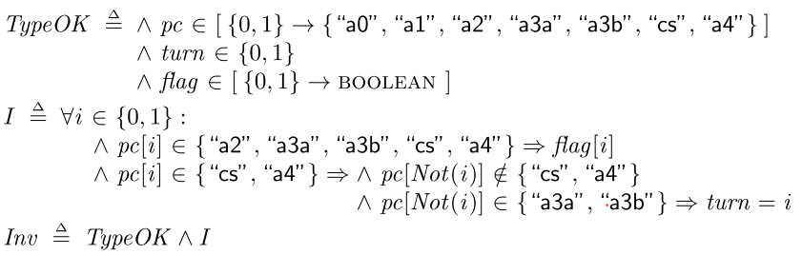

Deductive proof
THEOREM $Spec⇒ MutualExclusion$
l1. Init $⇒$ Inv
l2. Inv ∧ Next $⇒$ Inv’
l3. Inv $⇒$ MutualExclusion
Inv

Slide 9
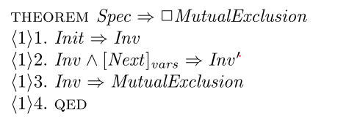


Hierarchical Proof
High-level proof
QED means that which was to be proved
Two temporal-logic
Independent
Prove QED first
Propositional Temporal Logic

Slide 10

Prove l1 and l3
Use DEFS keyword

Slide 11
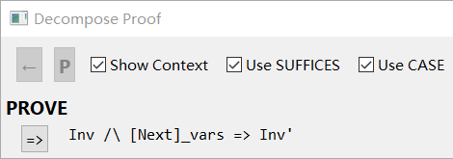
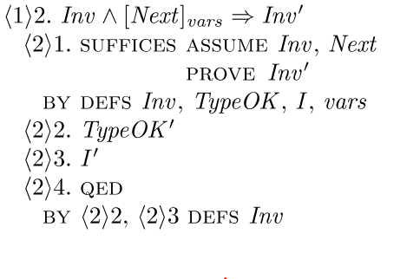
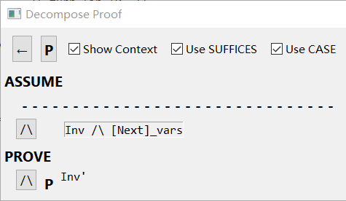
Prove l2
Leaf proof won’t solve
Use hierarchical proof
[Next]_{vars} = Next ∨ UNCHANGED vars
Prove UNCHANGED case

Slide 12
Prove TypeOK’ and I’
Zenon fails but Isa succeeds
Zenon and Isa fails
Need a hierarchical proof

Slide 13
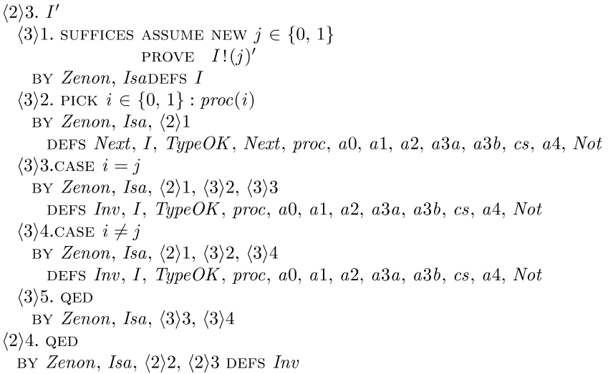



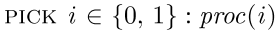

Quantifiers elimination
$∀−introduction$
Form of I’:
Introduce new var j:
$∃−\text{elimination}$
Form of Next:
Pick some value of self :
Inv, proc(i)⇒ I!(j)’

Slide 14
Decompose proc(i)
Usual procedure
Simple enough

Slide 15
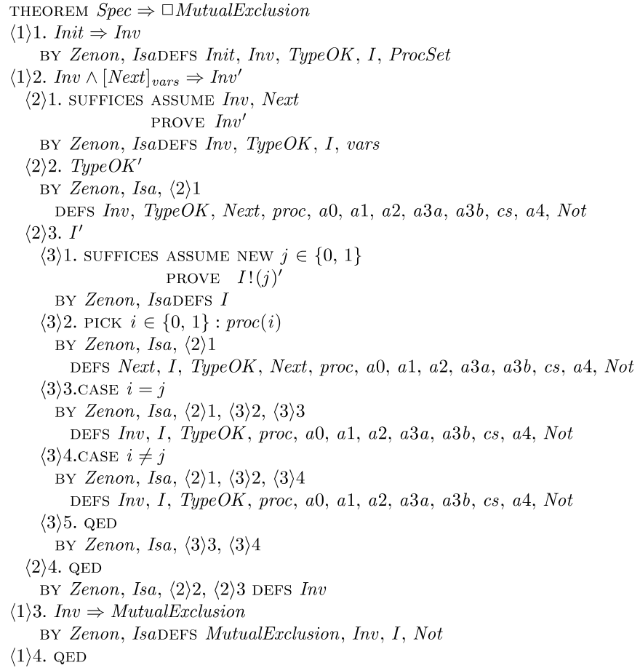
Complete proof

Slide 16
Summary

Slide 17
Summary
Prover
Each prover’s ability is not same.
Structure
Leaf proof:
OBIVOUS
DEFS
Hierarchical proof: decompose
SUFFICES
CASE

Slide 18
Thanks
& Questions

